Slide 1
Create a Royal Portrait
Create a portrait of King Charles III
using reused and recycled material

Slide 2
Stay safe
Whether you are a scientist researching a new medicine or an engineer solving climate change, safety always comes first. An adult must always be around and supervising when doing this activity. You are responsible for:
ensuring that any equipment used for this activity is in good working condition
behaving sensibly and following any safety instructions so as not to hurt or injure yourself or others
Please note that in the absence of any negligence or other breach of duty by us, this activity is carried out at your own risk. It is important to take extra care at the stages marked with this symbol: ⚠
Notes:
Safety Warning

Slide 3
Design brief
The coronation of King Charles III will take place on Saturday 6th May 2023
There will be a bank holiday on Monday 8th May
Lots of public events will take place to celebrate this historic event
Your task:
Design and create a collage portrait of King Charles III using reused and recycled materials.

Slide 4
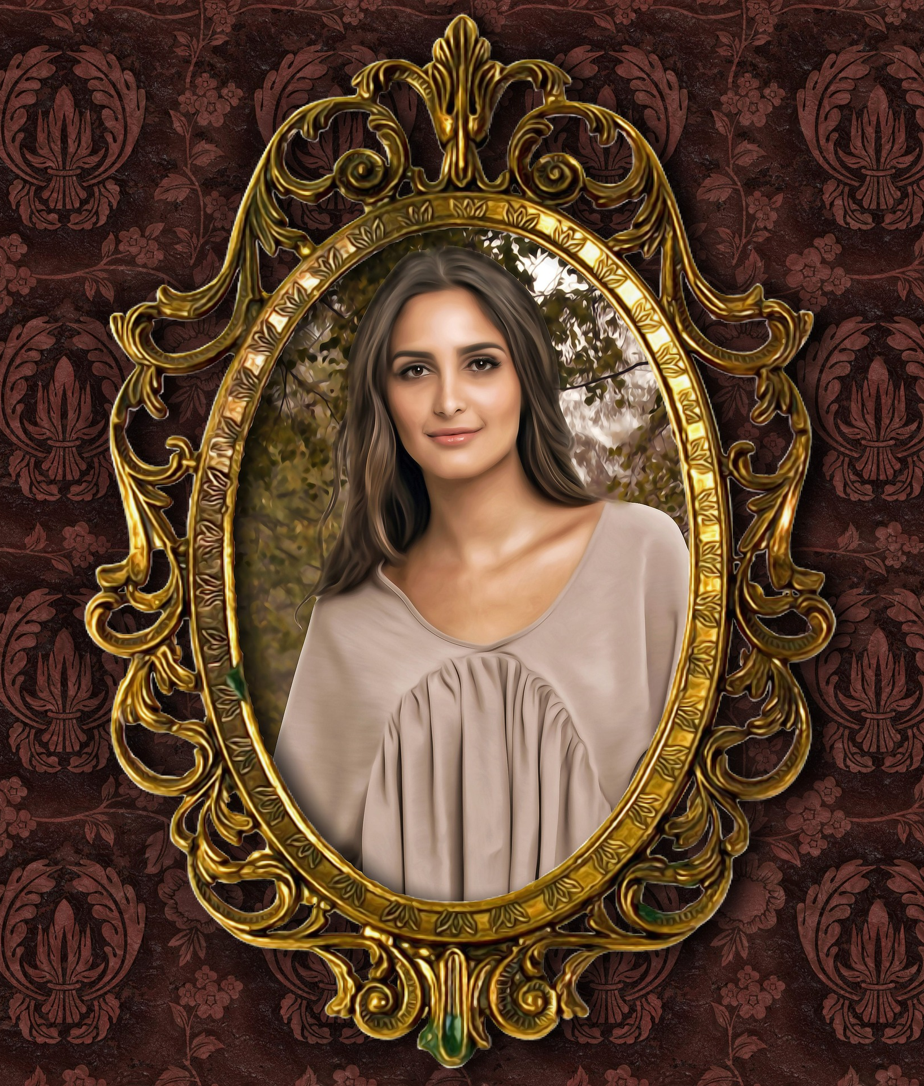
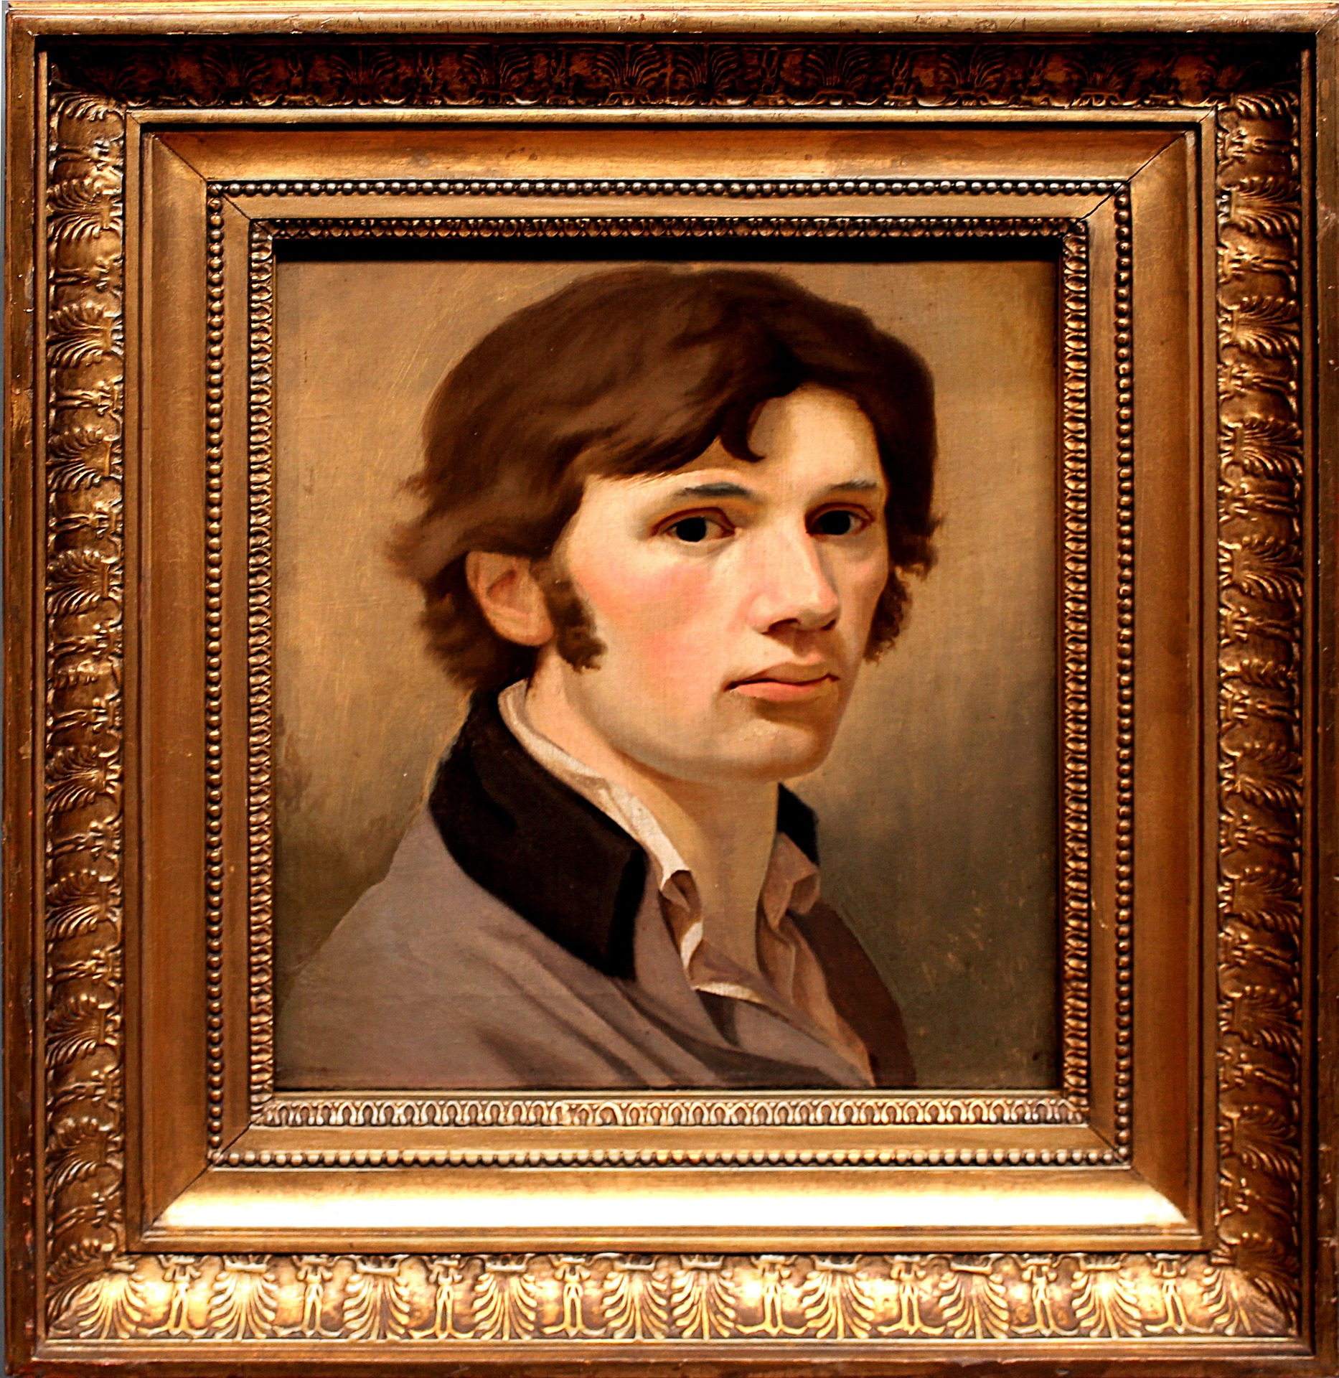
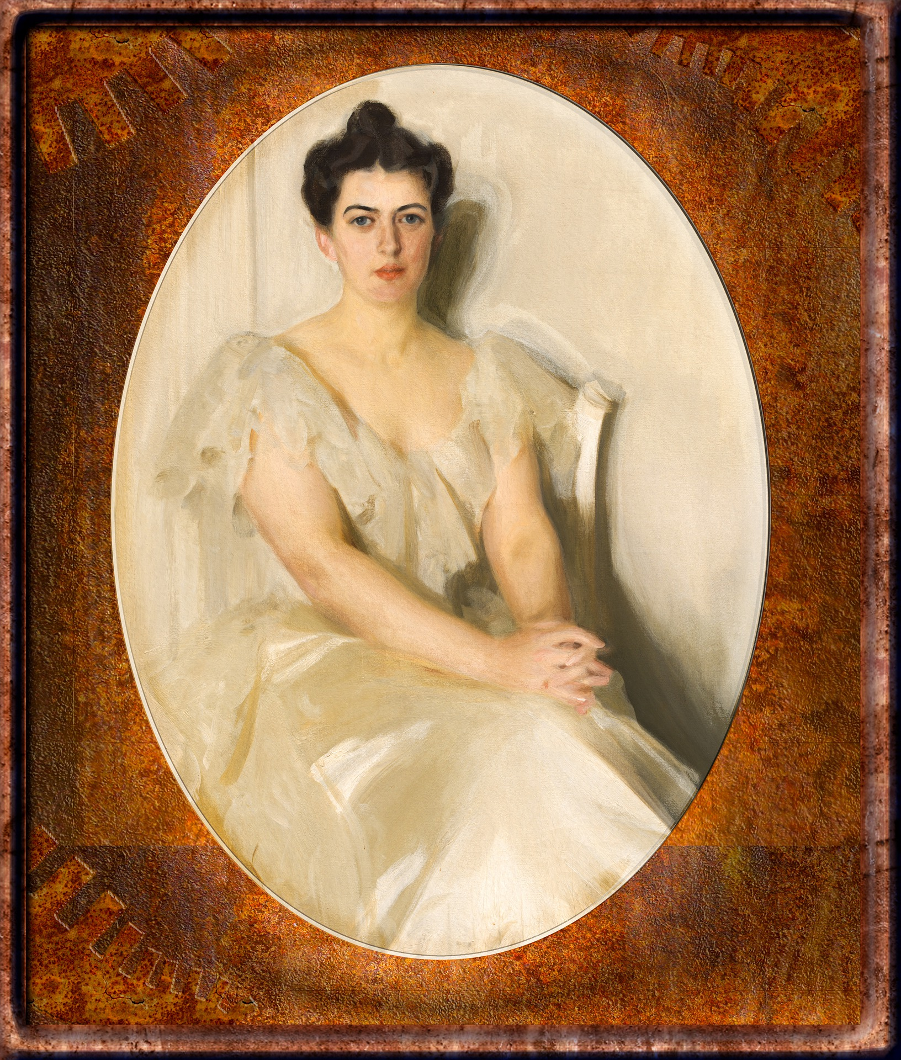
What is a portrait?
A portrait is a painting, drawing OR photograph of a person.
It normally shows their face or head and shoulders.

Slide 5
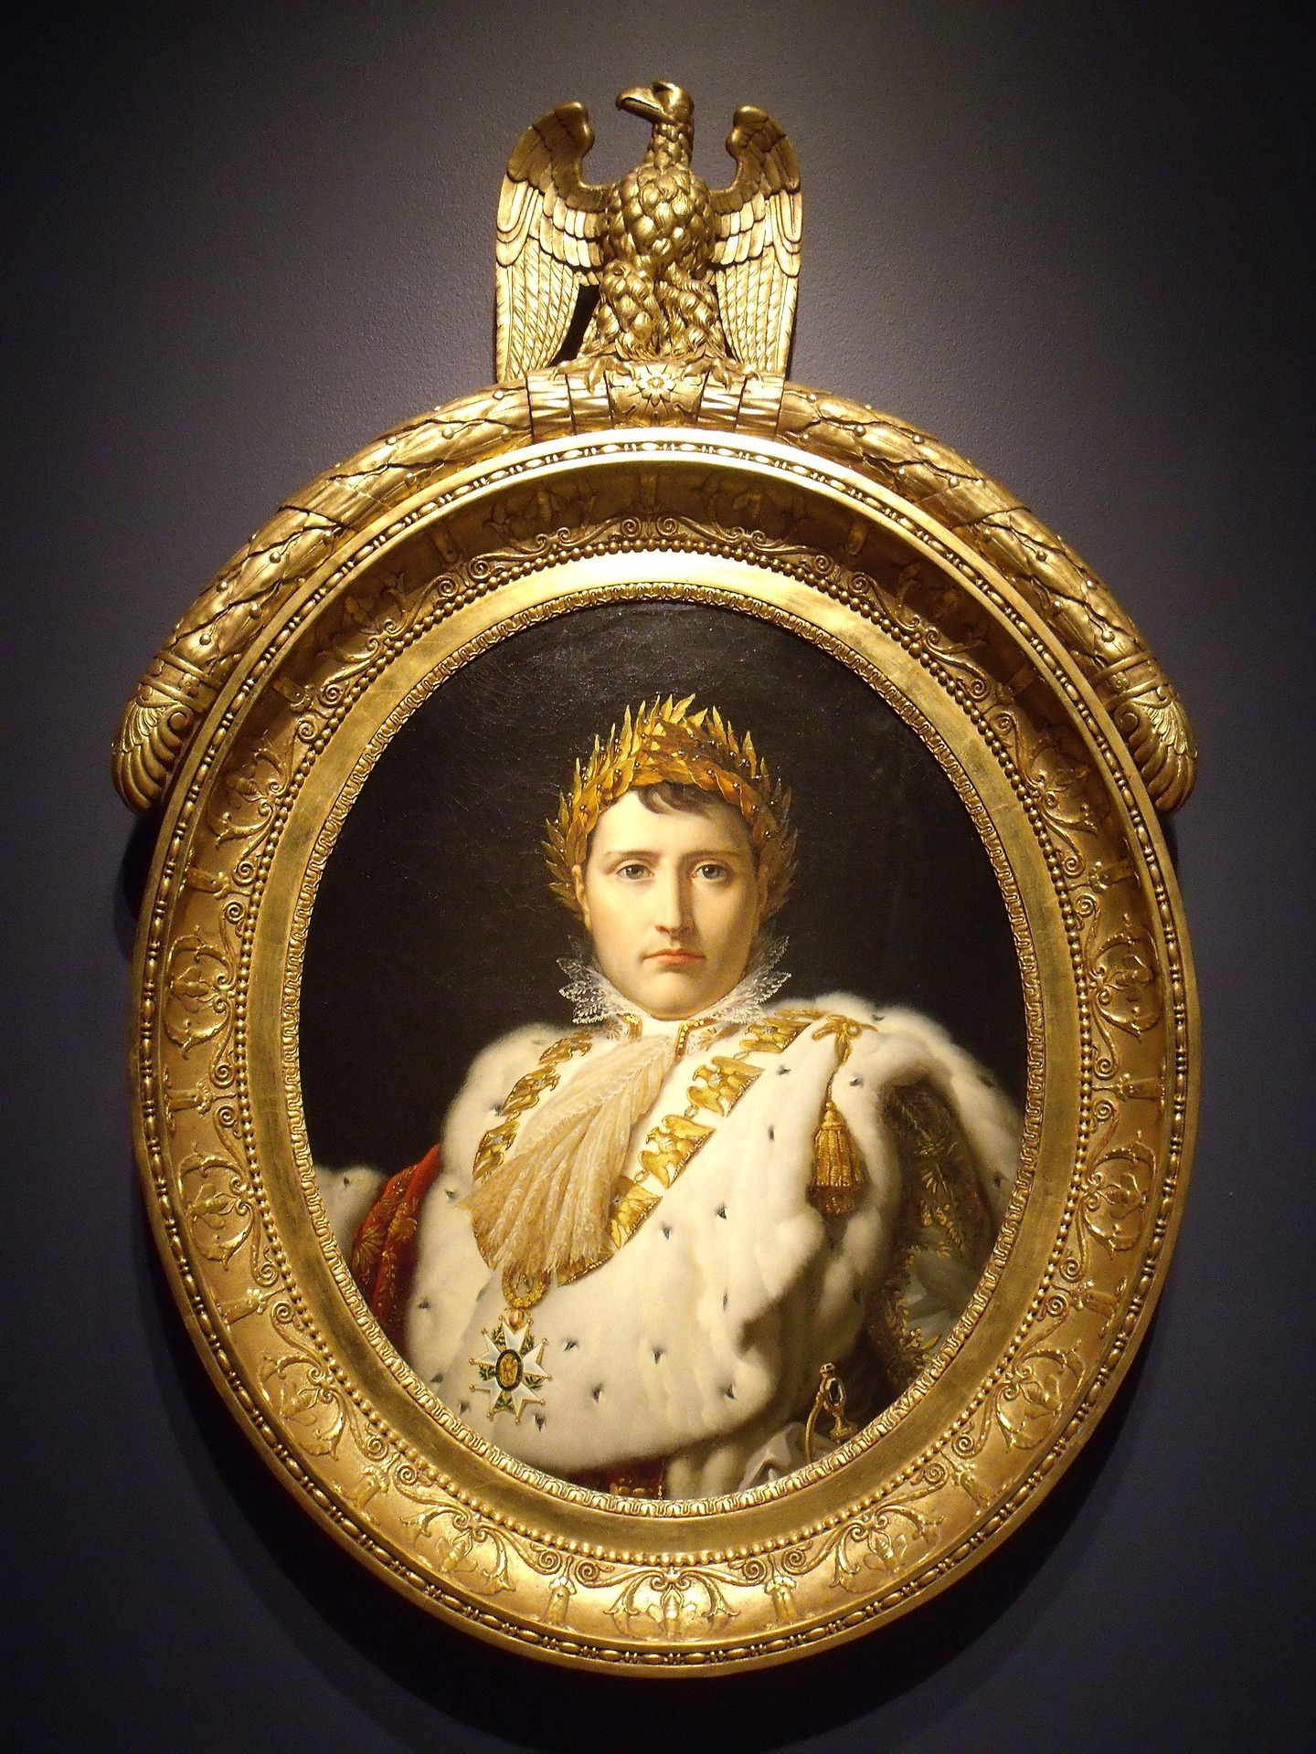
Why do kings and queens have portraits painted?
… because they are powerful and rich.
… to show people how important they are.
… for people to know what they look like.
Photographs were invented less than 200 years ago – before that kings and queens had to be drawn and painted.

Slide 6
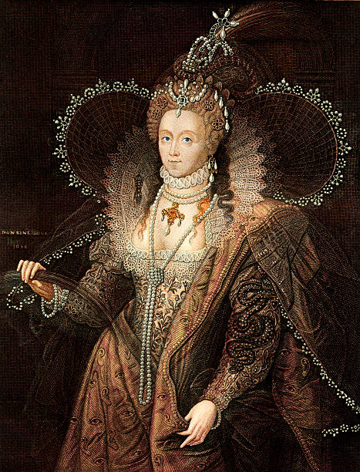
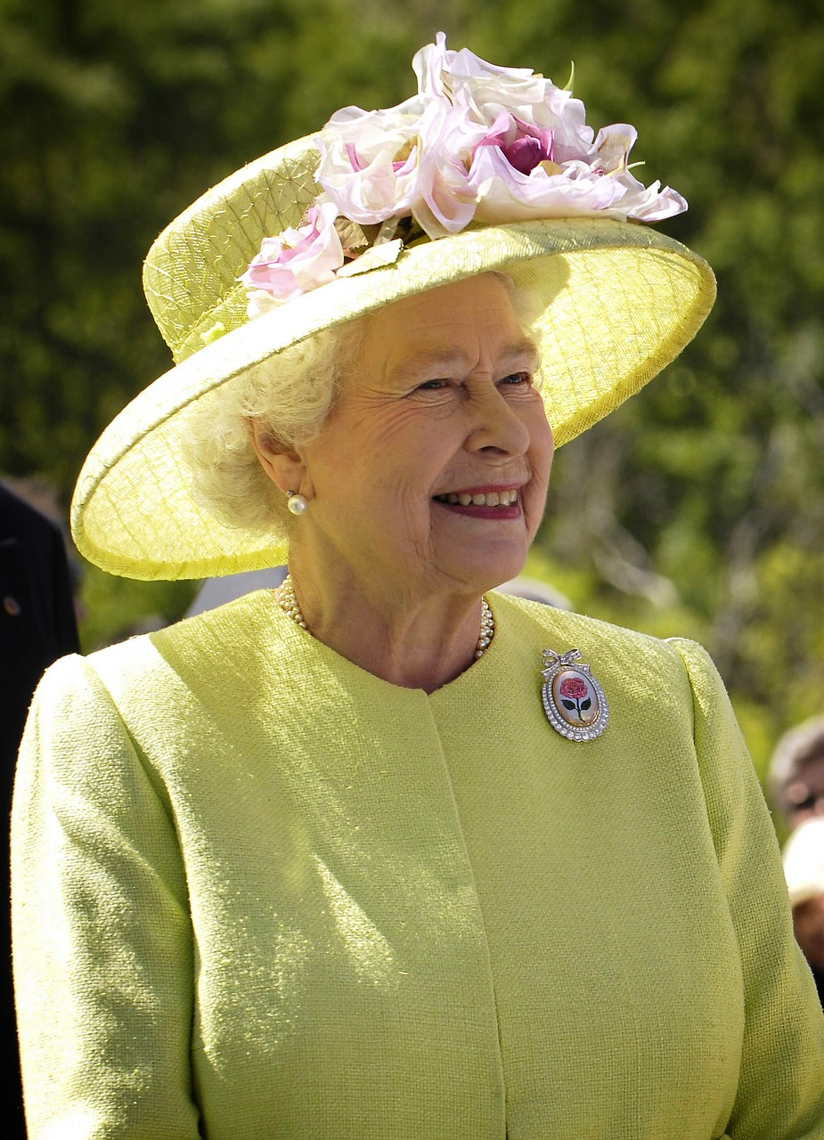
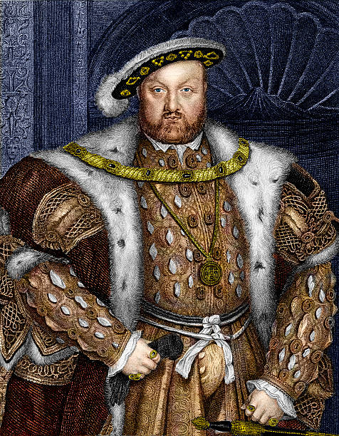
Some famous Kings and Queens - who are they?
Notes:
Queen Elizabeth I
Queen Elizabeth II
King Henry 8th

Slide 7
Where might you find a portrait of King Charles III?

Slide 8
What does reuse mean?
What does recycle mean?​
Notes:
Recycle - Recycling is the process of converting waste materials into new materials and objects
Reuse – to use a material again especially in a different way

Slide 9
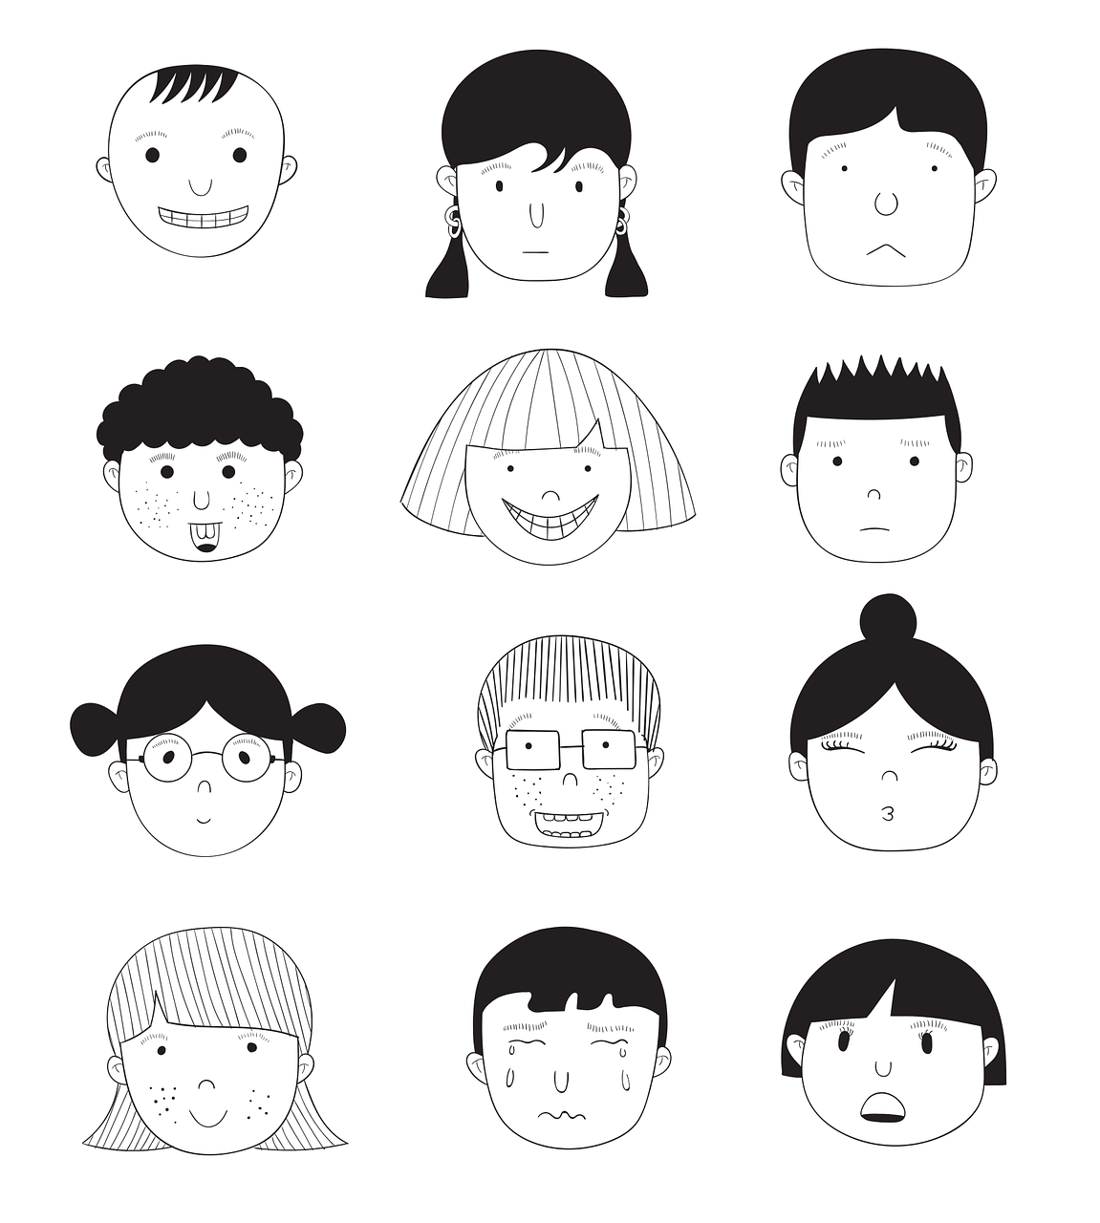
What needs to be included in your portrait?
Let's start by having a look in a mirror
What can you see? Study your face closely! Which materials could be suitable for different features and colours?
Can you draw your face?
Can you draw the person next to you?
Notes:
Hand out mirrors to pupils and get them into pairs. Get them to look in detail at their faces and features. They can draw their own face and their partners. Discuss with pupils if they will draw the portrait from the side or the front, are they going to include shoulders or any other items. Get pupils to talk about their face/partners and discuss eye colours, nose shapes, freckles, ears, hair…. And so on.

Slide 10
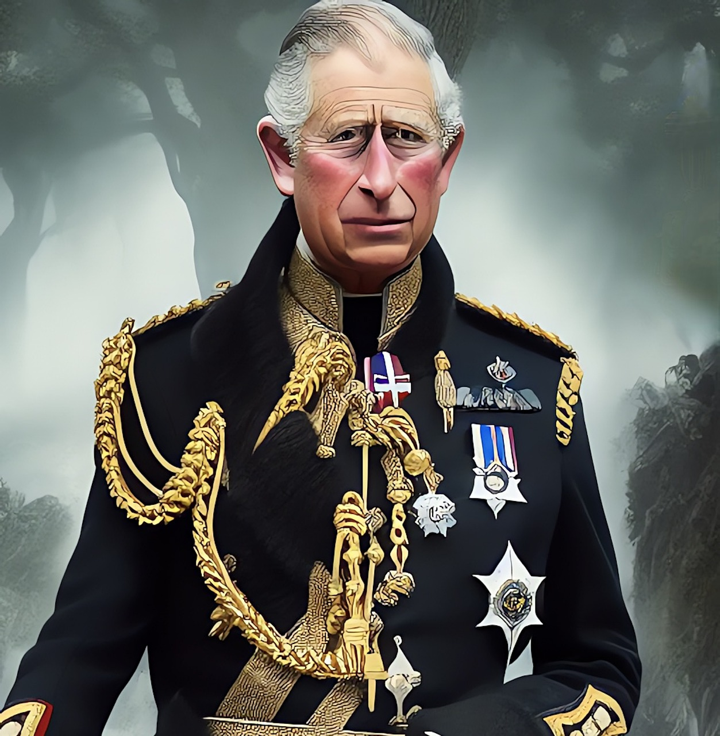
What does King Charles III look like?
More pictures can be found here: https://www.royal.uk

Slide 11
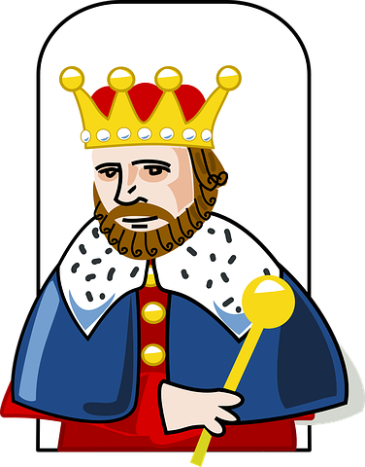
What could I add to my portrait of King Charles III ?
Notes:
Discuss the image - Crown, Robe, Sceptre

Slide 12
King Charles III likes looking after the environment.
He thinks it is very important to look after our planet.
You can help by reusing materials to make your portrait as a collage.
Making sure we look after our planet
Notes:
Why is the portrait made from recycled and reused materials? Discuss that King Charles is a keen environmentalist.

Slide 13
Planning – Where to start?
Find pictures of King Charles III and print them out.
Look at his face. What colour are his eyes? What is his nose like?
What materials could you use? Make a list.
Think about different colours, shapes and textures you could use.

Slide 14
Equipment and Resources
Materials such as newspaper, leaflets, bottle tops, foil, crisp packets, buttons, craft sticks.
Cardboard
Scissors
Pencils and rulers
Glue sticks
Template
Images of King Charles III
A4 plain and squared paper

Slide 15
Designing
Use the pictures of King Charles III to help you choose materials to use.
Put your materials on your paper without gluing them down so you can move them about.
Do you need to cut materials to change their shape?
Question?
Can you see the squares on your paper?
Why are they there?
Notes:
Discuss the grid on the paper - this will help pupils to place items and they can divide the picture of King Charles they have been given in to squares. Will also help when making a bigger version.

Slide 16
Designing
Notes:
Discuss the grid on the paper - this will help pupils to place items and they can divide the picture of King Charles they have been given in to squares. Will also help when making a bigger version.

Slide 17
Let’s get making!⚠
Here are some tips:
Don’t glue your materials straight away. That would stop you moving them about.
Have lots of different materials, shapes, colours and textures.
Stand back from your portrait to see how it look.
Keep looking at the picture of King Charles III you have.
⚠ Be careful when using the scissors

Slide 18
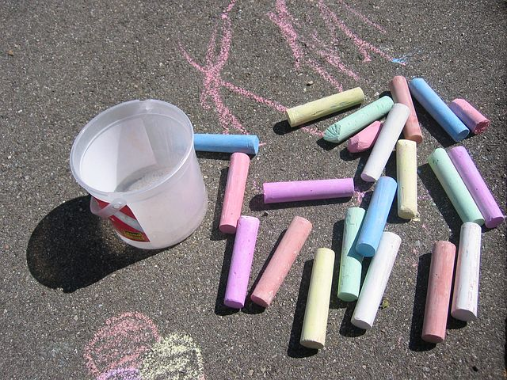
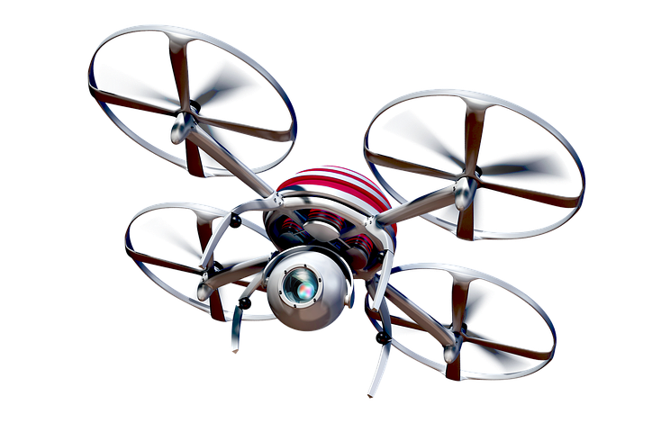
Want to go bigger? ⚠
Which portrait do you want to make bigger?
On the playground or school hall floor use chalks or tape to mark out squares. Just like you used in your smaller pictures!
As a class, place materials in the squares to make the portrait.
Can you get a drone to take a picture?
⚠ Be careful when using the scissors
Notes:
Using grid paper on the smaller portraits will help when producing the selected portrait on a bigger scale. Explain to pupils this method.

Slide 19
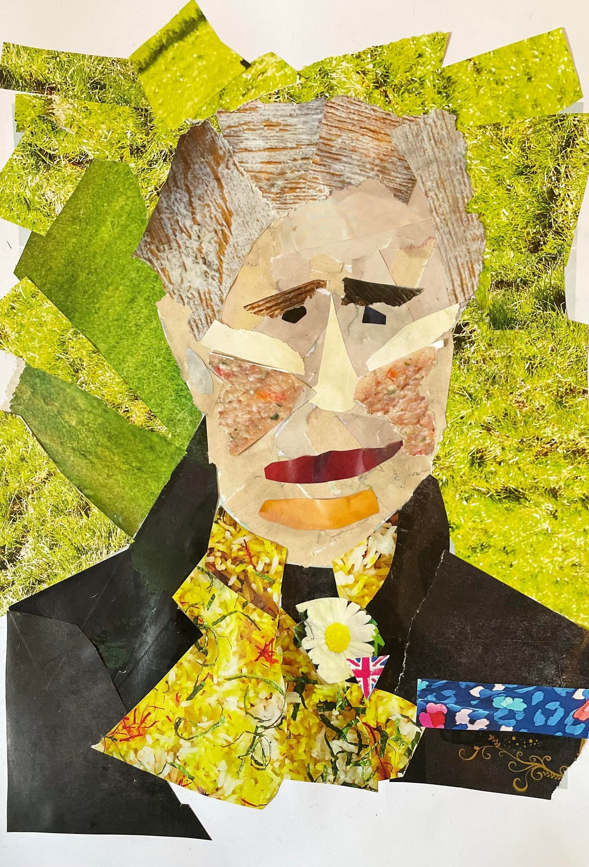
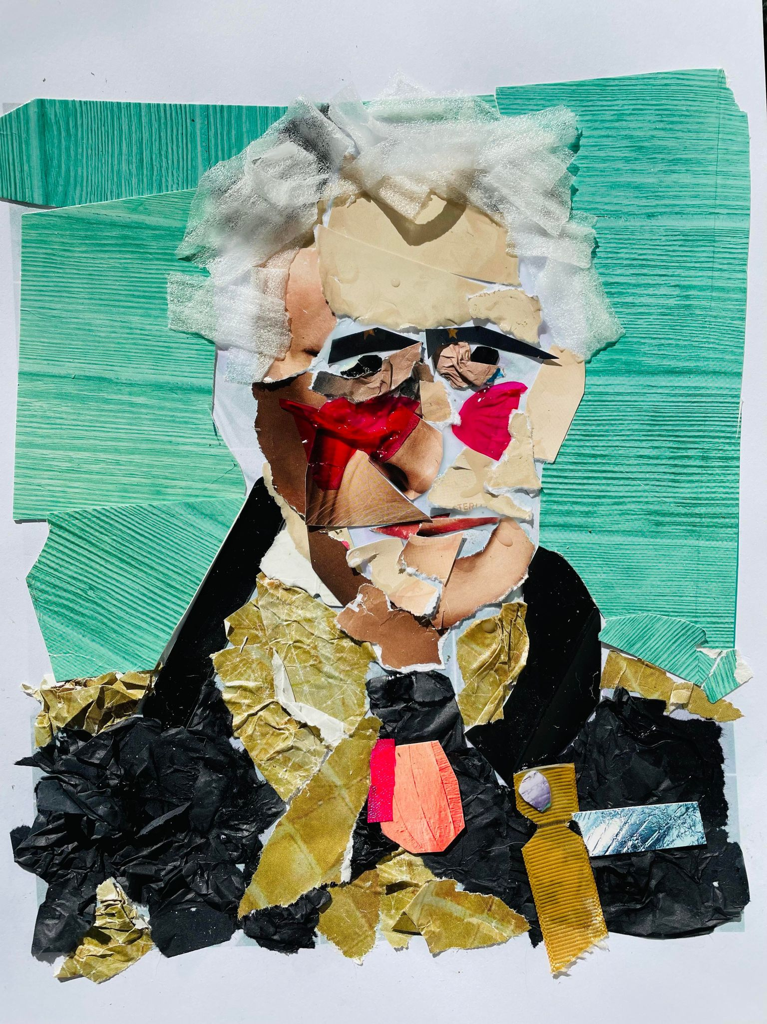
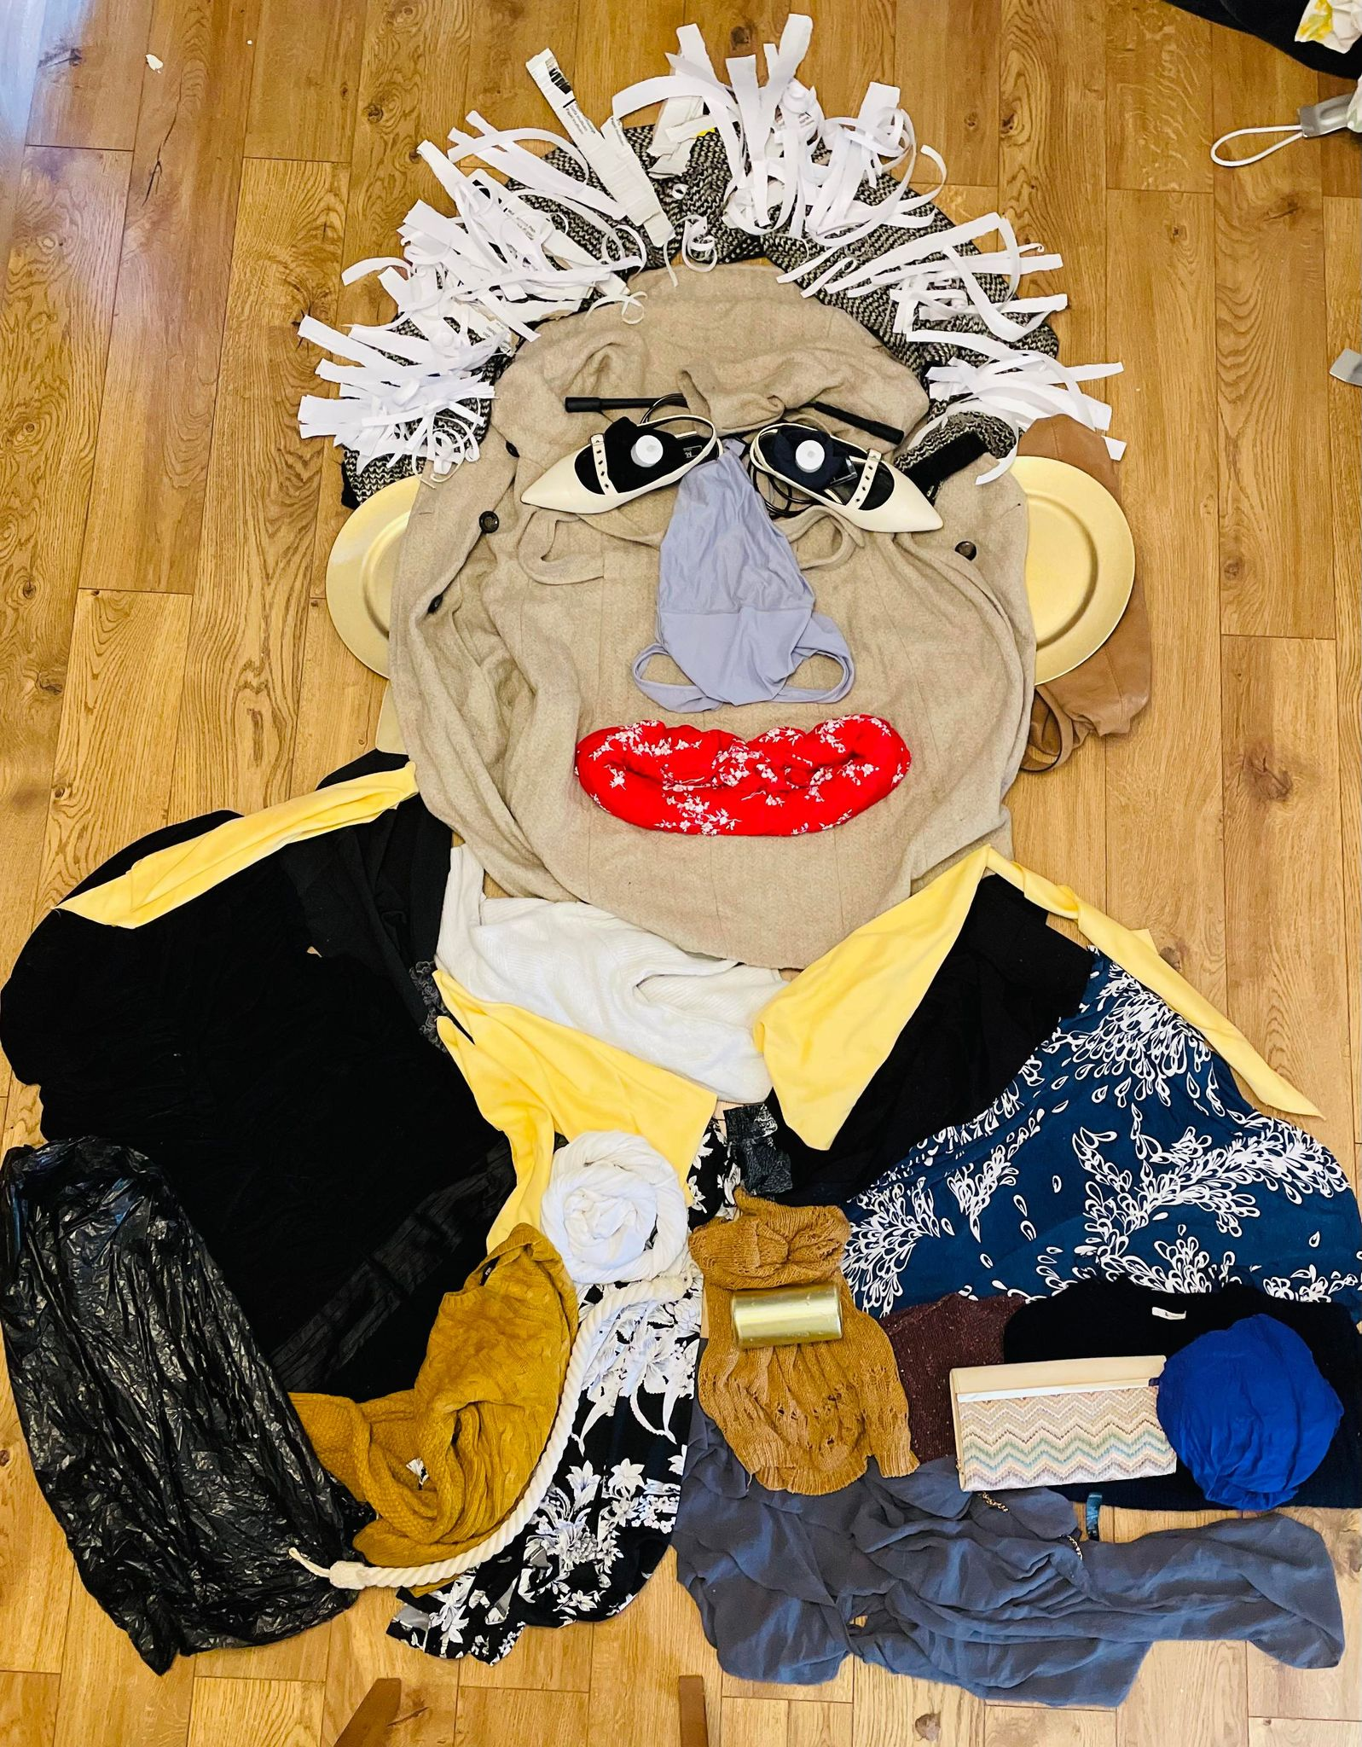
Examples
Notes:
The first and third images were collages made using old clothes, shopping bags and pages cut from magazines. The middle image was made from old clothes and shopping bags on a floor.

