Slide 1


Create a stone garden display
Creating a stone garden display for the school entrance to celebrate the coronation of King Charles III

Slide 2
Stay safe
Whether you are a scientist researching a new medicine or an engineer solving climate change, safety always comes first. An adult must always be around and supervising when doing this activity. You are responsible for:
ensuring that any equipment used for this activity is in good working condition
behaving sensibly and following any safety instructions so as not to hurt or injure yourself or others
Please note that in the absence of any negligence or other breach of duty by us, this activity is carried out at your own risk. It is important to take extra care at the stages marked with this symbol: ⚠
Notes:
Safety Warning

Slide 3

Design brief
The coronation of King Charles III will take place on Saturday 6 May 2023
There will be a bank holiday on Monday 8 May
Lots of public events will take place to celebrate this historic occasion
Your task is to create a stone garden decoration for the entrance to your school to celebrate the Coronation
Don’t forget to use your imagination!
Notes:
Share and discuss the design brief with learners.
Discuss the Coronation with learners, what this involves and its importance in the United Kingdom.
Explain that learners will paint rocks with Union Jacks to make a line or paint individual rocks with Red, White and Blue to make a larger flag display for a school entrance or front garden.

Slide 4
Starter
Look at examples of existing rock display designs
What is good about them and what could be done better?
Links to help:
https://www.tinselbox.com/american-flag-inspired-rock-garden-art/
https://www.youtube.com/watch?app=desktop&v=BJimE7w1iSs
Notes:
This could be done as a short class discussion or as a larger research based activity if learners have access to computers and the internet.
The first link shows an American flag styled rock garden.
The second link https://www.youtube.com/watch?app=desktop&v=BJimE7w1iSsis a video clip that could be watched to help with ideas.

Slide 5



What do we need?
Most of the garden will be made using painted stones
You need to think about the images that will be created with them
You could create a crown, a Union flag or something else that suits your school
Notes:
The learners can discuss what images might be used and explain their thoughts in a whole group discussion.
Learners could write down their image ideas, produce a spider chart or draw sketches if this helps them to plan it out.

Slide 6



The Union Jack flag
The Union Jack is made up of flags from three of the countries in the United Kingdom:
Scotland - St Andrew
Ireland - St Patrick
England - St George
All three are laid on top of each other to make the UK flag
Wales is not shown on the Union Jack – why do you think this is?
Flag of St Andrew
Flag of St Patrick
Flag of St George
Notes:
This slide could be shown to explain the origins of the UK flag.

Slide 7
Use this to help you lay out the Union Flag

Slide 8
Creating your design
Notes:
Use this slide or the activity design sheet handout as a template for the stones to be used.
These could be printed on red, white and blue paper so that when cut out they could be arranged to make up the flag or another suitable design.

Slide 9
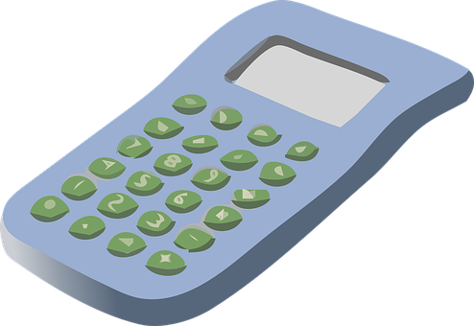

Scaling up: calculating the number of stones needed, part 1
Measure the width of the paper design This is Width_1
Measure the width of the area to be covered. This is Width_2
Use the same units to measure the two widths!
Divide Width_2 by Width_1
The result is the scaling factor, S
Notes:
Explain that learners will need to scale their design in order to create a full sized garden display.
The following slides give a maths activity learners could do to achieve this, or they could be given an appropriate scale by the teacher.

Slide 10
Scaling up: calculating the number of stones needed, part 2
Count the number of paper ‘stones’ you used for the design
Multiply this number by the scaling factor
Round the answer up to a whole number
The answer is the number of real stones you will need to make the big display

Slide 11
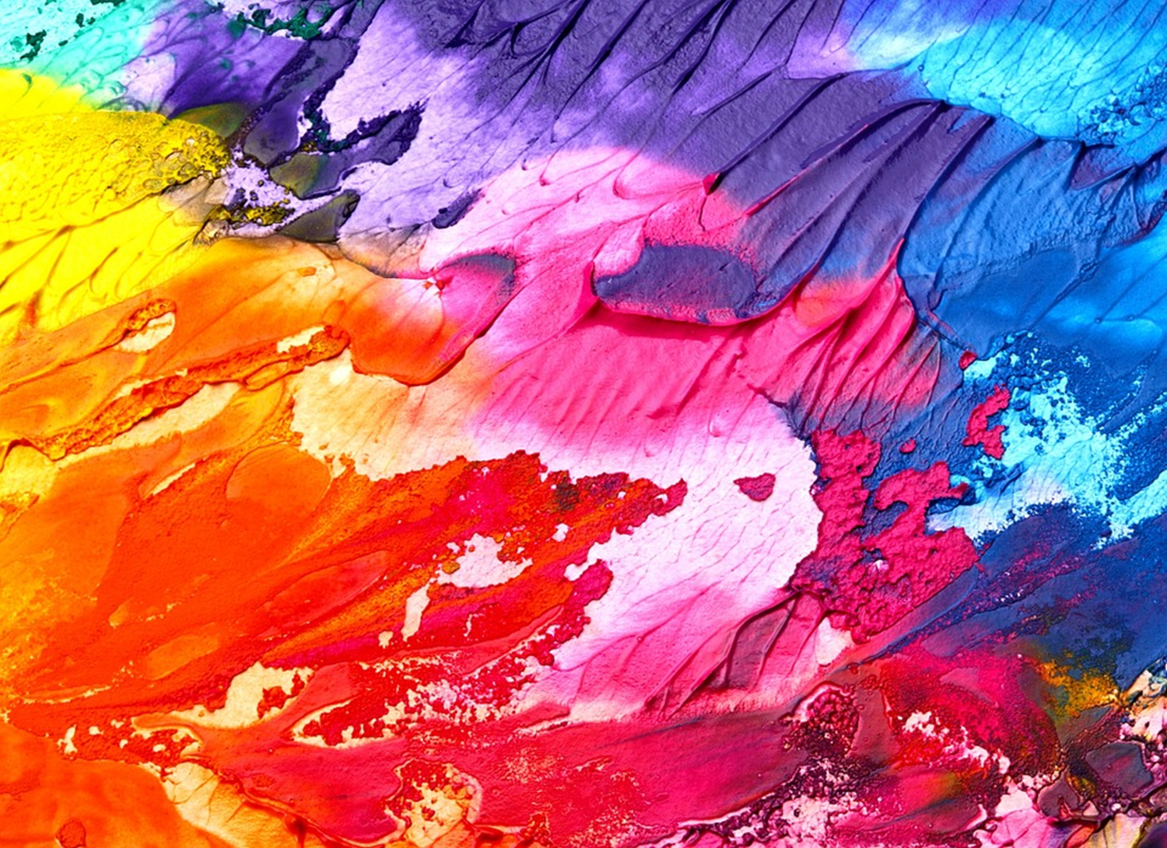
Being safe when painting
⚠
Paint can be messy
Paint looks great on the thing you are colouring
BUT
Not great on your clothes, hands, face, the floor or the furniture
Take care, use gloves and wash your hands afterwards
Notes:
Explain the safety requirements when using paint to colour the stones.

Slide 12
Extension
Create a border around the display
Include flowers and plants in the design to make the display look even better
Design a new flag that would represent the whole of the United Kingdom

