Slide 1
Design an organic meal for the King
Designing a meal for the King that uses only organic ingredients

Slide 2
Stay safe
Whether you are a scientist researching a new medicine or an engineer solving climate change, safety always comes first. An adult must always be around and supervising when doing this activity. You are responsible for:
ensuring that any equipment used for this activity is in good working condition
behaving sensibly and following any safety instructions so as not to hurt or injure yourself or others
Please note that in the absence of any negligence or other breach of duty by us, this activity is carried out at your own risk. It is important to take extra care at the stages marked with this symbol: ⚠

Slide 3
King’s Coronation
A coronation is a ceremony where the crown is placed on a new monarch’s head
The coronation for King Charles III and his Queen Consort will take place at Westminster Abbey on Saturday 6th May 2023
There will be a bank holiday to honour the event on 8th May
Notes:
Discuss the Coronation with learners, what this involves and its importance in the United Kingdom.

Slide 4
What are organic ingredients?
Organic ingredients are fresh or processed foods that are produced by organic farming methods
This means they are grown without the use of synthetic chemicals
They do not contain Genetically Modified Organisms (GMOs)
What makes organic food organic? (video 5:24)
Notes:
The video can be shown for further context and to help explain what is meant by organic food. https://www.youtube.com/watch?v=7Dxu97R077w
Links from slide above and other useful links for context/further study:
https://www.gov.uk/guidance/organic-food-labelling-rules
https://www.britannica.com/topic/organic-farming
https://education.nationalgeographic.org/resource/genetically-modified-organisms/
https://www.youtube.com/watch?v=7Dxu97R077w
https://www.bbcgoodfood.com/howto/guide/organic
https://www.bbc.co.uk/bitesize/guides/zgfj6sg/revision/4

Slide 5
Design brief
Charles III is the new King of the United Kingdom
He has been a big campaigner for environmental issues, including the benefits of organic food, for a number of years
Your task is to design a meal for the new King that only uses organic ingredients
Notes:
Share and discuss the design brief with learners.
This weblink could help with context https://edition.cnn.com/2022/09/16/business-food/king-charles-duchy-originals-waitrose/index.html

Slide 6
Design criteria
The meal for the King must:
Be made from only organic ingredients
Serve two people
Be either a starter and a main, or a main and a dessert
Be colourful and use varied textures
Cost less than £5 per person (optional)
Notes:
Discuss the design criteria with learners and how they might meet them with their designs.
Discussion: What foods do you think he would eat?
Special diets – Vegan/Vegetarian/Lactose free/Gluten Free/religious
Cost – optional extension task - organic vs non-organic – could involve some maths

Slide 7
Organic meal design
Use this space to sketch your idea for your organic meal for the new King.
Don’t forget to annotate your design to show how it meets the design criteria!
Notes:
Learners could use this sheet to present their design idea and annotations, or use blank paper.

Slide 8
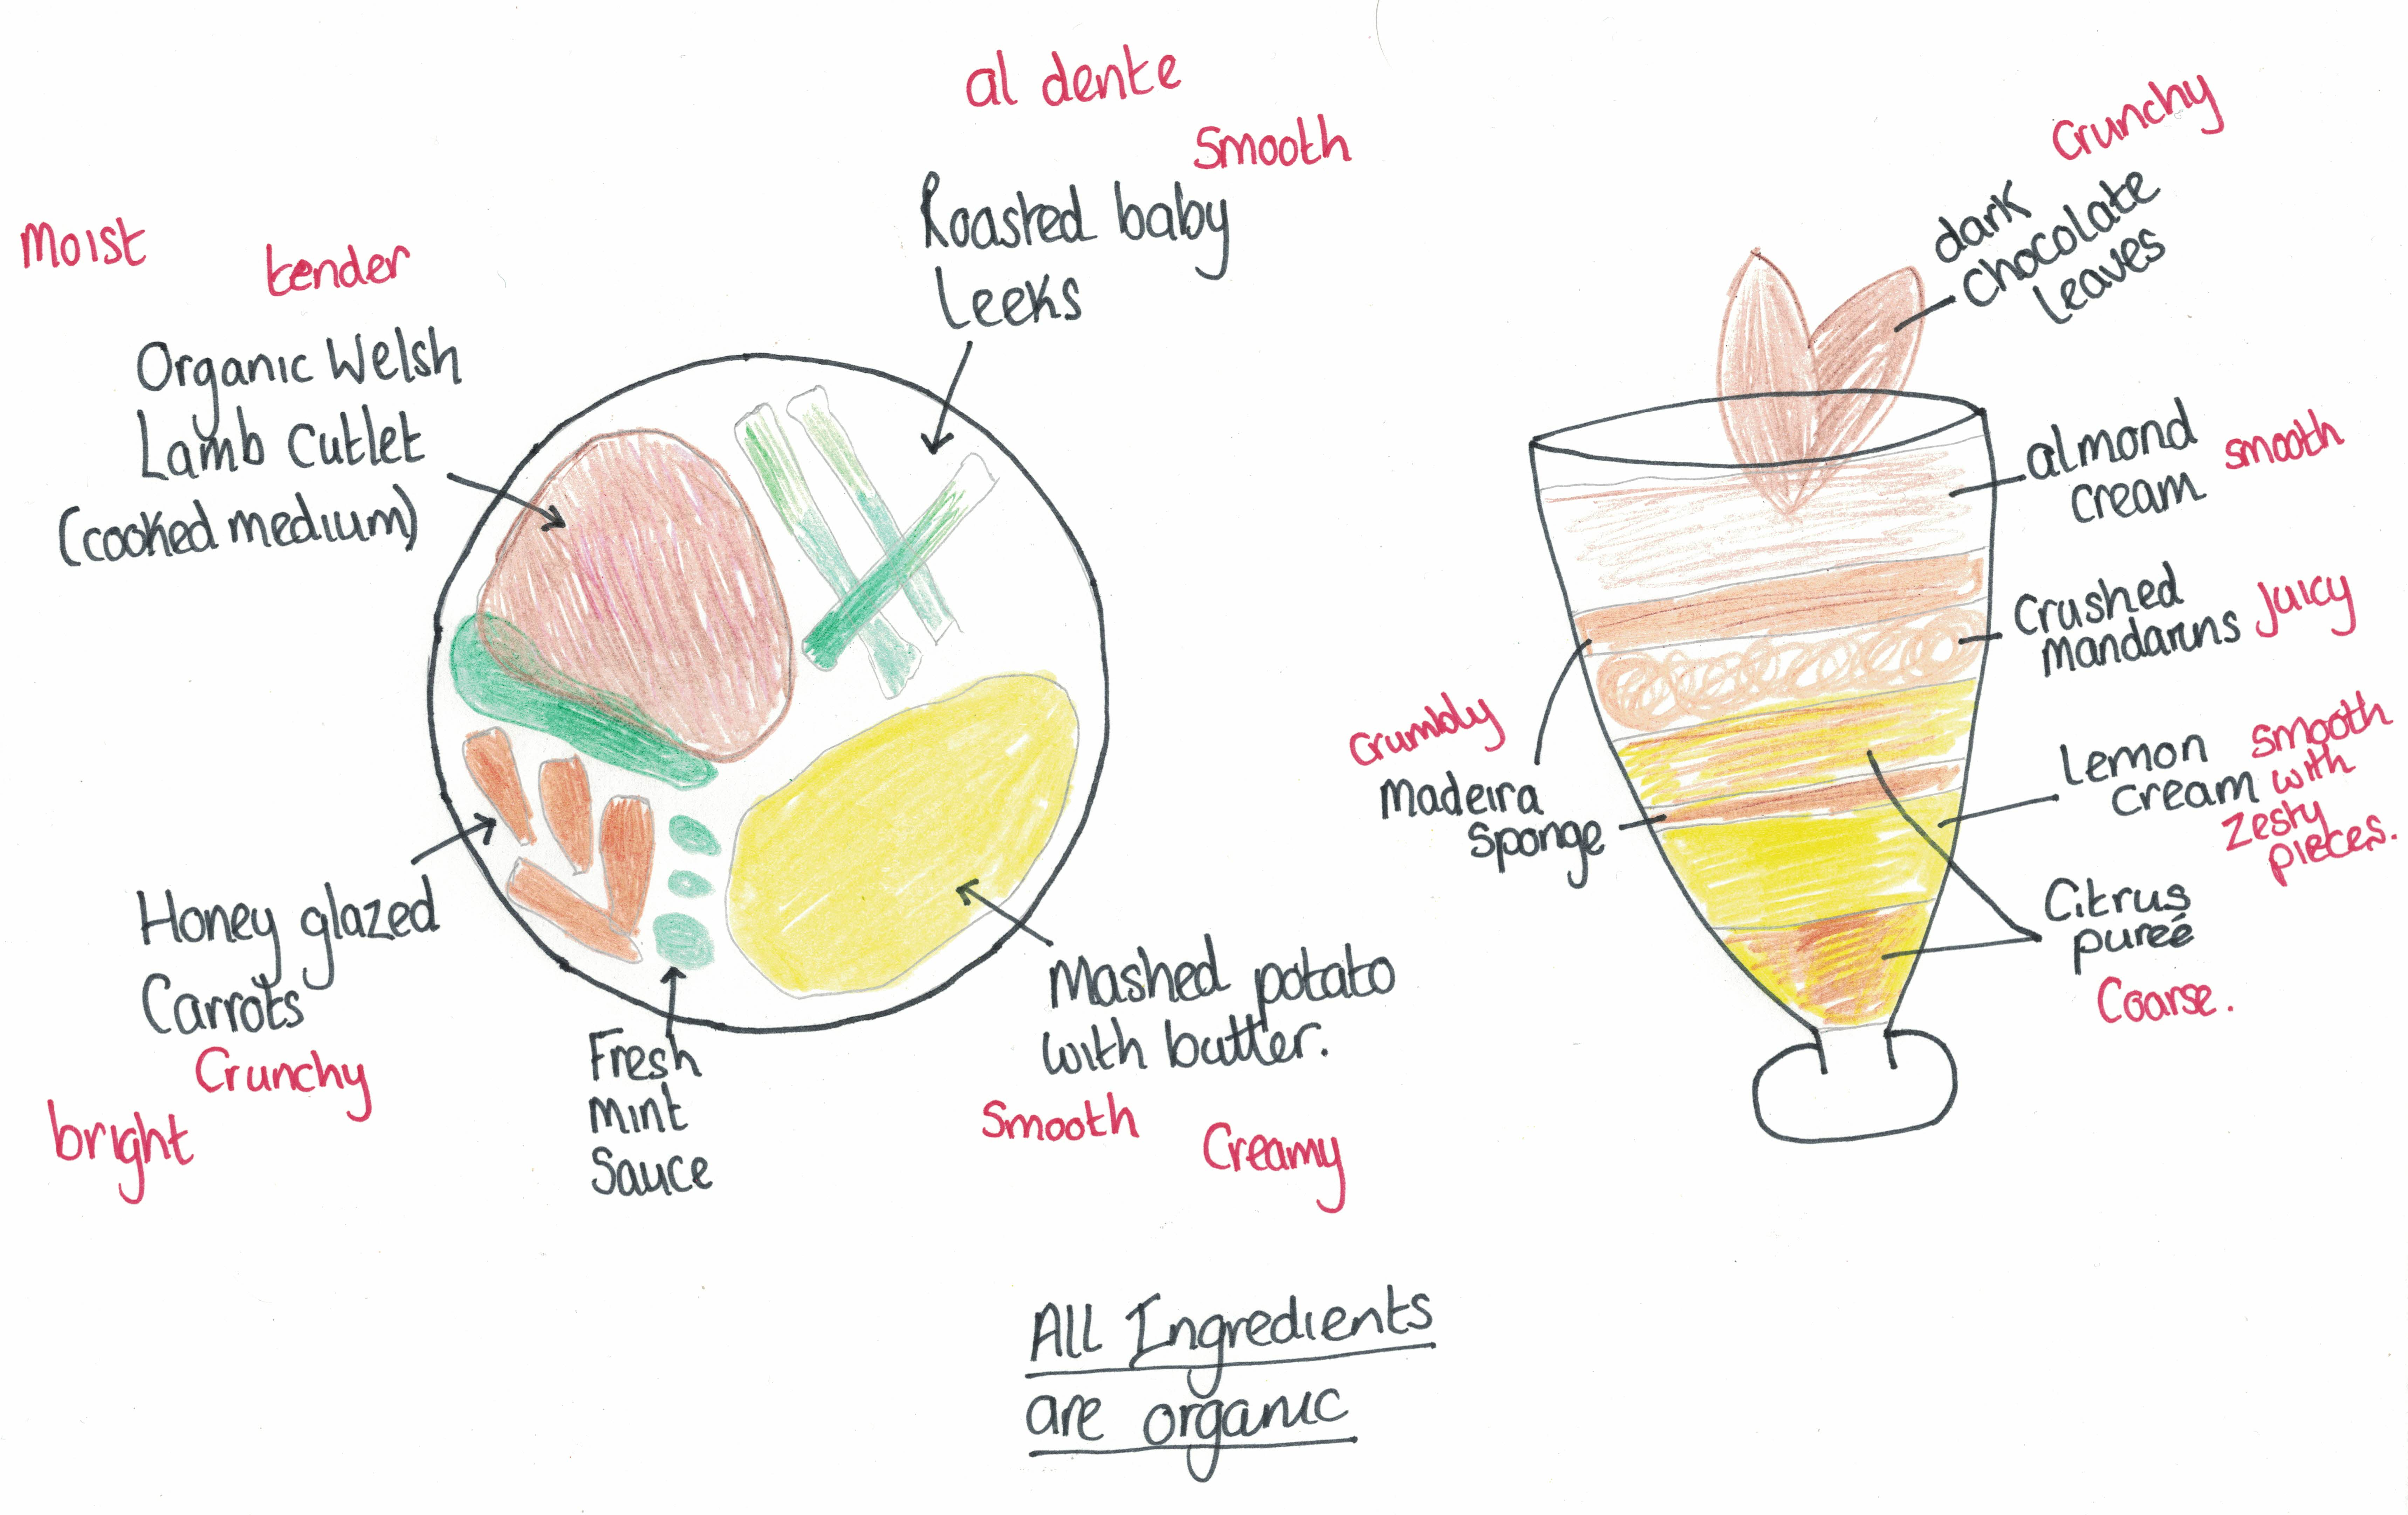
Example design
Notes:
This a pupil example that could be shared with learners to help them:
Welsh lamb with buttery mashed potato, honey glazed carrots and roasted baby leeks, served with a fresh mint sauce
Citrus layered desert
Consider textures and how they go together
What colours complement each other?

Slide 9
Extension
Extension 1 - Cost the meal per portion for the organic ingredients compared to non-organic ingredients
Extension 2 - Design a starter or dessert to compliment your meal
Extension 3 - Create a menu card to be put on to the King’s table

