Slide 1
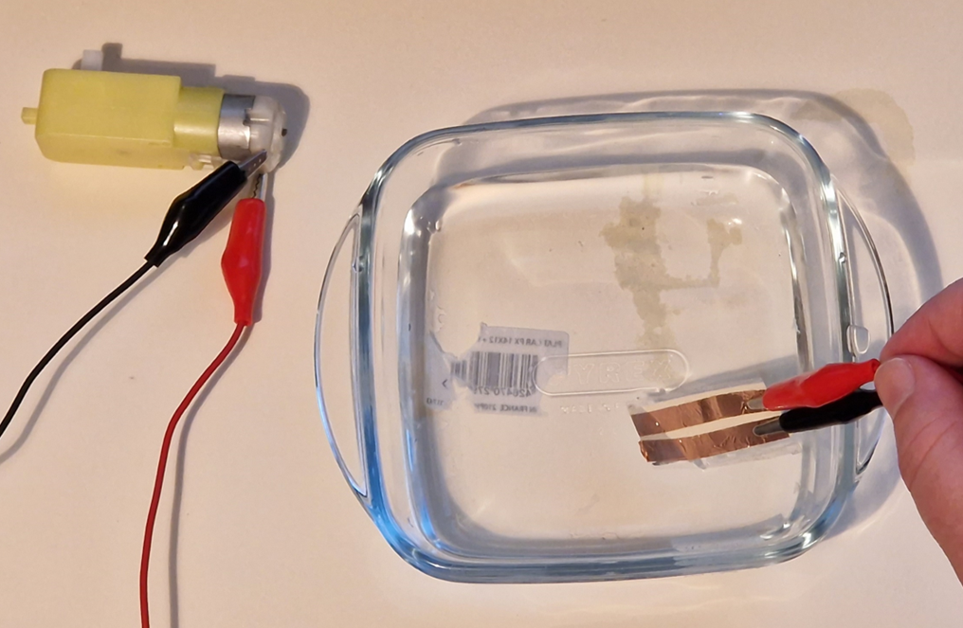
Make a flood barrier system
Designing and making a circuit to detect an overflow from a river and raise a temporary barrier using Crumble

Slide 2
Stay safe
Whether you are a scientist researching a new medicine or an engineer solving climate change, safety always comes first. An adult must always be around and supervising when doing this activity. You are responsible for:
ensuring that any equipment used for this activity is in good working condition
behaving sensibly and following any safety instructions so as not to hurt or injure yourself or others
Please note that in the absence of any negligence or other breach of duty by us, this activity is carried out at your own risk. It is important to take extra care at the stages marked with this symbol: ⚠

Slide 3
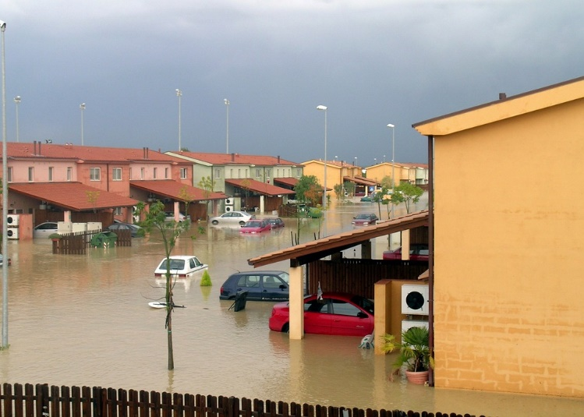
Design brief
Because of climate change, many parts of the world are now at risk of flooding
One way of protecting people and their homes from this is a barrier that prevents the water from reaching them
Your task is to design and make an automatic system that closes a barrier when the water level in a river gets too high
Notes:
Learners could research existing examples of flood barrier systems, such as the Thames Barrier.

Slide 4
Systems block diagram
Complete the block diagram below with a design idea for your system
What input, driver and output will you need?
INPUT
PROCESS
DRIVER
OUTPUT
Microcontroller
Notes:
This slide could be printed as a template for learners or they could draw their idea on a separate piece of paper, or in their exercise books. Higher ability learners could draw their idea without the template, or add additional blocks to their design to make it more complex. For example, a warning buzzer or flashing light when the barrier is being lifted.
Explain that the system will be controlled by a programmable microcontroller. Learners could then discuss the advantages and disadvantages of using a microcontroller instead of discrete components for the system.

Slide 5
Systems block diagram
Complete the block diagram below with a design idea for your system
What input, driver and output will you need?
INPUT
PROCESS
DRIVER
OUTPUT
Moisture sensor
Microcontroller
Motor driver IC
Barrier motor
Notes:
This slide shows an example block diagram for the system and could be used to aid lower ability learners.

Slide 6
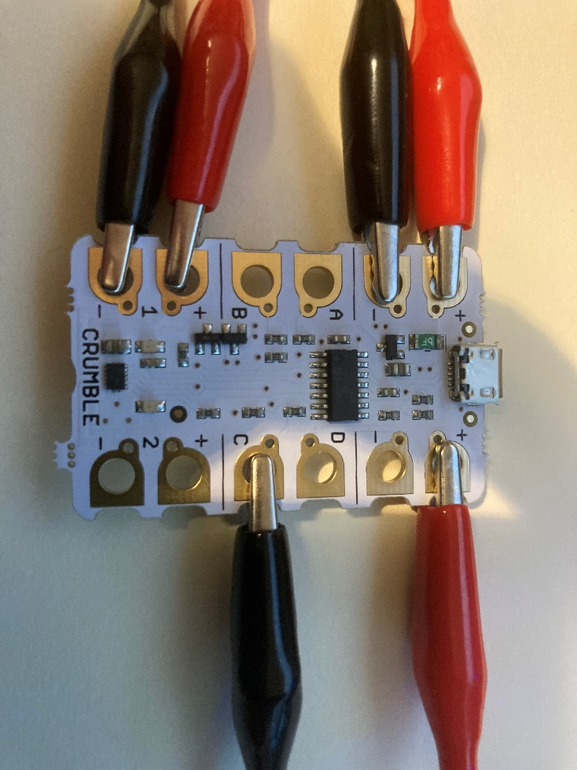
Resources
Crumble controller board and USB download cable
Three red crocodile clips and three black crocodile clips
Three AA batteries and battery pack
Crumble motor
To make a moisture sensor:
Copper tape
Card
Sellotape
Scissors
Notes:
The following slides presents an example solution based on the use of the Crumble programmable microcontroller system by Redfern Electronics. https://redfernelectronics.co.uk/crumble/. Kits can be purchased from the website containing the main parts and components required.
Additional resources for making a DIY moisture sensor are also shown.
These slides could be adapted by the teacher for other programmable systems as used in their own school.

Slide 7
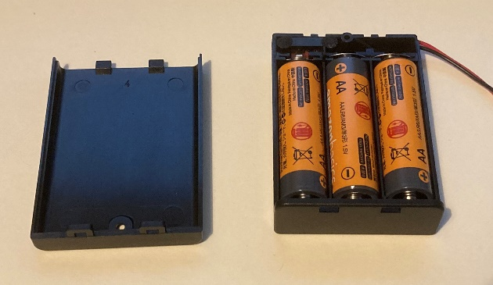
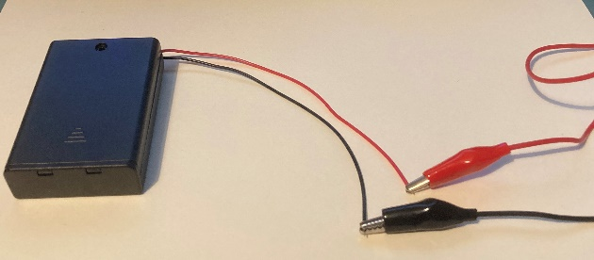
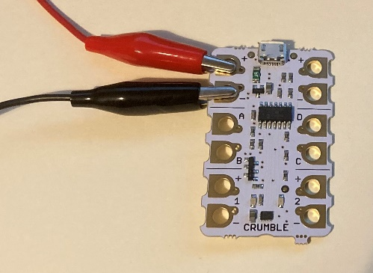
Step 1 – Power supply
⚠
Fit three AA batteries into the battery pack
Attach one end of a red crocodile clip to the red lead on the battery pack and the other to the + power port on the Crumble
Attach one end of a black crocodile clip to the black lead on the battery pack and the other to the - power port on the Crumble
Notes:
Care must be taken to put the batteries the correct way around in the pack (correct polarity).
Do NOT turn the power pack on at this point. If using a battery pack without an on/off switch do this step just before programming.

Slide 8
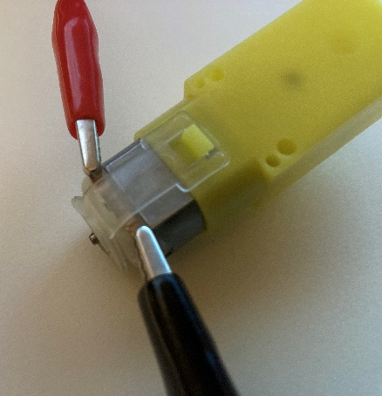
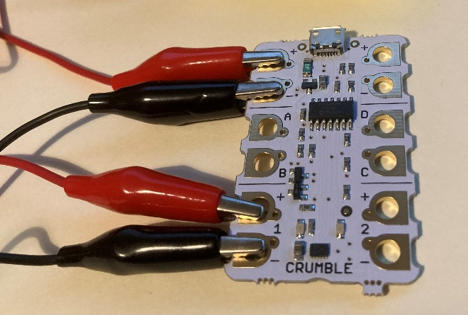
Step 2 – Connecting the motor
Connect one end of a red crocodile clip to the + leg of the motor and the other to the + motor 1 output port on the Crumble
Connect one end of a black crocodile clip to the - leg of the motor and the other to the - motor 1 output port on the Crumble

Slide 9
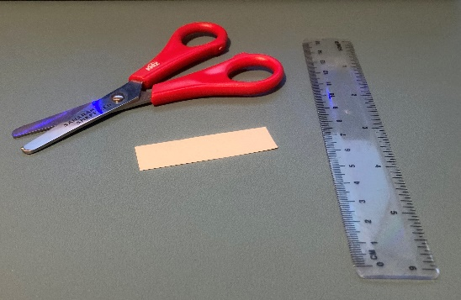
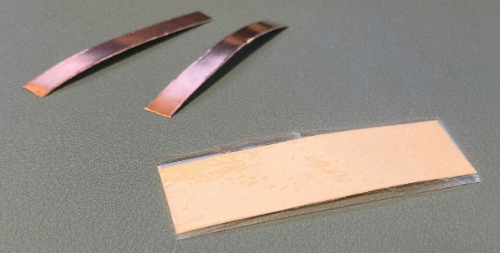
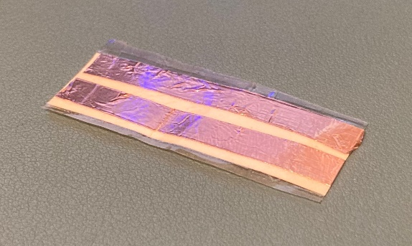
Step 3 – Moisture sensor
⚠
Cut out a piece of card measuring approximately 50 mm x 15 mm
Cover it in sticky tape so it is waterproof
Cut out two strips of copper tape 50 mm long
Stick these onto the card piece with a small gap between them
This will now act as moisture sensor!
Notes:
This step is optional as the system can operate by simply placing the ends of the appropriate crocodile clips into the water. It does however give an opportunity for learners to demonstrate additional practical skills and knowledge as to how a moisture sensor works.
When the sensor is placed in water current will conduct between the two pieces of copper tape, this ‘making’ the circuit and acting as a switch/sensor input to the Crumble microcontroller.
Take care when using scissors to cut out card and copper tape, and be careful of any sharp edges.
Further information about making a moisture sensor can be found here: https://redfernelectronics.co.uk/category/crumble-projects/

Slide 10
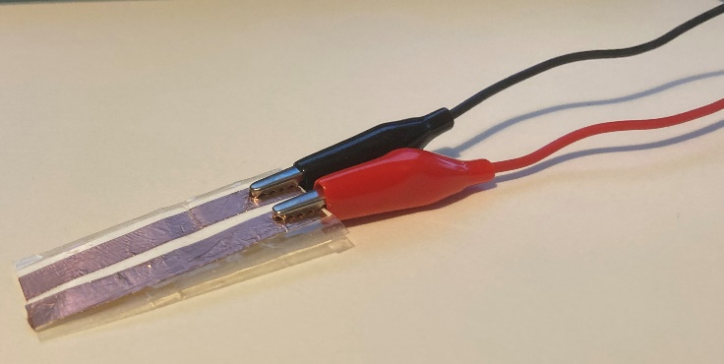
Step 4 – Connecting the sensor
Connect one end of a red crocodile clip to one of the copper strips and the other end to the + port on the right hand side of the Crumble
Connect one end of a black crocodile clip to the other copper strip and the other end to port C on the right hand side of the Crumble

Slide 11
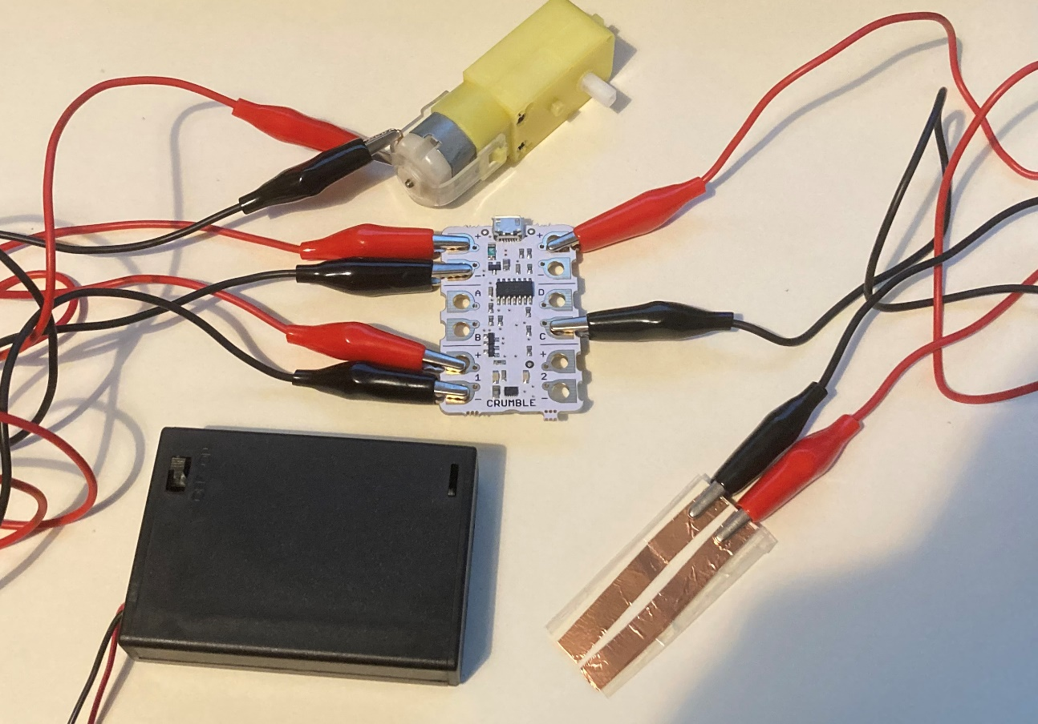
Completed hardware

Slide 12
Step 5 – Writing the program
Use the Crumble programming software to write your program for the flood barrier
You need the motor to turn on for a set period of time when the moisture sensor detects water
Notes:
An example program is shown to get learners started. This can be downloaded with the resource files for this activity.
This program will need to be reset each time it is used (this can be achieved by turning the battery pack off and on again) due to it being set to run through the code just once. This prevents the sensor from continuously triggering movement of the motor after the initial time period has elapsed (i.e. after the barrier has been moved into place).
Most learners should try to improve upon or modify this program (such as by adding a way for it to move the barrier back once the water levels have dropped etc) but weaker learners could download it straight onto their circuit.
Teacher should demonstrate use of the software if learners have not used it before.

Slide 13
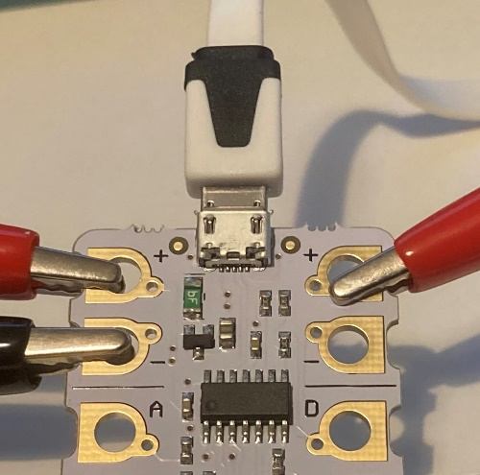
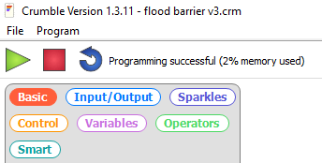
Step 6 – Downloading the program
Connect the download cable to the crumble board and the computer USB port
Turn the battery pack ‘on’
Press the green play button on the software to download your program to the Crumble microcontroller
Notes:
An example program is shown to get learners started. This can be downloaded with the resource files for this activity.
Once the program has been successfully downloaded to the Crumble microcontroller then the download cable can be removed from the circuit.

Slide 14
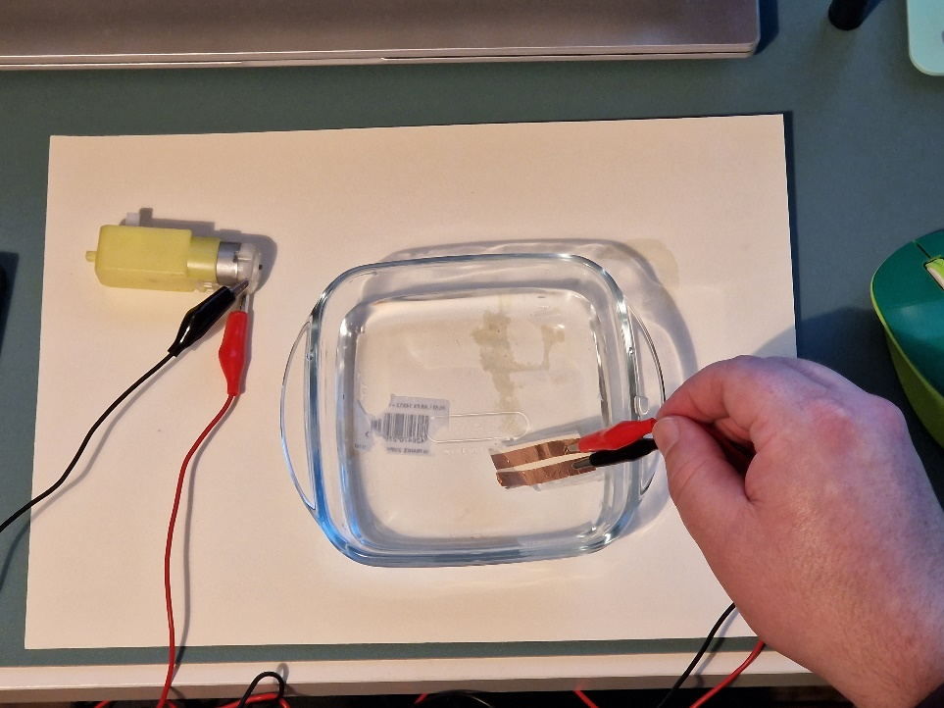
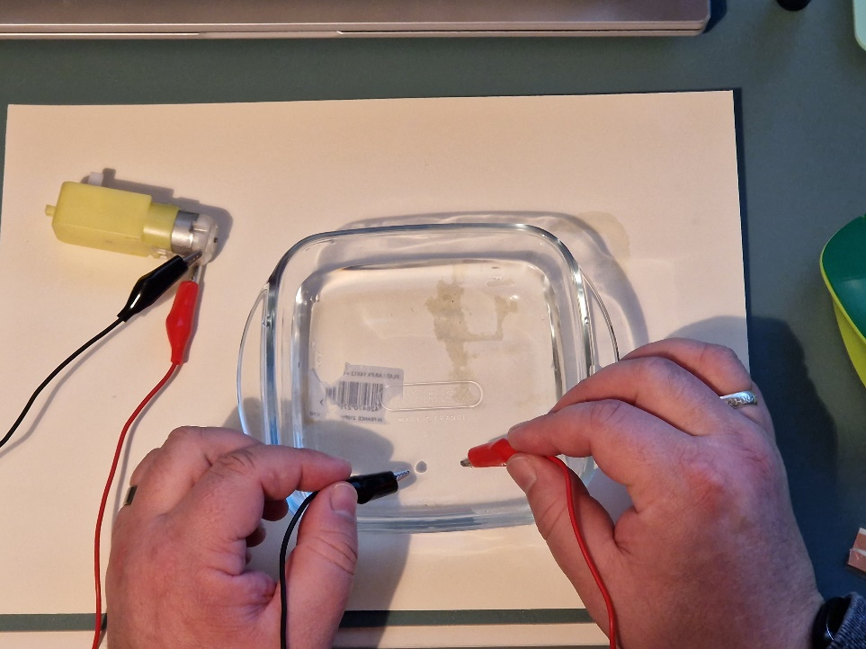
Testing
⚠
Place the sensor into water to test if your circuit works
Notes:
Always take care when using electricity near water. No other parts of the circuit should be placed in the water.
If a sensor hasn’t been made, then the circuit can be tested by placing the unused ends of the port C crocodile clips directly into the water.

Slide 15
Testing
⚠
Place the sensor into water to test if your circuit works
Notes:
Always take care when using electricity near water. No other parts of the circuit should be placed in the water.

Slide 16
Extension
Design a mechanical system to convert the rotary motion from the motor to the movement of a barrier
Update the program to take account of this mechanical movement (e.g. the time needed to move the barrier)
Add light or sound outputs to the system to warn people when the barrier is moving

