Slide 1
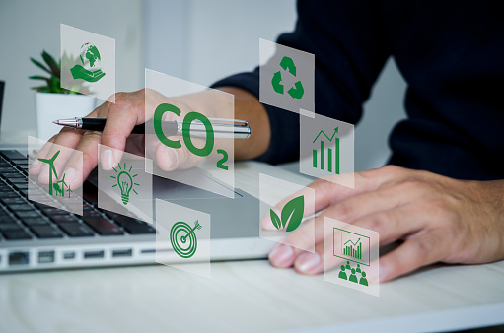
Greenhouse Effect Experiment
Investigating how carbon dioxide affects temperature

Slide 2
Stay safe
Whether you are a scientist researching a new medicine or an engineer solving climate change, safety always comes first. An adult must always be around and supervising when doing this activity. You are responsible for:
ensuring that any equipment used for this activity is in good working condition
behaving sensibly and following any safety instructions so as not to hurt or injure yourself or others
Please note that in the absence of any negligence or other breach of duty by us, this activity is carried out at your own risk. It is important to take extra care at the stages marked with this symbol: ⚠

Slide 3
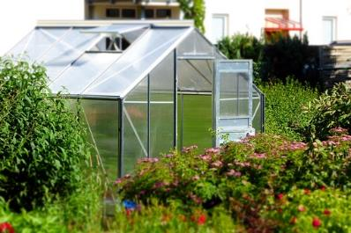
What is the Greenhouse Effect?
A greenhouse is a building with glass for the walls and roof.
The glass helps to trap heat inside. That makes it a great place to grow plants.
The Earth is surrounded by an atmosphere made up of gases.
The atmosphere traps the sun’s heat on the Earth’s surface. That makes our planet perfect for living organisms.

Slide 4
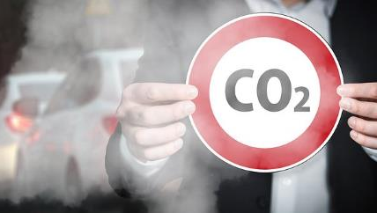
Carbon Dioxide
One of the most important greenhouse gases is carbon dioxide (CO₂).
When we drive cars and burn fossil fuels like gas and oil, we put more CO₂ into the atmosphere.
This causes more heat to be trapped on our planet.

Slide 5

Our aim…
We are going to investigate how trapped CO₂ affects the temperature of a closed environment.

Slide 6
The Experiment
Tools needed:
Scissors
Permanent marker
Measuring cups and spoons
Heat source – a radiator or a sunny window sill
Thermometer
4 empty jam jars
Bicarbonate of soda (Bicarb)
White vinegar
Masking tape
Cling film
Elastic bands

Slide 7
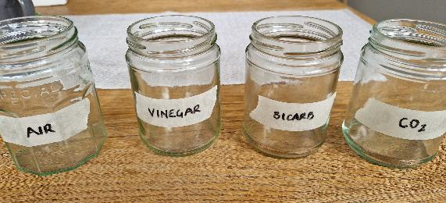
Prepare the jars
Label the jars as:
Air
Vinegar
Bicarb
CO₂

Slide 8
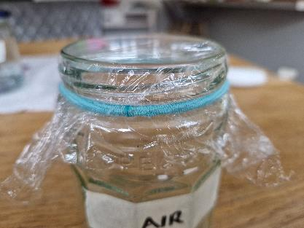
What is the Clingfilm for? ⚠
Using scissors, cut a piece of cling film big enough to cover the top of the jar, with a bit extra down the sides. ⚠
Repeat for other jars.
After the jars have been filled, add an elastic band round the rim, to ensure a tight seal.

Slide 9
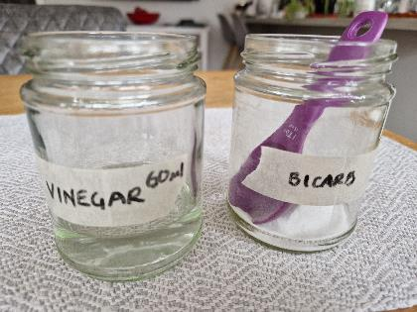
Now do this…
Place plastic wrap on the air jar and secure it with an elastic band.
Add 1/4 cup (60ml) of vinegar to the vinegar jar. Cover with cling film and secure with an elastic band.
Add 1 tablespoon of Bicarb to the Bicarb jar. Cover as before.

Slide 10
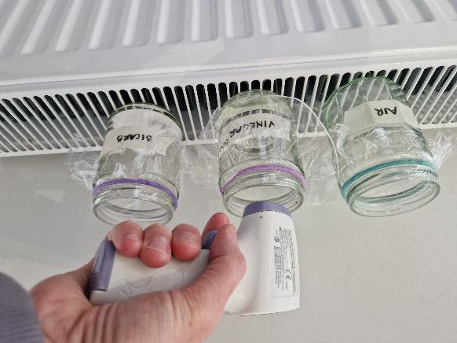
Measuring the temperature
Using your thermometer point it downwards into each jar.
If using a traditional type of thermometer – cut a small slit in the cling film.
Record your results on the activity sheet.

Slide 11

Making CO₂
Take your fourth jar.
Add 1 tablespoon of bicarb and 1/4 cup of vinegar.
Watch the reaction! The bubbles are CO₂ gas.
Cover with the cling film to trap the CO₂ gas in the jar.
After about 30 seconds take a temperature reading. What do you notice?
endothermic
adjective
CHEMISTRY
(of a reaction or process) accompanied by or requiring the absorption of heat.

Slide 12
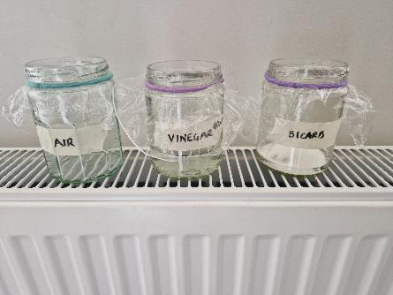
Turn up the heat!!
Carefully put the jars on a warm radiator – make sure they won’t fall off. The radiator will evenly apply heat.
This heat source acts like the warming effect of the sun.
Measure the temperature in each jar after 5 minutes, 10 minutes and 15 minutes.
Record your results on the activity sheet.

Slide 13

The Science behind it
In this experiment we are trapping the carbon dioxide gas in the jar.
When heat is applied, the carbon dioxide traps more heat in the jar than our controls.

Slide 14
Activity Sheet – Greenhouse Effect Experiment
Jar | ºC at start | ºC at 5 mins | ºC at 10 mins | ºC at 15 mins
Air
Vinegar
Bicarb
CO₂

