Slide 1
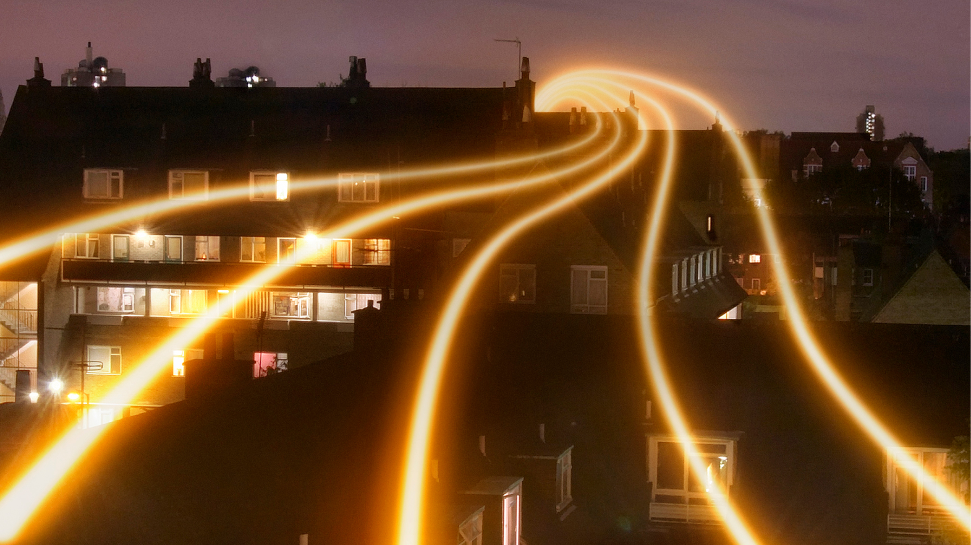
Calculate energy usage at home
Calculating the energy used by different electrical appliances and devices within the home

Slide 2
Stay safe
Whether you are a scientist researching a new medicine or an engineer solving climate change, safety always comes first. An adult must always be around and supervising when doing this activity. You are responsible for:
ensuring that any equipment used for this activity is in good working condition
behaving sensibly and following any safety instructions so as not to hurt or injure yourself or others
Please note that in the absence of any negligence or other breach of duty by us, this activity is carried out at your own risk. It is important to take extra care at the stages marked with this symbol: ⚠

Slide 3
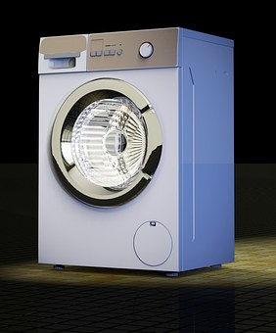
Starter
List all the electrical appliances that you use at home and at school
For example: washing machine, television etc.
Notes:
Learners could present this as a list or a spider chart.

Slide 4
Power sources in the home
TV
Cooker
Fridge
Dishwasher
Games console
“Mains” Electricity
Phone
Laptop
Tablet
Rechargeable batteries
Charger
“Solar” Electricity
Garden lights
Chemical Energy
Batteries
Battery powered toys etc.
Notes:
This slide could be used as a follow up to the starter to discuss the different types of power sources often used within homes.

Slide 5
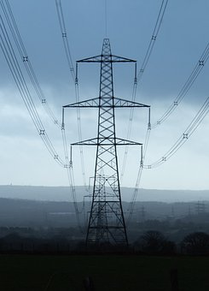
Mains electricity
Mains electricity is how most of us get our electrical power into our homes
It is generated in power stations and then sent to our houses and schools along cables
At the point where we plug into it, it is at 230 V AC
Mains electricity is very dangerous and can seriously hurt or even kill anyone who touches it
Notes:
Explain that mains electricity in the UK and Europe is at 230 V (both were brought in line from their respective 240 V and 220 V in 2009), which can be very dangerous if live wires are touched. It is different some countries, e.g. 120 V in the USA. This means devices designed for one country’s mains power supply will not always work on another’s.
Recap what is meant by voltage (V) and alternating current (AC) as necessary.

Slide 6
Power
Electrical power is calculated using the formula:
Power (P) = Current (I) x Voltage (V), or P = I x V
It is measured in watts (W), but you will often see it given in kilowatts (kW)
For example, a washing machine using 5 A of current and plugged into the mains:
P = 5 x 230 = 1150 W, or 1.15 kW
Notes:
Explain that we need to calculate power first, before we work out the energy used by different devices.
You may need to recap that current is measured in amps (A) and that kilo is x 1000.
Useful supporting link - https://electronicsclub.info/power.htm

Slide 7
Task 1
Complete the table by calculating the power used by each of the following devices when plugged into the mains:
Appliance | Voltage (V) | Current (I) | Power (I x V)
Vacuum cleaner | 230 V | 9 A | W kW
Kettle | 230 V | 10 A | W kW
Games console | 230 V | 0.7 A | W kW
Television | 230 V | 2.2 A | W kW
Slow cooker | 230 V | 0.9 A | W kW
Notes:
Teacher could change these appliances for others as required. Information about current draw can usually be found on a sticker on the appliance itself, or approximate values can be found online.
When using P = I x V with alternating current (AC) devices, the power found is an instantaneous value, i.e. the value at a particular instant. This is fine for purpose of these calculations, and doesn't need any further explanation to learners at this stage.
Explain that for the next stage we need the values to be in kW.
A calculator will be needed.

Slide 8
Task 1 Answers
Appliance | Voltage (V) | Current (I) | Power (I x V)
Vacuum cleaner | 230 V | 9 A | 2070 W 2.07 kW
Kettle | 230 V | 10 A | 2300 W 2.3 kW
Games console | 230 V | 0.7 A | 161 W 0.161 kW
Television | 230 V | 2.2 A | 506 W 0.506 kW
Slow cooker | 230 V | 0.9 A | 207 W 0.207 kW
Notes:
Teacher could change these appliances for others as required. Information about current draw can usually be found on a sticker on the appliance itself, or approximate values can be found online.
When using P = I x V with alternating current (AC) devices, the power found is an instantaneous value, i.e. the value at a particular instant. This is fine for purpose of these calculations, and doesn't need any further explanation to learners at this stage.
Explain that for the next stage we need the values to be in kW.
A calculator will be needed.

Slide 9
Energy used
Energy used by electrical appliances is given in kilowatt hours (kWh)
Energy used (in kWh) = Power (in kW) x the number of hours the appliance is in use
For example, a 1.15 kW washing machine switched on for 2 hours:
Energy used = 1.15 x 2 = 2.3 kWh
Notes:
Useful supporting link - https://electronicsclub.info/power.htm

Slide 10
Task 2
Use your power calculations to work out the energy used by each of the following devices for the given usage times:
Appliance | Power (kW) | Usage time (hours) | Energy (kWh)
Vacuum cleaner | 2.07 kW | 1 hour | kWh
Kettle | 2.3 kW | 0.25 hours | kWh
Games console | 0.161 kW | 3 hours | kWh
Television | 0.506 kW | 4 hours | kWh
Slow cooker | 0.207 kW | 10 hours | kWh
Notes:
A calculator will be needed.
Usage times are approximate for a day’s use of each and can changed as required by the teacher.

Slide 11
Task 2
Use your power calculations to work out the energy used by each of the following devices for the given usage times:
Appliance | Power (kW) | Usage time (hours) | Energy (kWh)
Vacuum cleaner | 2.07 kW | 1 hour | 2.07 kWh
Kettle | 2.3 kW | 0.25 hours | 0.575 kWh
Games console | 0.161 kW | 3 hours | 0.483 kWh
Television | 0.506 kW | 4 hours | 2.02 kWh
Slow cooker | 0.207 kW | 10 hours | 2.07 kWh
Notes:
A calculator will be needed.
Usage times are approximate for a day’s use of each and can changed as required by the teacher.

Slide 12
Review
What do your answers mean?
Are you surprised by any of these results?
How could you reduce your own energy usage?

Slide 13
Extension
Find other appliances at home or at school where you can find out the power requirements easily
Work out how much power the appliance uses every day
Explain how you could reduce your usage of these appliances and the benefits of doing so

