Slide 1
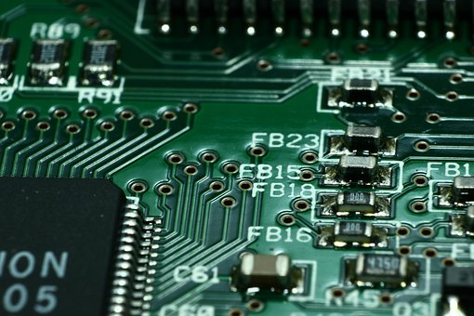
Explore electrical resistance
Testing the electrical resistivity of different materials

Slide 2
Stay safe
Whether you are a scientist researching a new medicine or an engineer solving climate change, safety always comes first. An adult must always be around and supervising when doing this activity. You are responsible for:
ensuring that any equipment used for this activity is in good working condition
behaving sensibly and following any safety instructions so as not to hurt or injure yourself or others
Please note that in the absence of any negligence or other breach of duty by us, this activity is carried out at your own risk. It is important to take extra care at the stages marked with this symbol: ⚠

Slide 3
The Basics of Resistance
Imagine water flowing through two pipes…
If one pipe has a narrow section this means that less water can flow through it.
The narrow pipe "resists" the flow of water.
Less Resistance
More Resistance

Slide 4
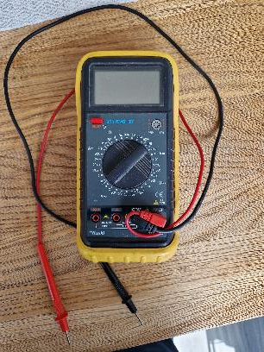
Measuring resistance
Resistance to the flow of electricity can be measured using an ohmmeter
This is one of the functions of a multimeter
This is an electrical instrument capable of measuring voltage, current, and resistance
Test probes

Slide 5
Equipment needed
Mulitimeter – digital/analogue
Assorted resistors
Breadboard
Crocodile clips
Paper/pencil
Glass of water
Table salt

Slide 6
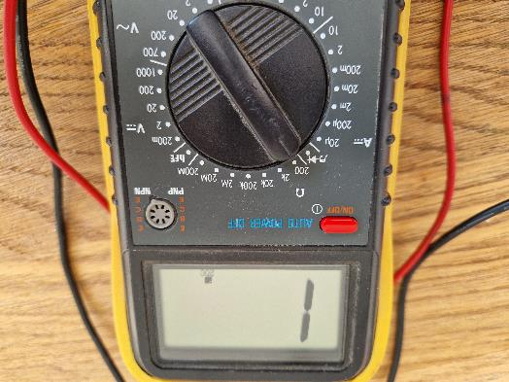
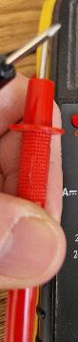
Measuring resistance with a multimeter
The resistance function is usually shown by the Greek letter omega (Ω) or sometimes by the word ohms
Set your multimeter to the highest resistance range available
Touch the two test probes of your meter together
When you do, the meter should register 0 Ω of resistance

Slide 7

WARNING:
Do not attempt to measure the resistance of a battery using a multimeter set to the resistance (“ohms”) function.
This could result in damaging the multimeter

Slide 8
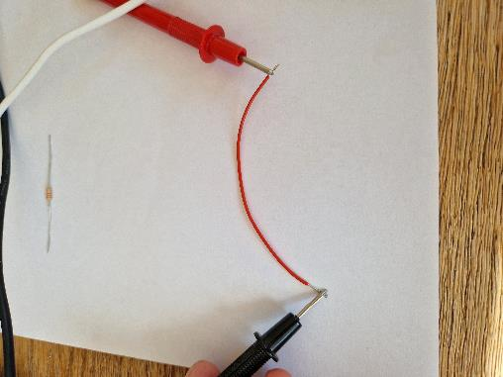
Continuity testing
Test the continuity of a piece of wire by touching the probes to the bare opposite ends of the wire. What happens?
What does it show if the meter doesn’t move at all when the probes are touched to the wire?
(Note: Some models say “OL” (open-loop), while others display dashed lines.)

Slide 9
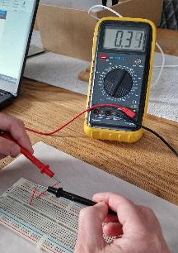
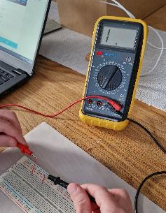
Continuity testing a breadboard
Use your meter to determine the continuity between the holes on a breadboard. Which holes are connected?
Continuity
No Continuity

Slide 10
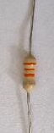
Resistors
Select a 33,000 Ω (33 kΩ) resistor.
For a 33 kΩ resistor, the three coloured bands will be orange, orange, orange.
The fourth coloured band represents the tolerance of the resistor. This might be gold (+/- 5%) or silver (+/- 10%).

Slide 11
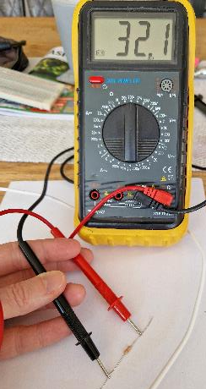
Measuring the resistance of a resistor
Set a suitable range on the ohmmeter scale (e.g. 100 kΩ)
Touch the meter’s test probes to each end of the 33 kΩ resistor.
Be careful not to touch both probe tips to your fingers at the same time – this will give a measurement lower than it should be.
You should see a value close to 33 shown on the display. Why is the number not exactly 33?
Notes:
If touching the probes, the value measured will be a parallel combination of the thing being touched and the body of the person touching the probes

Slide 12

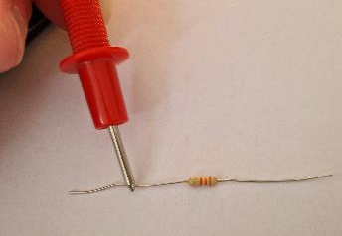
Investigating resistance
Try swapping which ends of the resistor the test probes are touching.
Does this change the measured value?
What does this tell us about the resistance of a resistor?
What happens when you only touch one probe to the resistor?
What does this tell us about resistance and how it is measured?

Slide 13
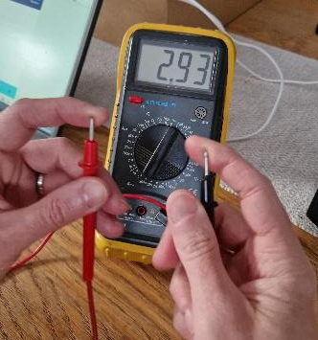
Measuring the resistance of a person
You can safely measure the resistance of your own body by holding one probe tip with the fingers of one hand and the other probe tip with the fingers of the other hand.
You may need to adjust the meter range as your body resistance may be greater than 50,000 ohms hand-to-hand.

Slide 14
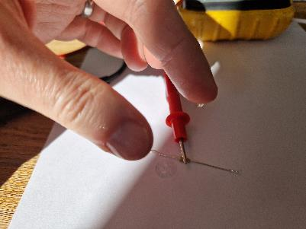
Factors that affect resistance
Try wetting the tips of your fingers with tap water and re-measuring resistance with the meter.
How does this affect the measured value?
Repeat the process, this time wetting your fingers with saltwater.
Does this affect the measured value? If so, why?
Notes:
Salt water can be prepared using a glass of water and table salt

Slide 15
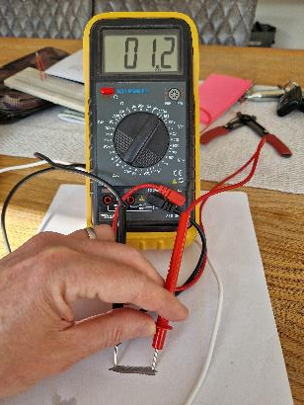
Measuring the resistance of pencil lines
Take a piece of paper and draw a very heavy black mark on it with a pencil (not a pen!)
Measure the resistance of the black strip with your meter, placing the probe tips at each end of the mark
Move the probe tips closer together on the black mark. How does the resistance value change?
What does this teach you about resistance versus the length of a conductive material?
Mark made with pencil
Notes:
If the results are inconsistent, the mark may need to be redrawn with more and heavier pencil strokes so that it is consistent in its density.

Slide 16

Extension
Investigate the resistance of other materials or substances. For example:
Plastics
Woods
Paper
Metals
Glass
Fabrics
Clean water
Dirty water

