Slide 1
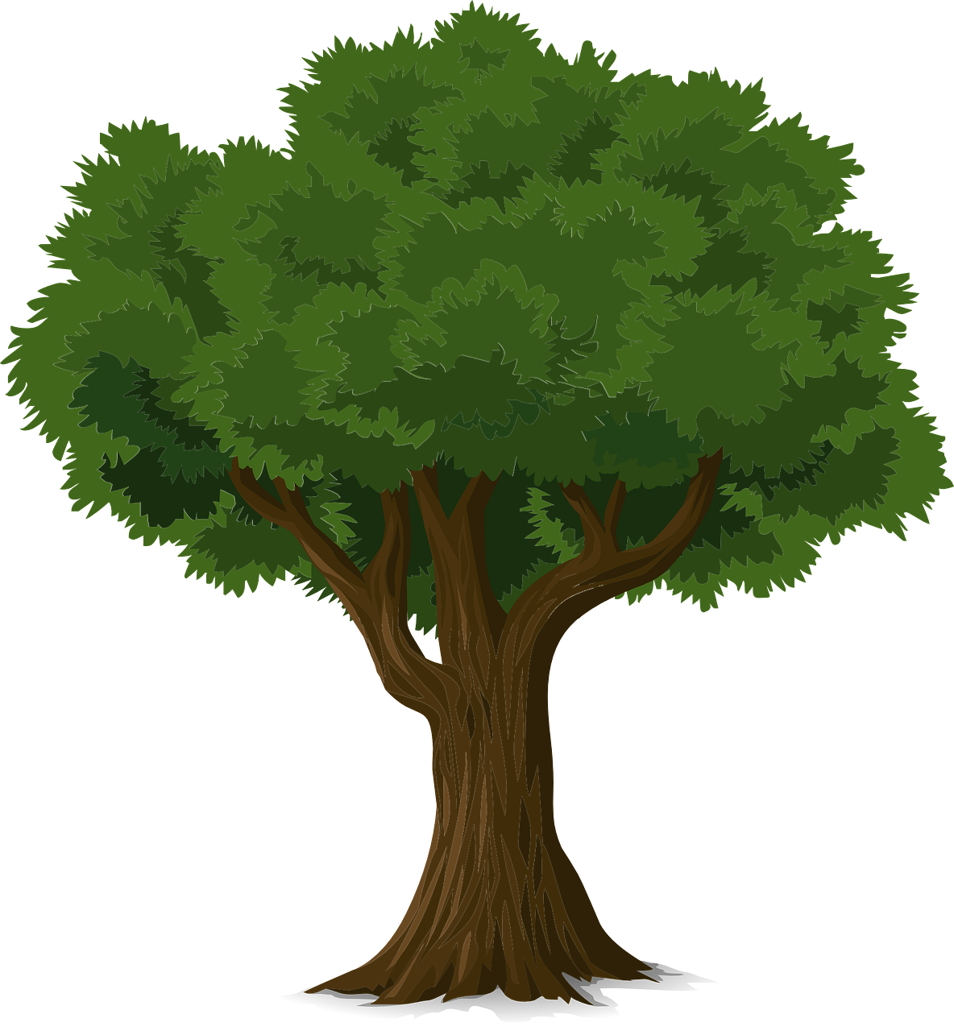
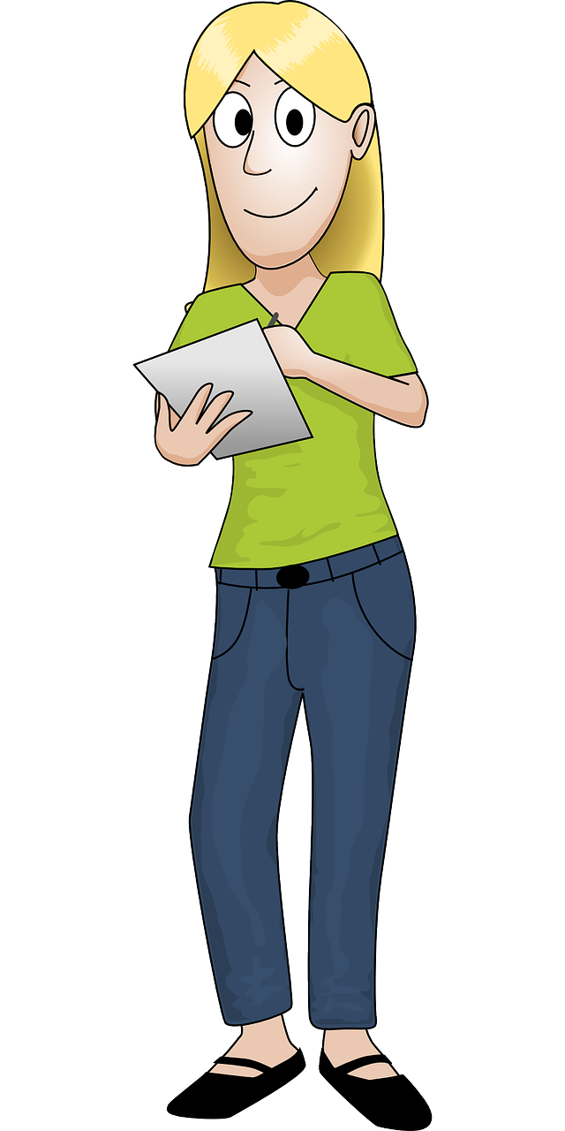
How do deciduous trees change?
Describing how a deciduous tree changes over a year
Notes:
In folklore or Greek mythology, a dryad is a nymph that inhabits a tree or wood. In this activity, which needs to be carried out over a school year, pupils will record the changes in a deciduous tree within the school grounds.
An appropriate tree within the school grounds needs to be identified. Ideally a tree visible from the classroom would be used. As applicable by local requirements, risk assessments may need to be carried out if the pupils need to go outside the school building to carry out this activity.

Slide 2
Stay safe
Whether you are a scientist researching a new medicine or an engineer solving climate change, safety always comes first. An adult must always be around and supervising when doing this activity. You are responsible for:
ensuring that any equipment used for this activity is in good working condition
behaving sensibly and following any safety instructions so as not to hurt or injure yourself or others
Please note that in the absence of any negligence or other breach of duty by us, this activity is carried out at your own risk. It is important to take extra care at the stages marked with this symbol: ⚠
Notes:
In folklore or Greek mythology, a dryad is a nymph that inhabits a tree or wood. In this activity, which needs to be carried out over a school year, pupils will record the changes in a deciduous tree within the school grounds.
An appropriate tree within the school grounds needs to be identified. Ideally a tree visible from the classroom would be used. As applicable by local requirements, risk assessments may need to be carried out if the pupils need to go outside the school building to carry out this activity.

Slide 3
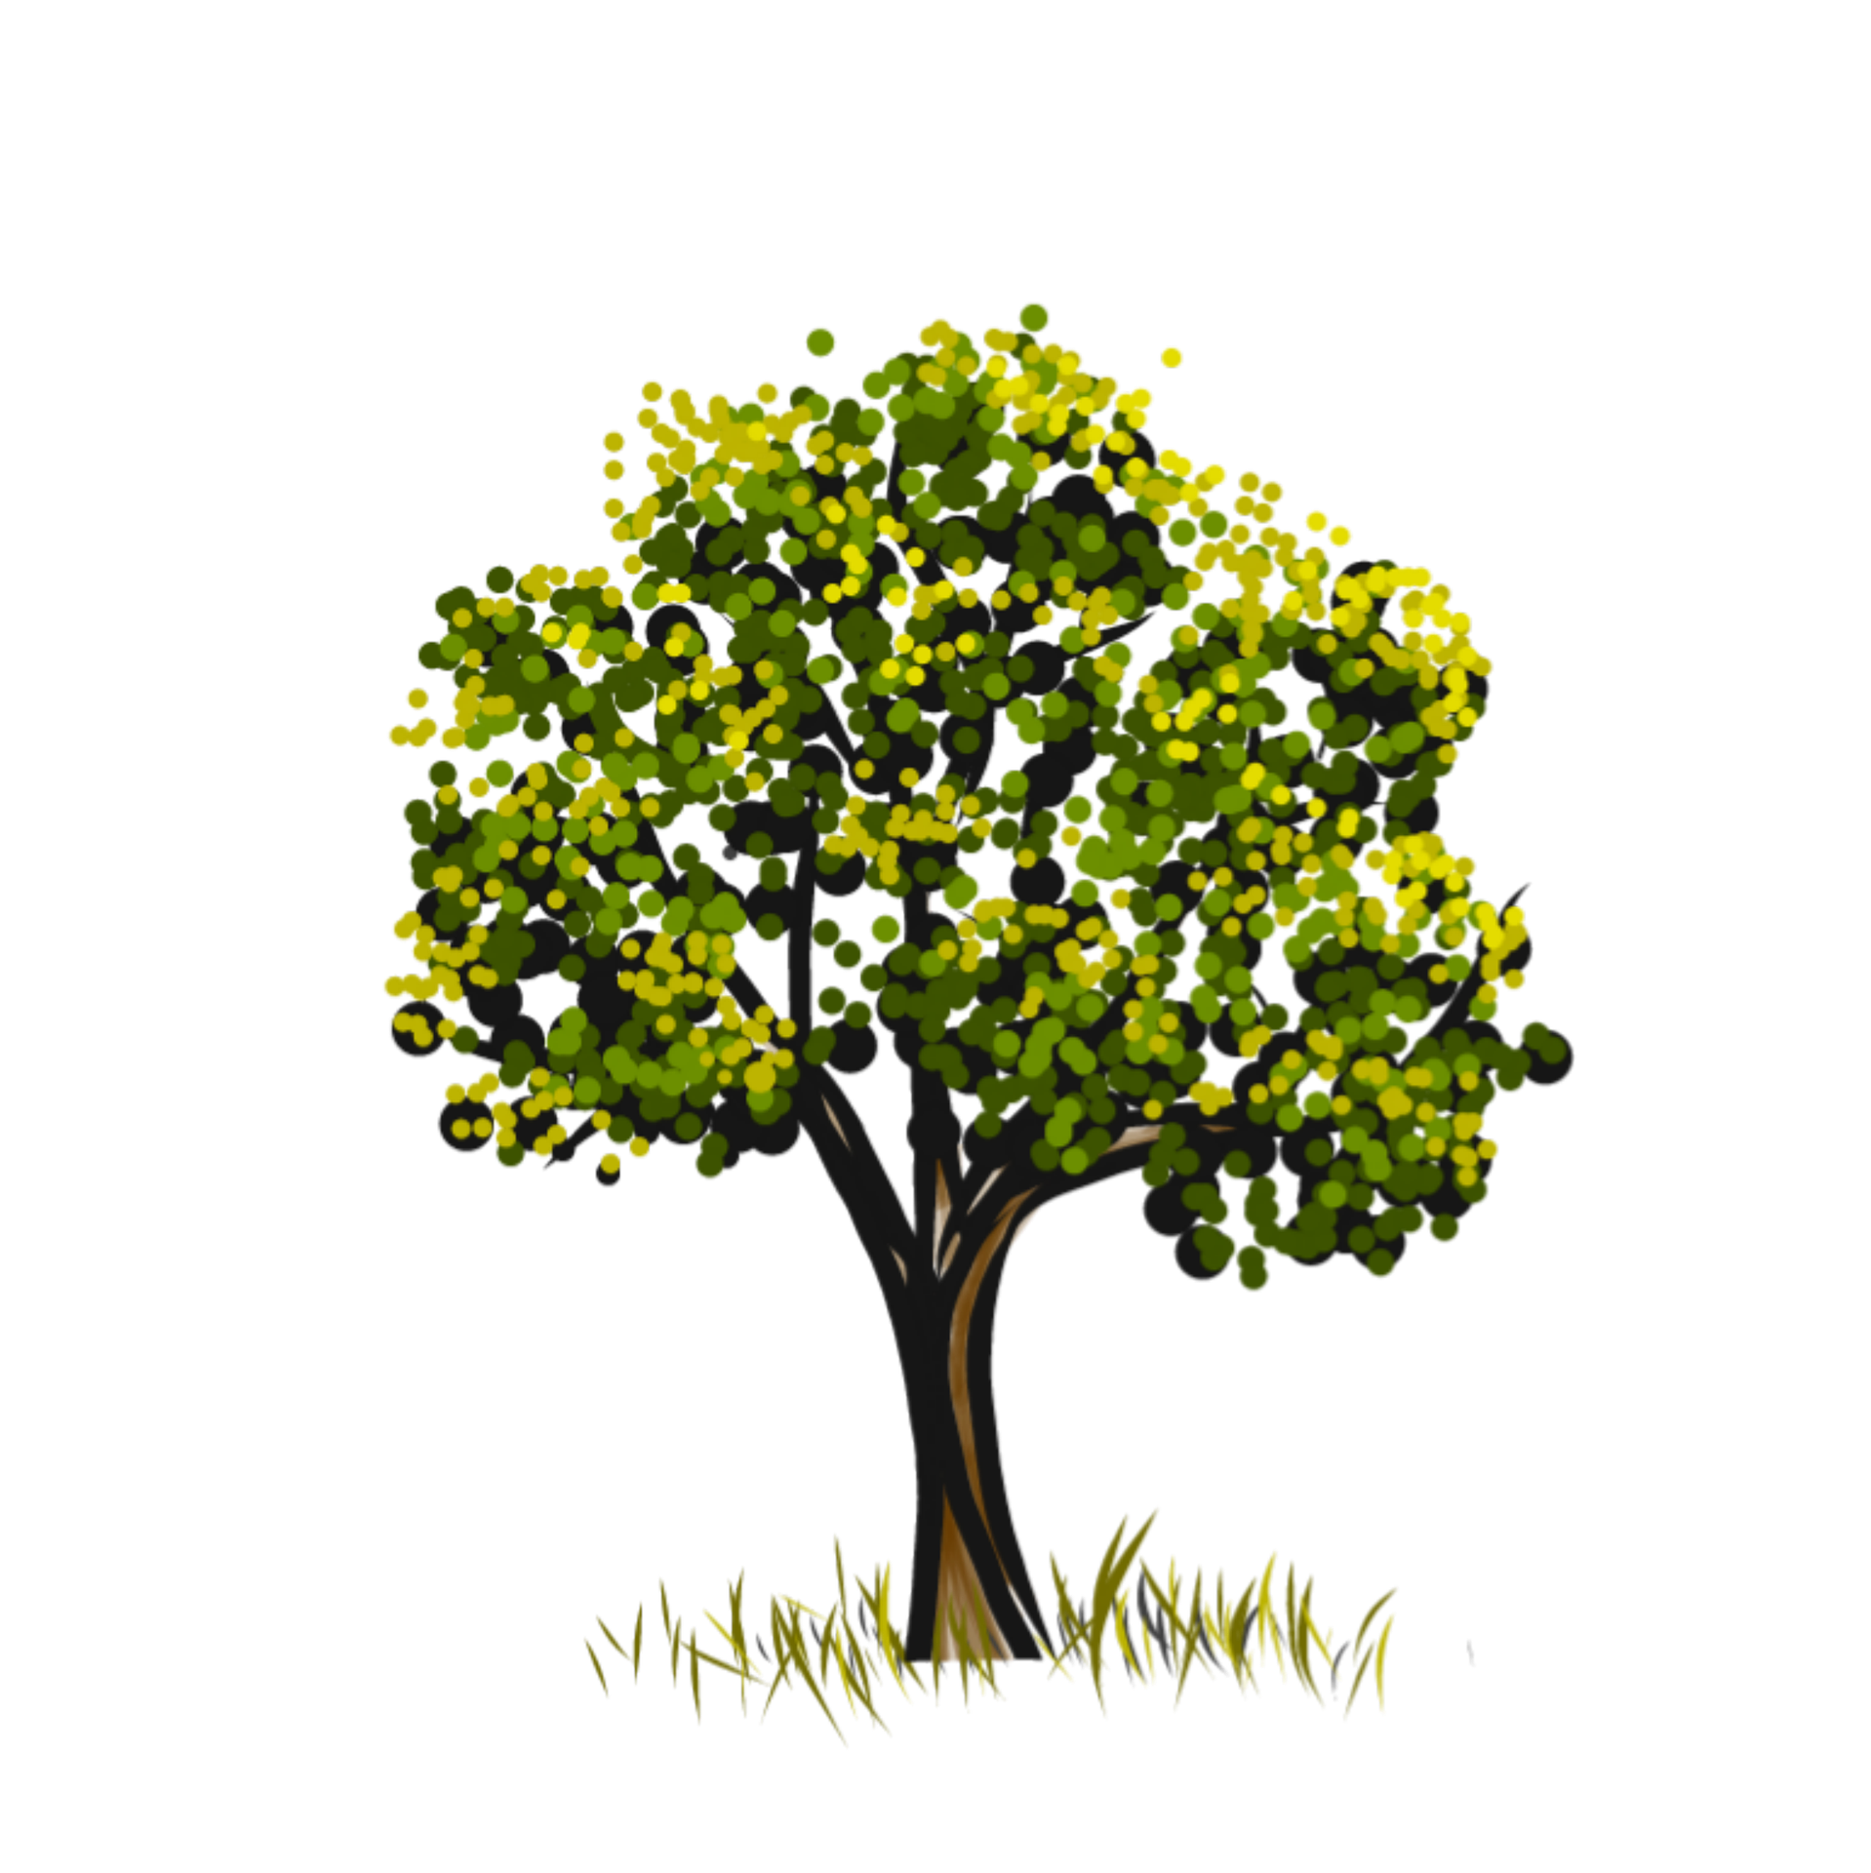
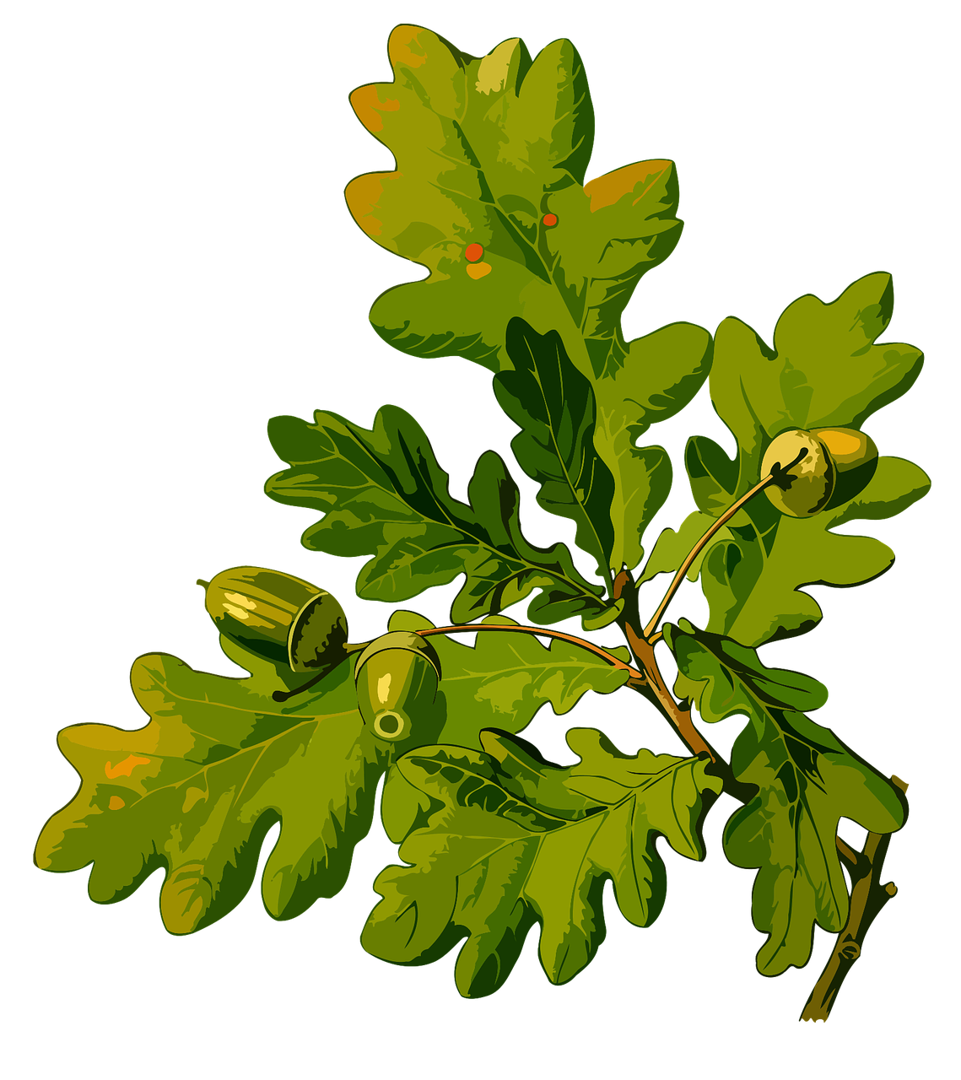
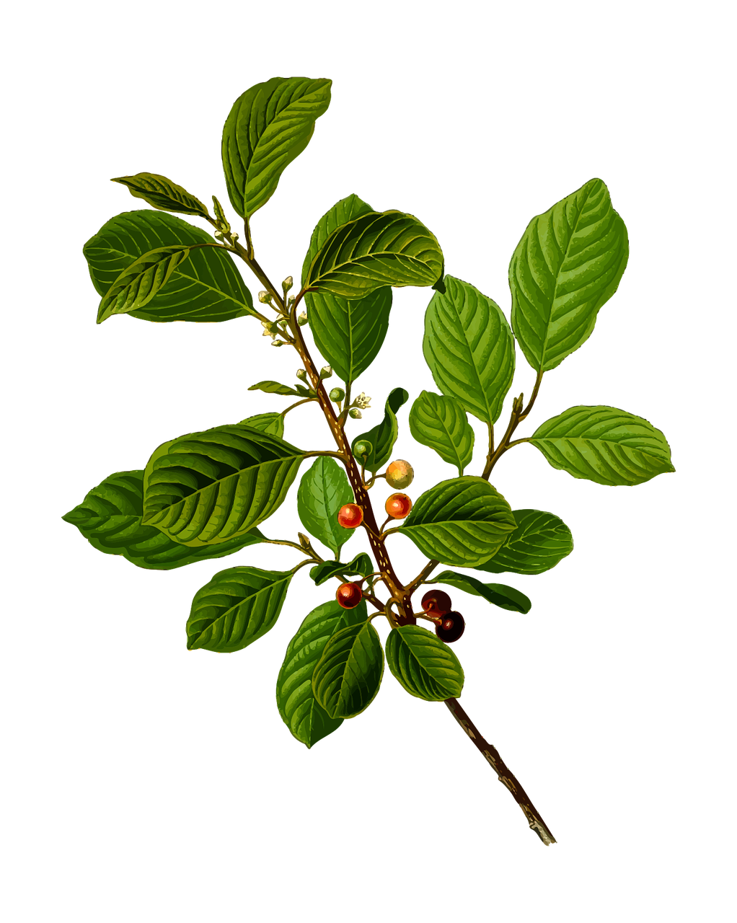
Deciduous trees
Deciduous trees have leaves
They grow new leaves every year
We are going to keep a diary of how one tree changes over the year
Deciduous tree
Notes:
The other type of tree is an evergreen tree, which keeps its needles (or pines) all year. Deciduous is the term used in the national curriculum, but some pupils may find hardwood easier. This term also fits in well with understanding needed in Key Stage 3 design and technology.

Slide 4
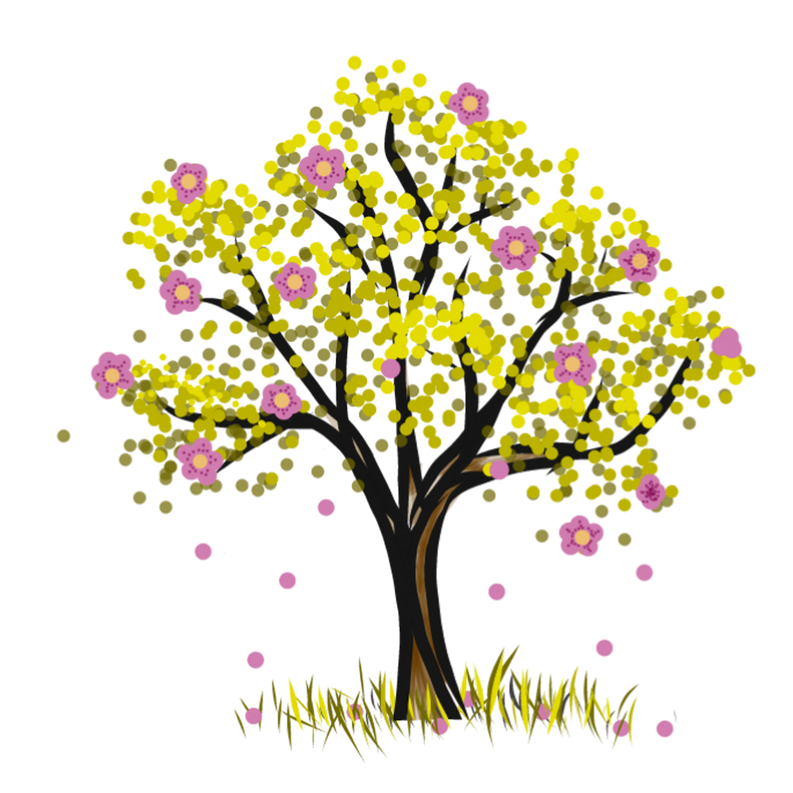
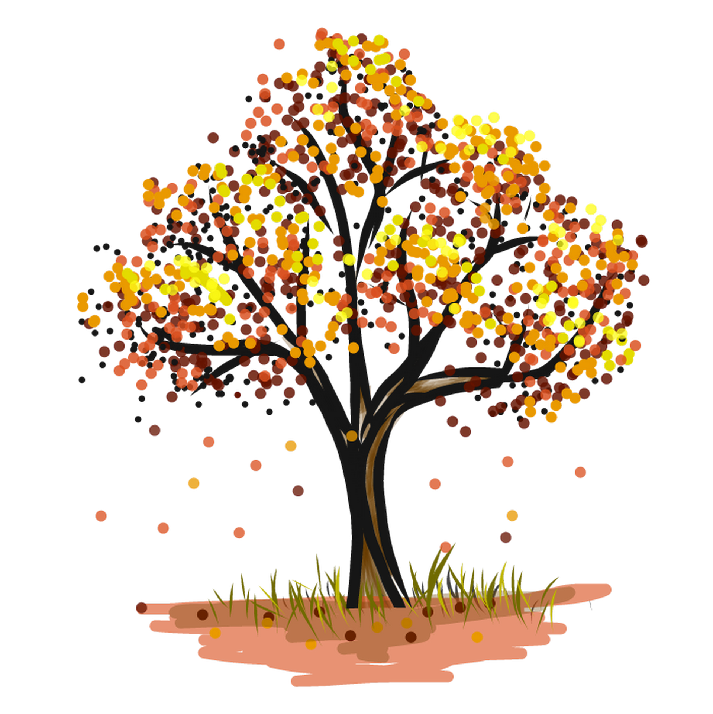
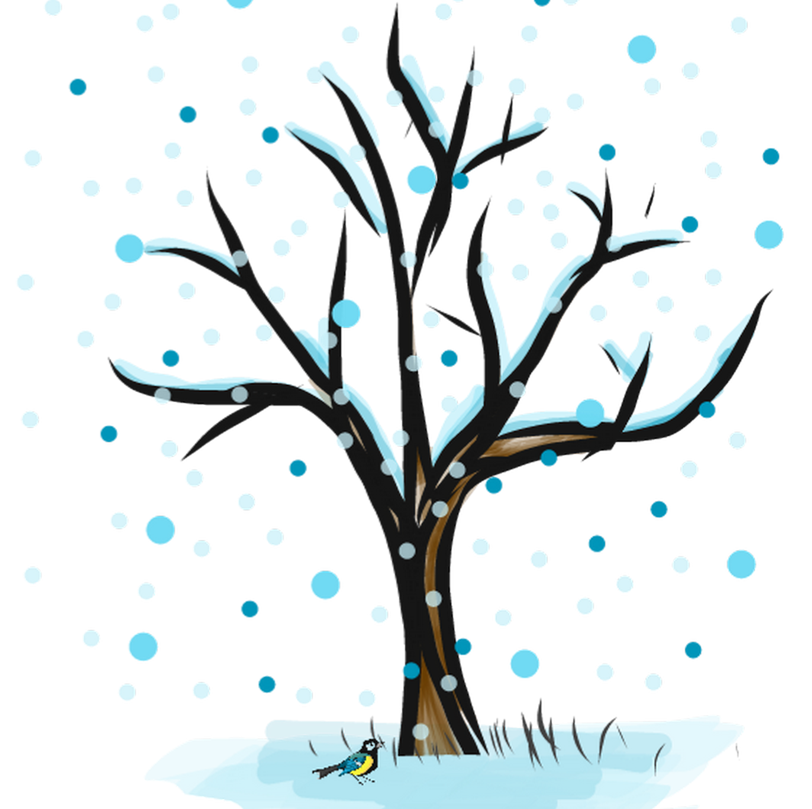
How deciduous trees change with the seasons
Deciduous trees grow a new set of leaves each year
autumn
winter
spring
summer
Notes:
The sequence shown above represents the likely sequence over the school year, assuming that this activity starts in the Autumn term.
Autumn leaves turn red and brown and fall, Winter has bare branches, Spring has blossoms, and Summer has green leaves.

Slide 5
Our Tree Diary
Date:
By:
What the Tree looks like:
Notes:
This could be completed as a class, or allocated to a different pupil each week.
For continuity it is advantageous to have a set position from which the observations are made (or picture taken).

