Slide 1
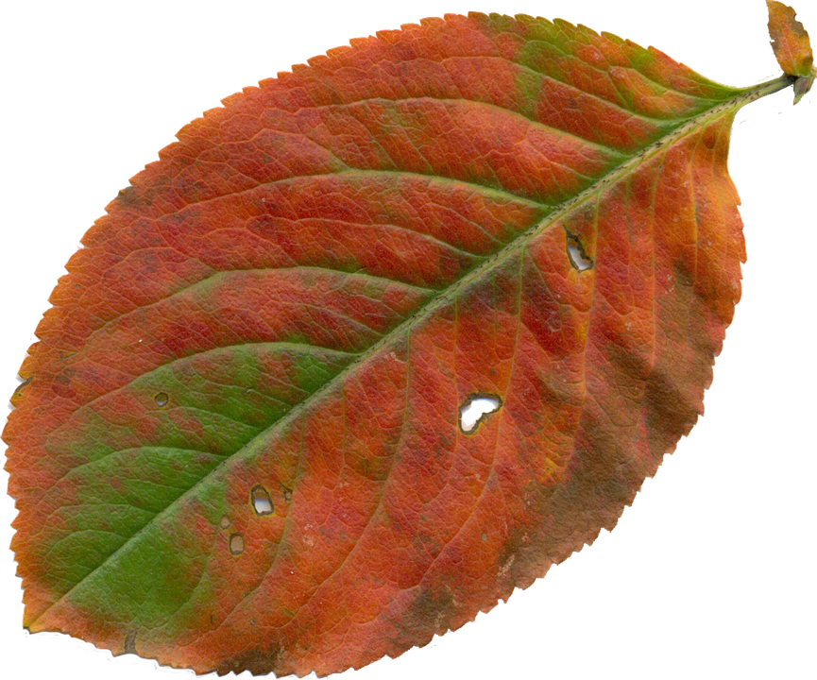
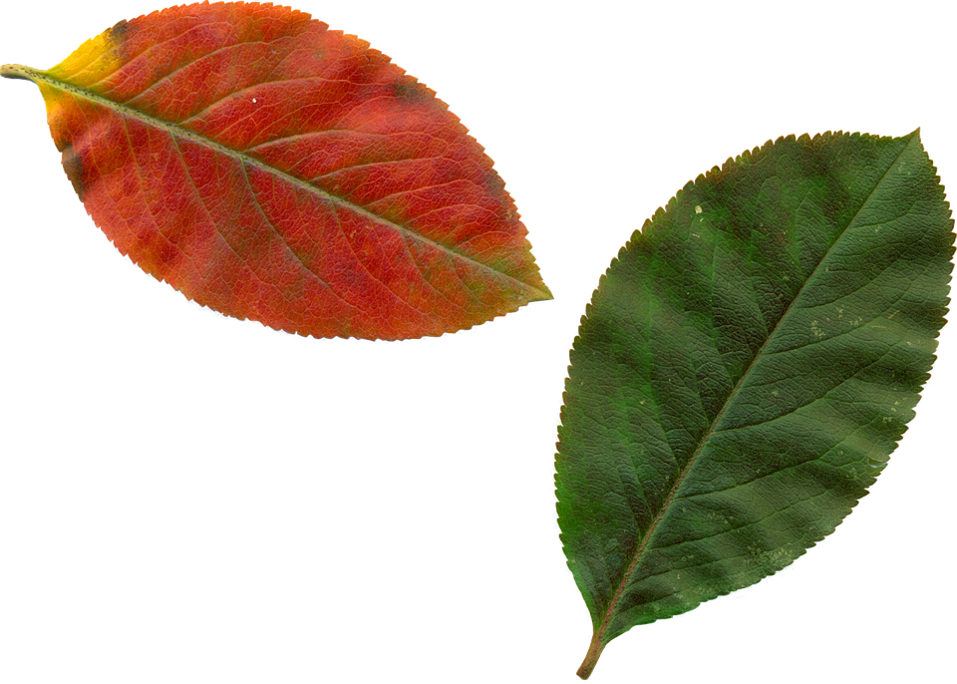
Make a leaf print
Making leaf prints and labelling the parts of a leaf

Slide 2
Making leaf prints
Select the leaves that you are going to use for your prints. Try to pick ones that look different or interesting!
Paint the surface of the leaf with a colour that you like. You could use different colours for each leaf!
Turn the leaf over and carefully press the painted side onto your piece of paper.
Carefully lift the leaf off the paper. You will see the print underneath!
Repeat using different leaves and colours!
Notes:
If it is not possible for learners to go outside and pick their own leaves then the teacher could arrange this in advance and have a selection already picked and ready to use. Avoid leaves that have fully dried out as these will not work. Desks will need protecting from paint etc – e.g. through the use of old newspapers. The teacher should demonstrate how to make the prints and produce an example for learners. Encourage learners to be creative with the colours, leaves and patterns they produce. A visualiser or small digital camera would be useful when demonstrating the process to learners.

Slide 3
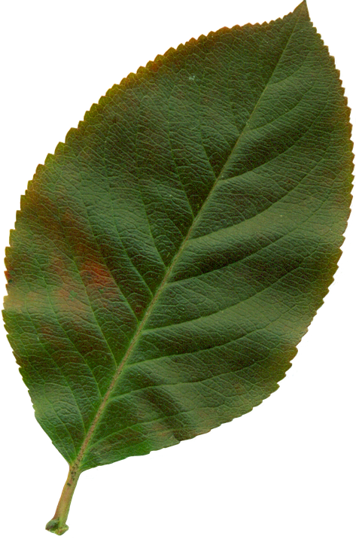
Parts of the leaf
Label the parts of the leaf by filling in the missing letters:
T_ _
B _ a _ e
V_ _n
Mi _ r _ b
_ a s _
P _ _ io _e
Notes:
This could be used as an additional related activity to link into areas for the Science curriculum. This slide could be printed and used as a worksheet or learners could write their responses in their exercise books, using the slide shown on the board.

Slide 4
Parts of the leaf - Answers
Label the parts of the leaf by filling in the missing letters:
Tip
Blade
Vein
Midrib
Base
Petiole
Notes:
Answers for the previous slide – students could peer and/or self assess their responses.

