Slide 1
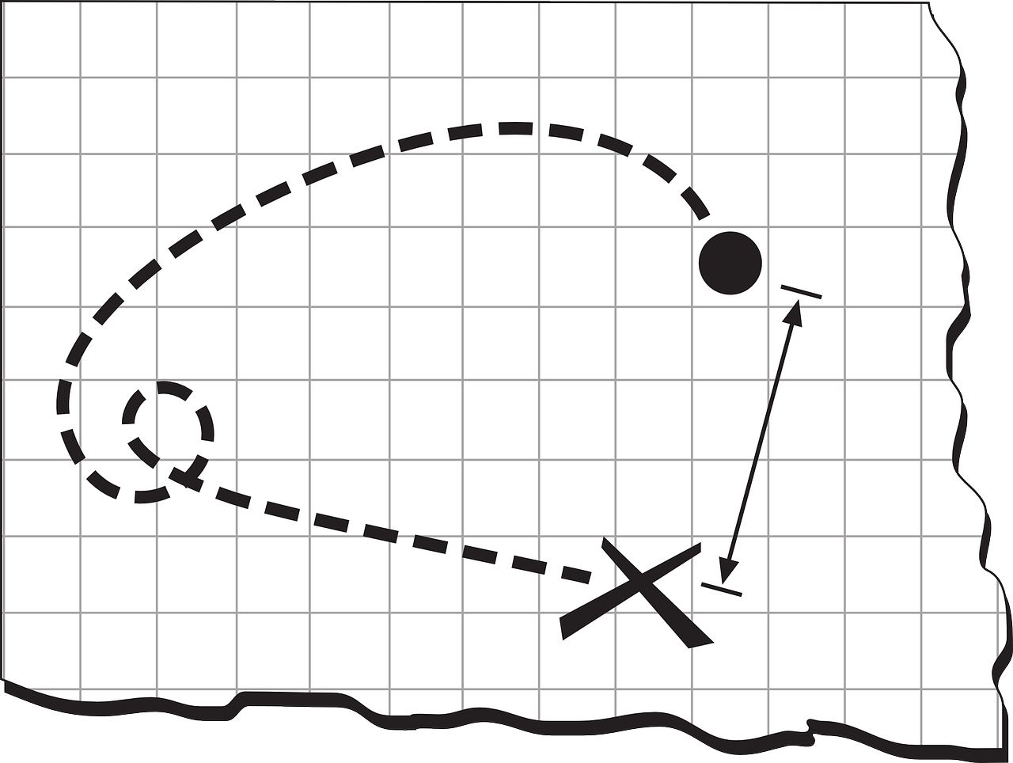
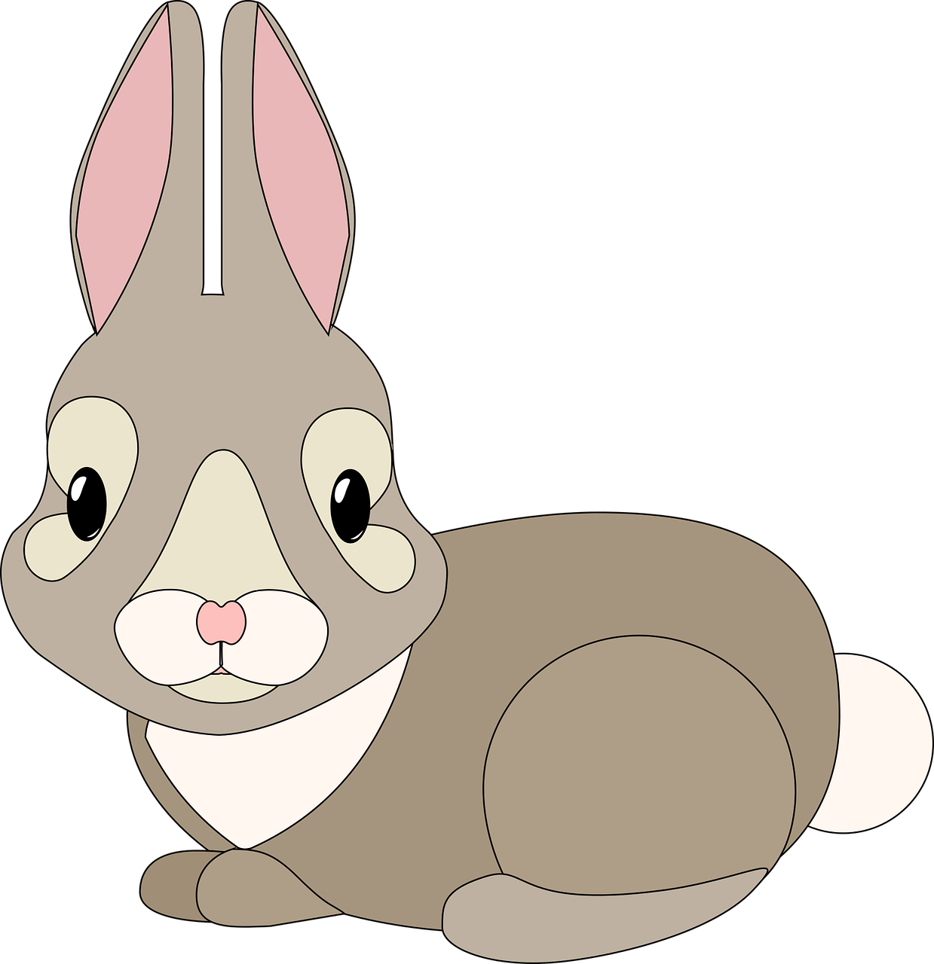
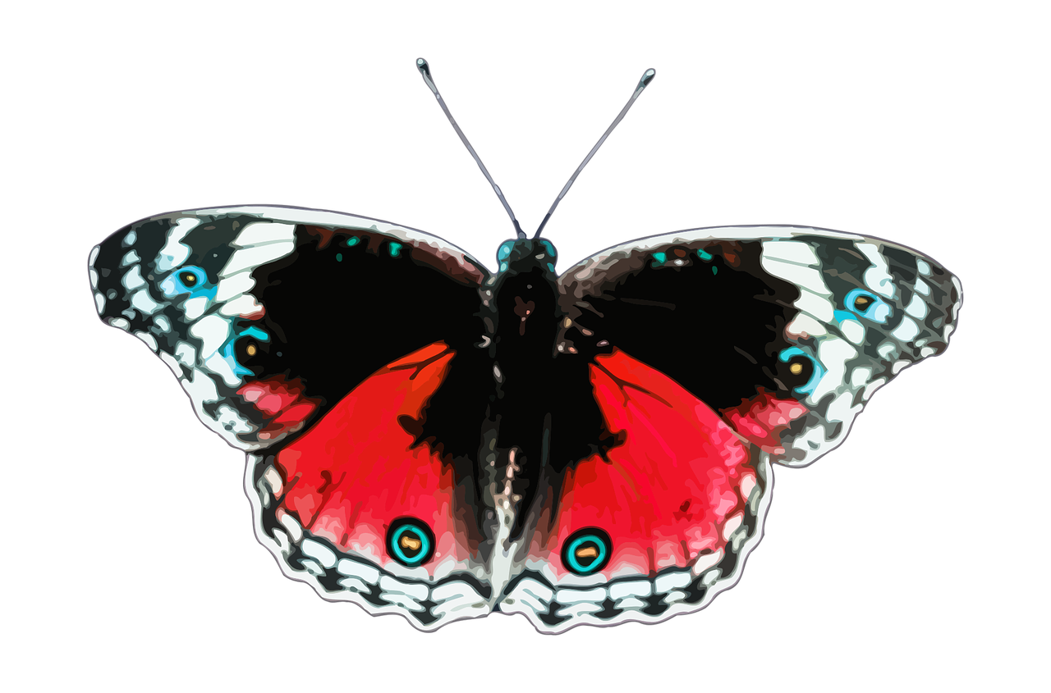

Create a Map of Local Flora and Fauna
Creating a guidebook to local plants and animals

Slide 2

What We Are Going To Do
We are going to make a guidebook to plants and animals in our area.
The guidebook will include:
  a map.
  a short description of each plant or animal.

Slide 3
Position and
Direction
Coordinates are a useful way to find a position on a map.
The co-ordinates make a grid.
This direction is called the y-axis.
This direction is called the x-axis.

Slide 4
Using Coordinates
To find a position, read the number in the x-axis, then the number in the y-axis.
Write these in brackets separated by a comma.
For example:
the rabbit coordinate is (2,4).
the butterfly coordinate is (5,5).

Slide 5
Creating Your Map
Using grid paper make a map of the area you have been given.
Each square on the grip paper is equal to a measurement of 0.3 meters (the length of a ruler).
Include any buildings, plants and animals.
Take a digital picture of each plant or animal in the area.
Record their location using x and y coordinates.

Slide 6

Back in the Classroom
For each plant or animal, complete the record sheet:
Stick on the photograph.
Write a short description:
  What is it called?
  What does it look like?
  Do you need to do anything else to find it?
We will put all of the maps and worksheets together to make our class guidebook!

