Slide 1
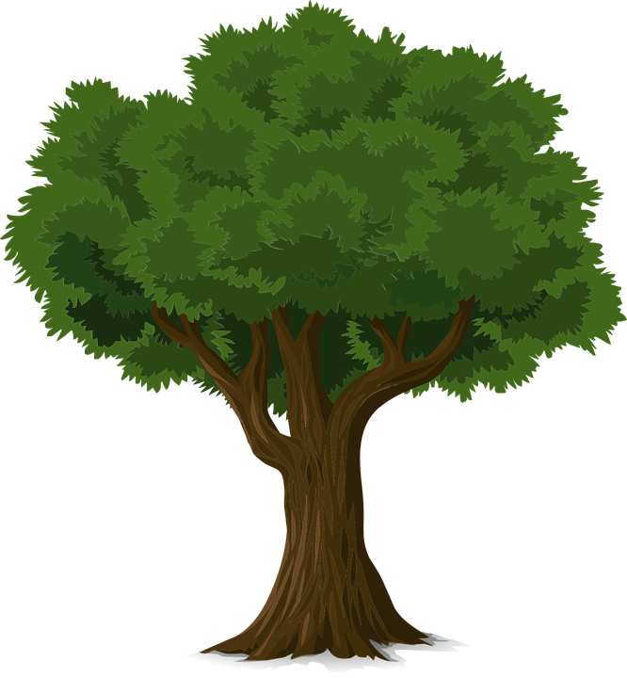
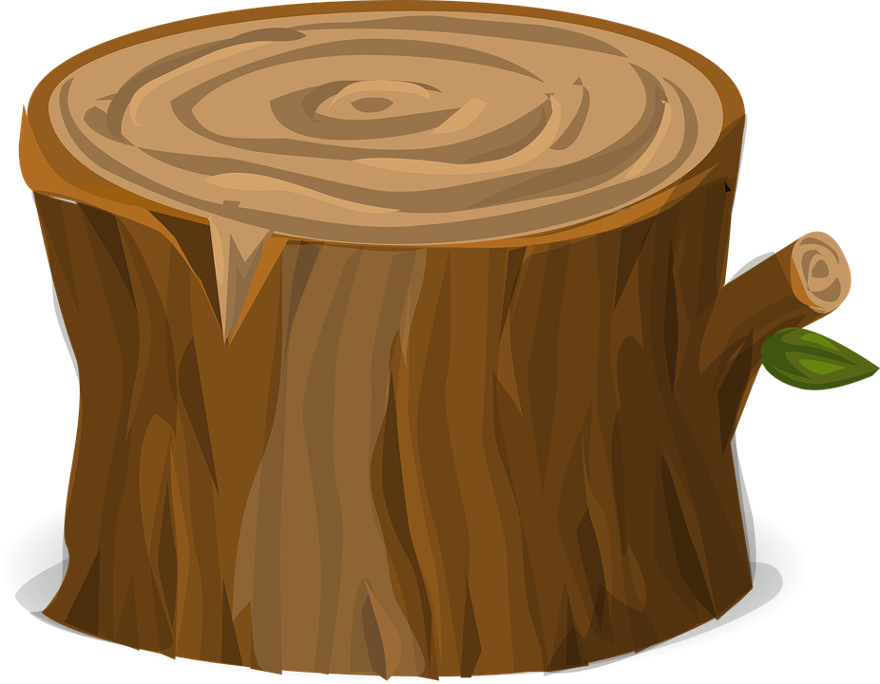
Tree trunk circumference
Measuring the circumference of tree trunks and working out their age
Notes:
As learners will be completing the activity outdoors, these slides could be shown in advance whilst still in the classroom, or printed to use as handouts whilst outside. If it is not possible to go outside, the learners could pretend to be trees and measure each other!

Slide 2
Stay safe
Whether you are a scientist researching a new medicine or an engineer solving climate change, safety always comes first. An adult must always be around and supervising when doing this activity. You are responsible for:
ensuring that any equipment used for this activity is in good working condition
behaving sensibly and following any safety instructions so as not to hurt or injure yourself or others
Please note that in the absence of any negligence or other breach of duty by us, this activity is carried out at your own risk. It is important to take extra care at the stages marked with this symbol: ⚠
Notes:
As learners will be completing the activity outdoors, these slides could be shown in advance whilst still in the classroom, or printed to use as handouts whilst outside. If it is not possible to go outside, the learners could pretend to be trees and measure each other!

Slide 3
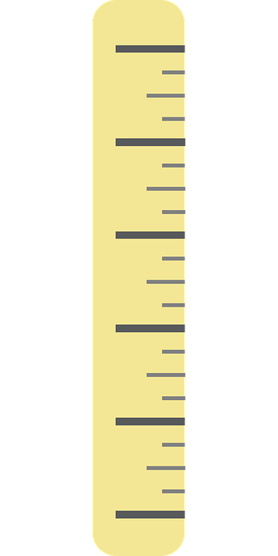
Measuring the girth of a tree 1
Identify the tree that you are going to measure.
Place the end of the measuring tape (0 mm) at the base of the trunk.
Measure upwards to find the point where the trunk is roughly 1500 mm high.
1500 mm
⚠
Notes:
In the UK the girth of a tree is measured at a height 1.5 metres, or 1500 mm. This value varies slightly in different countries.

Slide 4
Measuring the girth of a tree 2
Girth measurement
At the point where the trunk is roughly 1500 mm high:
Place the end of the measuring tape (0 mm) at any point on the trunk.
Wrap the measuring tape around the trunk, holding the end in place.
At the point where the tape meets the end again, read the measurement in mm. This is the circumference of the tree.
1500 mm
⚠
Notes:
This may need two learners working as a pair, one holding the end of the tape in place, the other wrapping around and taking the reading. The measuring tape must be kept straight and level to give an accurate reading. Teacher should demonstrate how to do this correctly in advance. The teacher could also discuss how the girth is basically the circumference of the trunk at the height of 1500 mm.

Slide 5
Working out the age of the tree
Girth measurement
Write down the measurement of the circumference in mm.
Every 25 mm is one year’s growth.
So, divide your girth measurement by 25 to find the age of the tree!
1500 mm
Notes:
Slides 2-4 could be repeated for a number of different trees, with the results compared against each other.

