Slide 1
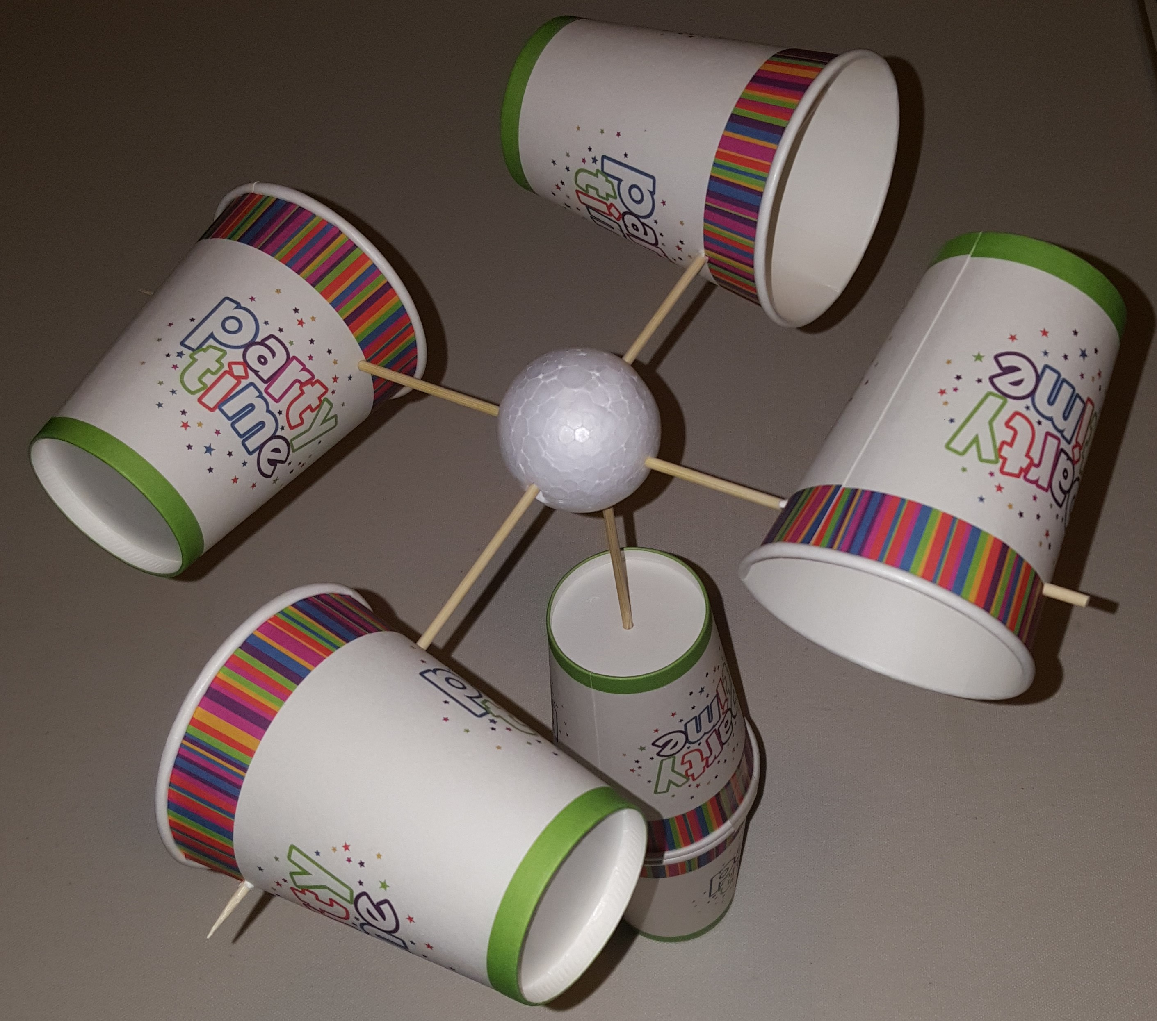
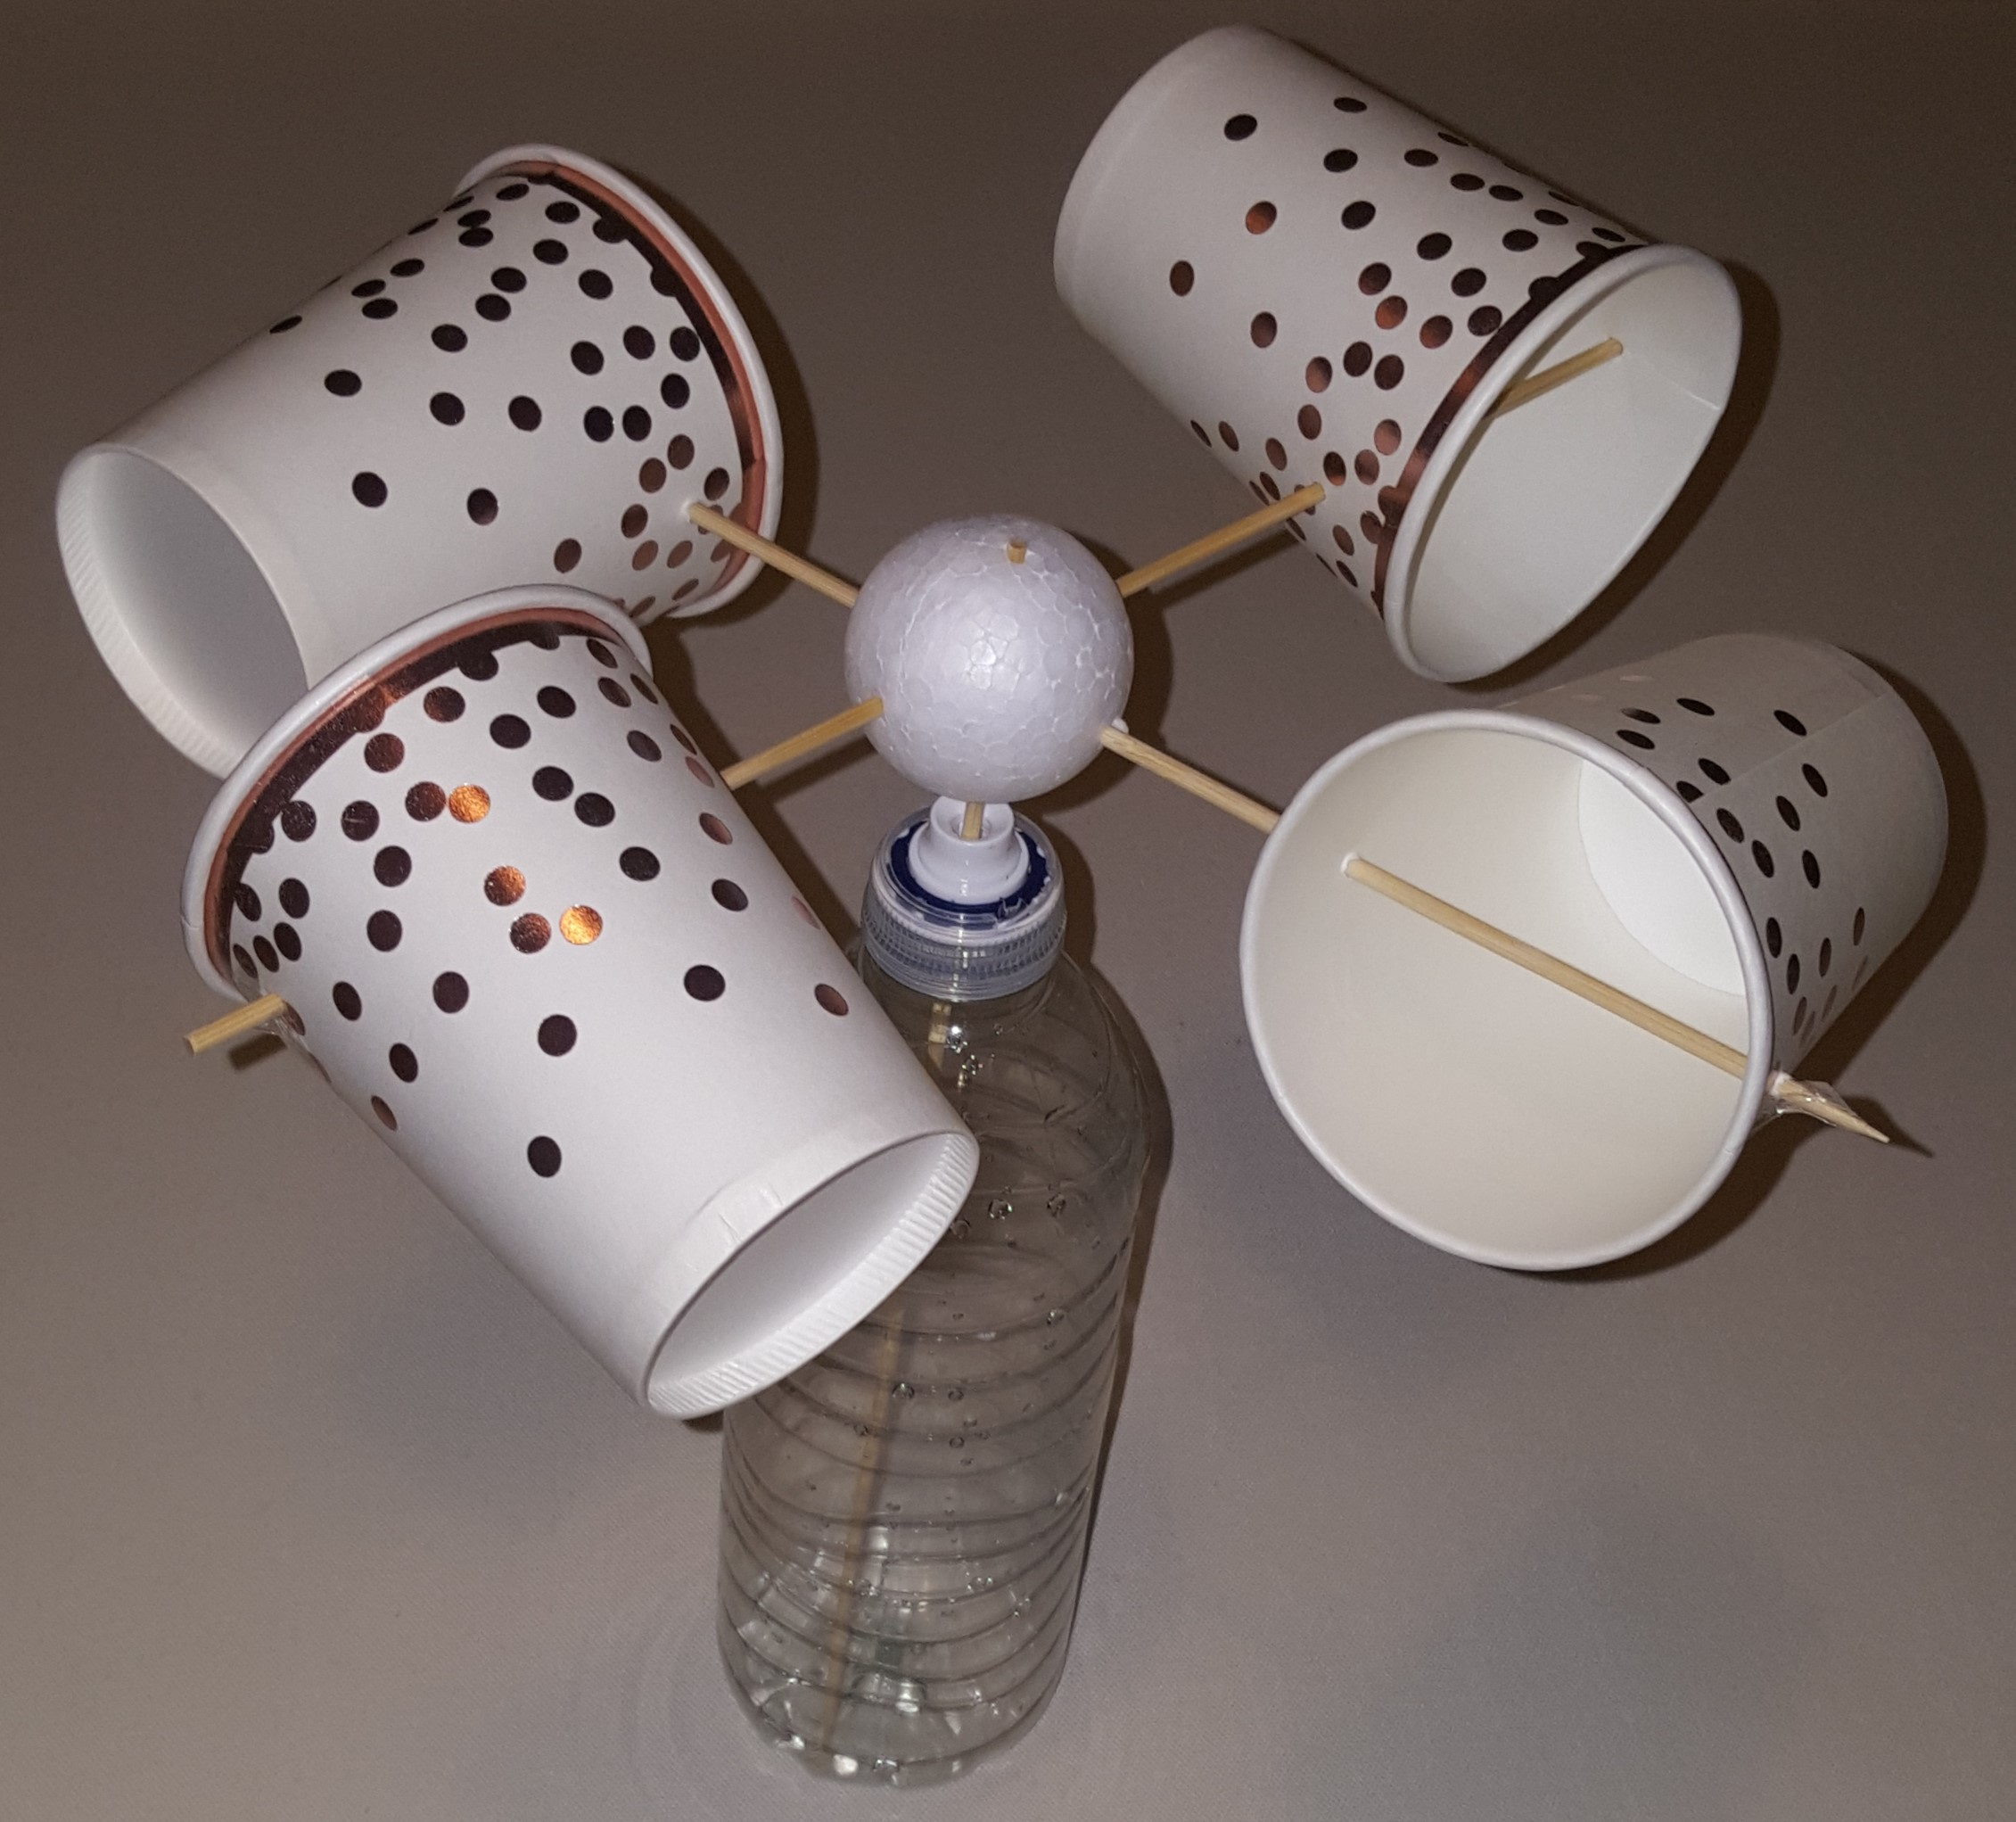
Make a Robinson Anemometer
Making a device to measure wind speed

Slide 2
Stay safe
Whether you are a scientist researching a new medicine or an engineer solving climate change, safety always comes first. An adult must always be around and supervising when doing this activity. You are responsible for:
ensuring that any equipment used for this activity is in good working condition
behaving sensibly and following any safety instructions so as not to hurt or injure yourself or others
Please note that in the absence of any negligence or other breach of duty by us, this activity is carried out at your own risk. It is important to take extra care at the stages marked with this symbol: ⚠

Slide 3
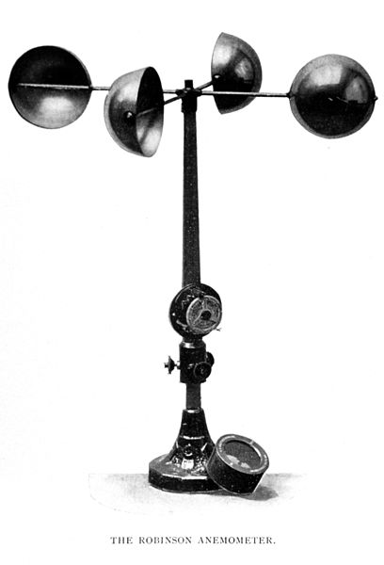
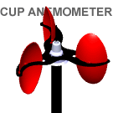
Making an Anemometer
We are going to make a device that measures how fast wind moves.
This is called an anemometer.
The type that we are going to make was invented by John Thomas Romney Robinson in 1846.
It is called a Robinson anemometer.
As the wind blows, the cups spin round. How fast the cups spin shows how fast the wind is moving.
Notes:
The image of the Robinson anemometer is in the public domain due to it’s age. It was originally published in The Aims and Methods of Meteorological Work by Cleveland Abbe, in Maryland Weather Service, Johns Hopkins Press, Baltimore, 1899. Volume I, page 316.
The image of the spinning cup anemometer is from Wikipedia commons – it is attributed to the author Jan Barani

Slide 4
You Will Need:
Polystyrene ball
Paper cup
1 polystyrene ball
3 wood skewers
Putty
EITHER:
6 paper cups OR
4 paper cups and a plastic bottle
Sticky tape, if needed
Wood skewer
2 cups or a plastic bottle
Notes:
The holes in the cups and polystyrene ball could be pre-made. The putty could be a proprietary product (such as Blutack or Whitetack) or modelling clay (such as clay, Plasticine or Playdough).

Slide 5
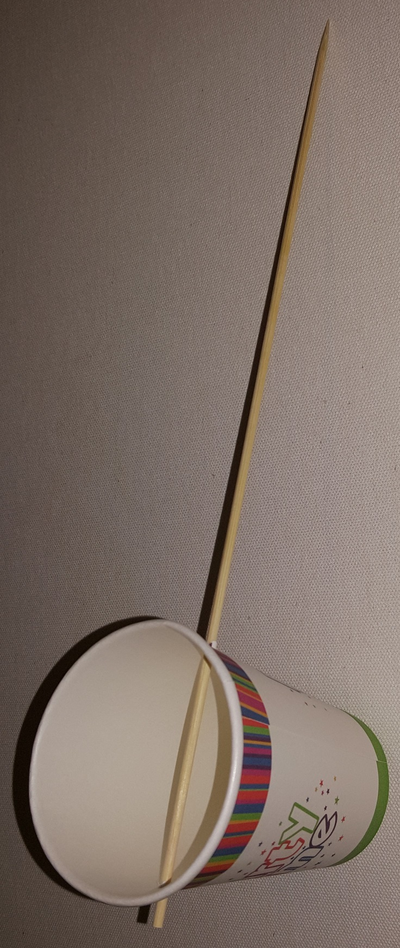
Step 1 – First Cup
Pointy end
Push the skewer through one cup.
Put the putty on a surface
Place the side of the cup on the putty
Push the pointy end of the skewer through the side of the cup into the putty
Pull out the skewer
Repeat on the opposite side of the cup
Once you have two holes, push the skewer through both, so the blunt end is sticking out about 10 mm
Notes:
The holes in the cups could be pre-made, avoiding this step. Holes should be on opposite sides of the cup, so that the skewer splits the circle made by the open end into two halves.
The putty

Slide 6
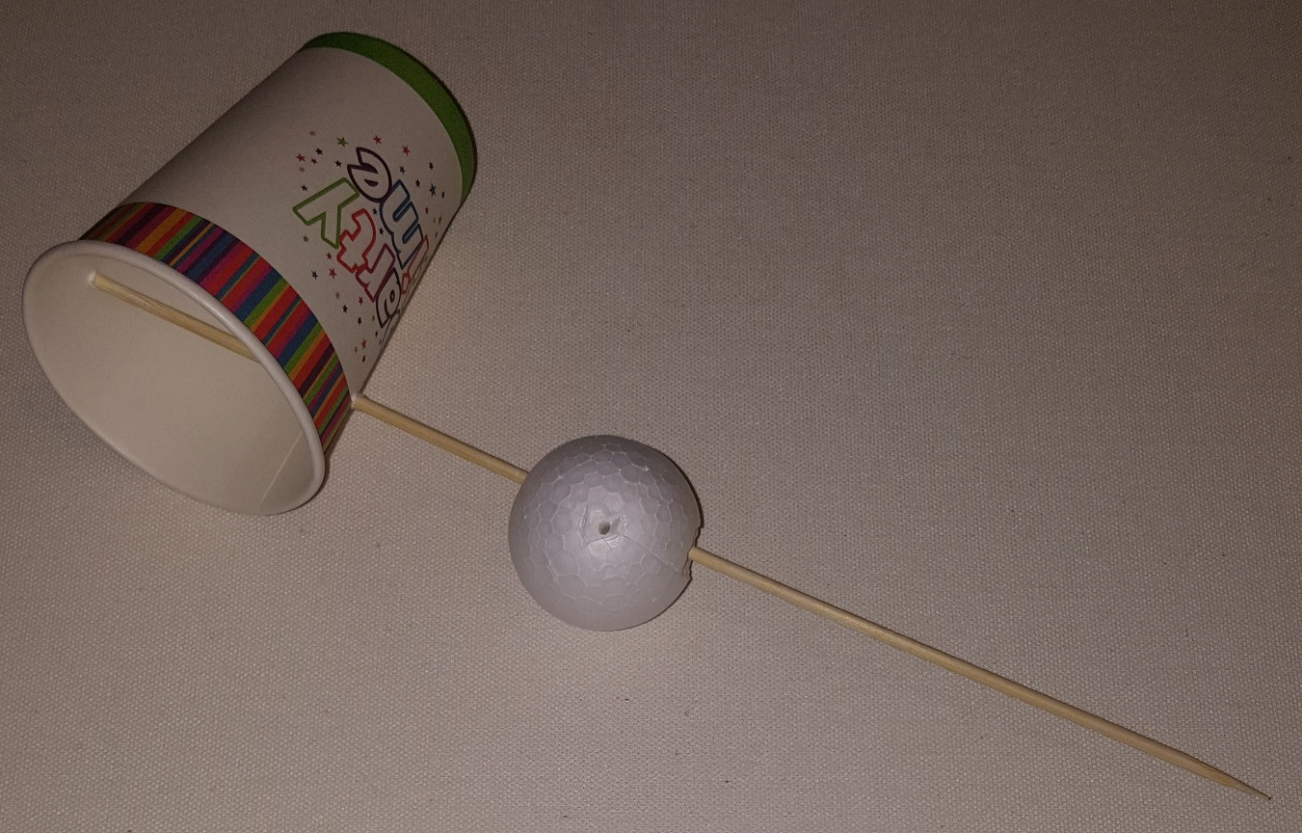
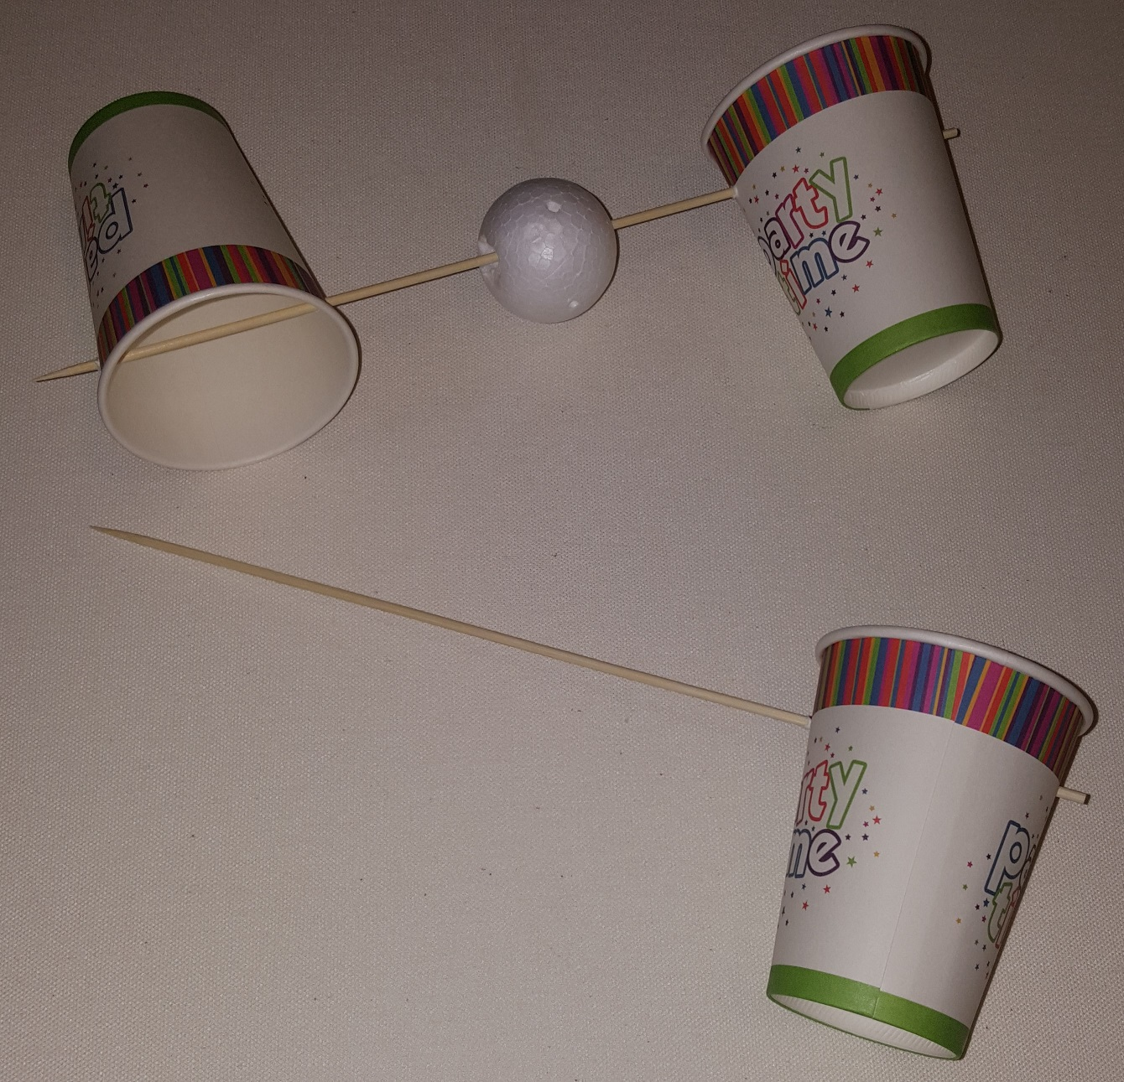
Steps 2–4
Push the polystyrene ball on to the skewer, so it is about the middle.
Push a second cup onto the other end of the skewer. The pointy end should stick out about 10 mm from the cup.
Repeat step 1, making another cup on a skewer.
Pointy end
Notes:
The holes in the cups and polystyrene ball could be pre-made, or made using the procedure described in step 1.

Slide 7
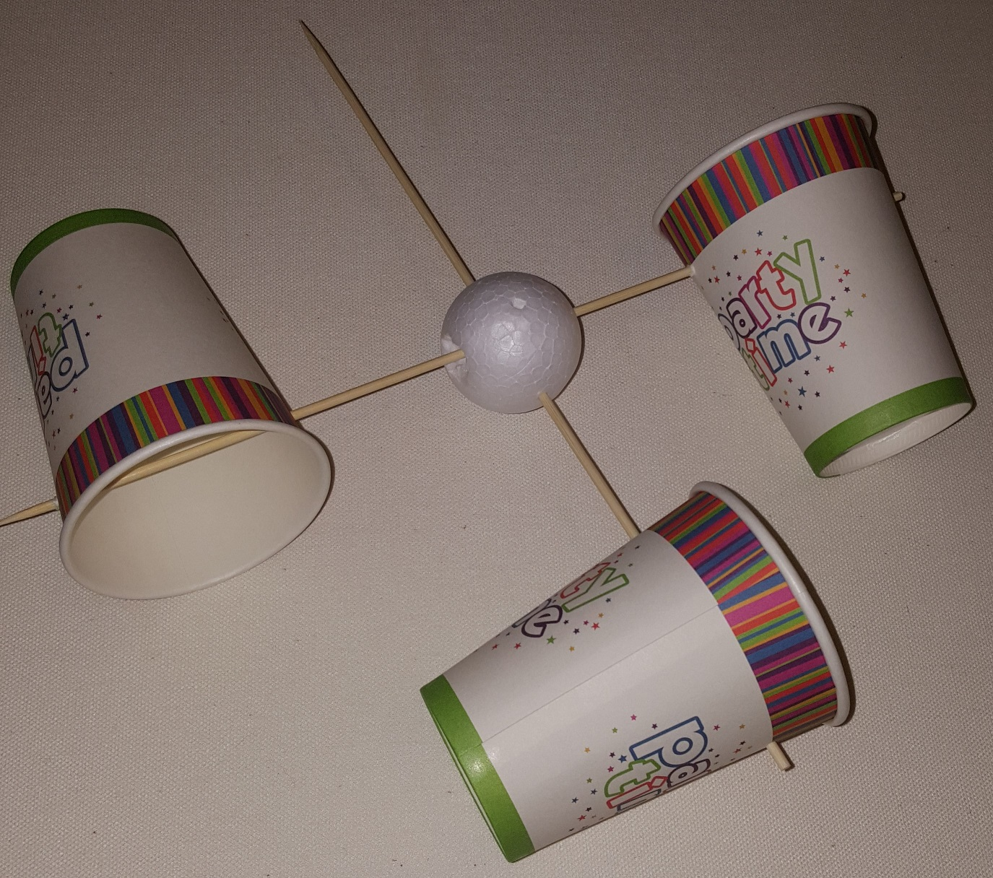
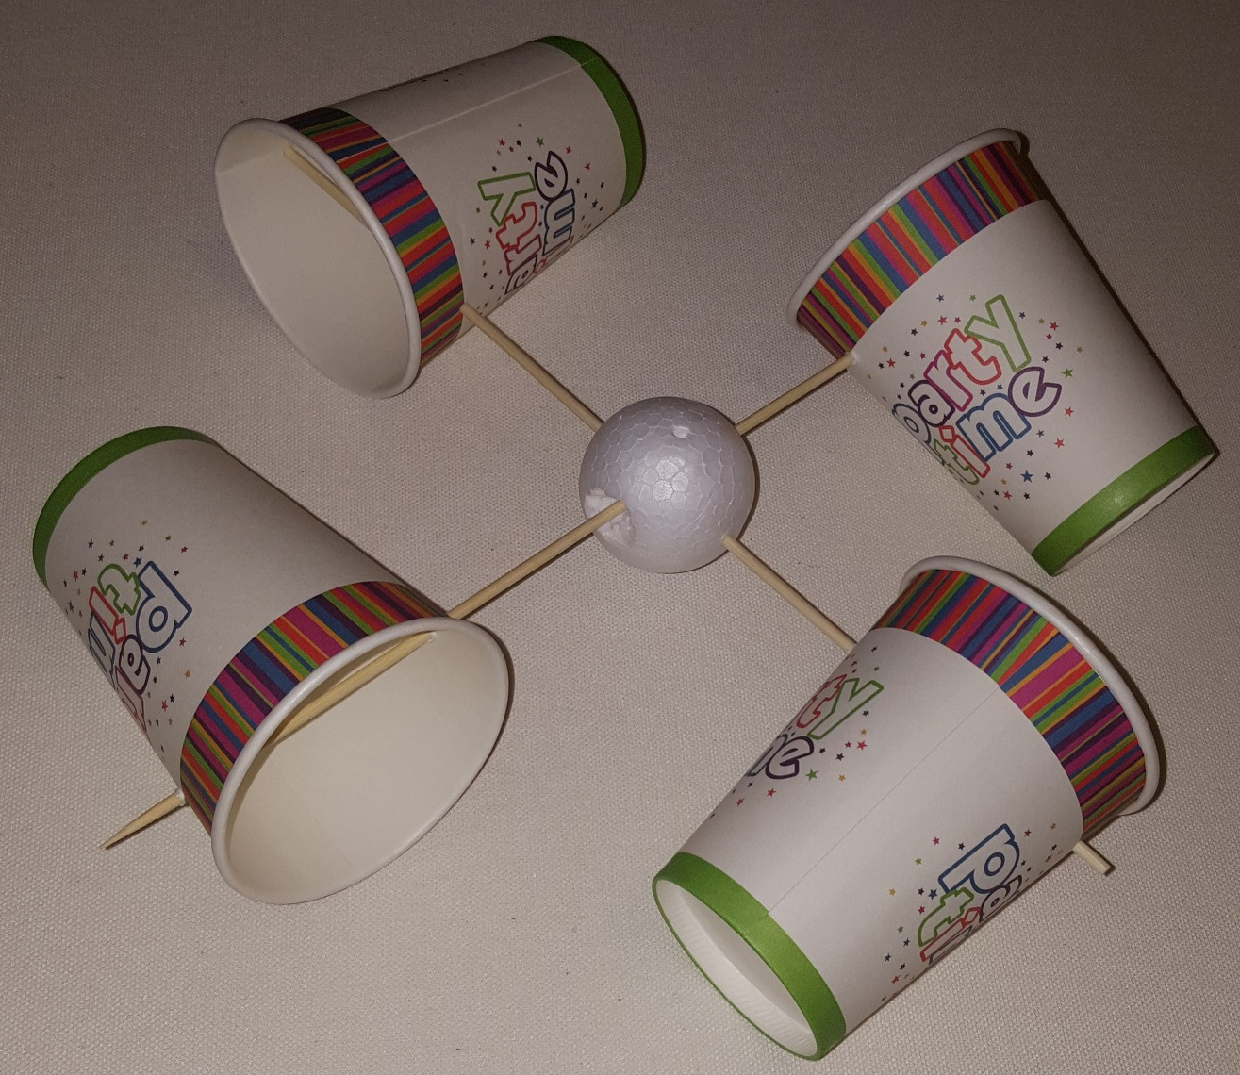
Steps 5-6
Push the skewer through the polystyrene ball, so the ball is ends up at about the middle.
Push a second cup onto the other end of the skewer. The pointy end should stick out about 10 mm from the cup.
Notes:
The holes in the cups and polystyrene ball could be pre-made, or made using the procedure described in step 1.

Slide 8
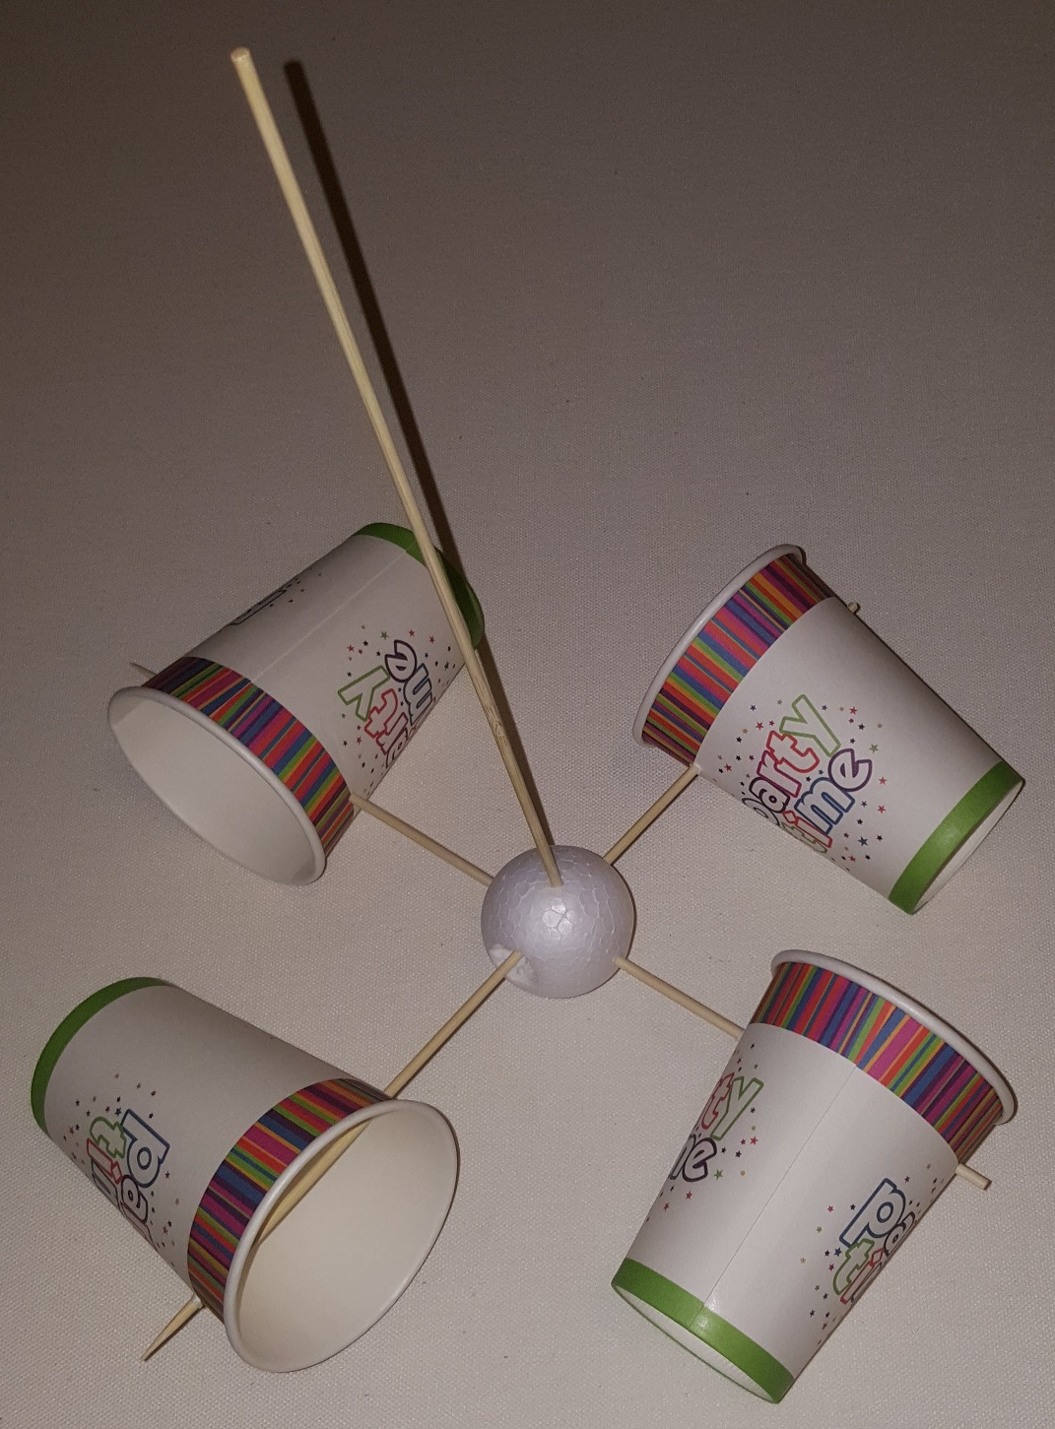
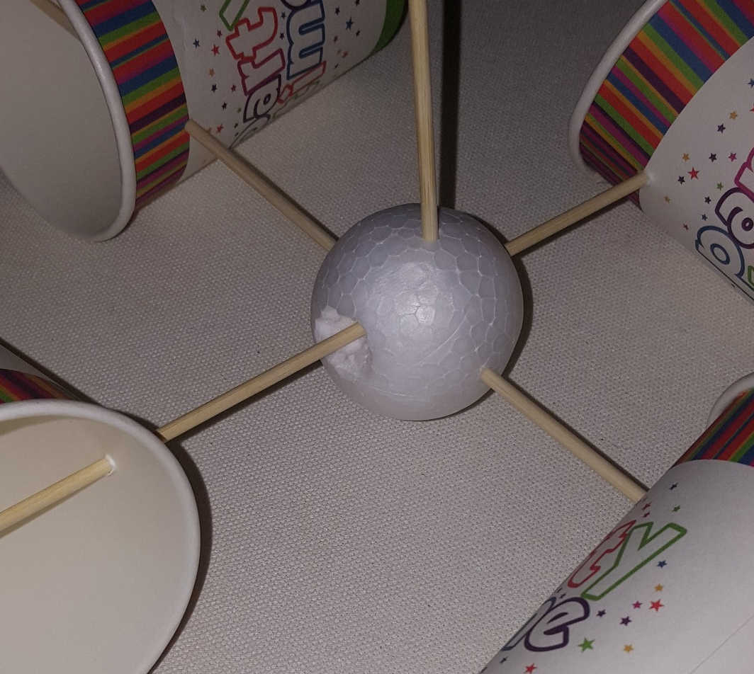
Step 7
Push the skewer through the polystyrene ball. It doesn’t have to stick out of the other side.
Notes:
The holes in the polystyrene ball could be pre-made, or made using the procedure described in step 1.

Slide 9
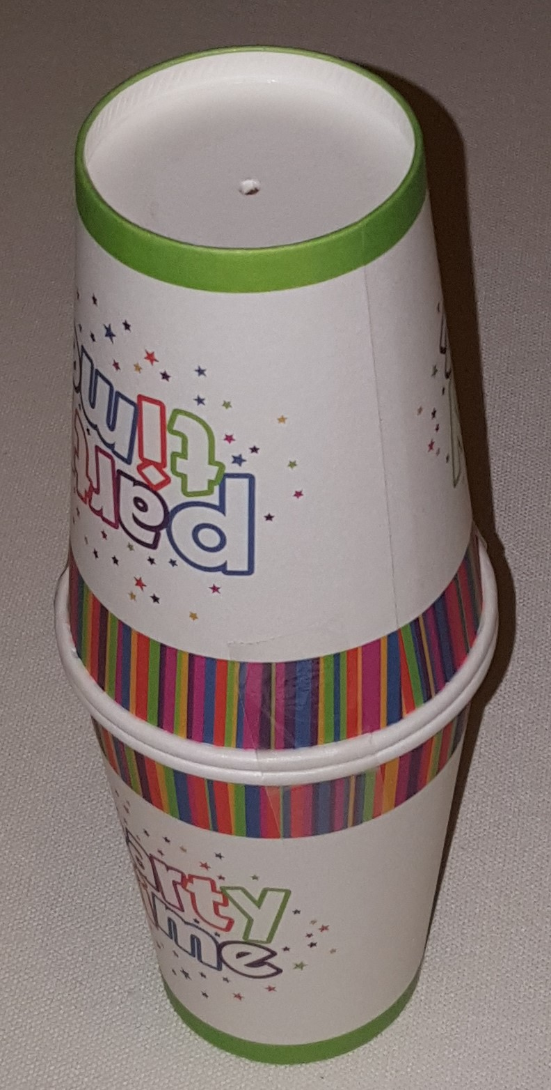
Steps 8-9 – Making the base
8) Make holes in the base of two cups. The holes should be in the exact centre of the base.
9) Using sticky tape, attach together the two cups
Notes:
The holes in the cups ball could be pre-made, or made using the procedure described in step 1. An effective way of attaching the cups together is to use three small strips of sticky tape running in the direction of the height of the cup, at equal intervals around the diameter. These steps could be deleted if a plastic bottle is used for the base.

Slide 10
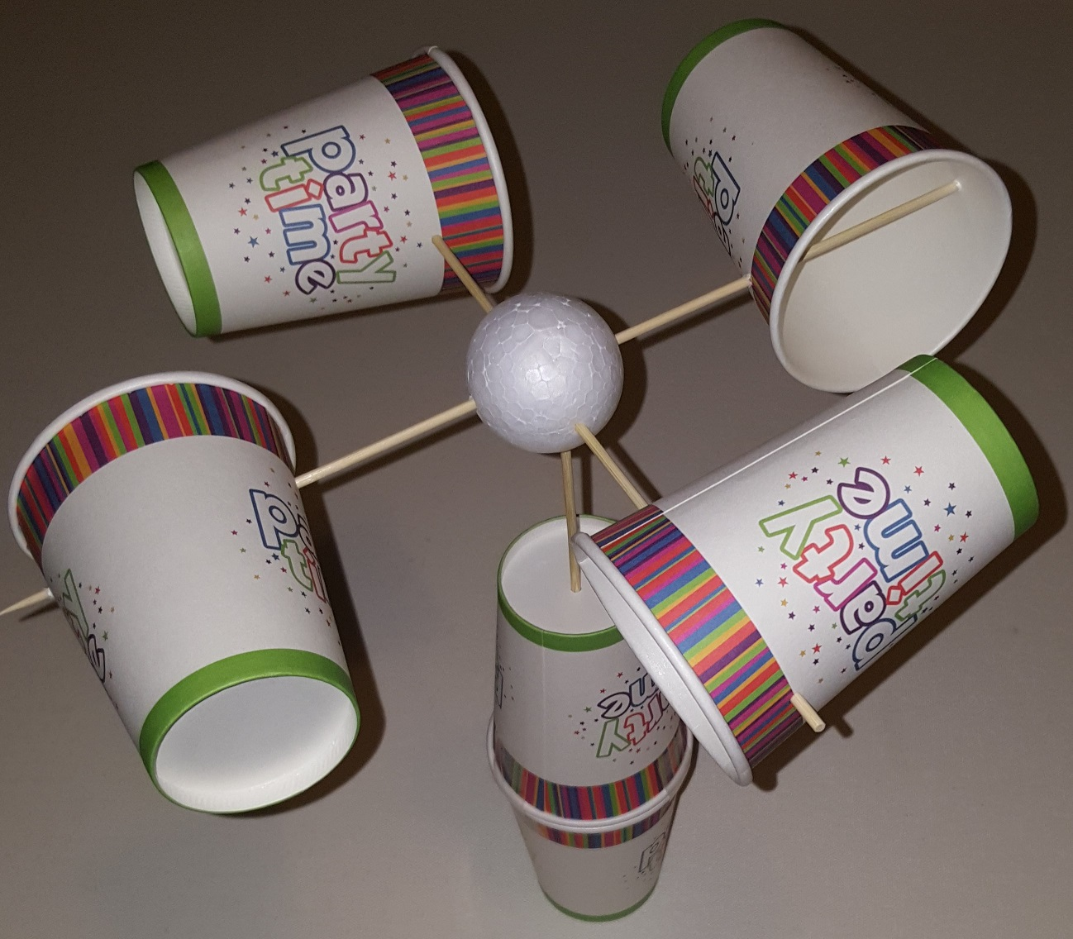
Final Assembly (cup base)
Push the central skewer through the two holes in the holder. The top should spin freely.
The cups must stay so they look like they are on their sides. If they move, use a piece of tap or putty to hold them firm to a skewer.
Notes:
The assembly should rotate freely when located in the base – if it does not, enlarge the holes in the cups slightly.

Slide 11
Final Assembly (bottle base)
Push the central skewer into the bottle. The top should spin freely.
The cups must stay so they look like they are on their sides. If they move, use a piece of tap or putty to hold them firm to a skewer.

Slide 12
Now try this…
How many times does your anemometer spin in five seconds when you blow on it?
How many times does your anemometer spin in ten seconds when a fan blows on it?
How many times does your anemometer spin in ten seconds when the wind blows on it outside?
Notes:
To make it easier to record the number of turns, one of the cups can be identified using a permanent marker or a piece of coloured tape.

Slide 13
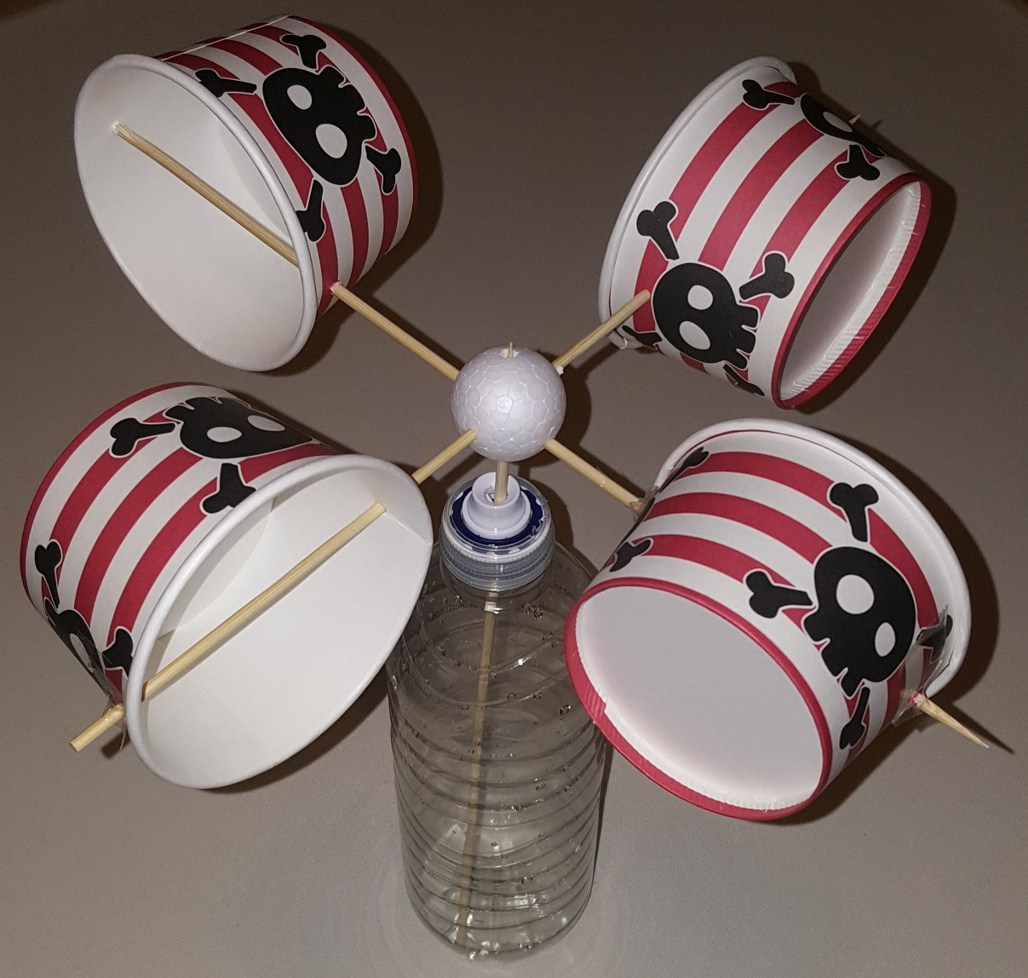
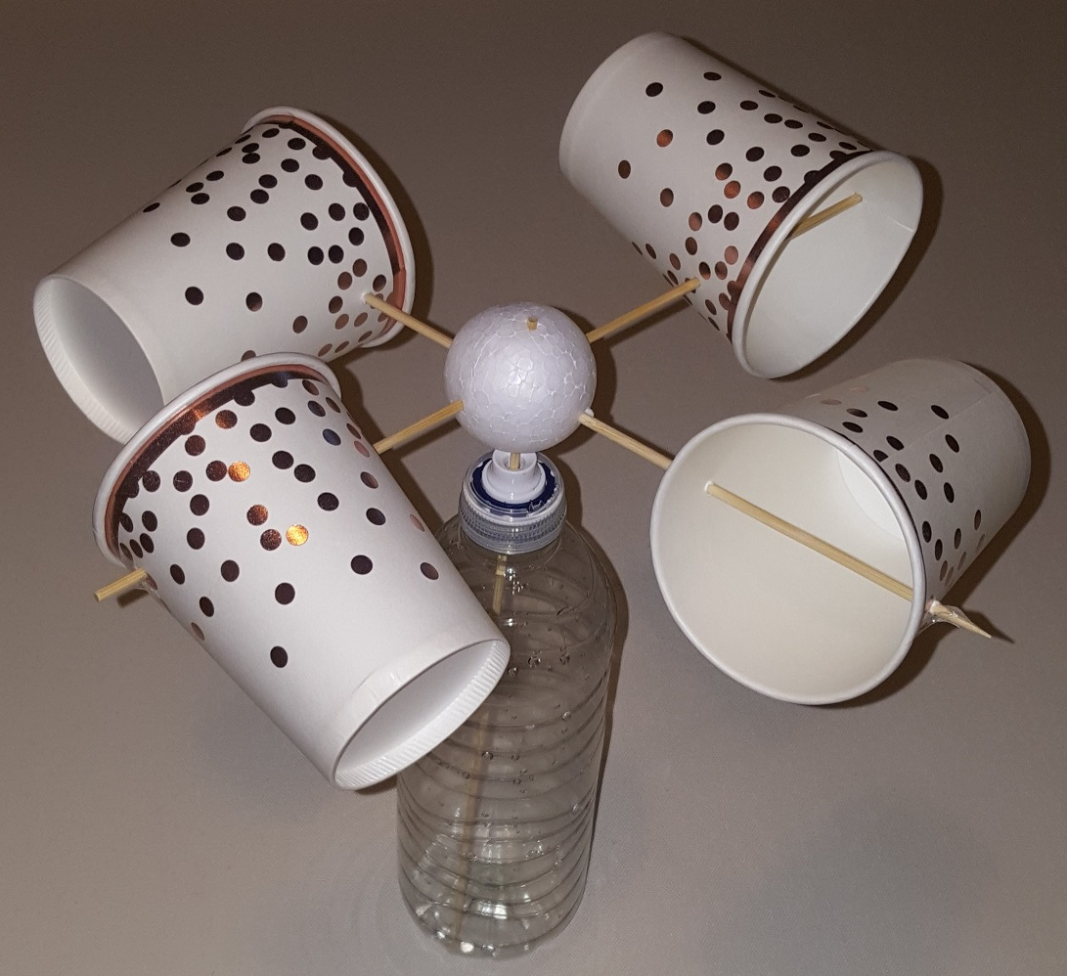
Examples of Pupil Projects
Notes:
The anemometer on the left used a 30 mm polystyrene ball and ice cream tubs instead of cups, but functioned equally well.

