Slide 1
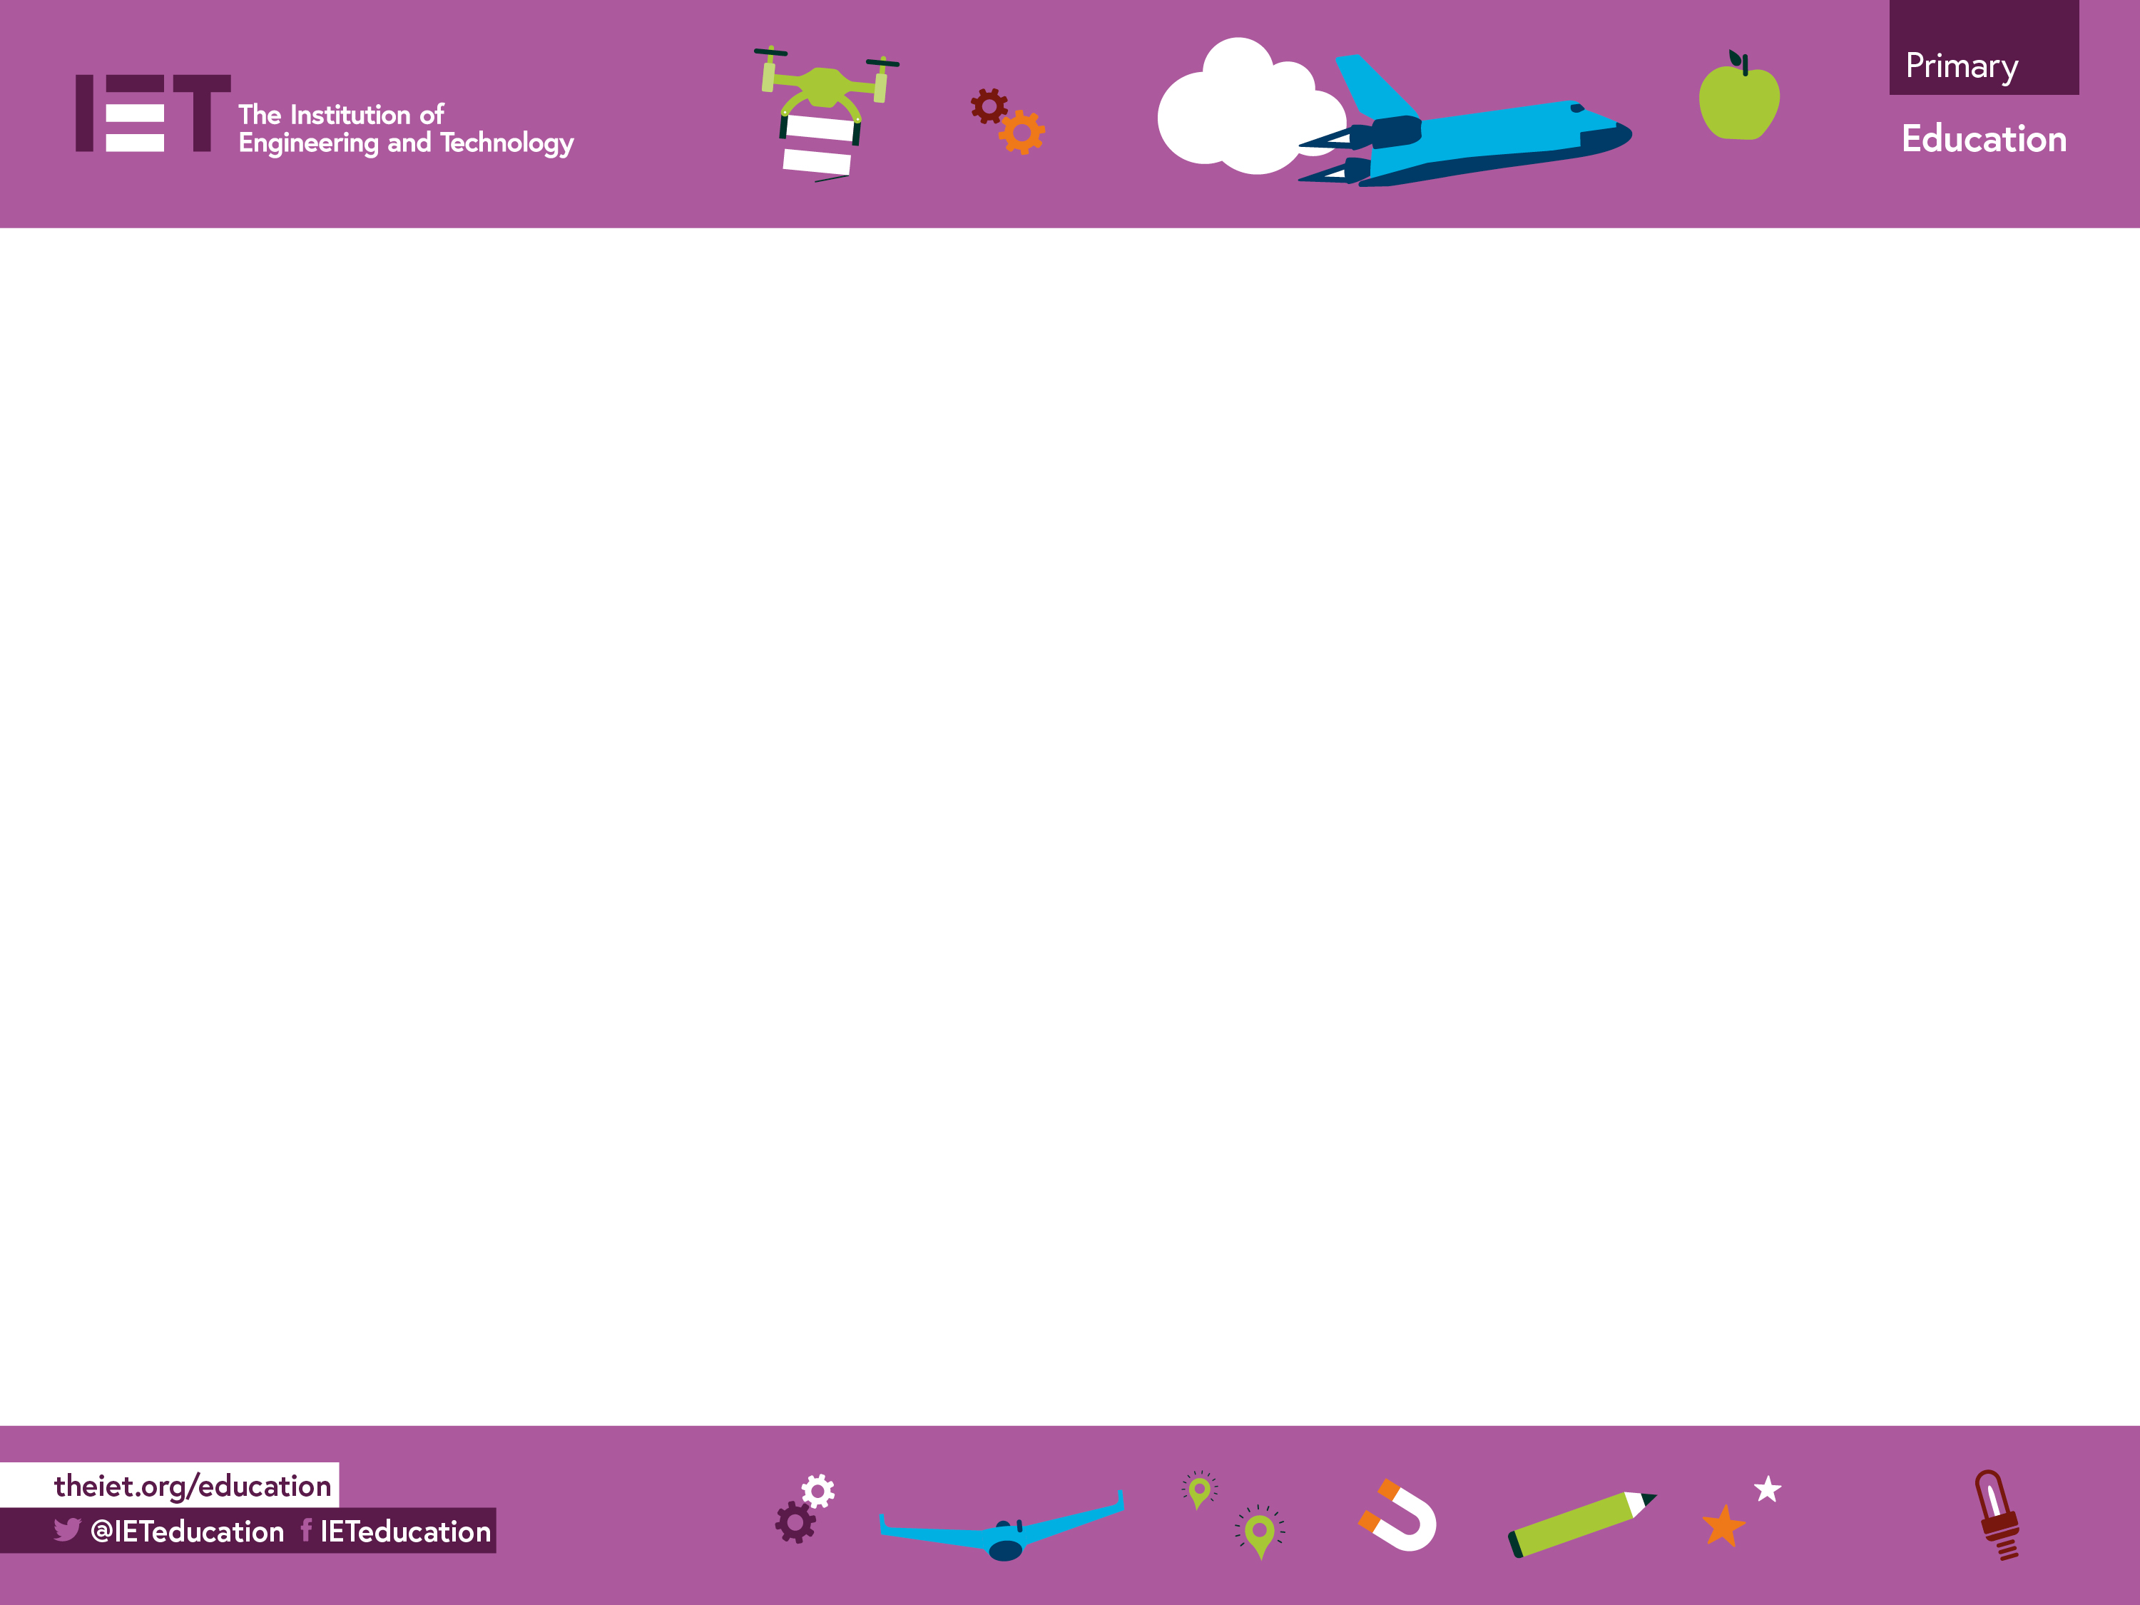

Balloon rocket
A counting down activity, using balloon rockets.

Slide 2
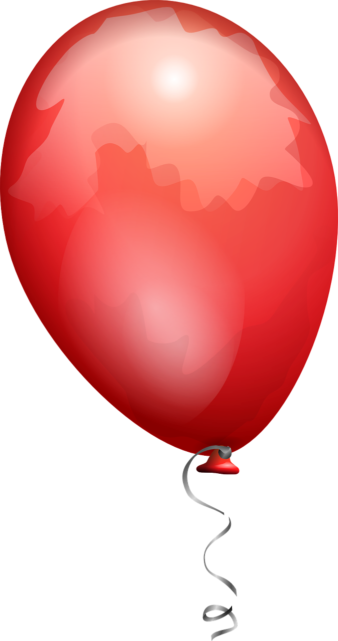
Blast Off!
Countdown
in 1s
5
4
3
2
1
0

Slide 3
Blast Off!
Countdown
in 2s
10
8
6
4
2
0

Slide 4
Blast Off!
Countdown
in 3s
15
12
9
6
3
0

Slide 5
Blast Off!
Countdown
in 5s
25
20
15
10
5
0

Slide 6
Blast Off!
Countdown
in 10s
50
40
30
20
10
0

