Slide 1
Halloween maze game
Using directions to guide pupils away from the haunted house!

Slide 2
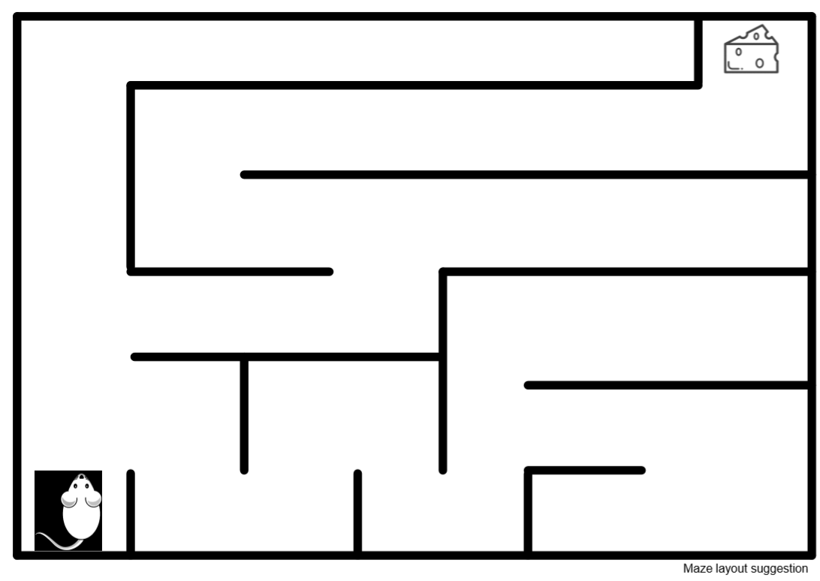
What is a maze?

Slide 3
Blindfold maze?
Working in pairs;
One person will give instructions
One will be blindfolded
The blindfolded person will wait at the start of the maze by the haunted house
The other person will give them instructions
Try to complete the maze and guide your partner home.

Slide 4
Instruction Bank
TURN RIGHT
TURN LEFT
WALK FORWARD
TAKE _?_ STEPS
WALK BACKWARDS
STOP

Slide 5
Using Fractions
Use quarter turns, half turns and three-quarter turns.
Use clockwise and anti-clockwise

Slide 6
Use angles for turns as follows:
90 degree turn right, left or clockwise, anti-clockwise
180 degree turn right, left or clockwise, anti-clockwise
360 degree turn right, left or clockwise, anti-clockwise
Using Angles

