Slide 1
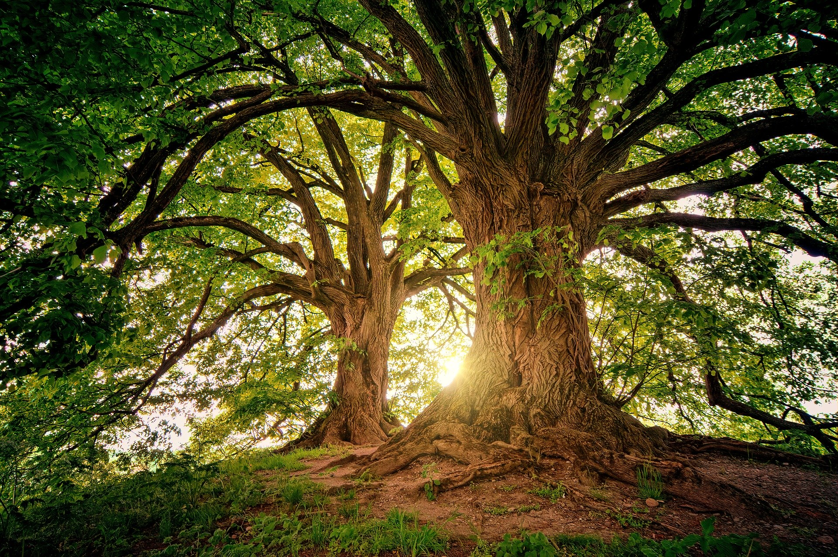
Understanding the difference between deciduous and evergreen trees

Slide 2
Fashionable Forests
Stay safe
Whether you are a scientist researching a new medicine or an engineer solving climate change, safety always comes first. An adult must always be around and supervising when doing this activity. You are responsible for:
ensuring that any equipment used for this activity is in good working condition
behaving sensibly and following any safety instructions so as not to hurt or injure yourself or others
Please note that in the absence of any negligence or other breach of duty by us, this activity is carried out at your own risk. It is important to take extra care at the stages marked with this symbol: ⚠

Slide 3
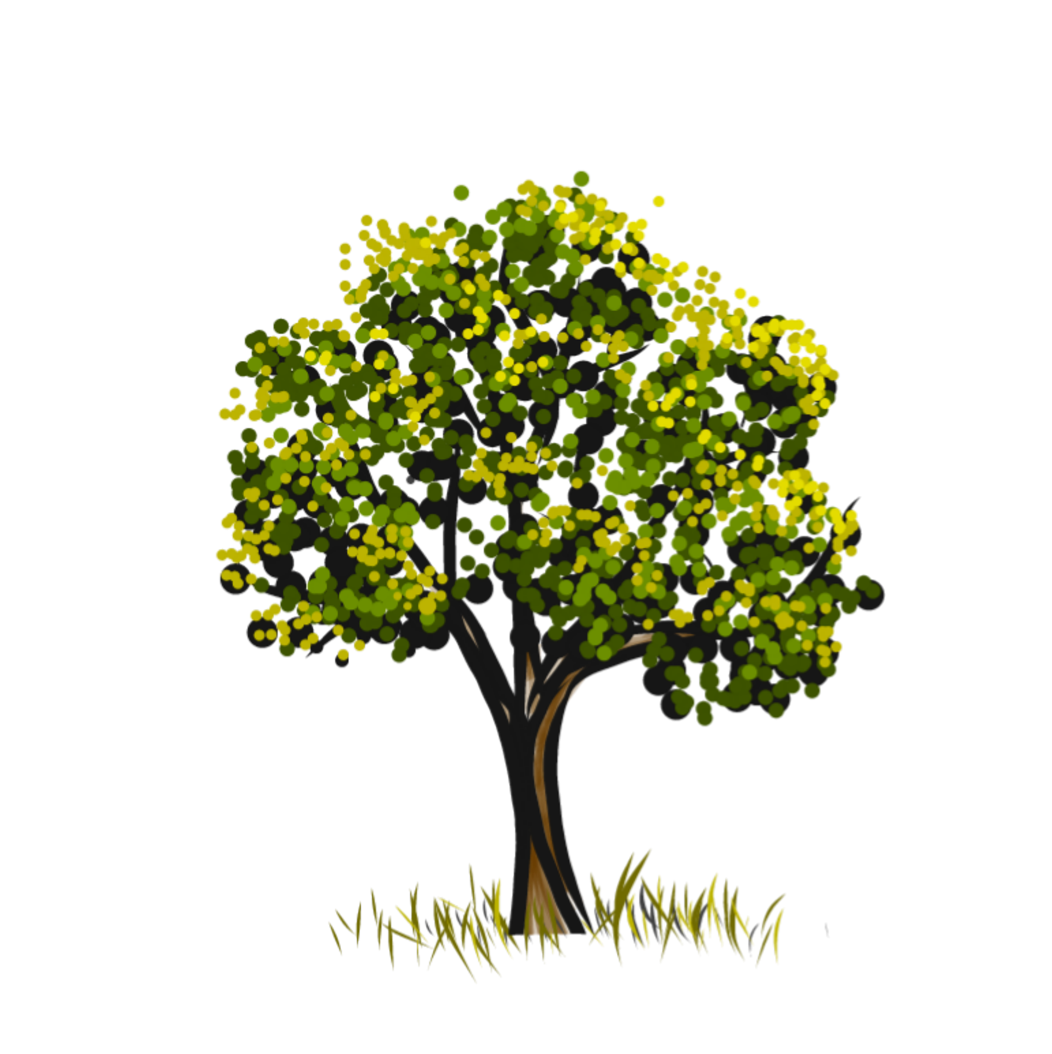
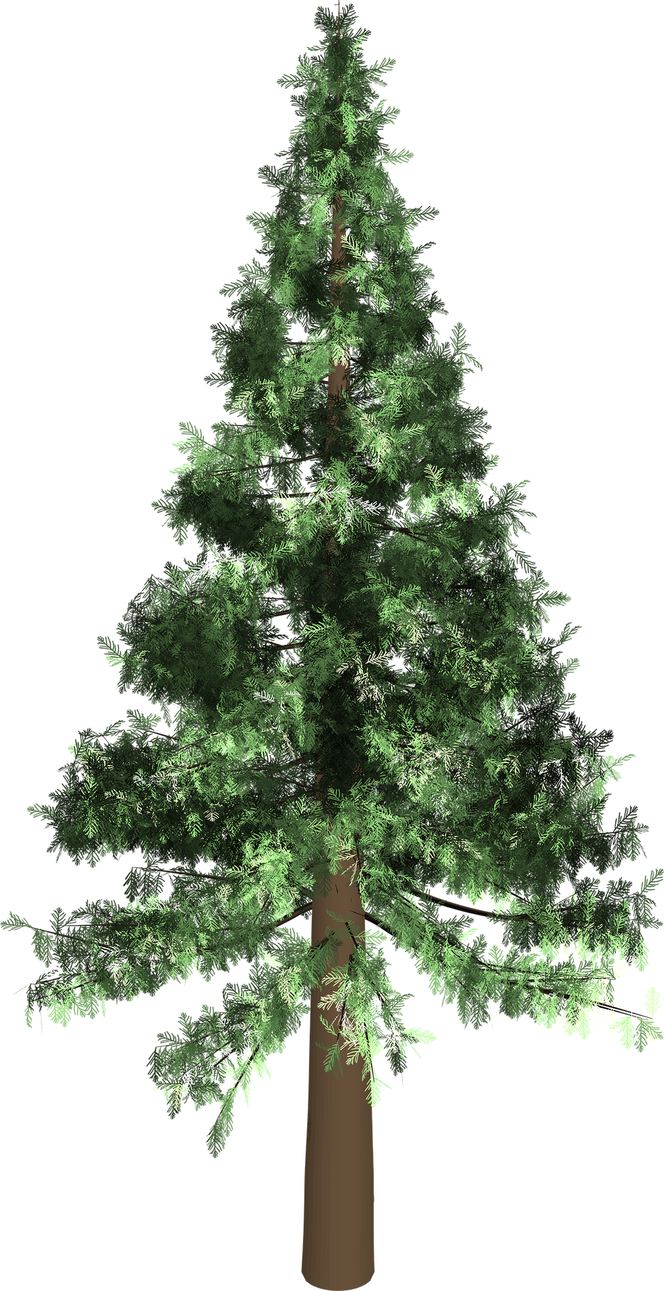
There are two types of tree:
Evergreen (softwood)
Deciduous (hardwood)
Notes:
Deciduous and evergreen are the terms used in the national curriculum, but some pupils may find hardwood and softwood easier. These terms also fit in well with understanding needed in Key Stage 3 design and technology.
Hardwoods come from deciduous trees and softwoods come from evergreen / coniferous trees. Note that these terms are just types of wood and not the properties of the wood – hardwoods are not necessarily hard (balsa is soft enough that it can be marked using a thumbnail) and softwoods are not necessarily soft (parana pine is used to make wooden stairs).

Slide 4
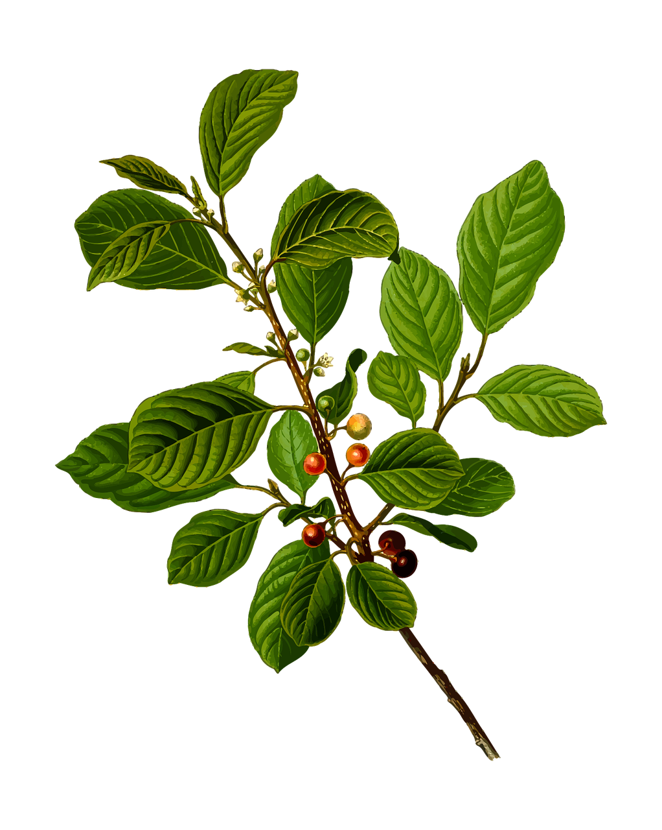
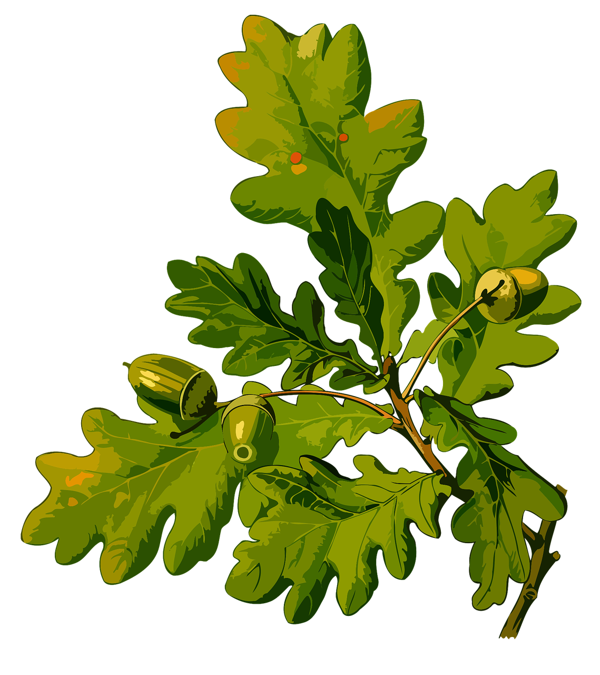
What is the difference?
Evergreen (softwood)
Deciduous trees have leaves
Evergreen trees have pines or needles
Deciduous (hardwood)
Notes:
Deciduous and evergreen are the terms used in the national curriculum, but some pupils may find hardwood and softwood easier. These terms also fit in well with understanding needed in Key Stage 3 design and technology.

Slide 5
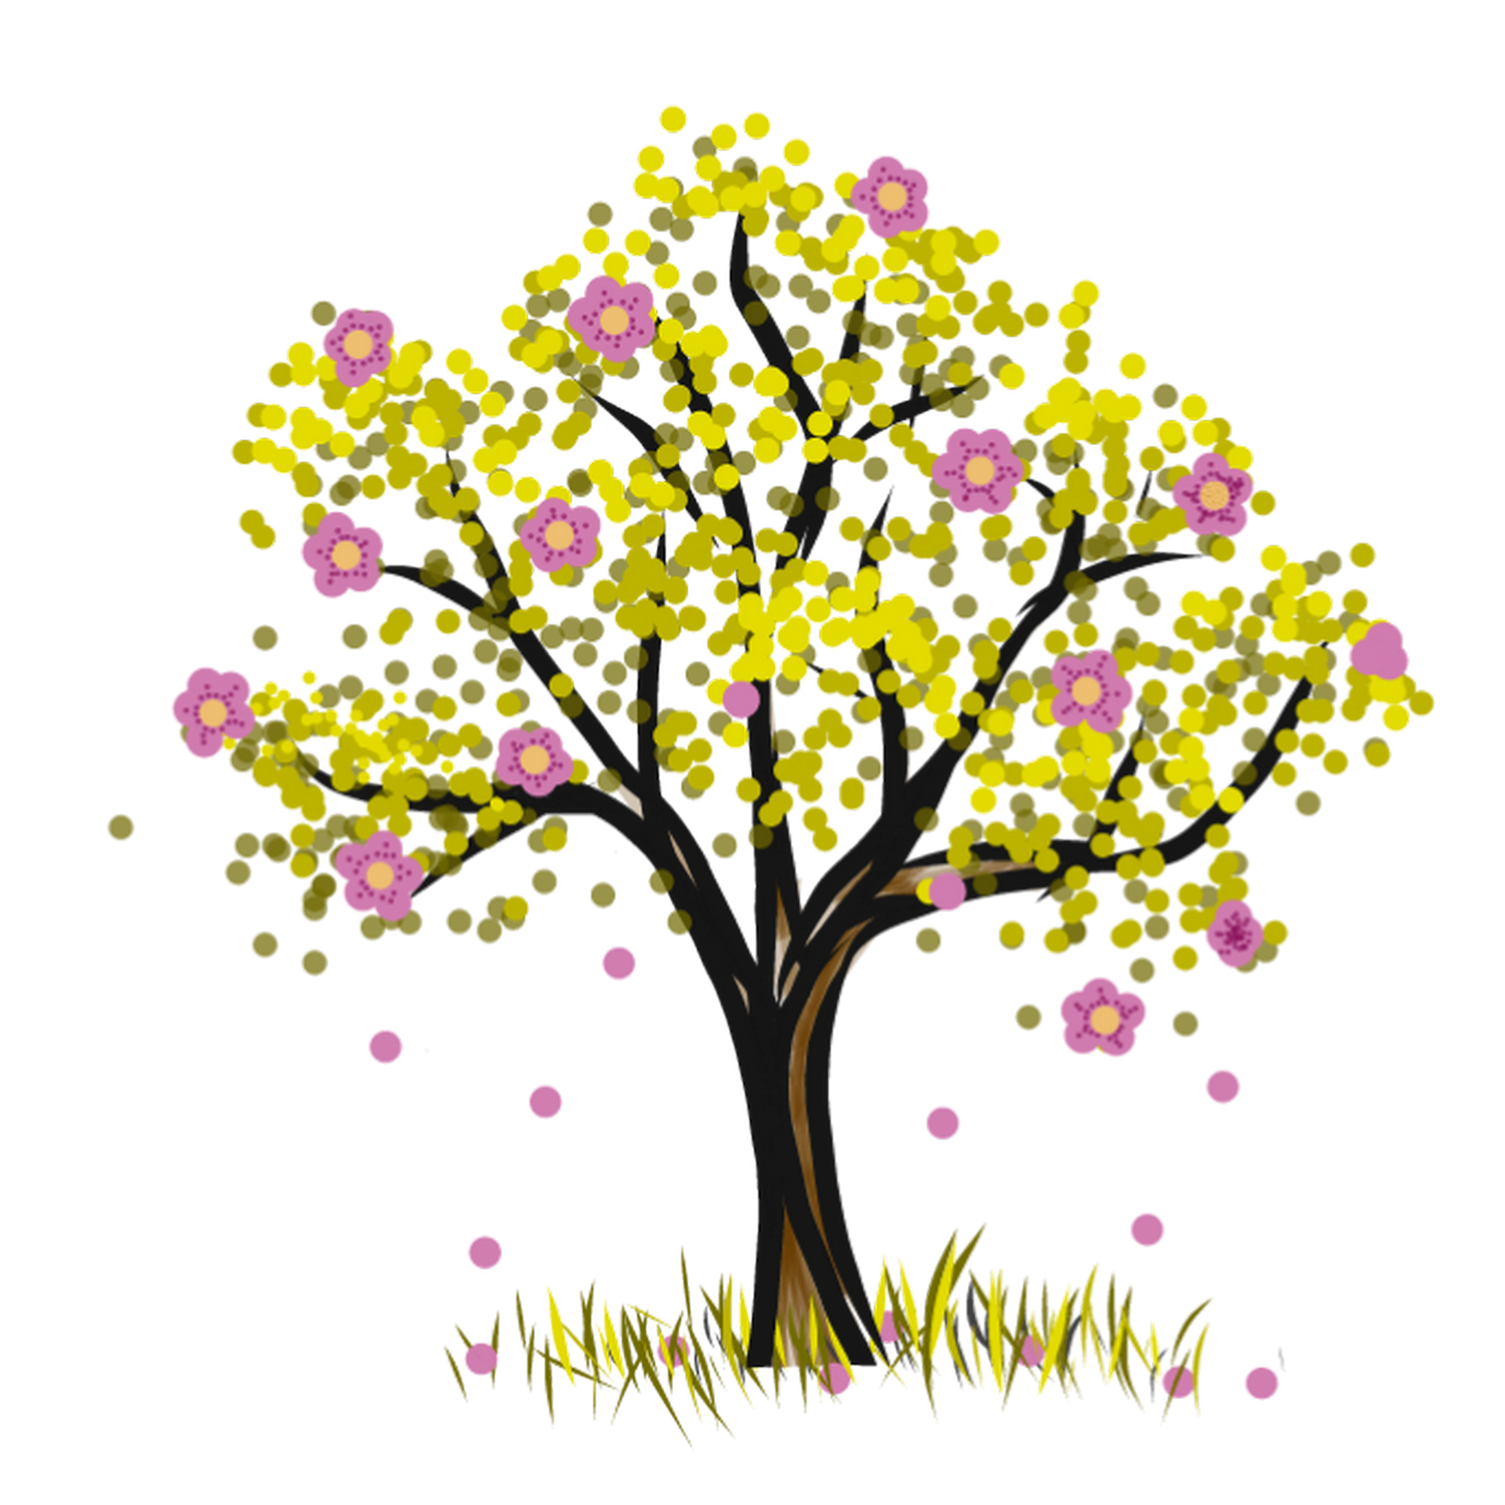
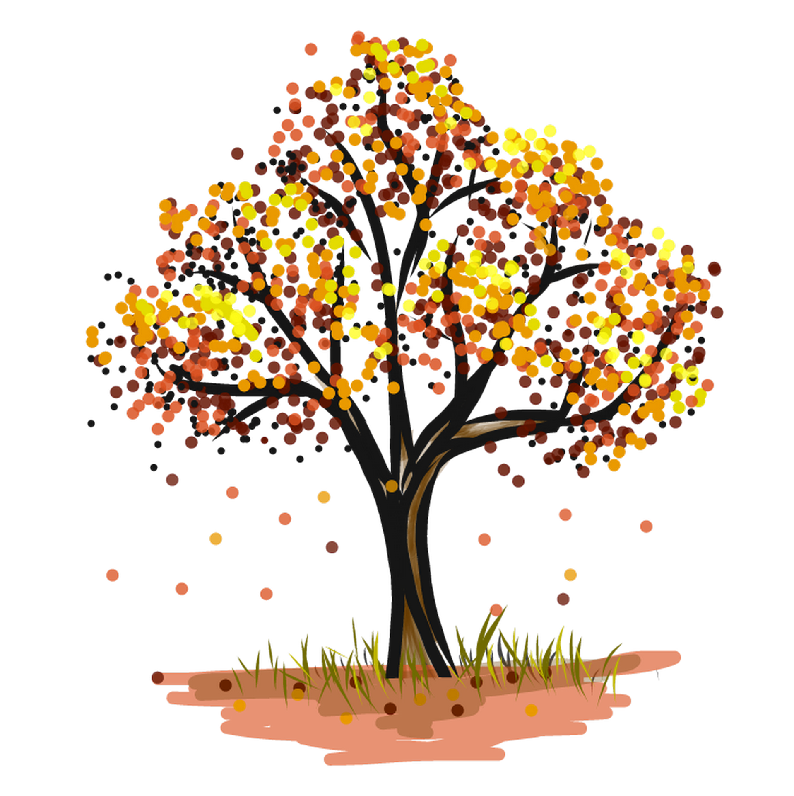
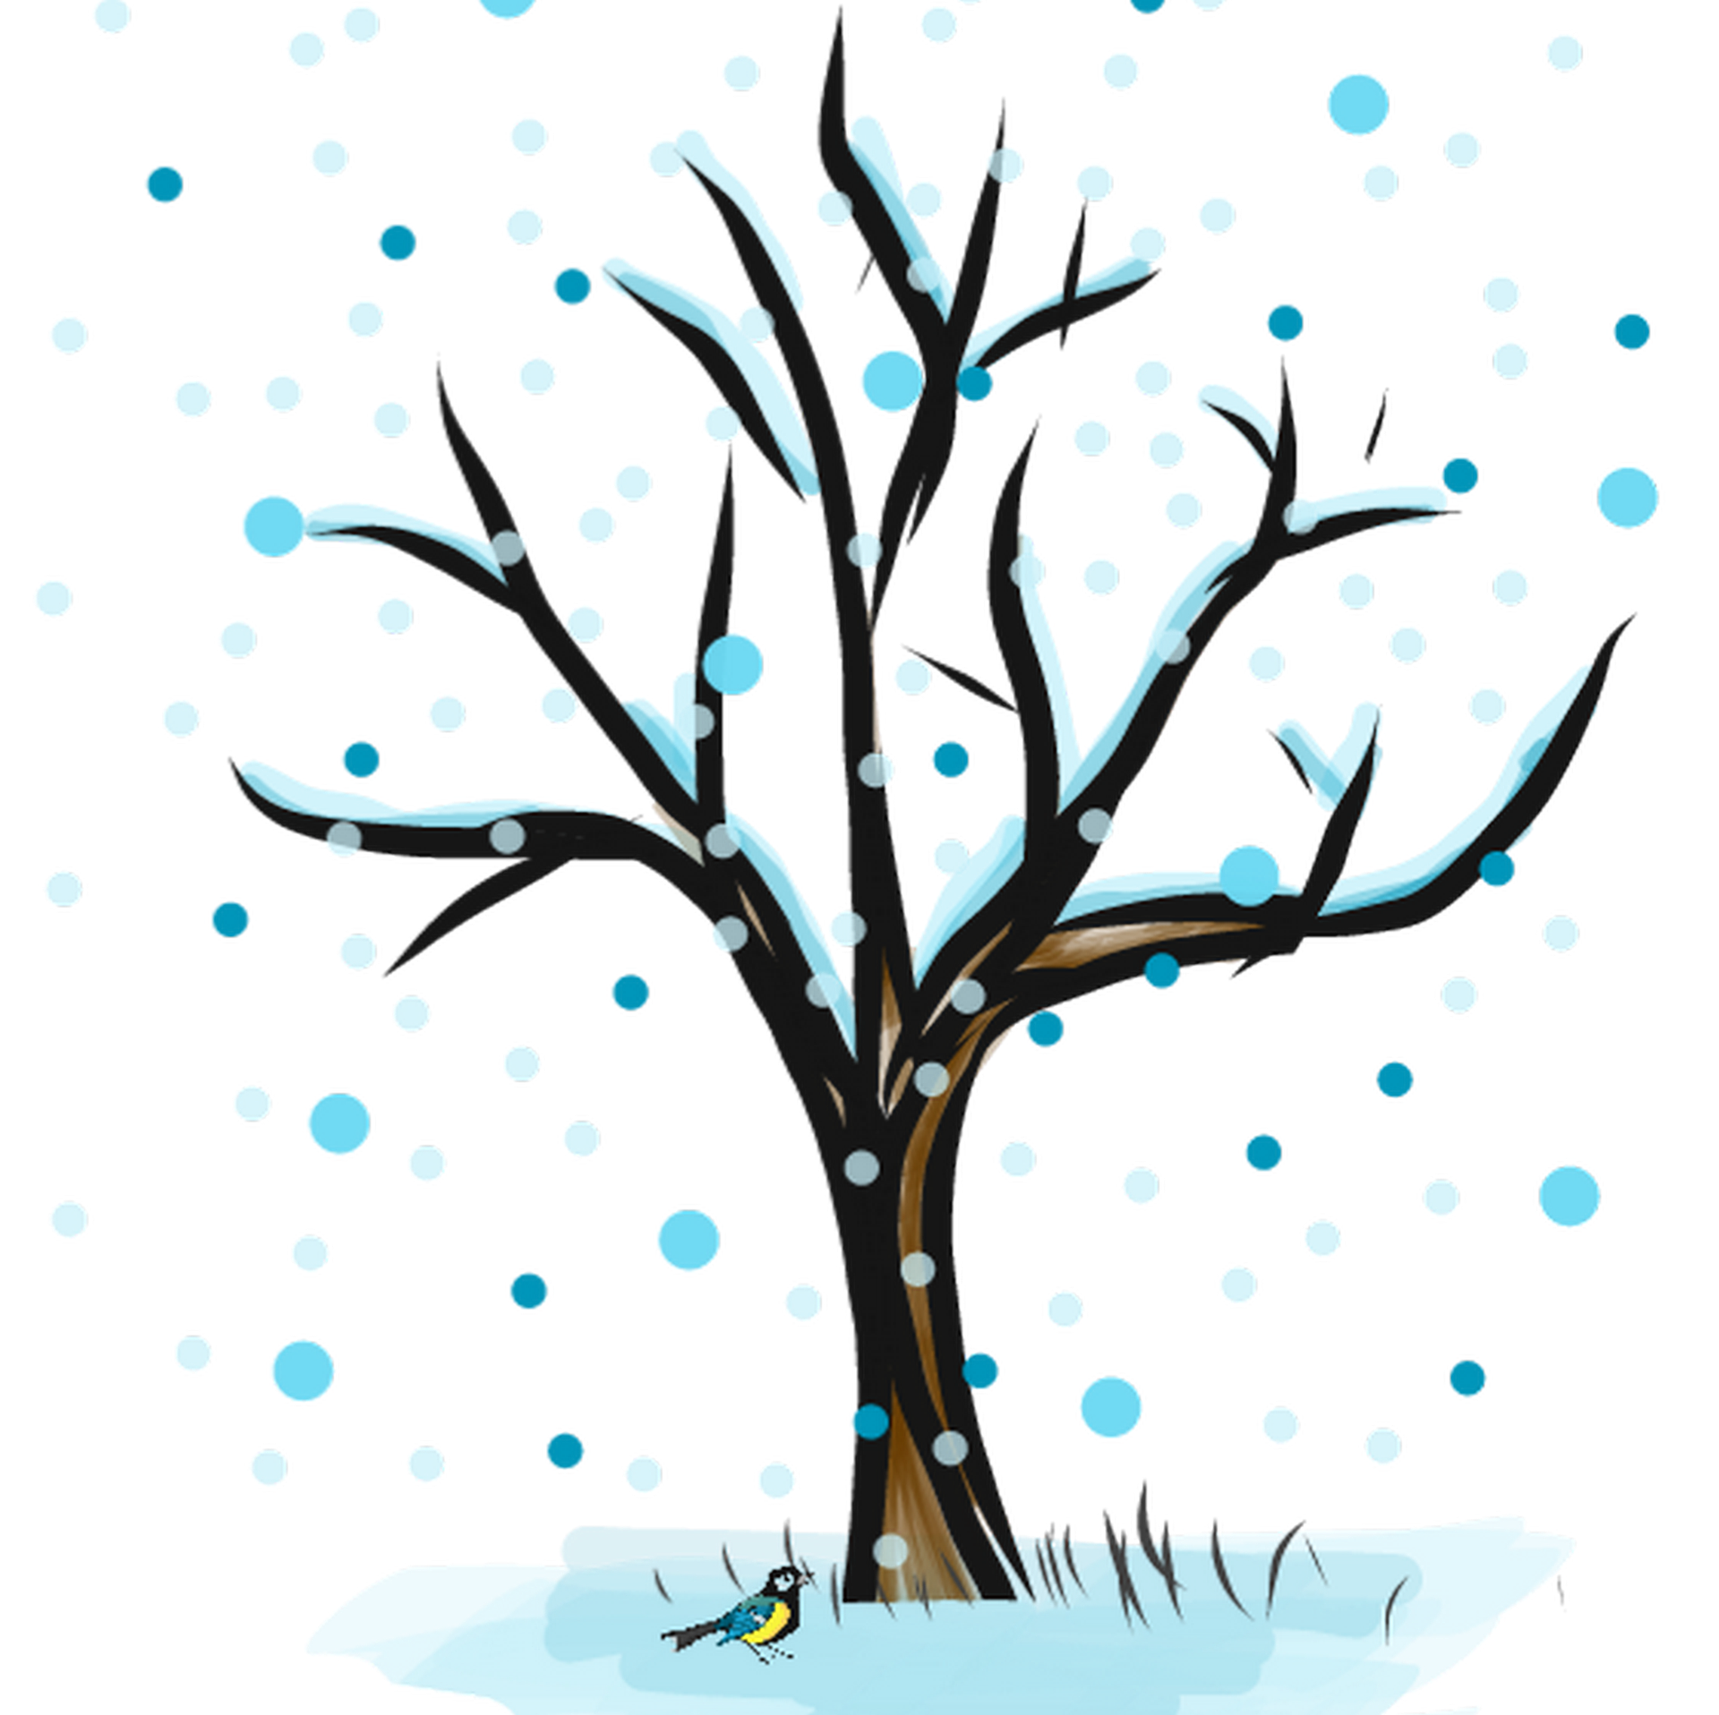
Deciduous tree over a year
Deciduous (hardwood) trees grow a new set of leaves each year
spring
summer
autumn
winter
Notes:
The Spring blossoms, Summer green leaves, Autumn leaves turn red and brown and fall, Winter bare branches

Slide 6
Evergreen tree over a year
Evergreen (softwood) trees stay green all year round
spring
summer
autumn
winter
Notes:
Evergreen trees keen their pines or needles all year. The clue is in the name!
As a result they normally grow much faster than hardwood trees – an evergreen tree might reach full size in 30 years, where a deciduous tree might need 100 years!

Slide 7
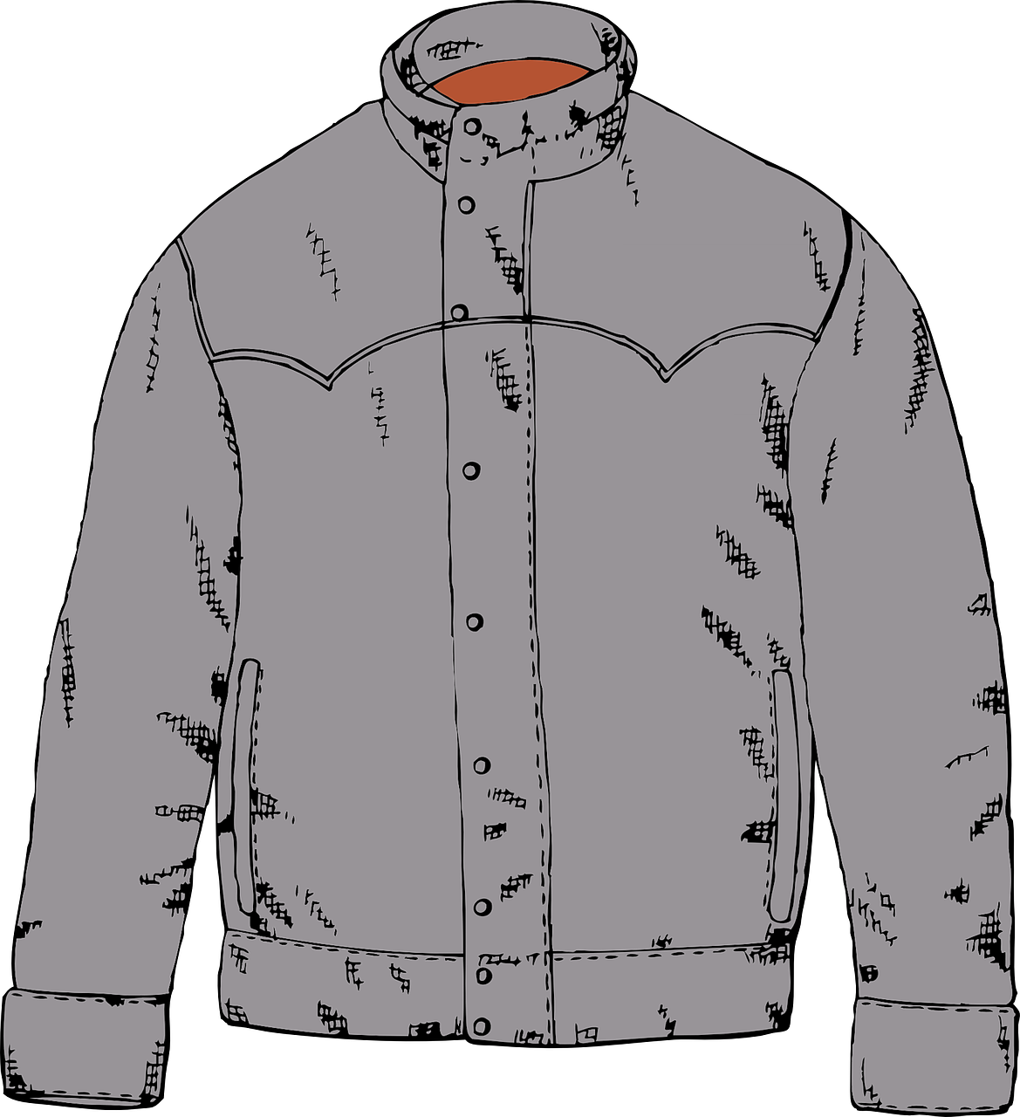
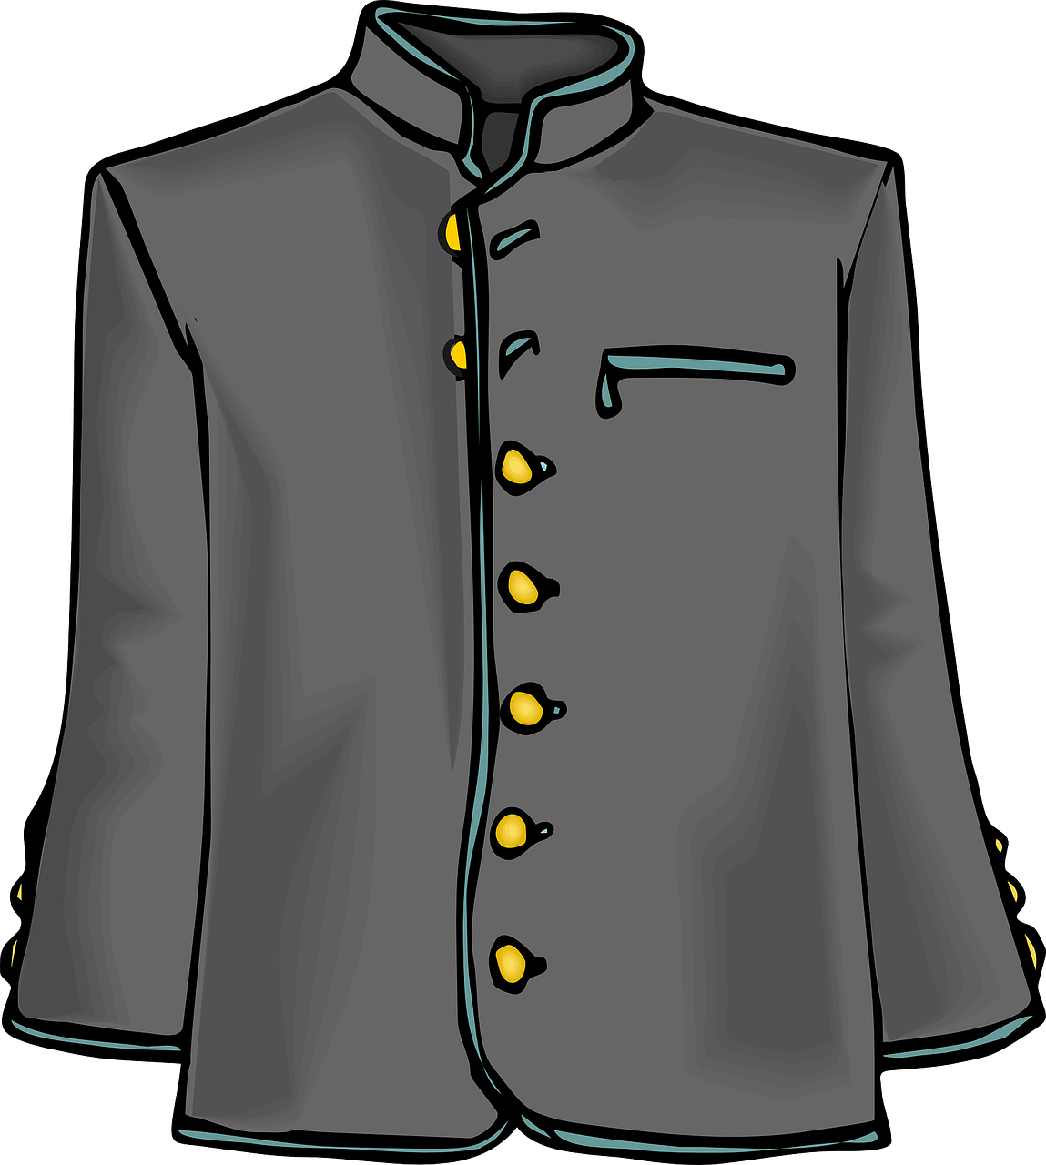
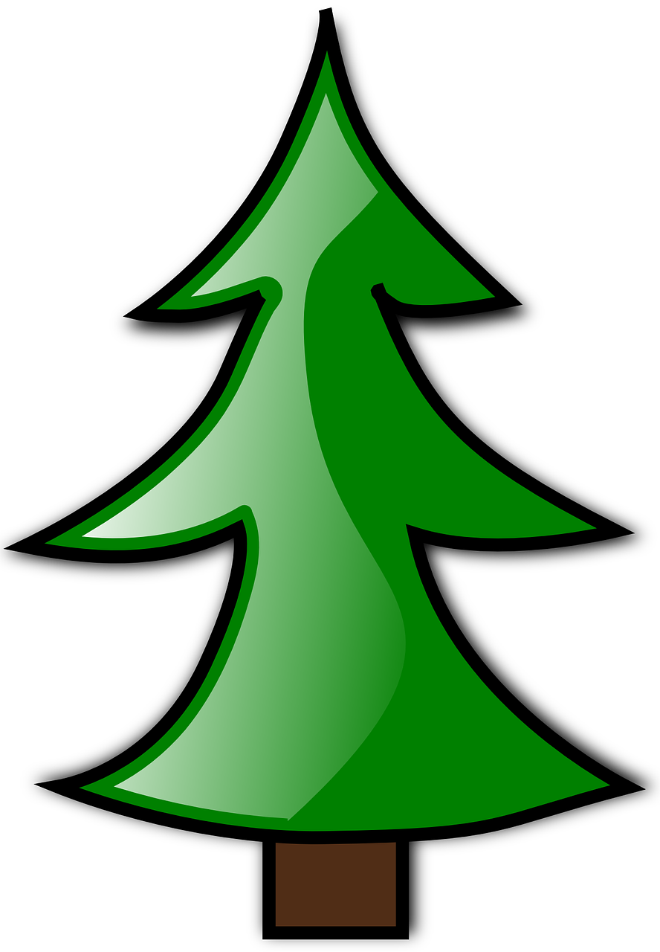
Trees in summer
Deciduous (hardwood)
Evergreen (softwood)
Notes:
Leaves are like the clothes worn by trees…

Slide 8
Trees in winter
Deciduous trees think they are ‘hard wood’ because they stand around without coats in the cold!
Deciduous (hardwood)
Evergreen (softwood)
Notes:
Evergreen (softwood) trees keep their green clothing all year. Deciduous (hardwood) trees lose their coats in winter. Hence as they stand in the cold, they might think of themselves as ‘hard’. However, what would we think of a person who did the same?

Slide 9
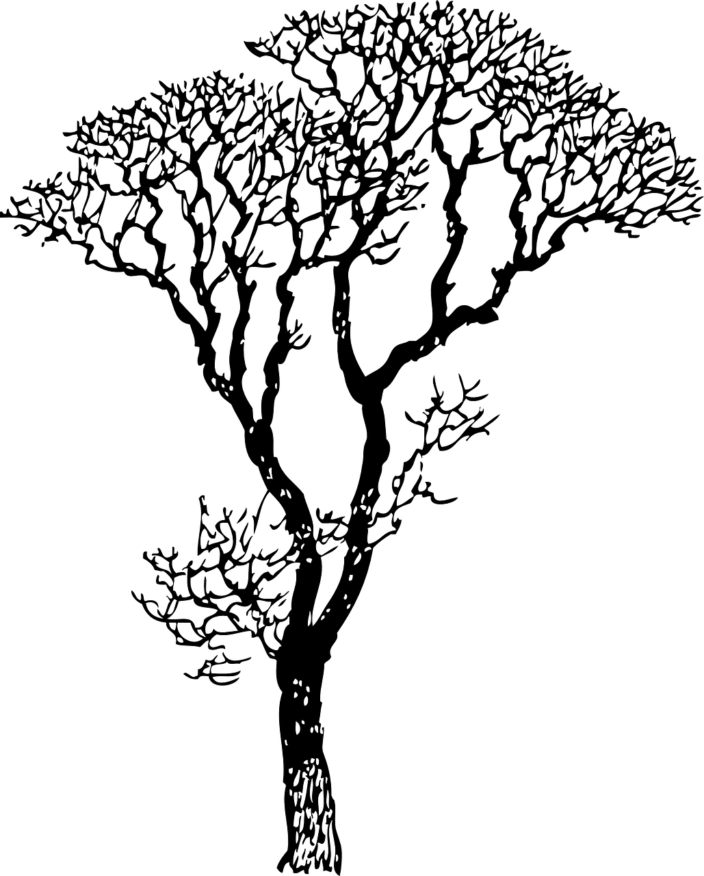
Making a class tree
Make a leaf with your name on it
Attach it to our class tree
There is a different class each year – so what type if tree is this?
Notes:
This could be used as an additional related activity to reinforce understanding. It is also a useful way of developing a class identity. The trunk and branches can be made from strips of brown sugar paper stapled to a noticeboard.

