Slide 1
Counting the Score - BBC micro:bit Quiz Counter
Decade Counter Circuits

Slide 2
Stay safe
Whether you are a scientist researching a new medicine or an engineer solving climate change, safety always comes first. An adult must always be around and supervising when doing this activity. You are responsible for:
ensuring that any equipment used for this activity is in good working condition
behaving sensibly and following any safety instructions so as not to hurt or injure yourself or others
Please note that in the absence of any negligence or other breach of duty by us, this activity is carried out at your own risk. It is important to take extra care at the stages marked with this symbol: ⚠

Slide 3
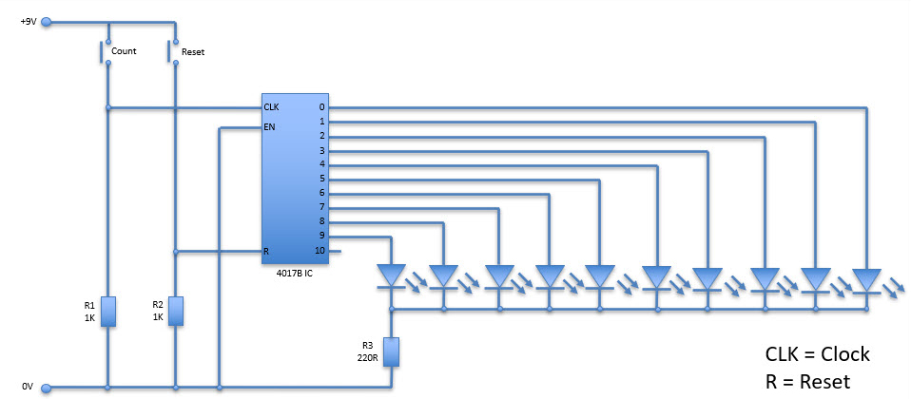
Decade Counter Circuit Diagram

Slide 4
Investigating the Circuit
Use circuit simulation software to draw and test the decade counter circuit.
What happens each time the count and reset switches are pressed?
You may encounter switch bounce. What does this mean and how could you overcome it?
How does this circuit differ from your programmable counter system?

