Slide 1
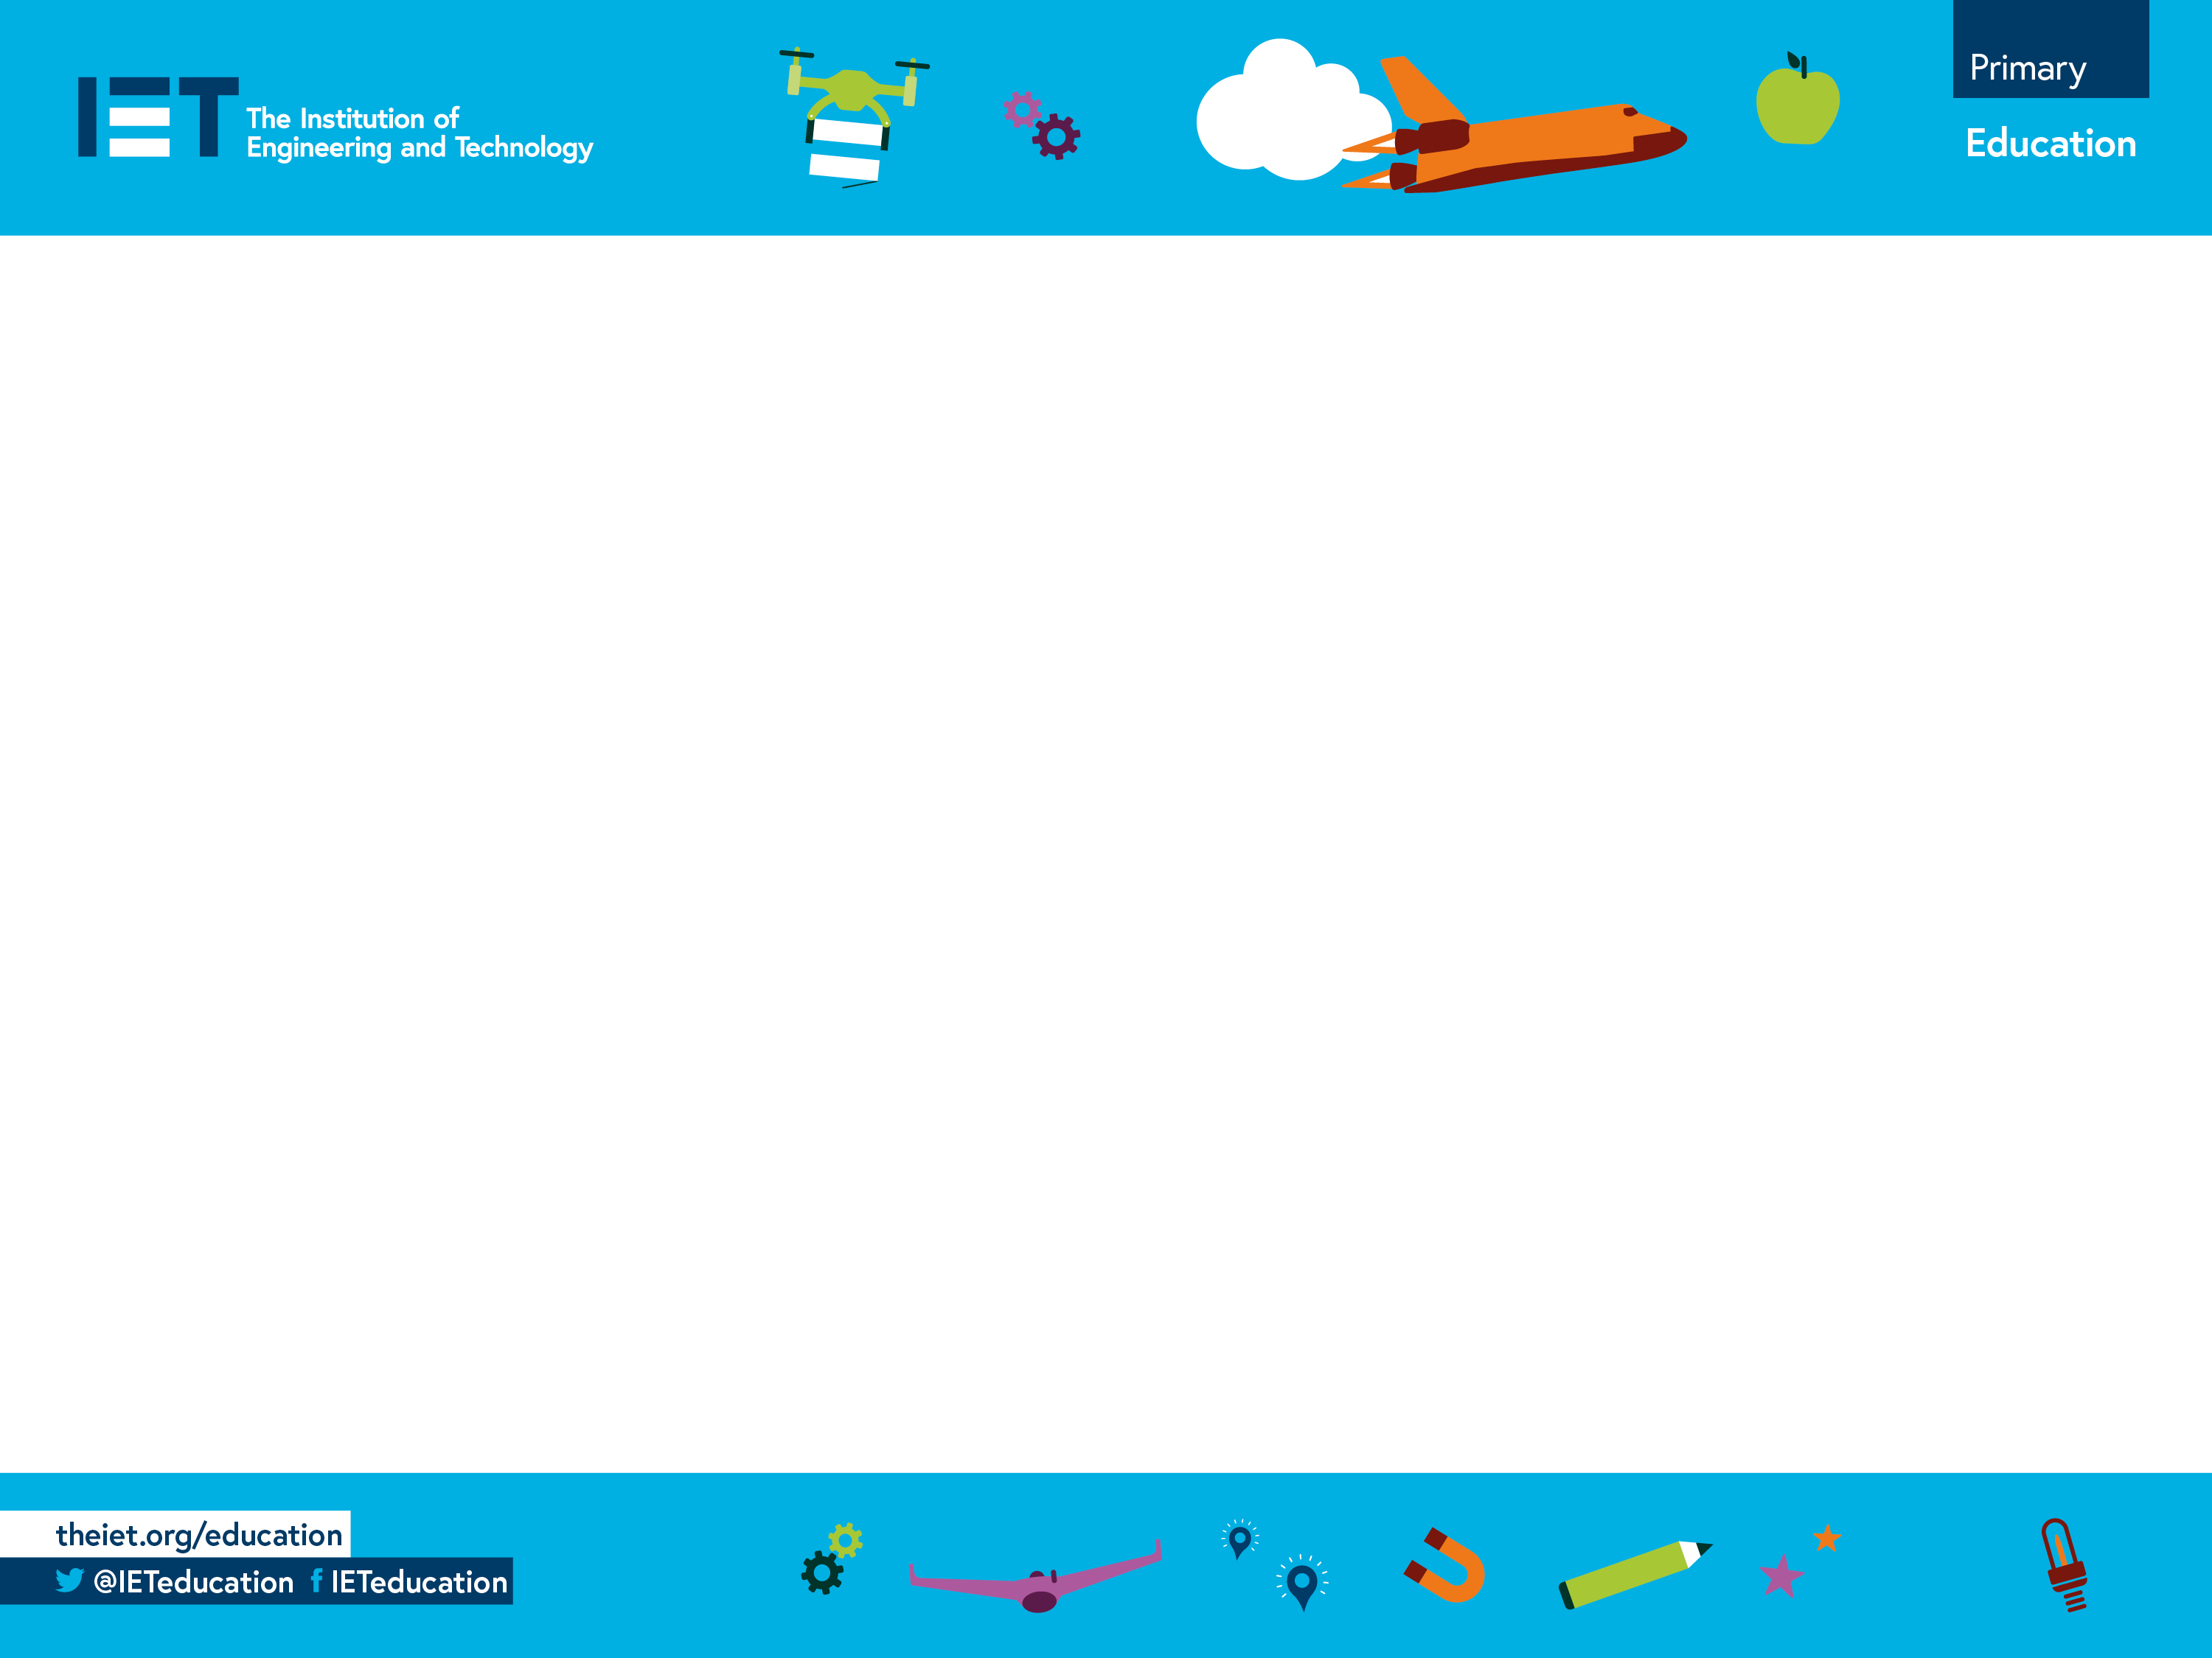
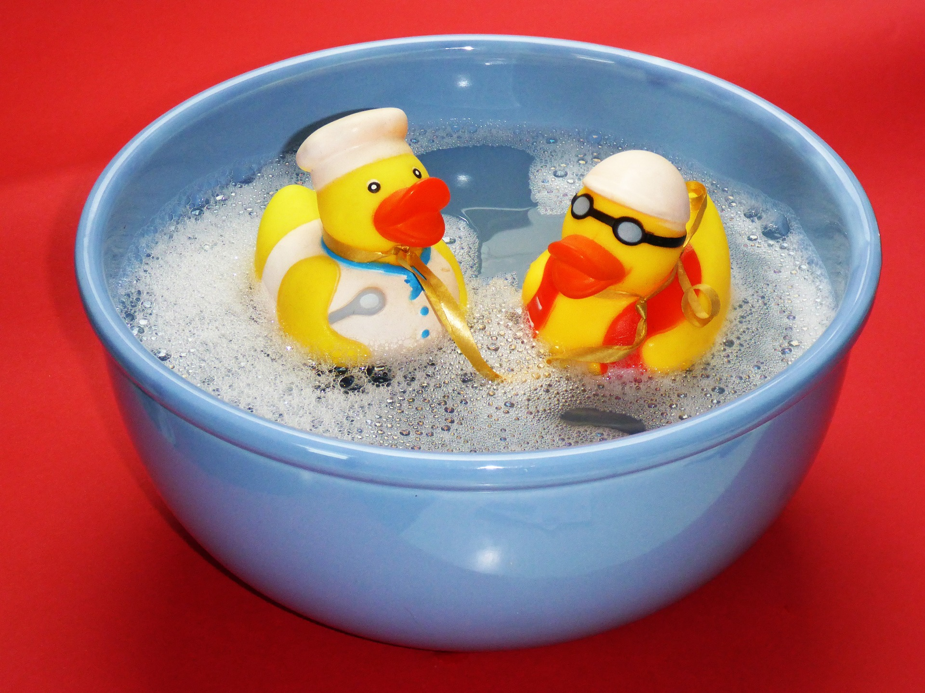
How to calculate density
Finding the density of materials by weighing items and immersing them in water

Slide 2

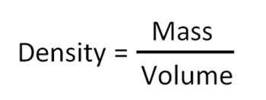
What is Density?
If two things are the same size, the one that is more dense is heavier.
The cubes are the same size
High density
Low density
The density of an object is its mass divided by its volume:
The units of density are g/cm³

Slide 3
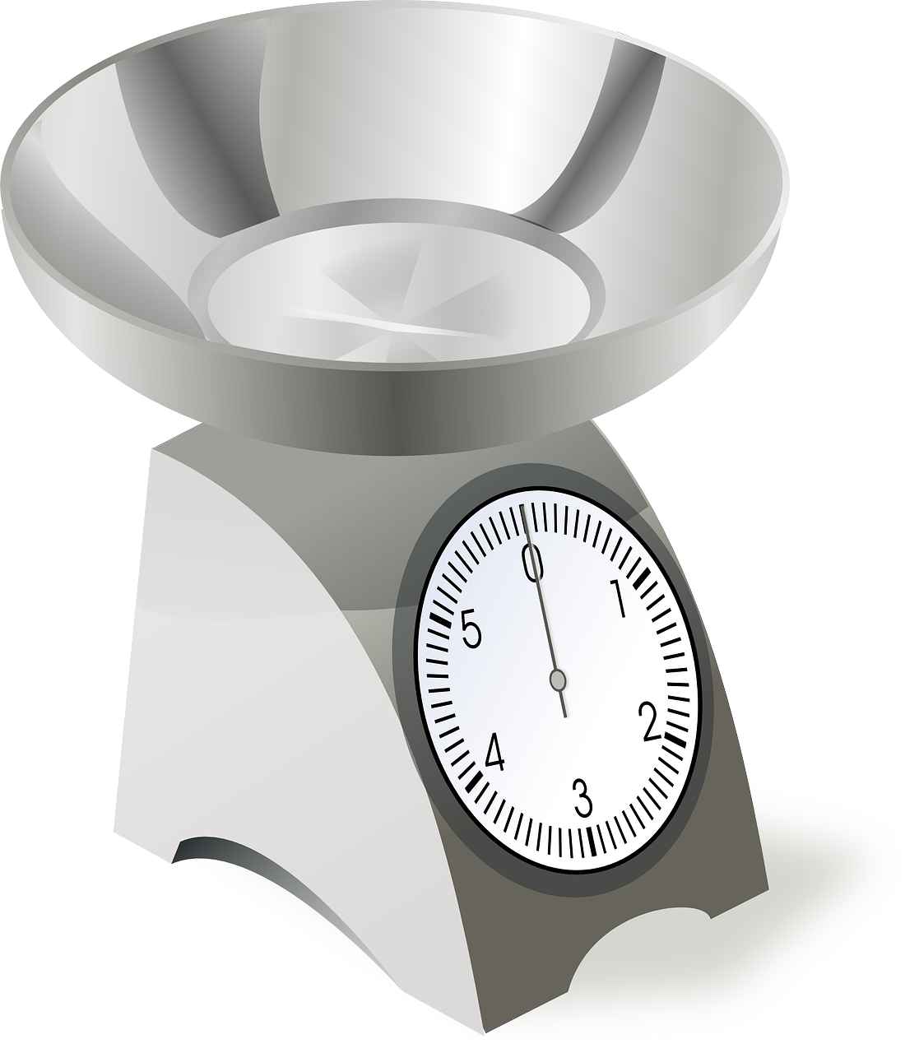
What is Mass?
Mass is how heavy something is.
It is measured in grams, g.

Slide 4
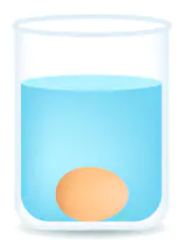
What is Volume?
Volume is the amount of space an object takes up.
It is measured in cm³.
We can measure volume by putting an object in water and seeing how much the water rises.

Slide 5
Testing Activity – Step 1
Weigh each object.
Write down the weight in g.

Slide 6
Step 2 – Find the Volume
Place a bowl on a tray.
Fill the bowl to the brim with water.
Put the object in the water.
The tray will catch all
the water that
overflows.

Slide 7
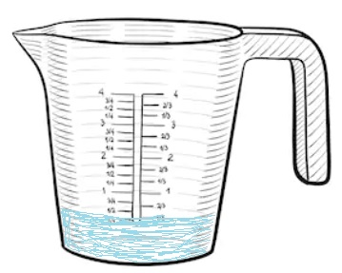
Step 3 – Measure the Water
Carefully take the bowl from the tray.
Pour the water on the tray into a jug.
Write down how much water has been collected in ml.

Slide 8

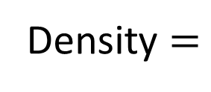
Step 4 – Work out the density
Weight = 9 grams
Volume of water = 4.5 ml = 4.5 cm³
9
____
Density $=$
$$=$$
2 g/cm³
4.5

