Slide 1
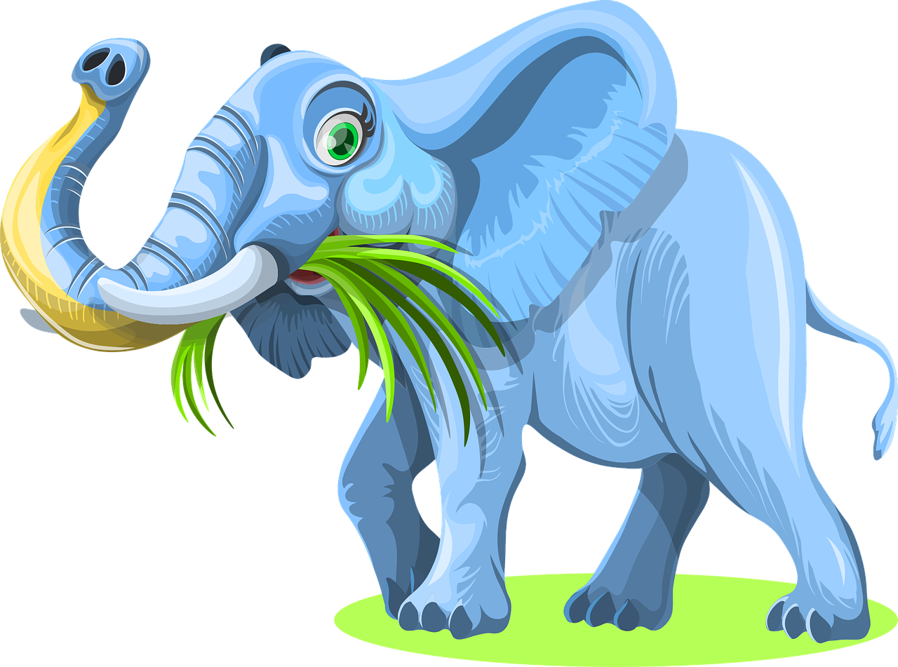
Animal diet game (KS1)
Card matching activity with animals and foodstuffs

Slide 2
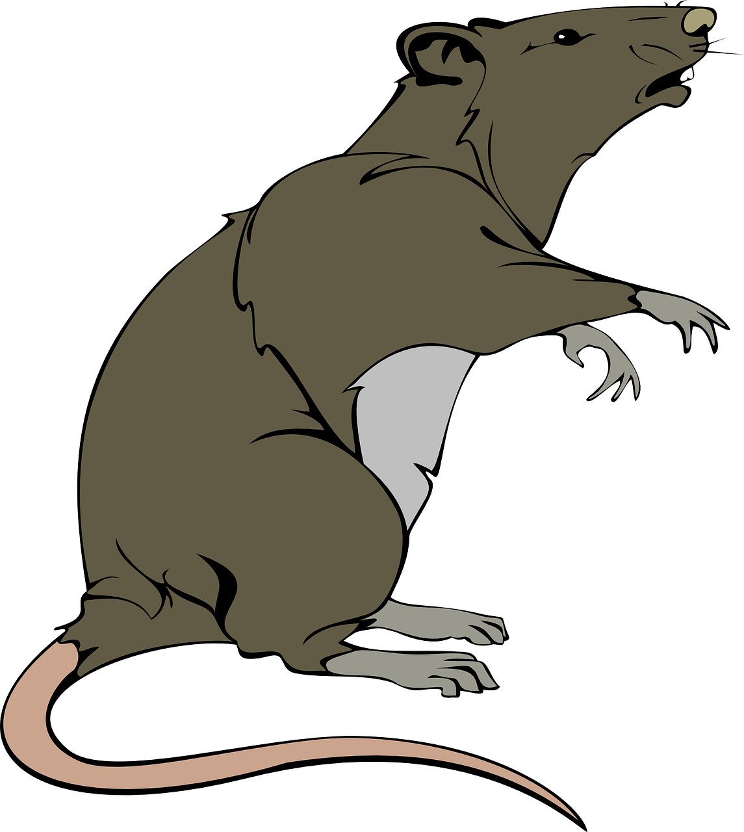
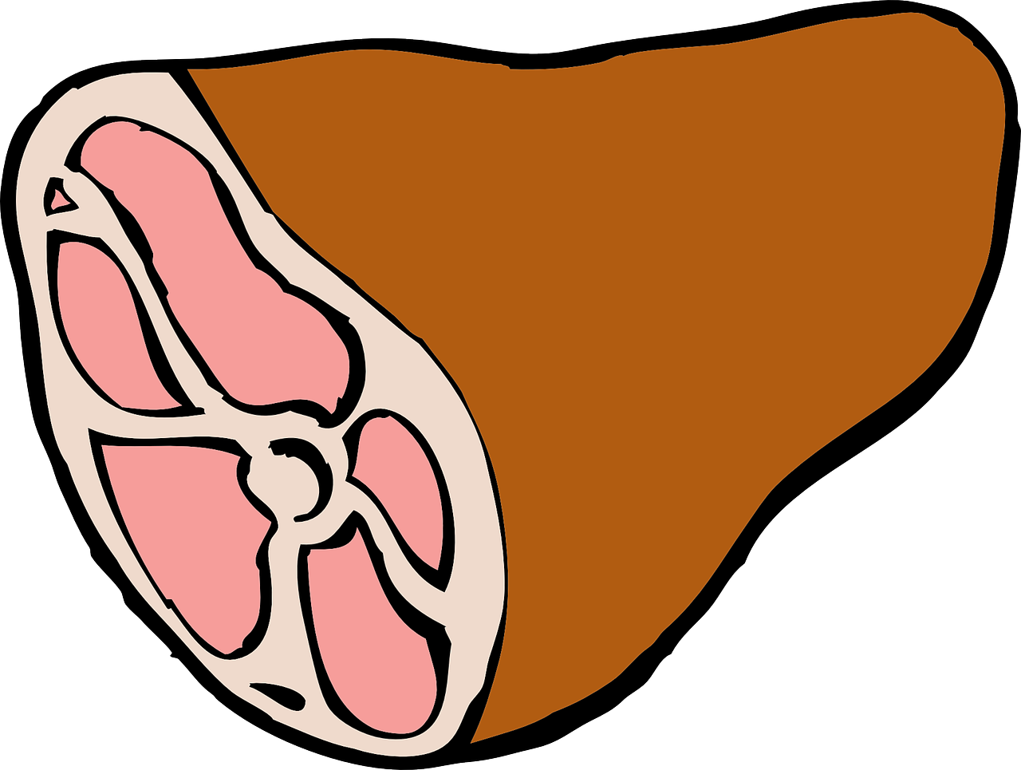
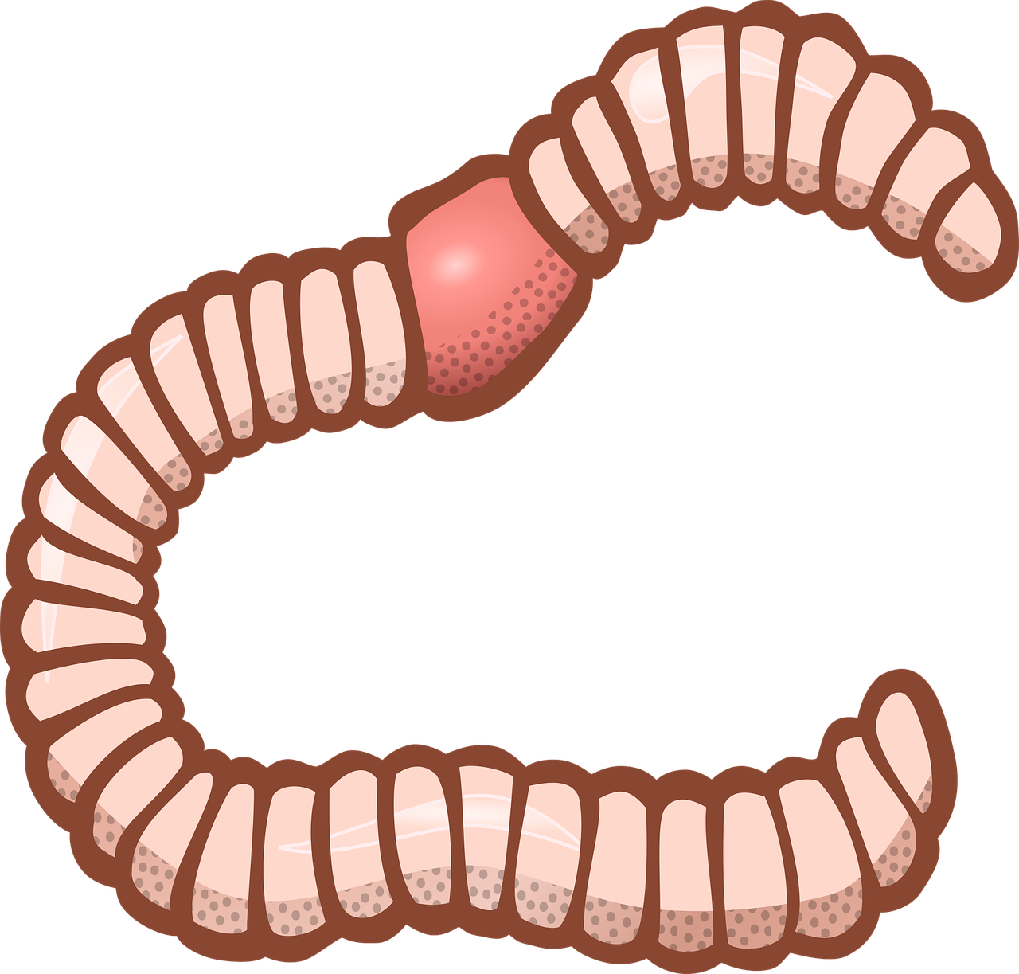
Carnivores eat meat

Slide 3
Herbivores eat fruit and vegetables

Slide 4
Omnivores eat meat, fruit and vegetables

Slide 5
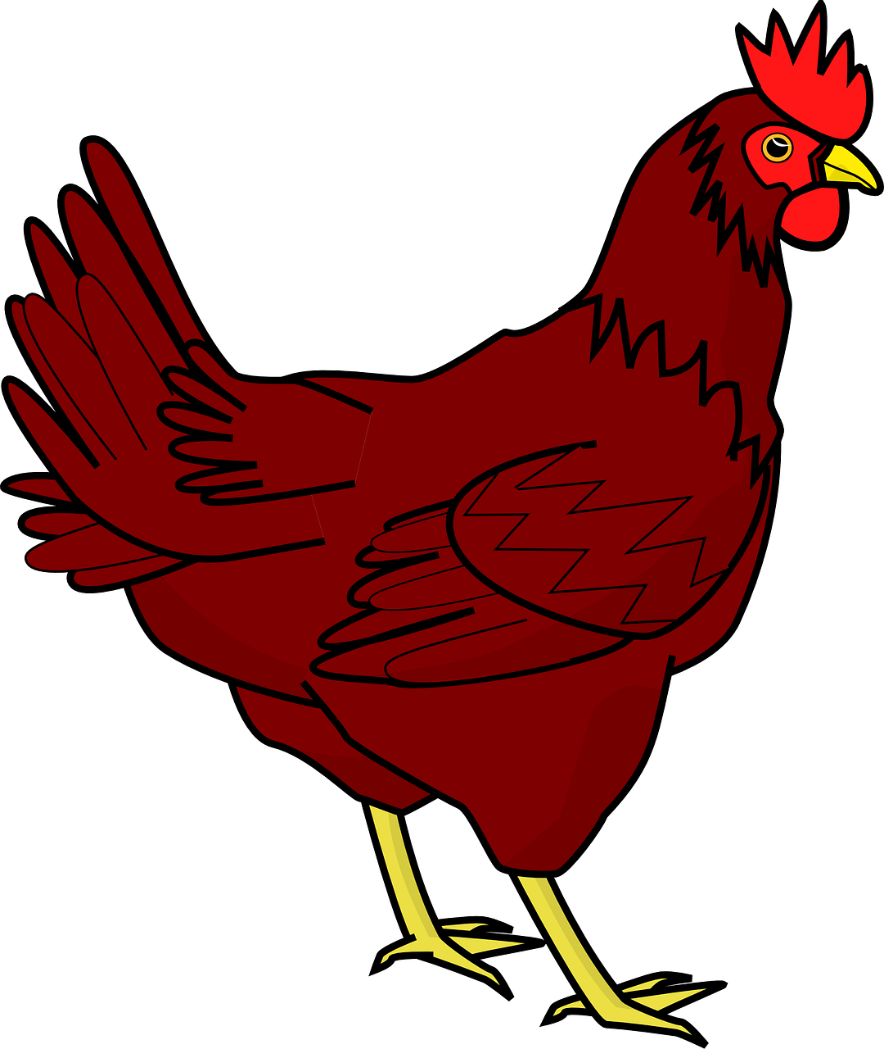
I Eat WHAT??? - Sorting Cards
Read the information on the cards
Sort the cards into three groups:
carnivores
herbivores
omnivores.
chicken
They eat grain, fruit
and insects

Slide 6
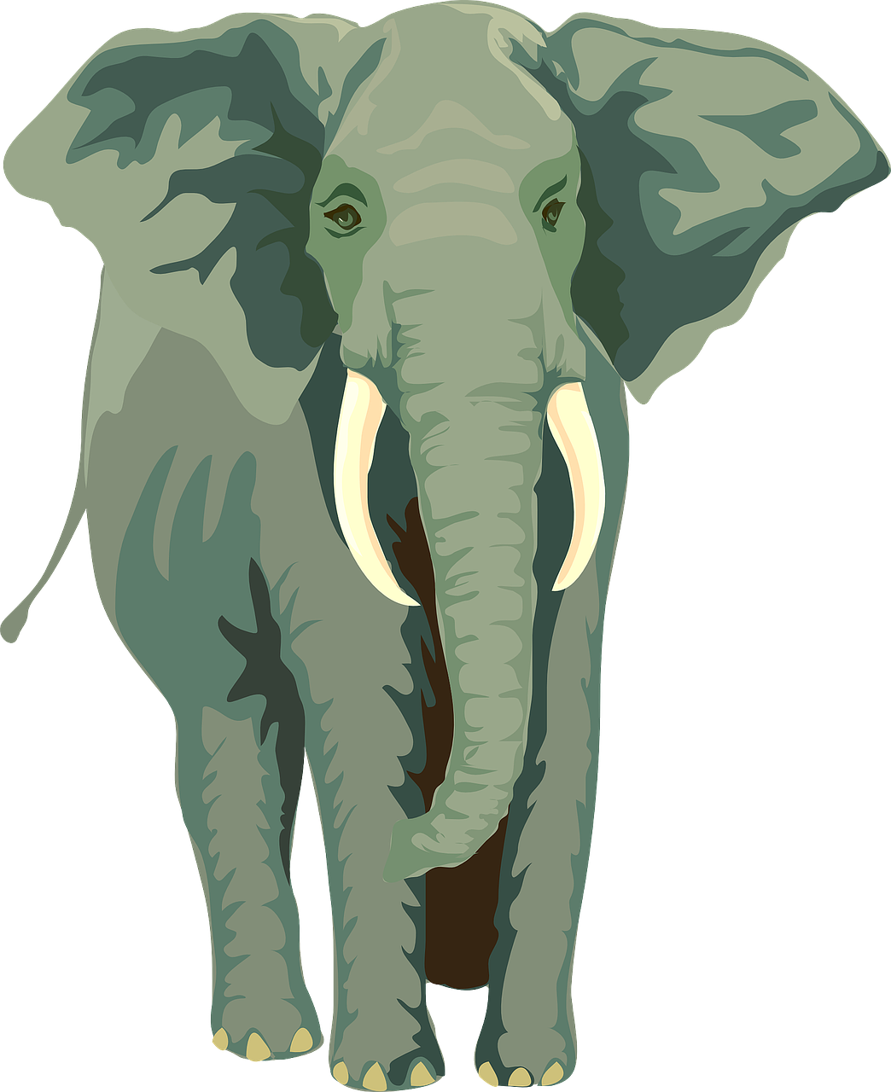
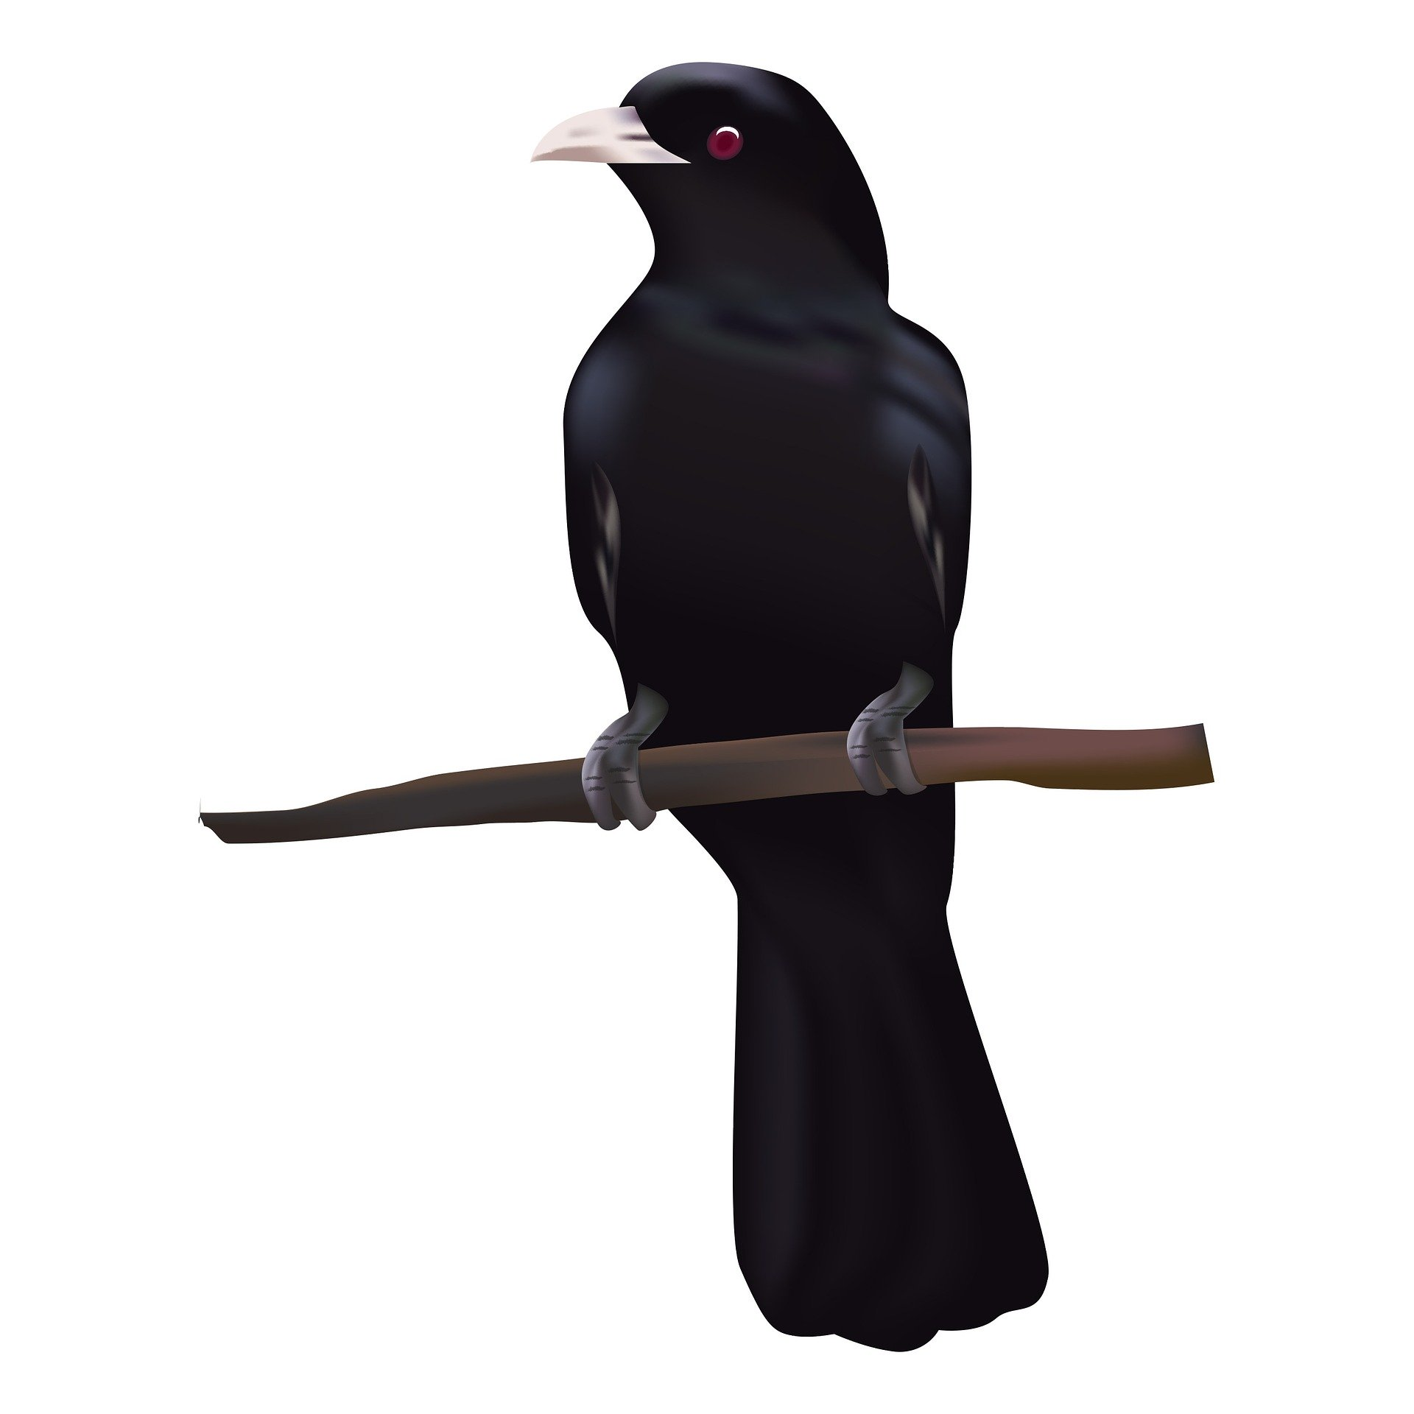
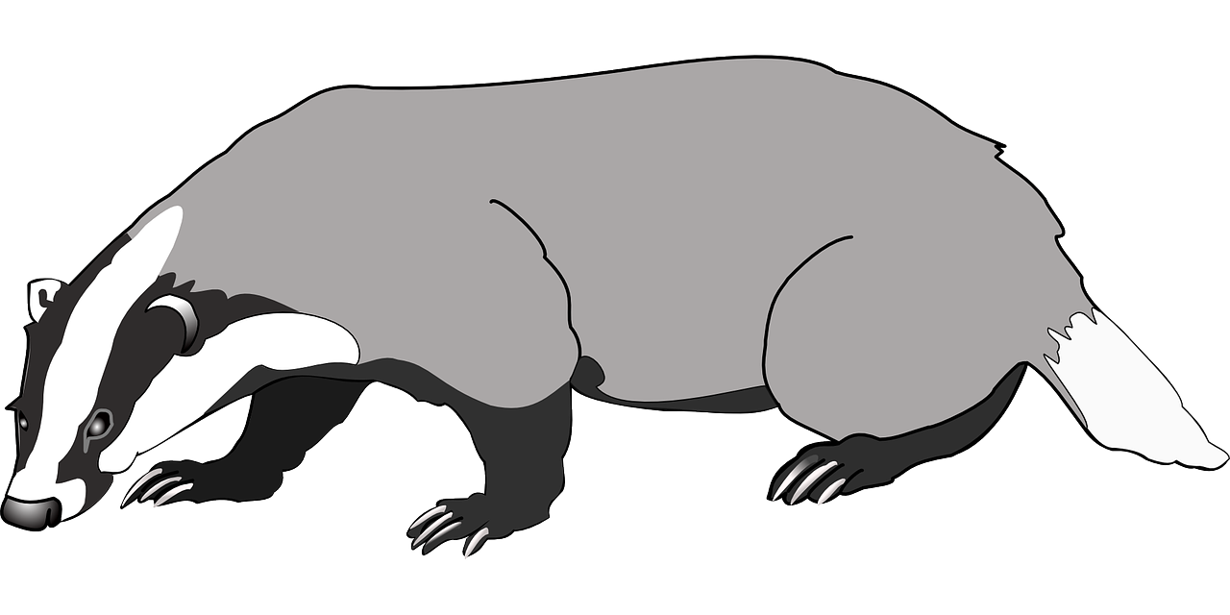
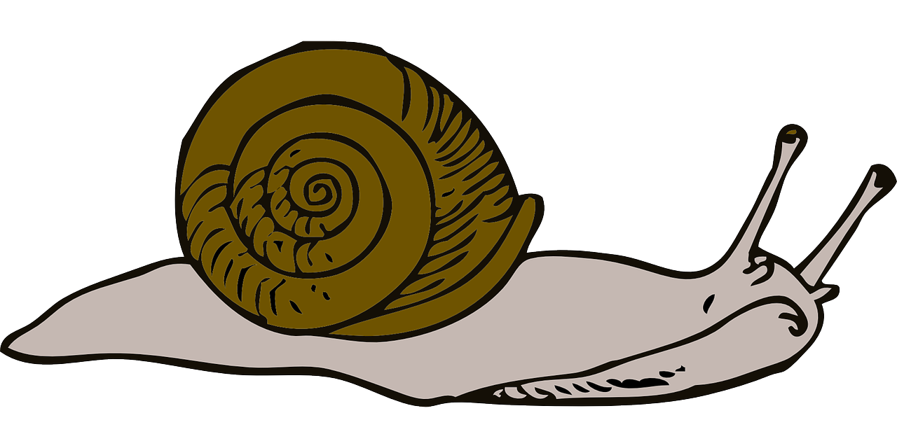
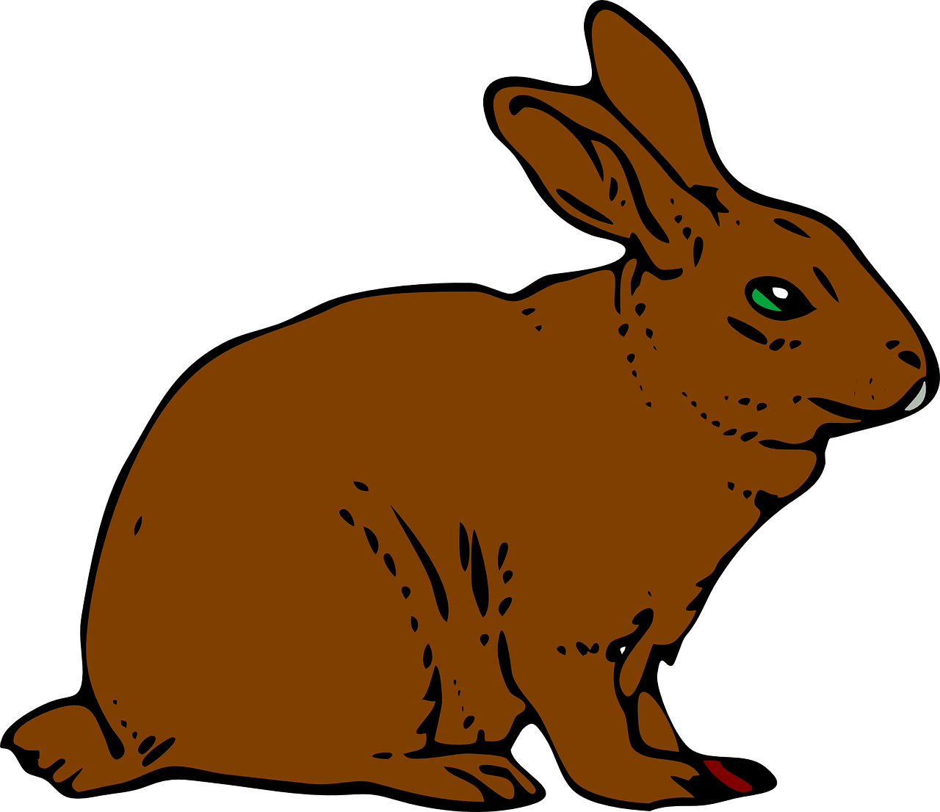
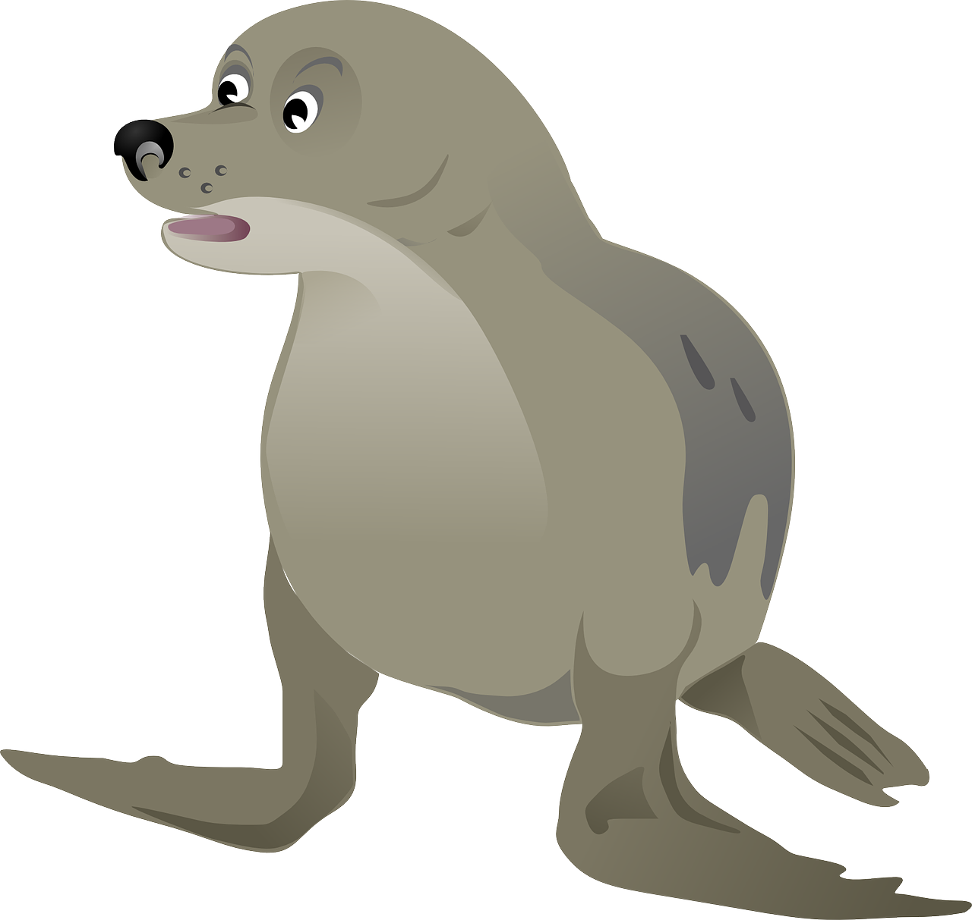
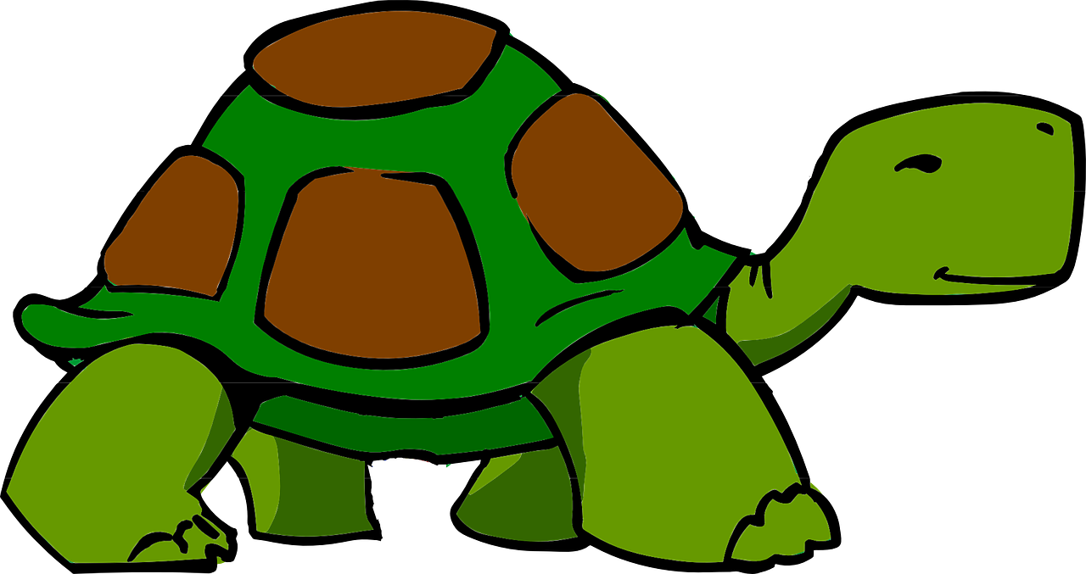
chicken
elephant
badger
crow
tiger
They eat grain, fruit
and insects
They eat grass, plants,
fruit and twigs.
They eat insects,
worms, small animals,
fungi and fruit
They eat insects,
worms, small animals,
reptiles and fruit
They eat pigs, zebra,
cows, buffaloes
and goats.
snail
human
rabbit
seal
tortoise
They eat leaves,
fungi and fruit
They eat meat,
fungi, plants and fruit
They eat leaves, grass
and flowers.
They eat fish, shrimp
and squid.
They eat leaves, grass
and flowers.

Slide 7
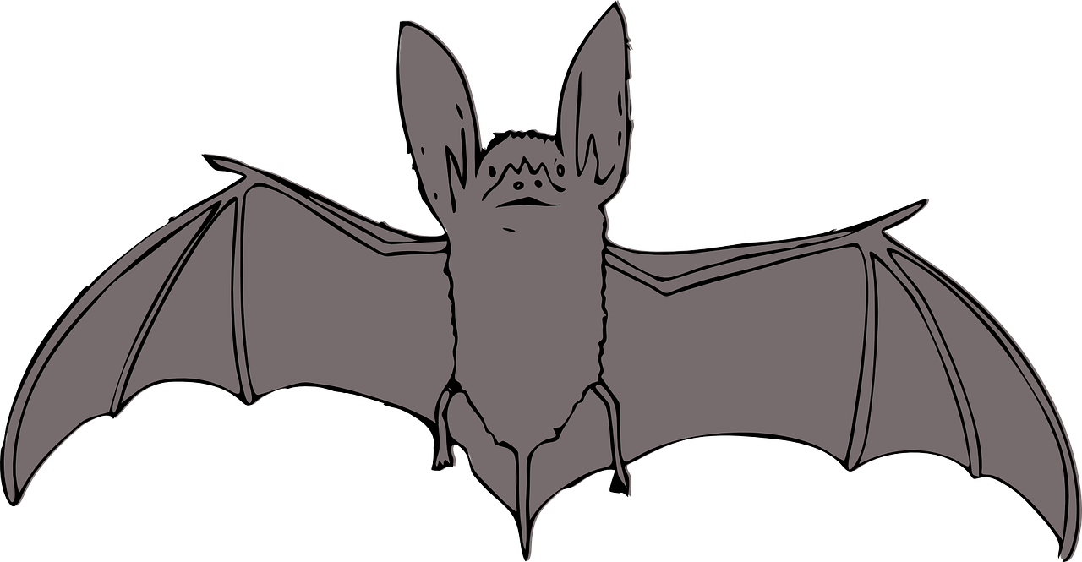
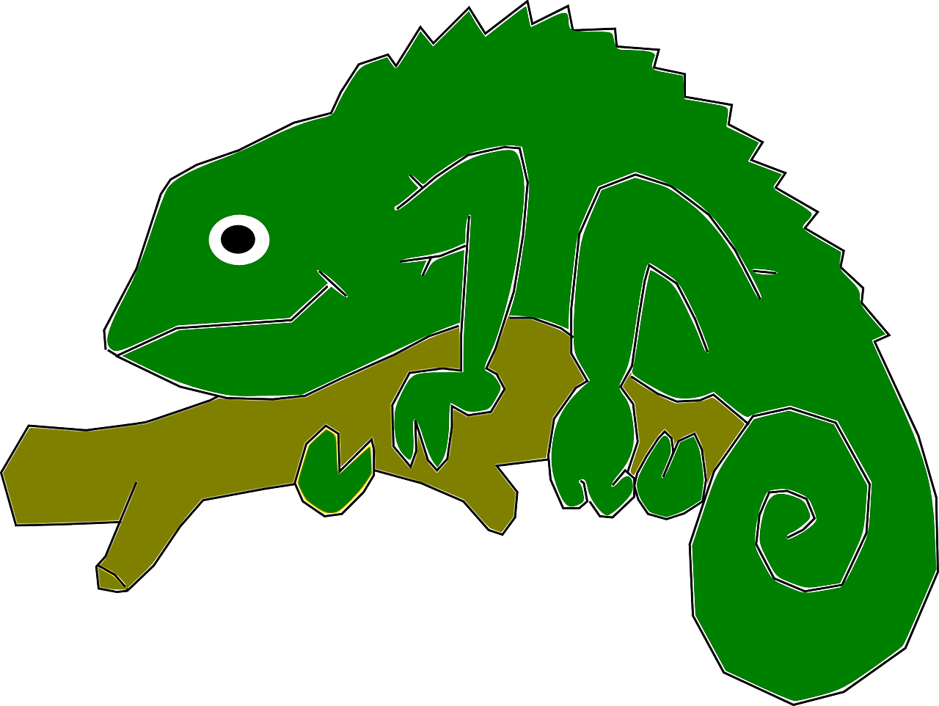
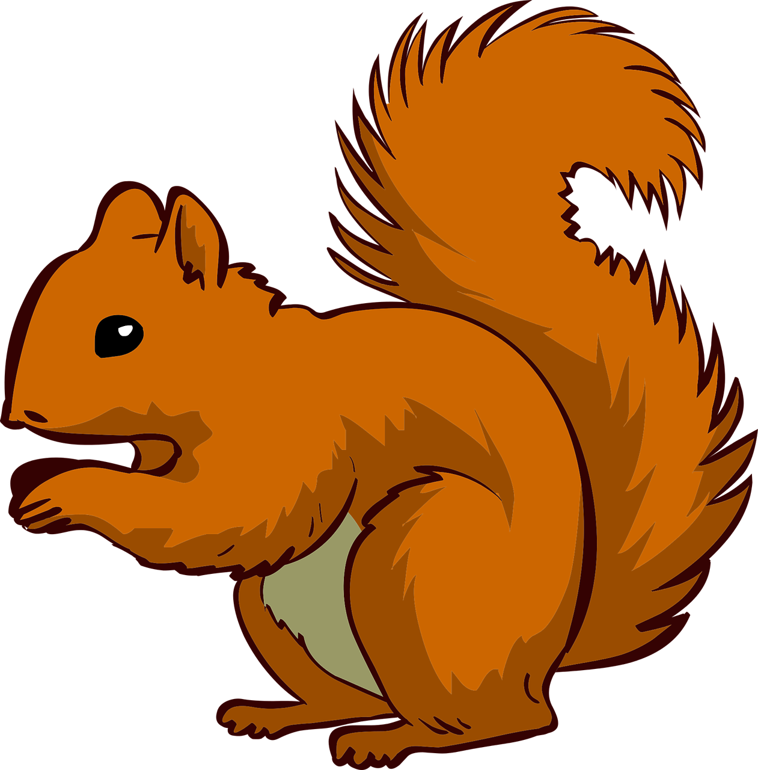
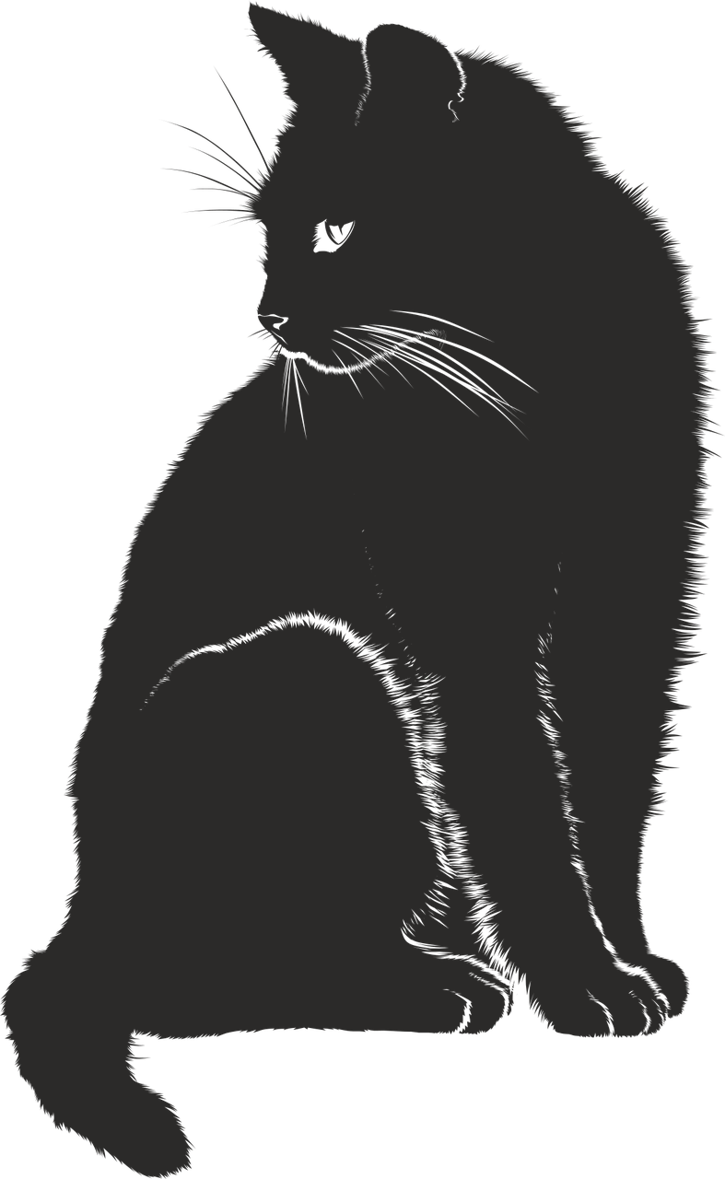
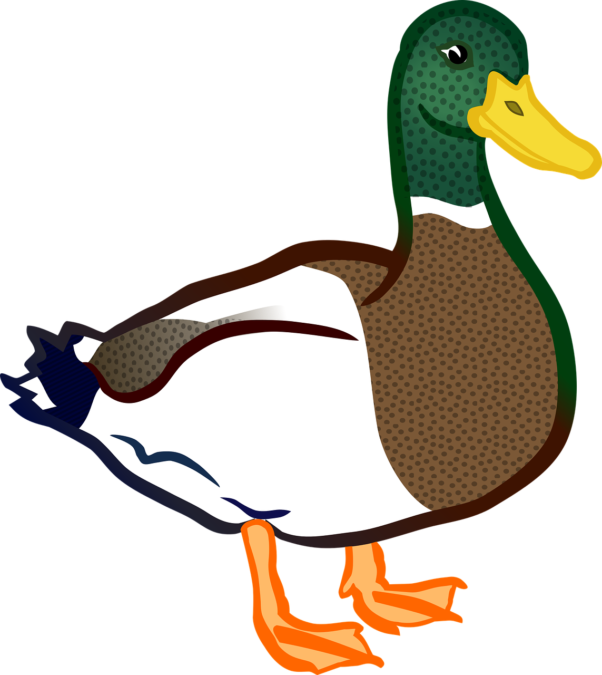
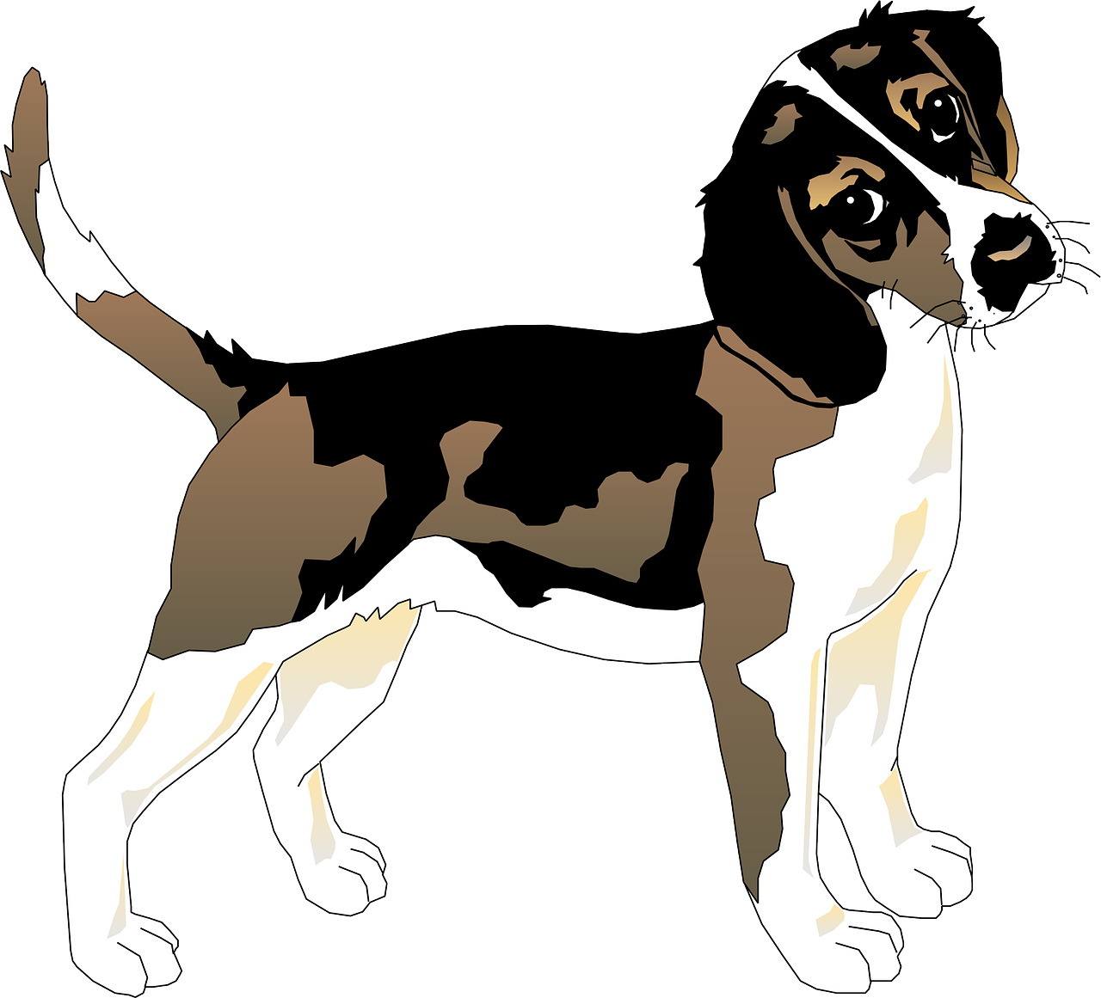
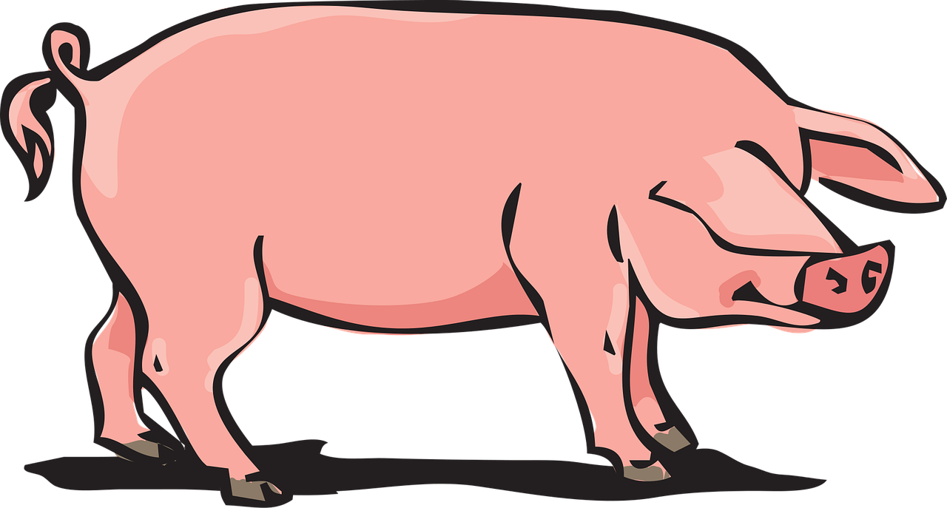
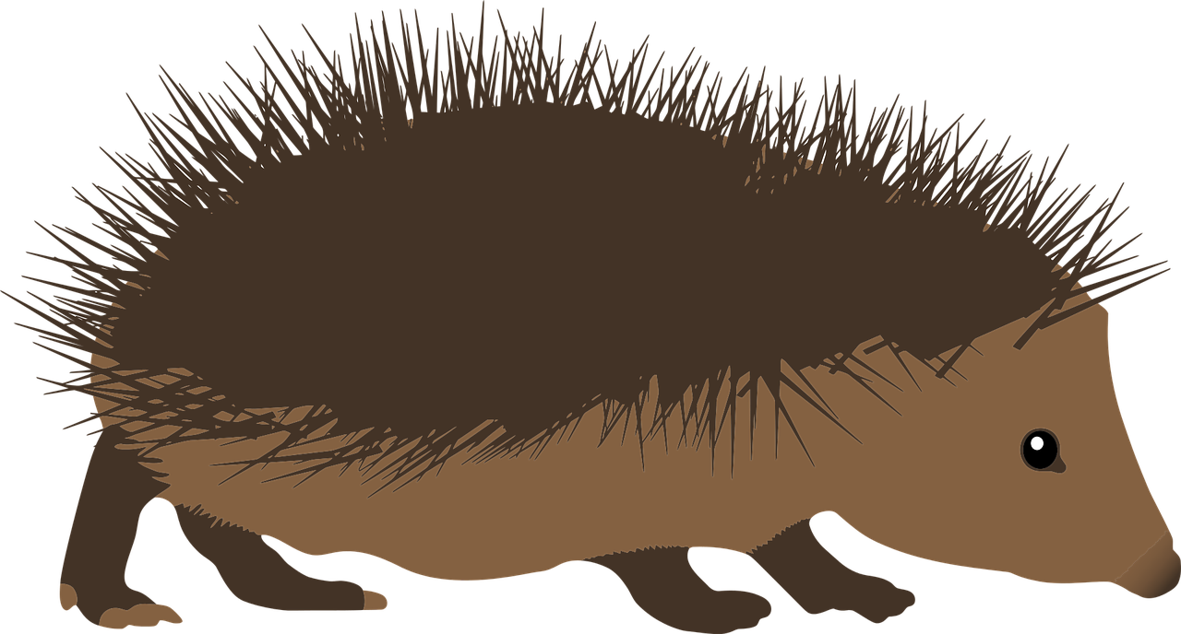
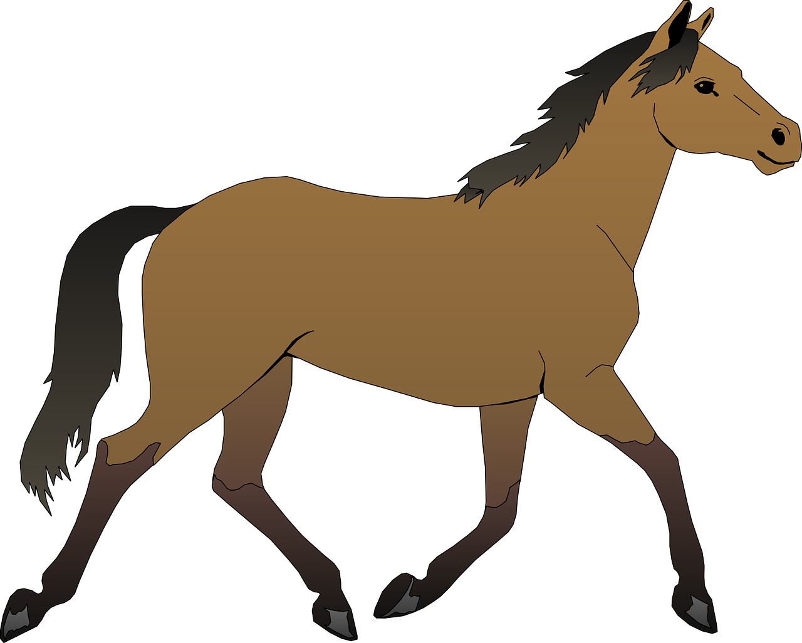
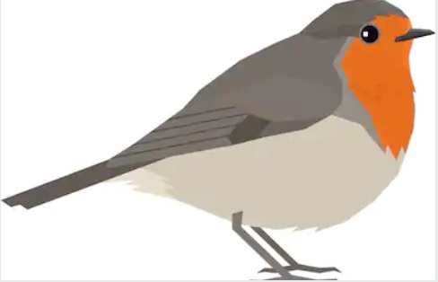
bat
chameleon
squirrel
cat
duck
They eat insects,
moths, and
beetles.
They eat berries,
Insects, leaves and
spiders
They eat fruit, plants,
nuts, acorns, fungi
and pine cones.
They eat small
mammals, birds and
bugs.
They eat nuts, plants, small fish and insects.
dog
pig
hedgehog
horse
robin
They eat meat.
They eat roots, grass,
fruit, leaves and
flowers.
They eat insects, slugs,
worms, snails beetles
and frogs.
They eat leaves, grass
hay and grain.
They eat worms, seeds,
and fruit.

Slide 8
Now your turn…
In pairs, choose an animal.
Draw the animal and what it eats.
Is the animal an omnivore, herbivore or carnivore?

