Slide 1
How do magnets work?
Investigating everyday products to see if they are magnetic

Slide 2
Magnetic materials
Magnets are made from materials such as iron and nickel.
They can stick to some materials, but not others.
You are going it test different products to see if they are magnetic!

Slide 3
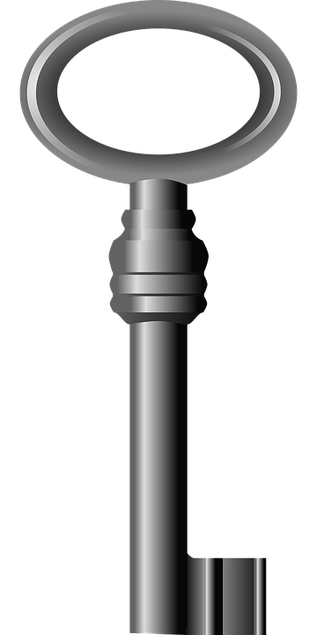
Which products are magnetic?
For each of the products given to you:
Write down the name of the product and the material that you think it is made from.
Write down whether you think the product will be attracted to the magnet and why.
Place your magnet near the product.
Write down whether or not the product is attracted to the magnet and why you think this happened.
Notes:
Learners could be given all the products at once to test, or the teacher may wish to lead through one product at a time, recapping the key tasks and questions for them to consider as they go through.

Slide 4
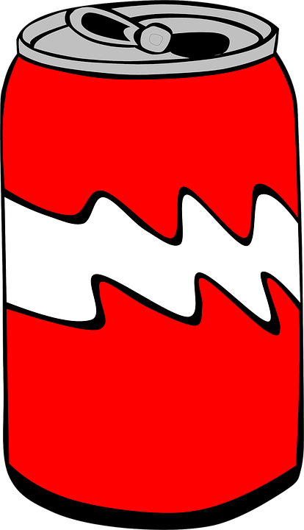
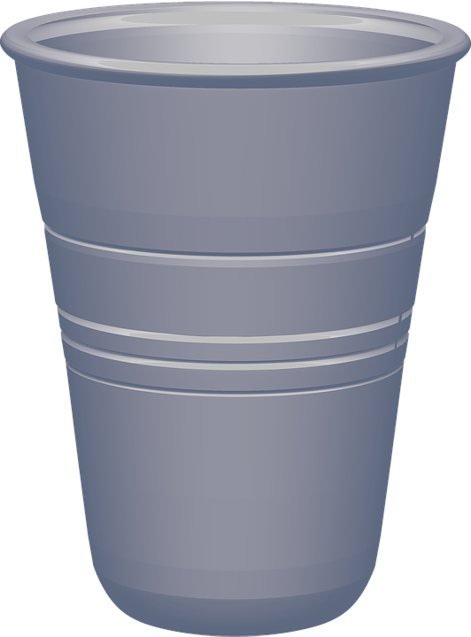
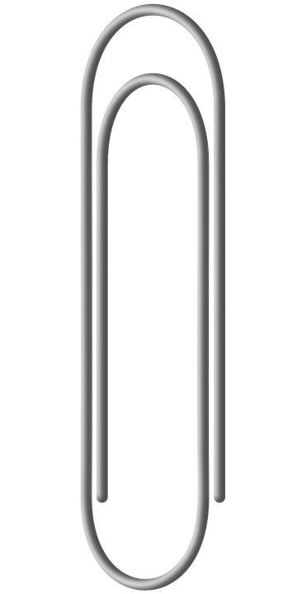
Products to test
2p coin
Door key
Drinks can
Drinks cup
Toy car
Paper clip
Notes:
Materials that the products should be made from and expected results:
Drinks cup – plastic – not magnetic
2p coin – copper plated steel – magnetic as it has iron within the steel core (Note: if a pre-1992 2p coin is used then this will not be magnetic as these were made from copper plated bronze)
Door key – steel – magnetic as steel contains iron (keys made solely from brass are not magnetic)
Drinks can – aluminium – not magnetic (Note: some drinks cans are made from tinplate, which is tin-plated steel, and is magnetic as it contains iron – aluminium cans are typically marked as being aluminium)
Paper clip – steel – magnetic as contains iron
Toy car – wood – not magnetic

Slide 5
What have we learnt?
What do we mean when we say that a material is magnetic?
Which materials are magnetic?
Which materials are not magnetic?
Why are some materials magnetic, but not others?
What uses could magnetic materials have in products?
Notes:
Discuss these key questions with learners to assess what they have learnt during the activity.

