Slide 1
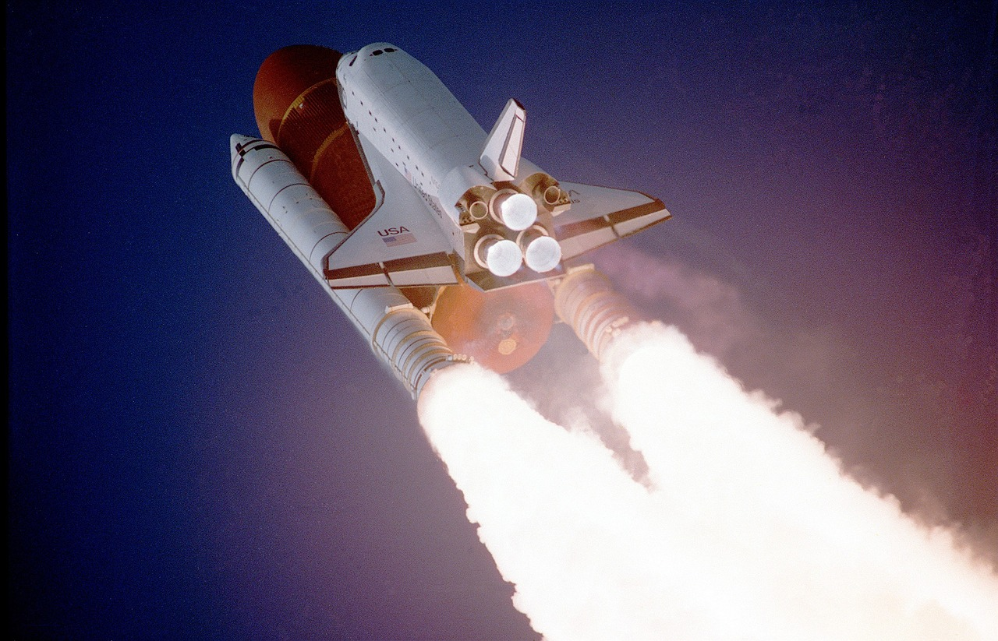
Design an astronauts’ menu
Selecting and comparing foods for a spaceflight to the moon

Slide 2
Stay safe
Whether you are a scientist researching a new medicine or an engineer solving climate change, safety always comes first. An adult must always be around and supervising when doing this activity. You are responsible for:
ensuring that any equipment used for this activity is in good working condition
behaving sensibly and following any safety instructions so as not to hurt or injure yourself or others
Please note that in the absence of any negligence or other breach of duty by us, this activity is carried out at your own risk. It is important to take extra care at the stages marked with this symbol: ⚠

Slide 3
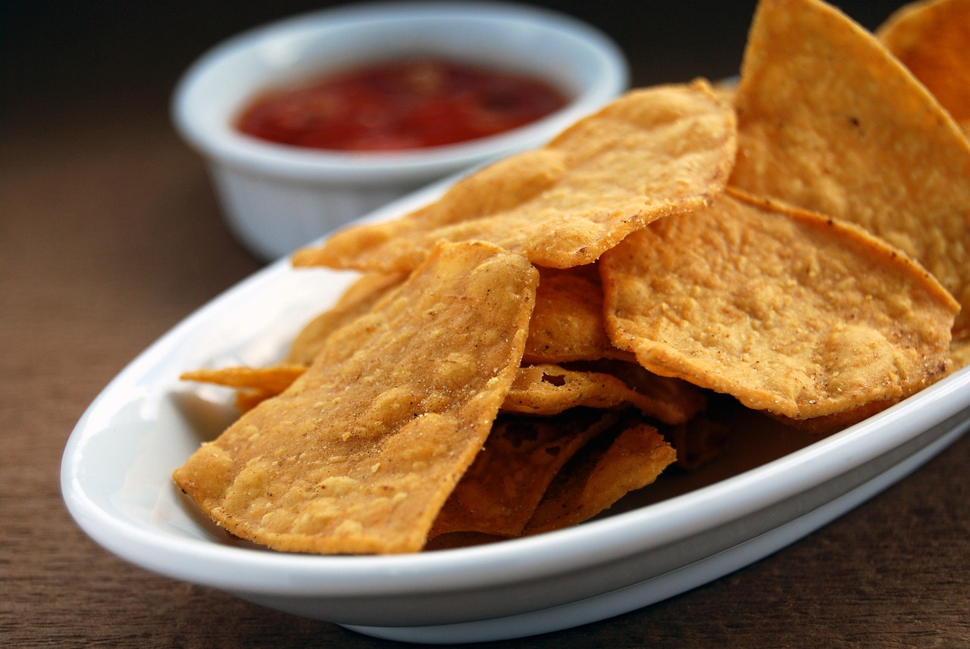
Starter
Watch the video https://www.youtube.com/watch?v=AZx0RIV0wss
Why do astronauts eat tortillas instead of bread?
Notes:
One of the favorite foods of the astronauts is the tortilla.
They are nutritious.
Tortillas contain large amounts of carbohydrates.
They are easily stored since they lay flat and they don’t take up too much room.
They are the perfect space foods because they do not produce crumbs.
Crumbly or loose foods can float and damage equipment.

Slide 4
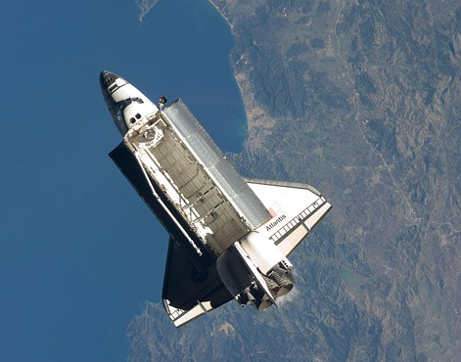
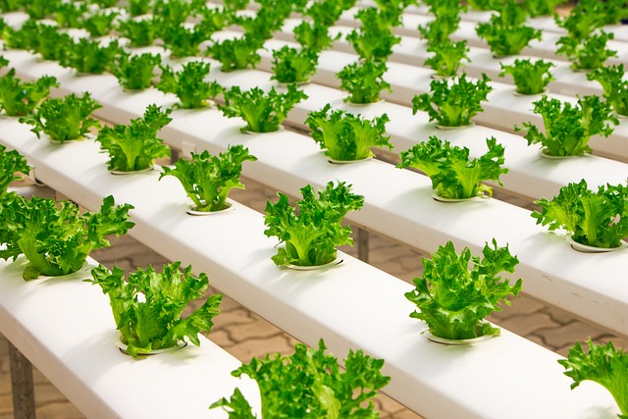
Space food
What types of food are good for long space flights?
Taste and nutrition are both important
Explorers need enough to eat, and ways to package and store the food
Growing food might be possible during space travel, as well as on the moon

Slide 5
Design brief
Design a menu that is suitable for astronauts to take into and eat in space
As part of this you will need to experiment with and try different types of food
Your food must be:
Tasty and nutritious
A good source of energy
Easy to store and carry during a spaceflight
Long lasting so as not to spoil
Notes:
Additional questions to support discussion:
How do astronauts eat in space?
Is eating in space the same as eating on Earth?
How do the astronauts make sandwiches?
How do the astronauts drink?
What if astronauts want ketchup on their food?
Can you eat chips in space?
What do food packages on Earth look like?

Slide 6
Design criteria spider chart
Easy to package
Portion control
Stores well for long periods of time without spoiling
Spaceflight
Tastes good
Does not produce crumbs
Travels well and fits into storage areas
Simple to prepare for eating
Notes:
Learners could produce a spider chart such as this to list the possible design criteria for the food, or add their own criteria.

Slide 7
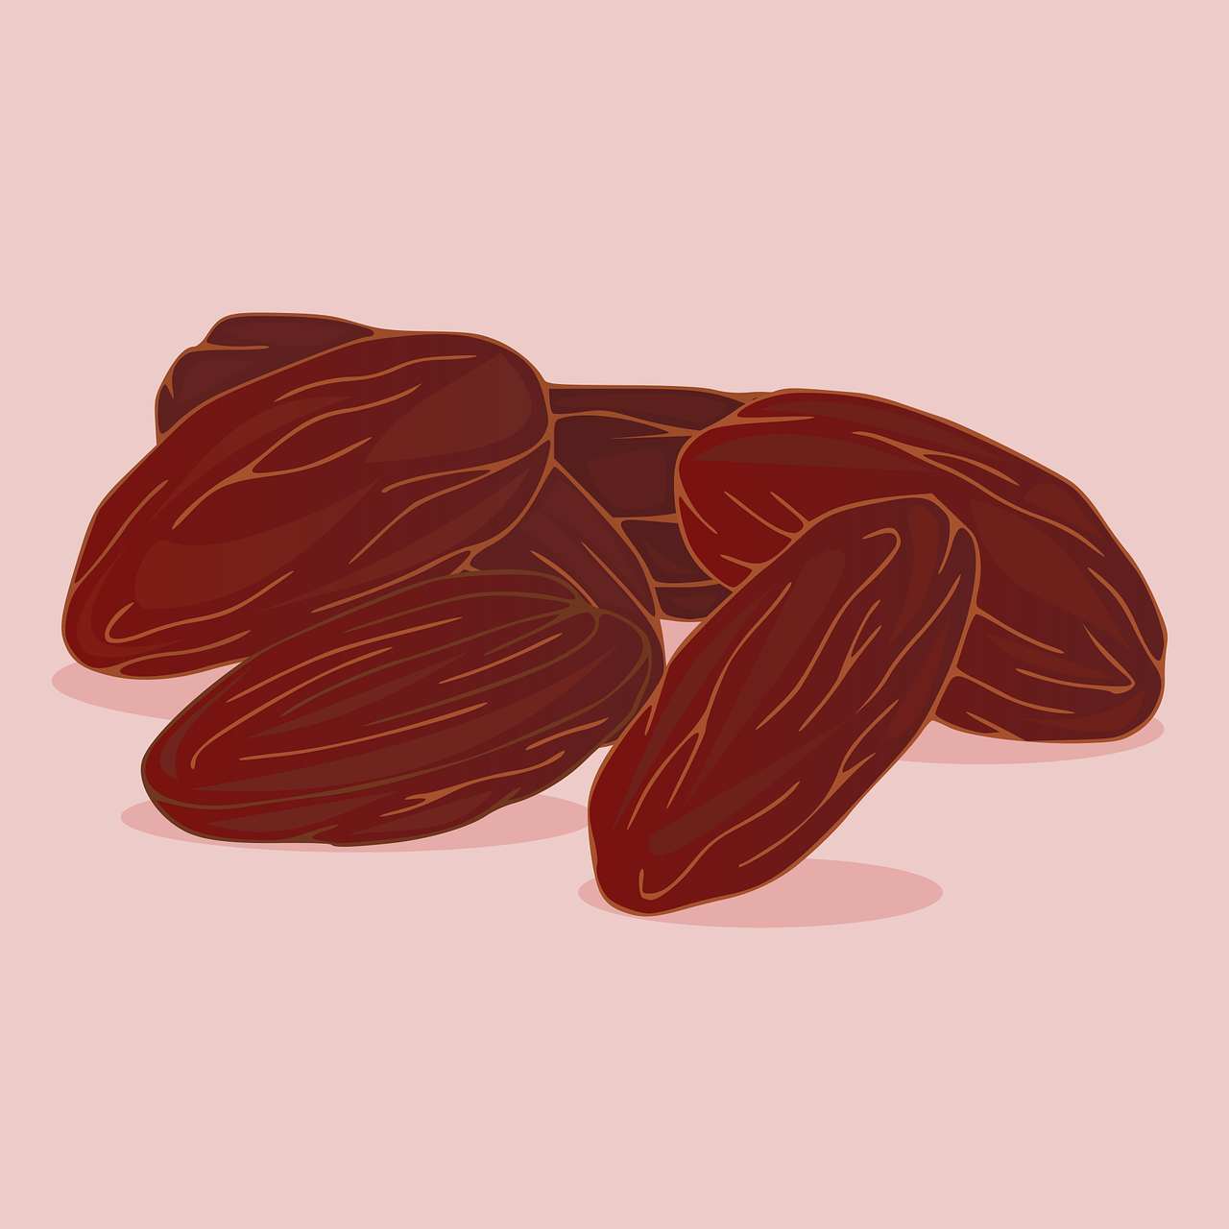
Step 1
Mind map the kinds of foods that the astronauts could take into space
The foods must meet the needs of the design brief
For example, freeze dried foods would be long lasting

Slide 8
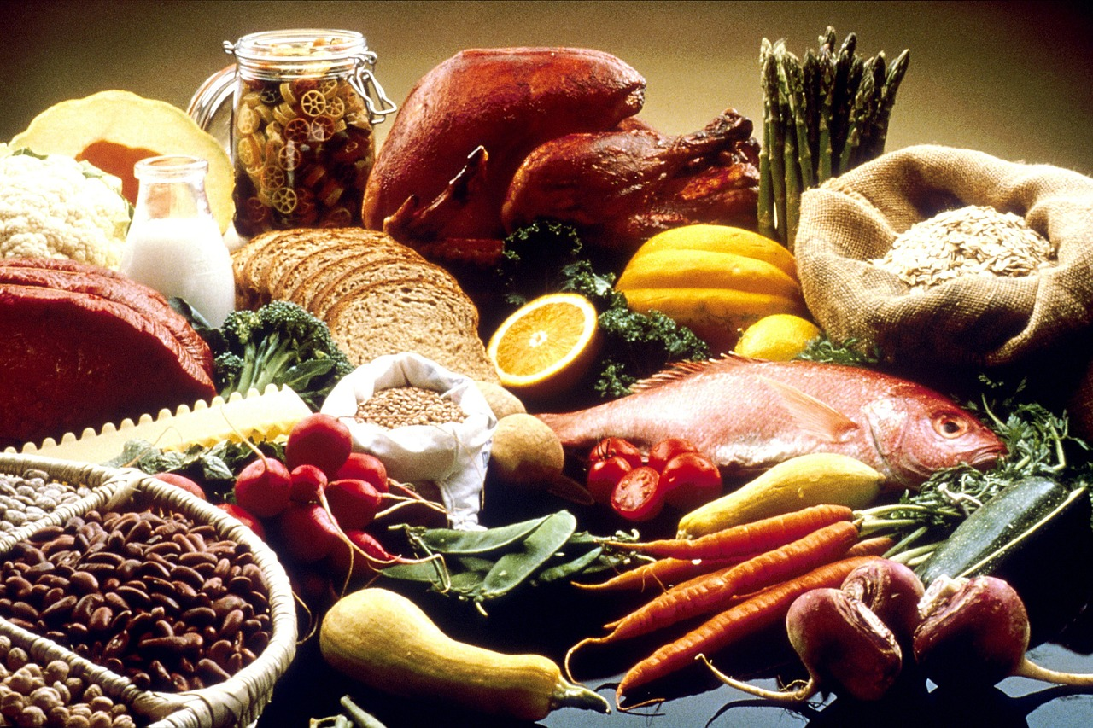
Step 2
Get into small groups
Place your foods on a table for discussion
Discuss with your group why you brought the foods you did
Notes:
Prior to this step, the teacher will have needed to ask learners to bring in portioned foods from home that could be suitable for use in space.
Alternatively, the teacher could provide some relevant examples.
Teacher could set groups (3-4 maximum) or learners could select their own depending on the class.

Slide 9
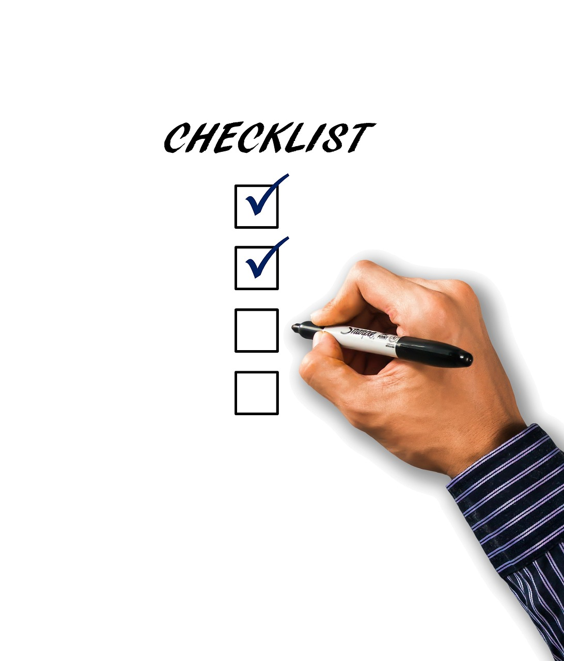
Step 3
As a group, list different ways in which your food items suitable for spaceflight
Record this on the worksheet
Take it in turns to share thoughts

Slide 10
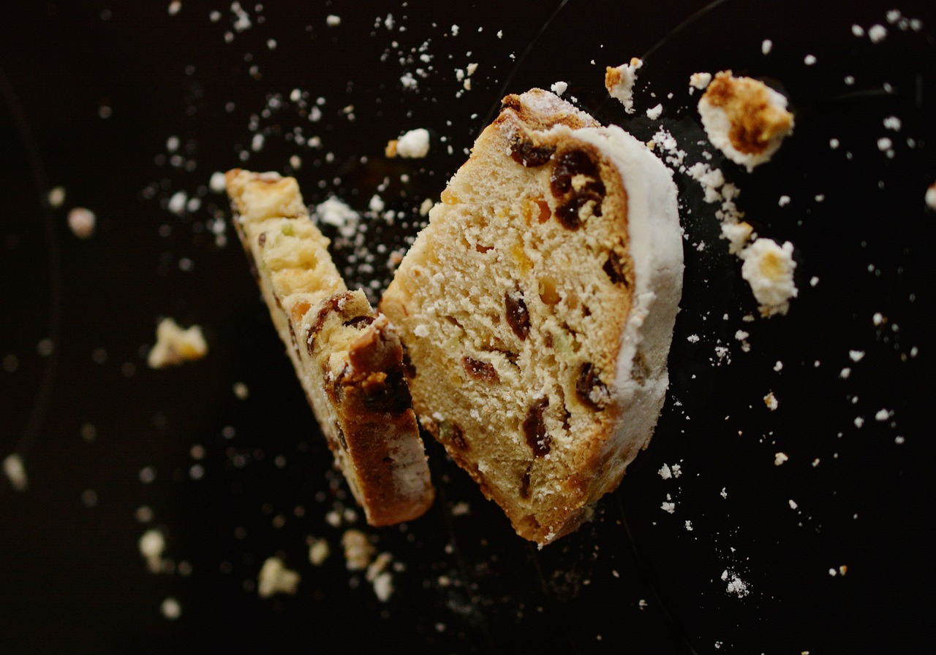
Step 4
What tests could be used to check if the food can be taken into space?
Write down ideas for these tests on your worksheet
For example:
Tasting the food
Handling the food to test for crumbs
Wafting the food to test for good smells
Bite test to produce crumbs
Notes:
This step could be skipped for weaker learners, with the teacher giving the tests that could be used in line with the examples shown.

Slide 11
Step 5
Test each item of food using the tests you wrote down
Which food items are suitable for use in space? Which are not? Why?
Record your results on your worksheet
Notes:
This

Slide 12
Step 6
Breakfast
Use the results of your tests to design your menu for astronauts going to the moon
Lunch
Dinner

Slide 13
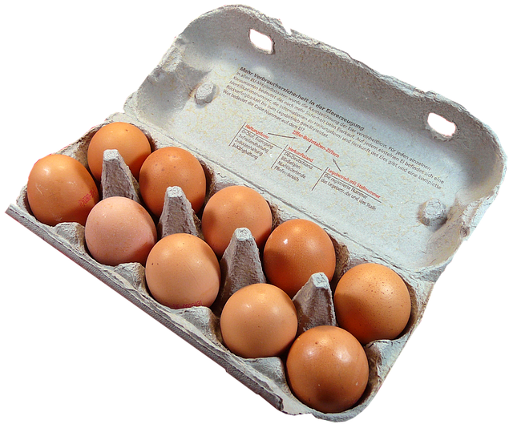
Extension
Design packaging for each of the food items in your menu
Discuss ways of storing the packaged food on a spacecraft, so it is kept safe on the way to the moon

