Slide 1
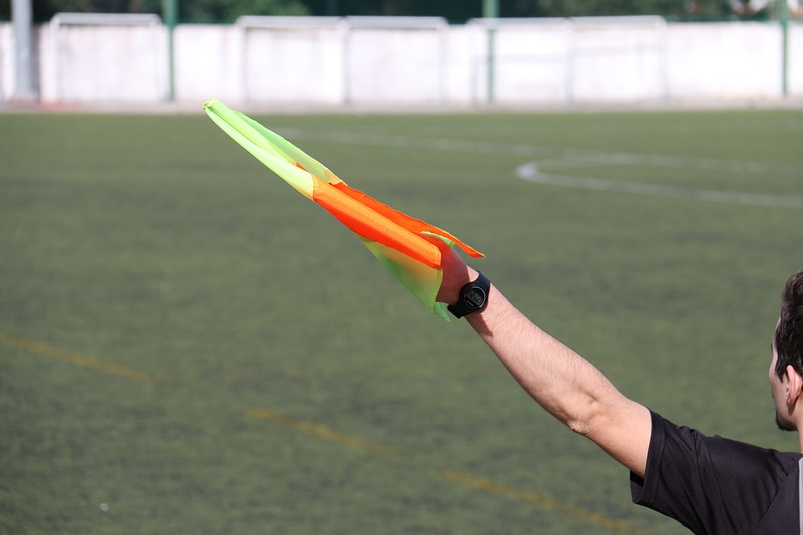
Design a football robot referee
Designing a robot that can perform the duties of an assistant referee during a football game on the moon

Slide 2
Stay safe
Whether you are a scientist researching a new medicine or an engineer solving climate change, safety always comes first. An adult must always be around and supervising when doing this activity. You are responsible for:
ensuring that any equipment used for this activity is in good working condition
behaving sensibly and following any safety instructions so as not to hurt or injure yourself or others
Please note that in the absence of any negligence or other breach of duty by us, this activity is carried out at your own risk. It is important to take extra care at the stages marked with this symbol: ⚠

Slide 3
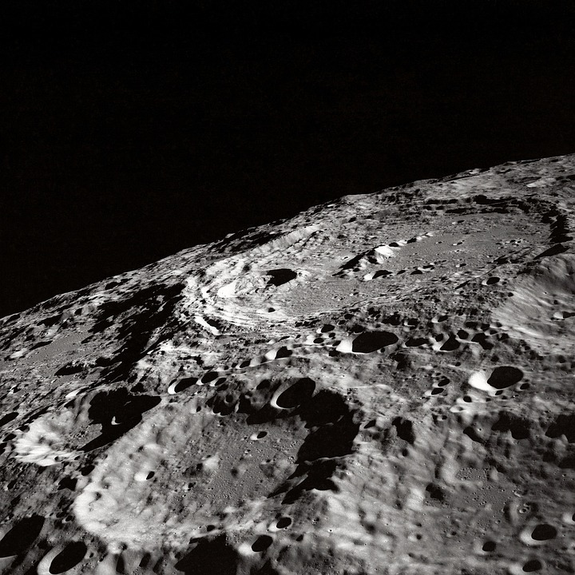
Football on the moon
Playing football on the moon would be very different to here on Earth!
How would you be able to breath?
How would you cope with much lower gravity?
What surface would you play on? (there is no grass!)
How would you mark out a pitch to play on?
Notes:
This slide could be used to introduce the theme of football on the moon.

Slide 4
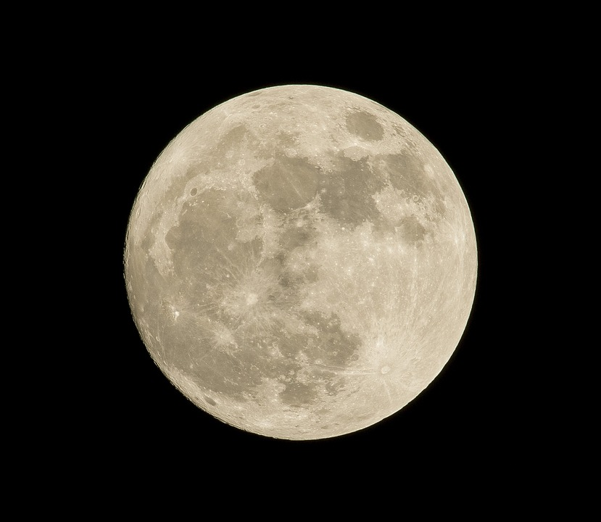
Starter
Think about playing football on the Moon
What problems would the people involved have? E.g.:
The players
The referee
The spectators
Notes:
Learners could present this as a list or a spider chart.
Learners could consider problems such as the reduced gravity, how to breathe, how to avoid injury on the rough terrain etc.

Slide 5
Design brief
Situation
The Lunar League manages football games on the moon
As part of this assistant referees are needed to indicate when the ball has gone out of play and to retrieve it
The Lunar League want this task to be completed by a robot
Brief
Design a robot that can act as an assistant referee in a game of football on the moon
Notes:
Explain the brief and discuss with learners.
Discuss the roles, responsibilities and duties of an assistant referee.
This website gives the duties of an assistant referee: https://www.thefa.com/football-rules-governance/lawsandrules/laws/football-11-11/law-6---the-other-match-officials#:~:text=1.-,Assistant%20referees,a%20substitution%20is%20requested

Slide 6
Design criteria
The robot must be:
Able to indicate when the ball has gone out of play
Able to retrieve the ball from outside the field of play and return it to the players
Powered sustainably
Carry logos and advertising to raise money for the Lunar League
Notes:
Explain the design criteria and discuss with learners. How will they meet each of these?

Slide 7
Robot assistant referee design
Use this space to sketch your idea.
Don’t forget to annotate your design to show how it meets the design criteria!
Notes:
Learners could use this sheet to present their design idea and annotations or use blank paper.

Slide 8
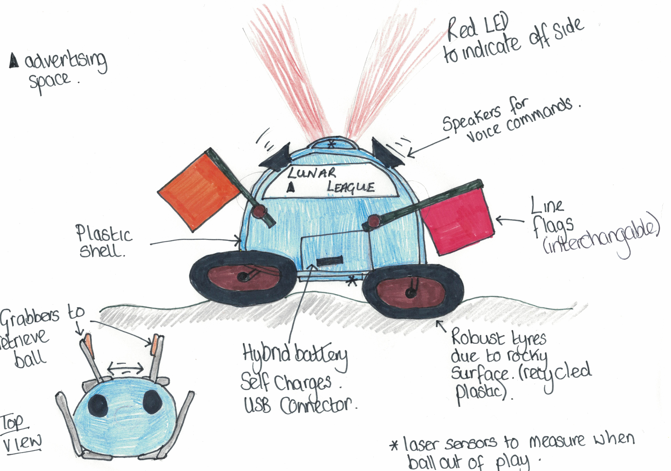
Example sketch
Notes:
An example sketch of a robot assistant referee for the moon. This could be used to aid learners when coming up with their own deas.

Slide 9
Extension
Design a logo for the Lunar League that could be shown on the side of the robot assistant referee
Produce a model and prototype of your design idea, using electronics to make it functional
Design a robot referee for the games of football to be played on the moon

