Slide 1
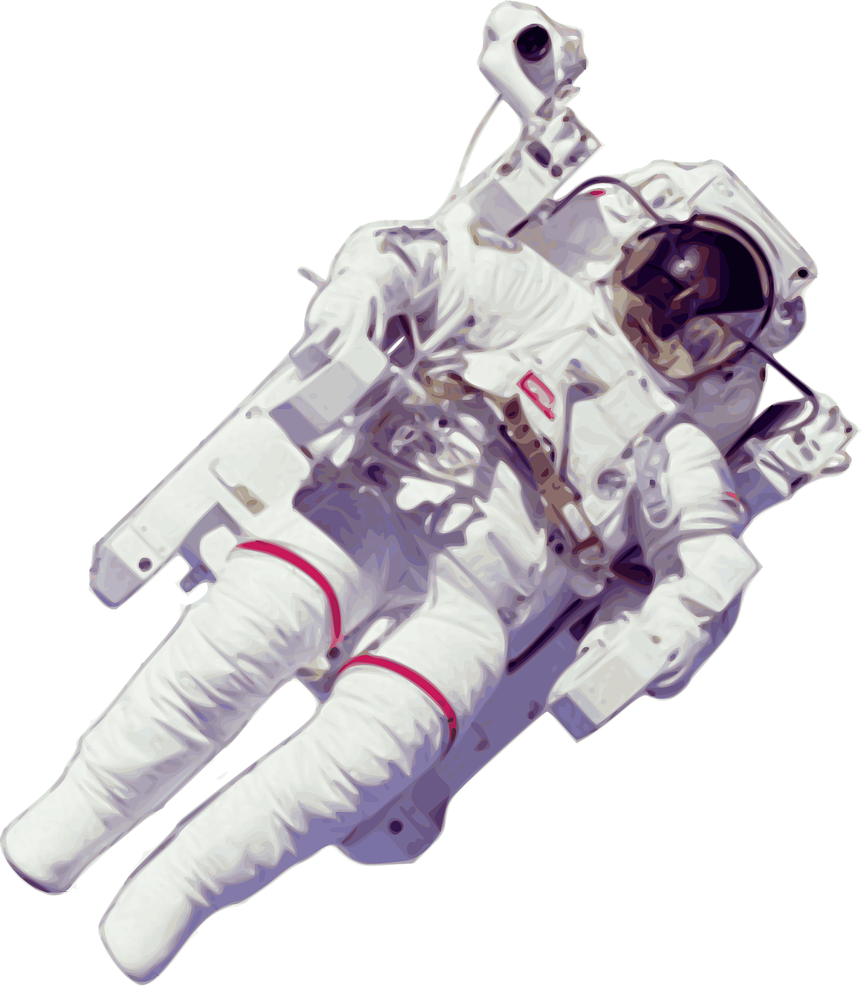
Design a jetpack for playing football on the moon
Consider how a jetpack works and sketch an idea for a wearable jetpack

Slide 2
Stay safe
Whether you are a scientist researching a new medicine or an engineer solving climate change, safety always comes first. An adult must always be around and supervising when doing this activity. You are responsible for:
ensuring that any equipment used for this activity is in good working condition
behaving sensibly and following any safety instructions so as not to hurt or injure yourself or others
Please note that in the absence of any negligence or other breach of duty by us, this activity is carried out at your own risk. It is important to take extra care at the stages marked with this symbol: ⚠

Slide 3
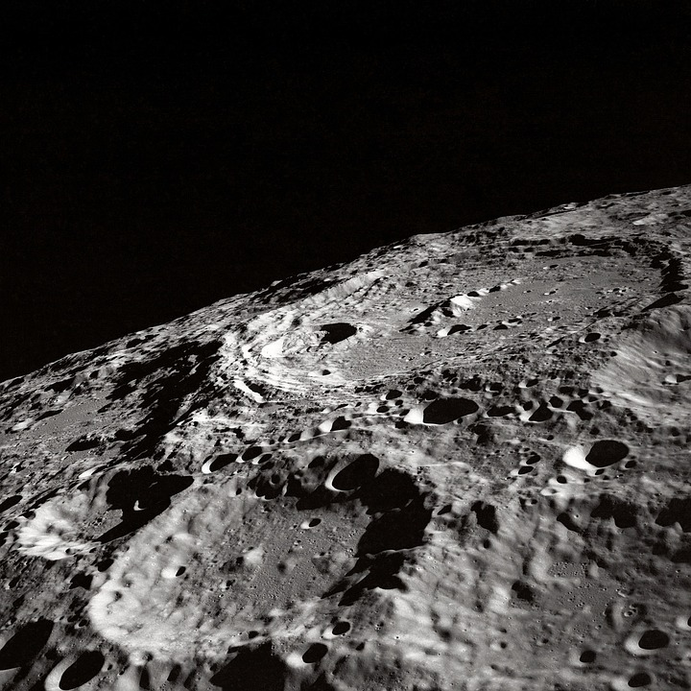
Football on the moon
The moon is covered in craters, dust and space debris - it is very rocky surface
There is no atmosphere on the moon - there is no air to breath
There is no water on the moon or different weather conditions
Notes:
This slide could be used to introduce the theme of football on the moon.
More information about he Moon can be found here: https://solarsystem.nasa.gov/moons/earths-moon/overview/

Slide 4
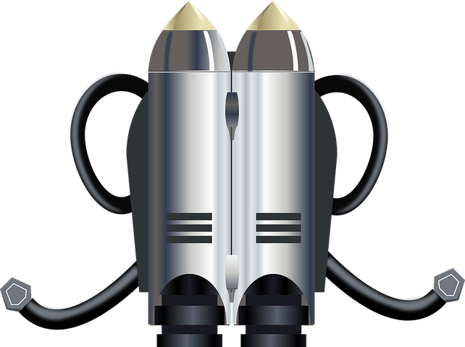
Starter - what parts make up a jetpack?
Notes:
Discuss with learners what parts are needed to for a jetpack to work.
This slide could also be printed and labelled by learners.

Slide 5
Starter - what parts make up a jetpack?
Straps to secure pack to the user
Fuel tanks (often 2 so the pack is balanced)
Speed controls
Spin control
Rockets for thrust
Controls for manoeuvrability
Notes:
Discuss with pupils what parts are needed to for a jetpack to work.
Ask learners when do they think the first jetpacks were invented and by whom? Answer: 1919 then in the 1940s - developed by the US army

Slide 6
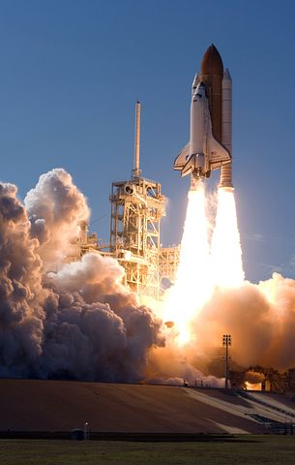
How does a Jetpack work?
A jetpack, or rocket pack, works by thrusting the user into the air
Thrust is to push or drive with force
An example is a rocket ship - the engines push downwards in one direction causing the rocket to take off in the opposite direction - so upwards
Thrust can be created with gas or liquid
Notes:
An example of jetpack: https://www.bbc.co.uk/news/uk-england-54331994

Slide 7
Have they been used in space before?
Jetpacks have been used in space successfully when astronauts have had to carry out work outside of a space shuttle or space station
They work well due to lack of gravity and weightlessness in space
A jet suit is often used - this is where a suit includes the jetpack and jets in the arms to help the user move about
Notes:
Extra information that could be shared with higher ability learners.

Slide 8
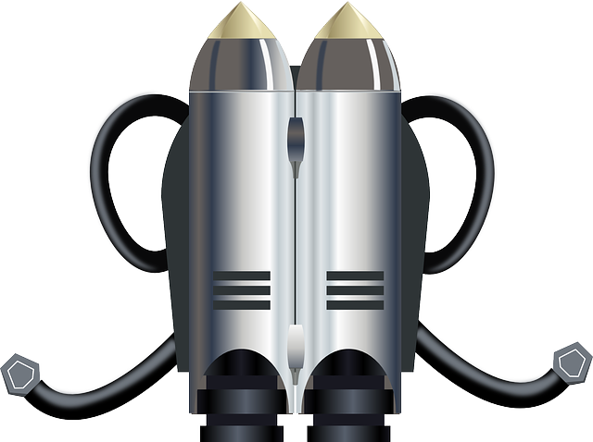
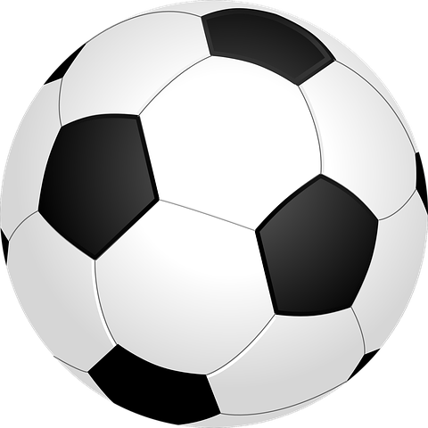
Design brief
Design a jetpack that can be worn by the referee and footballers so they can play football on the moon
It must be:
Lightweight
Compact
Wearable
Safe
Designed to allow movement
Notes:
Explain the brief and discuss with learners.
Footballers – think about how they move.
Discuss how the jet pack must fit, the weight of the pack, how it can be wearable, materials it could be made from. Could a logo or team be added, could it be personalised?

Slide 9
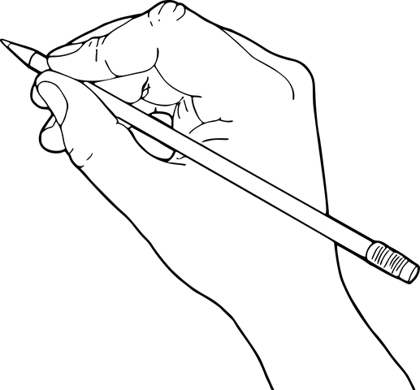
Designing the jetpack
Sketch your ideas on paper for a jetpack that meets the requirements of the brief
Use the templates to help you
Add your favourite team colours, player or logo
Notes:
Learners could design a jetpack for either the players or the referee, or both.

Slide 10
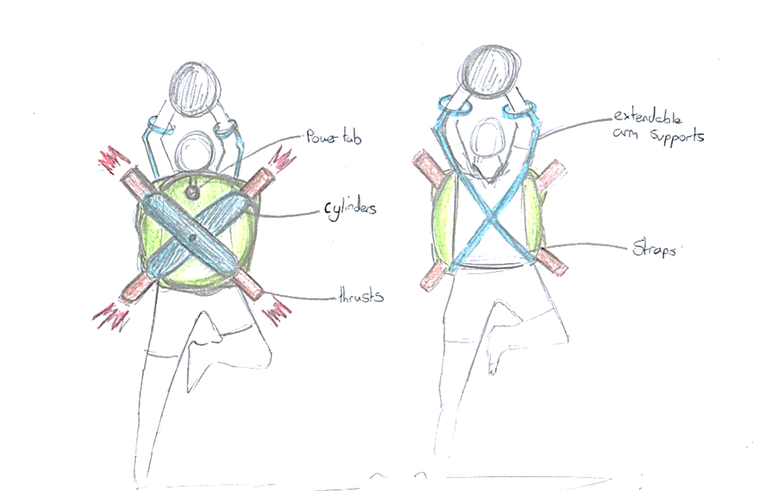
Example sketch
Notes:
An example sketch. This could be used to aid learners when coming up with their own ideas.

Slide 11
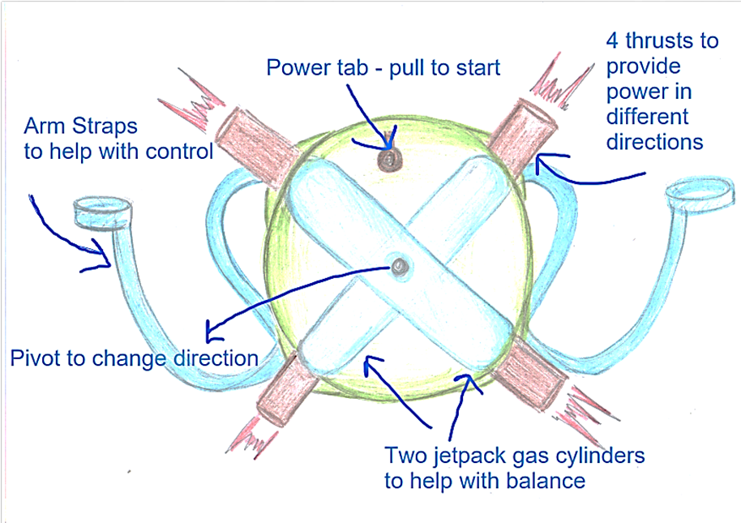
Example sketch
Notes:
An example sketch. This could be used to aid learners when coming up with their own ideas.

Slide 12
Extension
Make a life size model of your jetpack - you will need:
Scissors, craft knives and safety rules
Materials such as paper, card, plastics (use your design sheets to help you)
Blue tack, masking tape, hot glue gun
Tools - hacksaws, files, cutting mats, rulers, workshop equipment
Notes:
If you have access to workshops think about how the designs could be manufactured using different materials.

