Slide 1
Sketch your own football pitch
Designing a football arena for the Moon

Slide 2
Stay safe
Whether you are a scientist researching a new medicine or an engineer solving climate change, safety always comes first. An adult must always be around and supervising when doing this activity. You are responsible for:
ensuring that any equipment used for this activity is in good working condition
behaving sensibly and following any safety instructions so as not to hurt or injure yourself or others
Please note that in the absence of any negligence or other breach of duty by us, this activity is carried out at your own risk. It is important to take extra care at the stages marked with this symbol: ⚠

Slide 3
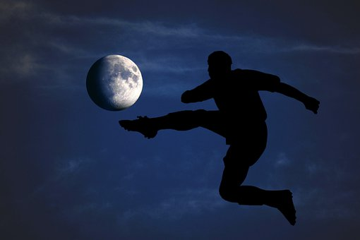
Design brief
Your task is to design a new stadium for playing football on the moon
It should allow regular football to be played wearing standard kit
The games are to be played in standard atmosphere
It should be different and original
Notes:
Discuss the brief with learners. How will they meet the requirements?

Slide 4
You will need
Design a pitch worksheet
Coloured pencils
Drawing pencils
Computer for research

Slide 5
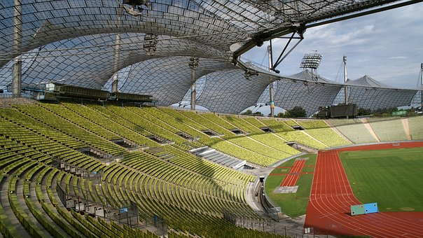
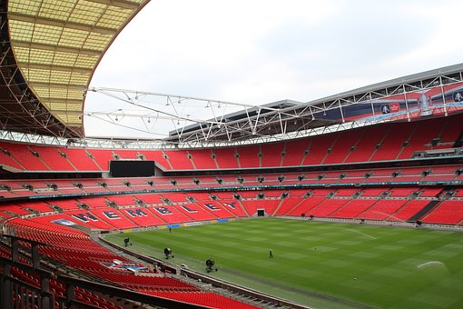
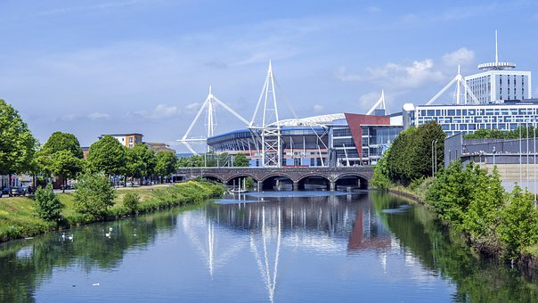
Research
Olympic Stadium, Munich
Wembley Stadium, London
Principality Stadium, Cardiff
Camp Nou, Barcelona
Notes:
Show examples of existing football stadia. What are there good and bad points? How could they be adapted for football on the moon?
Learners could research other examples using the internet if available.

Slide 6
Things to think about
How will you make the stadium look visually appealing, both inside and outside?
How will the games be different to regular football played on Earth?
How could the players use the roof as part of the game?
How will the layout of the pitch differ to regular football?
Notes:
Discuss the factors that could affect the design of the football stadium and the environment it is to be used in.

Slide 7
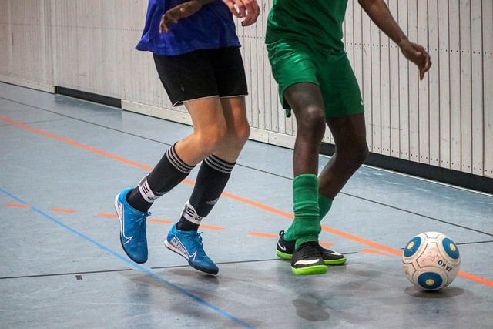
Other considerations
Scoring by bouncing off the roof:
Add to your design sheet how players can score a goal/point by using the roof and walls
Notes:
Discuss additional considerations with playing football ‘indoor’ and how this would affect the design of different aspects of the stadium.

Slide 8
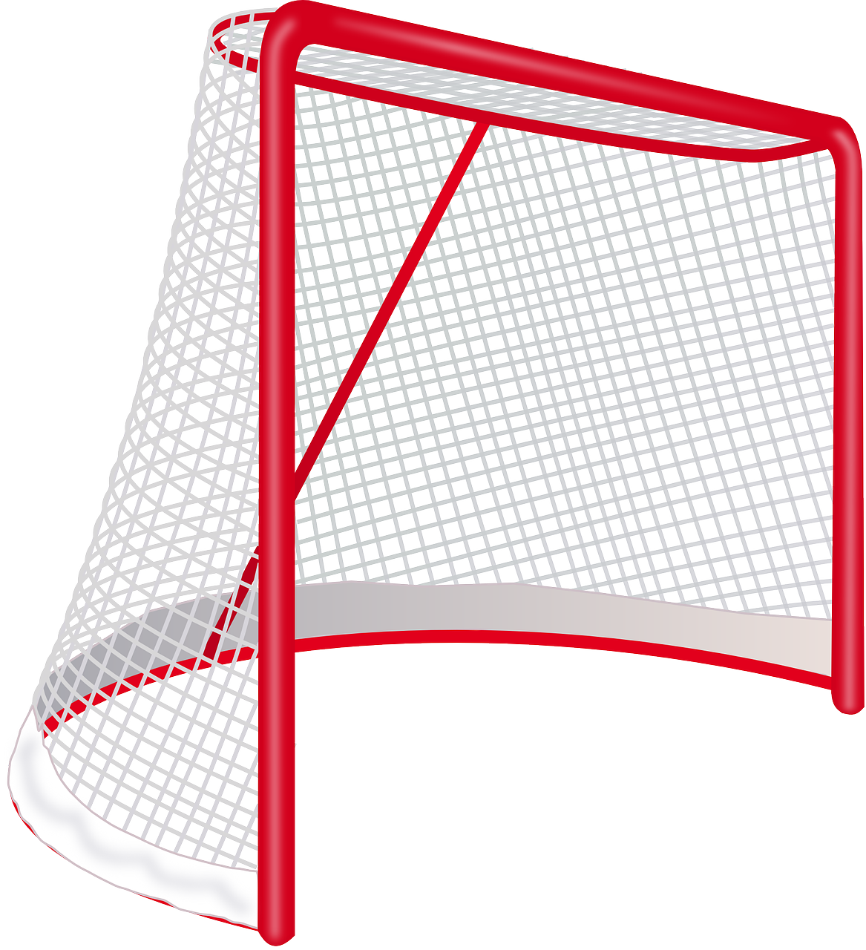
Other considerations
Design of goals:
Do you need to change the shape and size of the goals if players can use the walls?
Could it be like Rugby/Gaelic/Australian Rules Football instead?
Notes:
Discuss additional considerations with playing football ‘indoor’ and how this would affect the design of different aspects of the stadium.

Slide 9
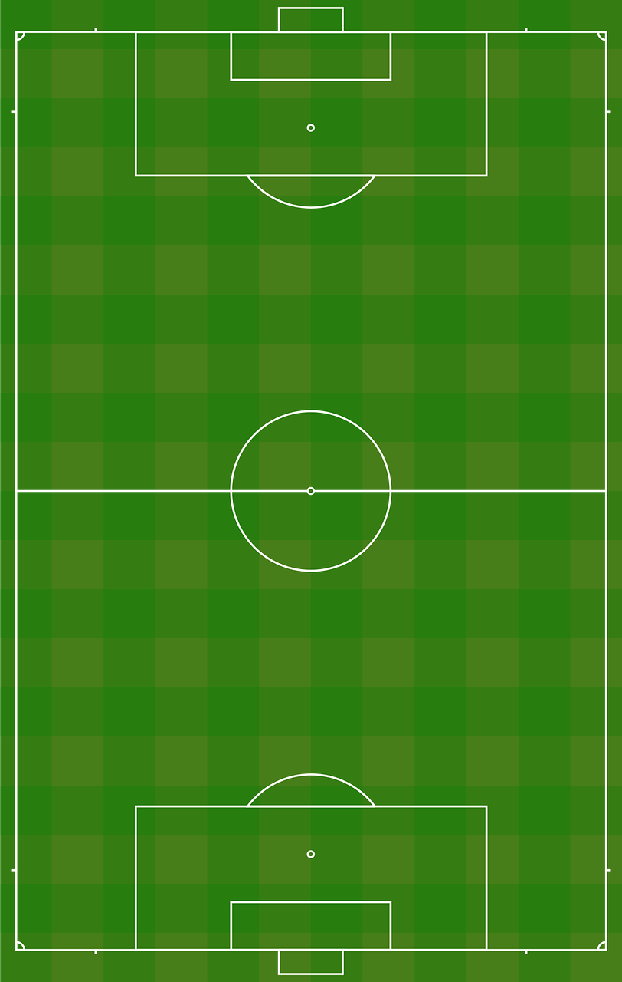
Other considerations
Size of pitch:
Should the pitch be the same size as regular football?
Could you change it seeing as the ball will never go out of play?
Players would need a break!
Notes:
Discuss additional considerations with playing football ‘indoor’ and how this would affect the design of different aspects of the stadium.

Slide 10
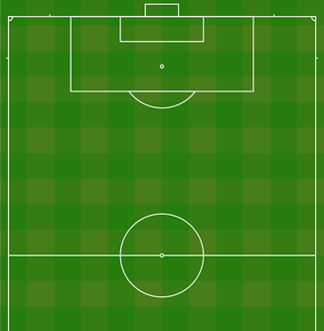
Other considerations
“D”
Lines on pitch:
If the pitch is smaller, does the layout of the lines need to change?
Why is there a centre circle/”D” in front of the goals?
Centre Circle
Notes:
Discuss additional considerations with playing football ‘indoor’ and how this would affect the design of different aspects of the stadium.

Slide 11
Your task
Complete each section of the worksheet to produce your design ideas
Be creative!

Slide 12
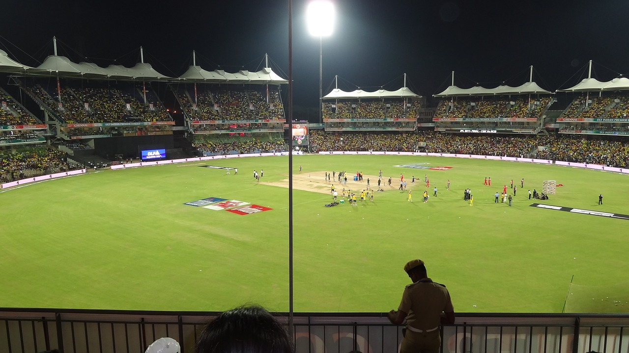
Extension
Make a card scale model of your stadium
Design a stadium for playing other sports on the moon, such as athletics, rugby, cricket or netball
How would the requirements of these differ from football?

