Slide 1
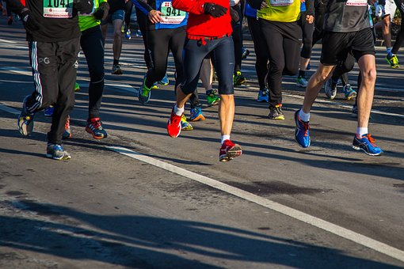
Marathon charity costume
Designing a charity costume to wear on the day

Slide 2
A marathon
What is it?
When is it?
What do you wear when taking part?
Is it FUN?
Notes:
Possibility for cross-curriculum links: Science, Geography, Food Technology and Textiles.

Slide 3
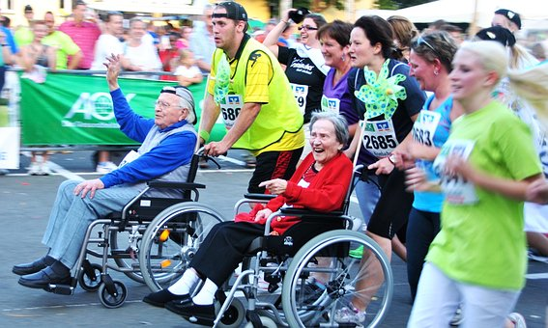
Marathons
26.2 mile road race
Different places around the country all year round
You can run in normal clothing, but many wear fancy dress!
It’s as fun as you make it!
Notes:
The London Marathon is an annual marathon held in London and is the 2nd largest annual road race in the UK, after the Great North Run in Newcastle.
Typically held in April but moved to October for 2020 and 2021 due to Covid.

Slide 4
Design brief
Your task is to design a charity costume to wear when running a marathon
It must help to advertise the charity
It must look fun and interesting
It must include technologies to keep the wearer cool
Notes:
To help with gaining ideas and inspiration, learners could create a mood board of people running wearing fancy dress.

Slide 5
Things to consider:
Fabric type
Who will wear it
Colour
How easy it is to run in
Other things to consider:
Recyclable/recycled fabric

Slide 6
Clothing Types
Notes:
What clothing types can you think of?
Why do you need to consider different types?
What about subcategories, for example if choose tops, then go onto t-shirts, vests, shirts etc?
Ask learners to consider which charity they will be designing for.

Slide 7
Tops
Bottoms
Clothing Types
Clothing Types
Fancy dress
Footwear
Headwear
Notes:
This slide could be used as a prompt for a spider chart to consider different ideas.
Ask learners to consider which charity they will be designing for.

Slide 8
Selecting fabrics
“Fabrics are cloth or other material produced by weaving or knitting fibres”
Fabrics are chosen based on factors including:
working properties,
aesthetics (looks),
environmental impact,
function (what they do)
how they are made
It is important to choose a fabric that is fit for purpose
Notes:
Fit for Purpose
“good enough to do the job it was designed to do”.
The following slides can be used to help learners with selecting appropriate fabrics for their design. This would be especially useful for weaker learners or those who have not done much textiles based work in the past.

Slide 9
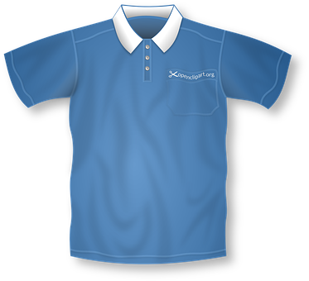
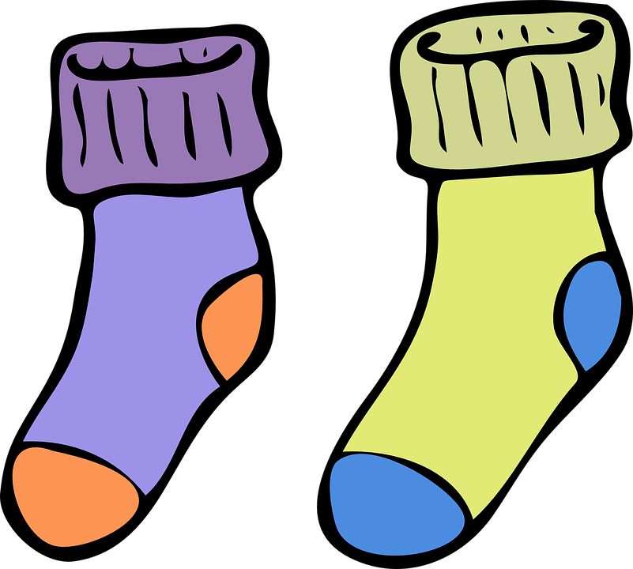
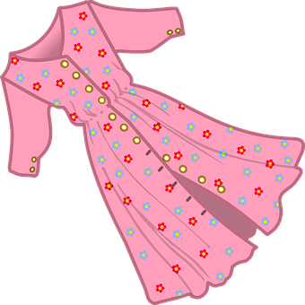
Fabrics: Natural Fibres
From animals, plants or insects
 | Properties | Uses
Cotton | Strong, absorbent, not warm | T-shirts, jeans
Wool | Absorbent, warm, not strong | Socks, jumpers
Silk | Strong, warm, durable | Shirt, dresses
Notes:
The fibres that make a fabric will affect its properties, making them suitable for different uses, e.g. cotton is cool to wear and suitable for a summer T-shirt, whereas wool is warm so would make a warm winter jumper.
Natural fibres come from plants, animals or insects. They are also renewable and biodegradable.
Natural Fibres
Plant fibres - cotton, linen, jute, sisal and more unusual fibres such as bamboo or coconut.
Animal fibres - wool, silk and hair.
Could you make the costume out of any of these? Give reasons why.

Slide 10
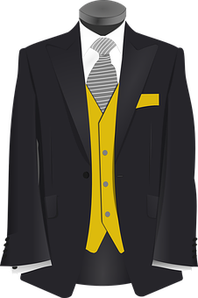
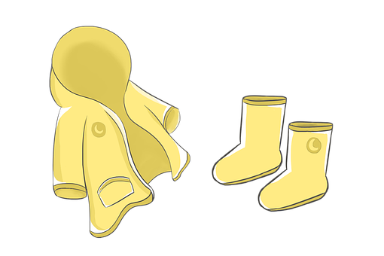
Fabrics: Synthetic Fibres
Made mainly from non-renewable coal and oil
 | Properties | Uses
Polyester | Strong, not very absorbent or warm | Suit jacket and shirts
Acrylic | Very warm, strong, not absorbent | Jumpers, cardigans
Nylon | Strong, durable, not absorbent | Outdoor jackets
Elastane | Strong, not absorbent or warm | Sportswear
Notes:
The fibres that make a fabric will affect its properties, making them suitable for different uses, e.g. cotton is cool to wear and suitable for a summer T-shirt, whereas wool is warm so would make a warm winter jumper.
Synthetic fibres are made mainly from non-renewable coal and oil. The do not degrade easily but they can be made into any length (continuous filament) and thickness and for any purpose.
Synthetic Fibres
Refined fibres (using oil) - polyester, nylon, lyocell and acrylic
Regenerated fibres (remade) - viscose

Slide 11
Smart textiles
There are fabrics which can help keep you cool while you run!
Question: How does a fabric keep you cool?
Notes:
Smart Textiles
Smart textiles provide an added benefit to the user beyond the usual use of the fabric. They respond and adapt to their environment, e.g. taking sweat away from a person’s skin.

Slide 12
Wicking
Fabrics that cool using temperature balance focus on wicking.
Wicking
The fibres in a cloth garment draw sweat away from the skin and up to the surface of the fabric, allowing the moisture to evaporate quickly.
Could your runner have a ‘base layer’ made of wicking fabric and then your costume on top?
Notes:
Useful articles:
https://science.howstuffworks.com/innovation/everyday-innovations/cooling-fabrics.htm
https://medium.com/running-for-your-life/your-clothes-matter-the-best-fabrics-for-a-good-run-7feabffd244c
https://www.dailymail.co.uk/sciencetech/article-2364040
www.greatrun.org/training/keeping-cool-in-fancy-dress/

Slide 13
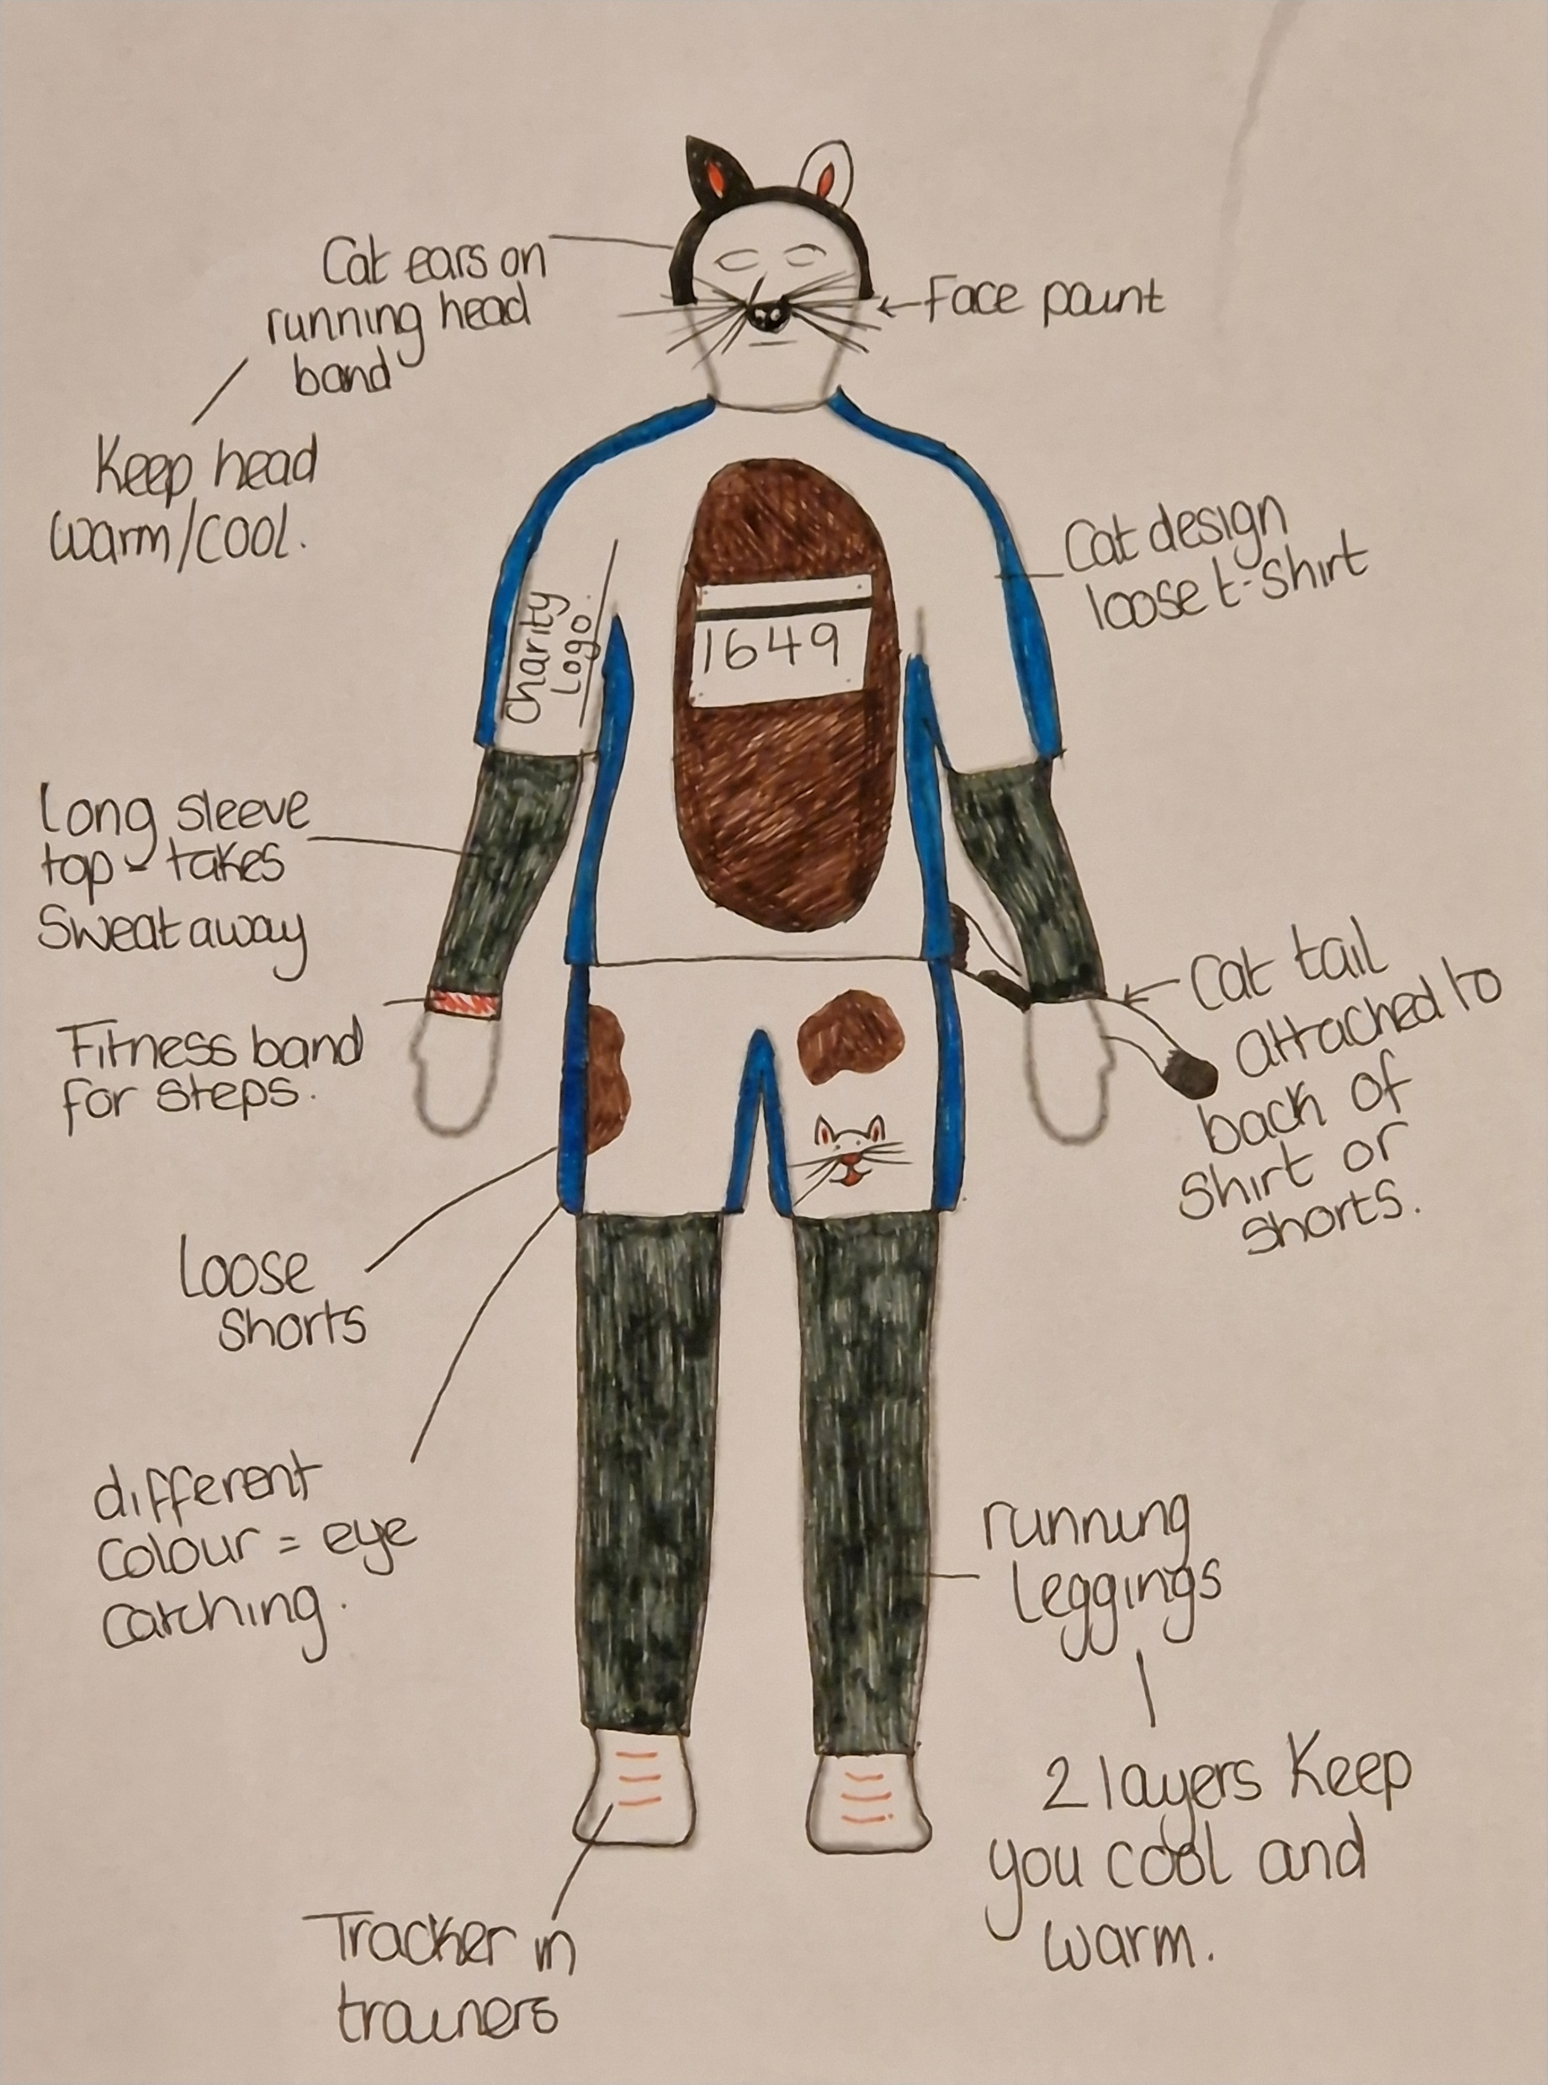
Example design 1
Notes:
‘Cat’ – middle ability example e.g. for RSPCA
Base layer of wicking/running material designed.
Looser top layer for the costume; helps the runner keep cooler.
Fitness watch to track their steps.
Headband made of running material so it keeps sweat off the head and makes it more comfortable for the runner.
Basic costume that is light and easier to run in.

Slide 14
Example design 2
Notes:
‘Banana’ – higher ability example e.g. supporting Fair Trade
Personalised base layer with wicking material and extra ventilation from larger holed material on the outside of the legs.
Larger elastic waistband creates comfort so the leggings don’t fold over or move while running.
GPS tracker in the sole of the shoe to help with timings, steps and recording heart data.
Costume made of neoprene as it is light, breathable and flexible for when the runner is moving.
Arm holes curved into the runners body so that arms are free to move; same with the costume finishing above their knees.
Additional ventilation holes around the head of the costume so help keep the runner cool.

Slide 15
Example design 3
Notes:
‘Pirate’ – lower ability example
Pirate hat – maybe held on with elastic for fit and doesn’t fall off when running.
Eye patch – real or painted on
White long sleeve t-shirt – could ‘rag’ the arms so its looks ‘shipwrecked’.
Striped trousers and black belt – belt could be made out of fabric so lighter when running.

Slide 16
Extension
Design a range of accessories to compliment your fancy dress outfit
Create a social media advertisement for a Marathon

Slide 17
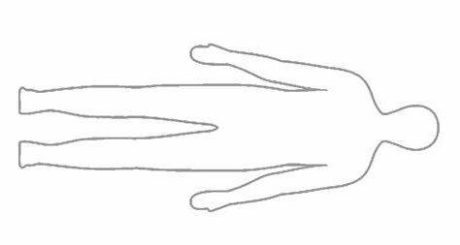
Notes:
These are templates that could be printed and cut out to used for the designs.

Slide 18
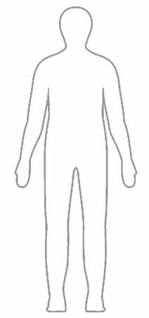
Notes:
These are templates that could be printed and cut out to used for the designs.

