Slide 1
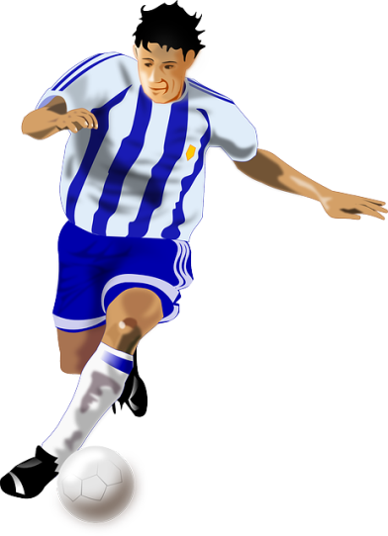
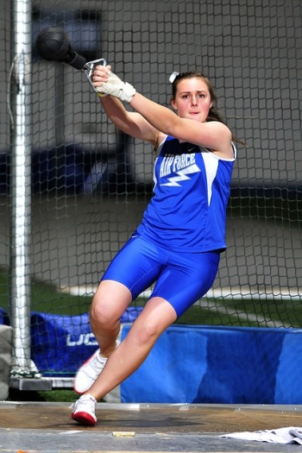
Technology in Sports - BBC micro:bit Beep Tester

Slide 2
Stay safe
Whether you are a scientist researching a new medicine or an engineer solving climate change, safety always comes first. An adult must always be around and supervising when doing this activity. You are responsible for:
ensuring that any equipment used for this activity is in good working condition
behaving sensibly and following any safety instructions so as not to hurt or injure yourself or others
Please note that in the absence of any negligence or other breach of duty by us, this activity is carried out at your own risk. It is important to take extra care at the stages marked with this symbol: ⚠

Slide 3
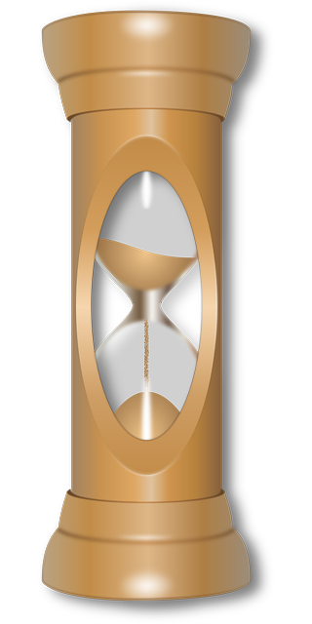
Just a Minute
Get into teams of four. Your topic will be ‘the use of technology in sport’.
In turn, speak about this topic to your team for 60 seconds. You must try not to hesitate, deviate or repeat any information!
During each speech, the audience must add up the number of hesitations, deviations and repetitions.
At the end, give the presenter feedback on the content, structure and clarity of their speech.

