Slide 1
Sports logo development
A project to design a logo for a sports team

Slide 2
Stay safe
Whether you are a scientist researching a new medicine or an engineer solving climate change, safety always comes first. An adult must always be around and supervising when doing this activity. You are responsible for:
ensuring that any equipment used for this activity is in good working condition
behaving sensibly and following any safety instructions so as not to hurt or injure yourself or others
Please note that in the absence of any negligence or other breach of duty by us, this activity is carried out at your own risk. It is important to take extra care at the stages marked with this symbol: ⚠

Slide 3
Design Brief
Situation
A sports team is designing a new kit and you have been asked to design a new logo for the team. They want the logo to represent the sport and be eye-catching.
Brief
Design a sports logo for a sports team of your choice.
Your design should use an image or a simple shape that represents the sport, use 2 to 3 appropriate colours and if used, only one font style.

Slide 4
Design Criteria
The sports logo must:
Represent the sport
Use 2 – 3 appropriate colours
Use an image or simple shape
Use only one font style
Be aesthetically appealing

Slide 5
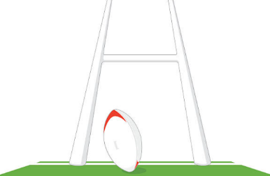
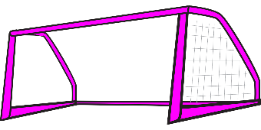
Mood Board Sports

Slide 6
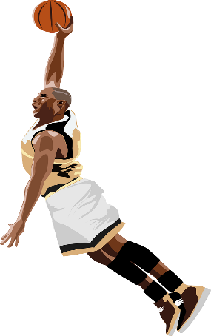
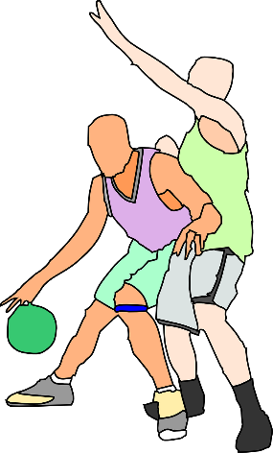
Mood Board - Basketball

Slide 7
1. Making a Sports Logo
Often sports logos include a ball
To convert an image into a logo:
1. Select an image
2. Add simple colour pattern to show movement
3. Add another colour to highlight the movement lines

Slide 8
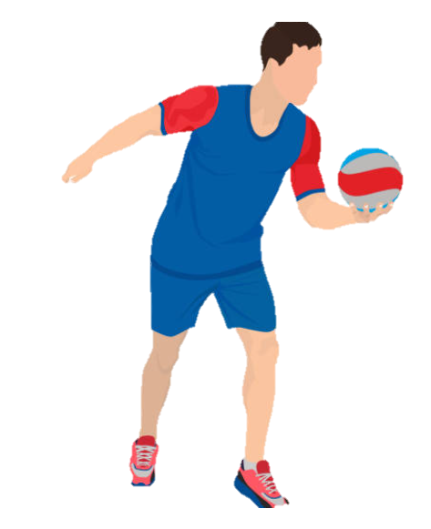
2. Making a Sports Logo
Often sports logos include a sports person
To convert an image into a logo:
1. Select an image
2. Make the image black
3. Add simple colour patterns to show movement

Slide 9
3. Making a Sports Logo
Try different shapes for the background

Slide 10
4. Making a Sports Logo
Add text and other shapes to the logo
U
K
B
A
UKBA

Slide 11
Sports Logo Design
Use this space to sketch your idea for your sports logo.
Don’t forget to annotate your design to show how it meets the design criteria!

Slide 12
Peer Review
Ask three people to suggest one improvement each to your design.
Select one of these suggested improvements and use it to update your design.

