Slide 1

Session 2
Visual Effects Director
Notes:
Session 2 Tips =
Example prompts for goal setting are provided in the Engineering Notebook.
Remind the team to back up saved program files.
After a program is downloaded onto the controller, it cannot be transferred back to be opened and edited.
Have the team practice their new skills by trying to drive the robot to a model and then returning to home.
Robot Game Connection: Have the team code the robot to push an object and deliver it to a target area on the mat.

Slide 2

Session Overview
Outcomes
The team will build a driving base and code it to move forward, move backward, and turn.
The team will make connections from the mission models to the visual effects director Project Spark ideas.
Notes:
Facilitator Tips
Each session in this guide takes two hours. If needed, split each session into two separate 60-minute meetings by having the team complete each page in a 60-minute meeting.
Sessions 1-4 may take additional time to complete the builds.
Session 2 Tips =
Example prompts for goal setting are provided in the Engineering Notebook.
Remind the team to back up saved program files.
After a program is downloaded onto the controller, it cannot be transferred back to be opened and edited.
Have the team practice their new skills by trying to drive the robot to a model and then returning to home.
Robot Game Connection: Have the team code the robot to push an object and deliver it to a target area on the mat.

Slide 3
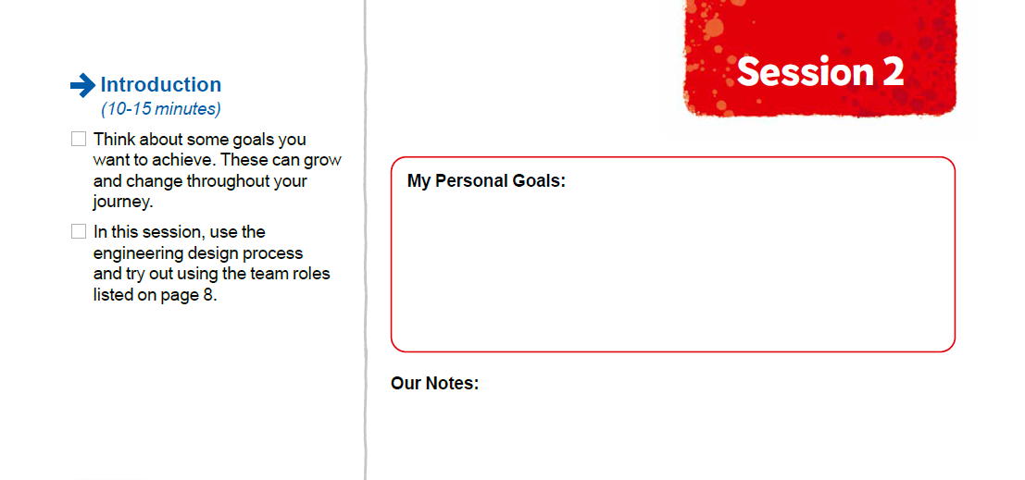

Introduction
Think about some goals you want to achieve. These can grow and change throughout your journey.
Notes:
Introduction (10-15 minutes)
Facilitator Tips
Example prompts for goal setting are provided in the Engineering Notebook.
Remind the team to back up saved program files.
After a program is downloaded onto the controller, it cannot be transferred back to be opened and edited.
Have the team practice their new skills by trying to drive the robot to a model and then returning to home.
Robot Game Connection: Have the team code the robot to push an object and deliver it to a target area on the mat.

Slide 4
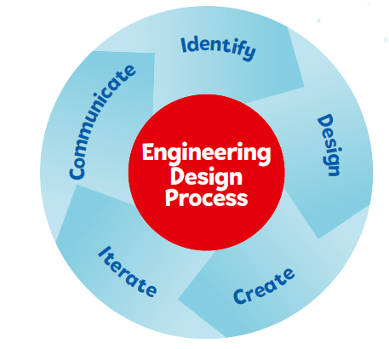
Introduction
In this session, use the engineering design process and try out using the team roles listed on page 8.
Notes:
Facilitator Tips
Some of the team may excel at model building and can help others who get stuck. If the team talks over each other, refer them to the team roles and designate one person as the communicator.
Session 2 Tips =
Example prompts for goal setting are provided in the Engineering Notebook.
Remind the team to back up saved program files.
After a program is downloaded onto the controller, it cannot be transferred back to be opened and edited.
Have the team practice their new skills by trying to drive the robot to a model and then returning to home.
Robot Game Connection: Have the team code the robot to push an object and deliver it to a target area on the mat.

Slide 5
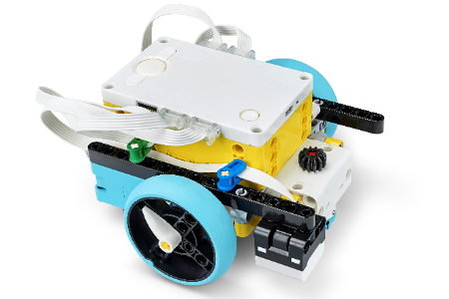

Robot Lesson 2
Open the SPIKE™ Prime app. Find your lesson.
Determine what coding and building skills you can apply in the robot game.
Try it out! Which missions look like the most fun?
See if you can use the skills you learned to drive your robot to one of the mission models.
Notes:
Team Tasks (100-120 minutes) - Training Camp 1: Driving Around – https://education.lego.com/en-us/lessons/prime-competition-ready/training-camp-1-driving-around#lesson-plan
URL for SPIKE on-line: https://spike.legoeducation.com (remember to use a Chrome browser)
Facilitator Tips
Example prompts for goal setting are provided in the Engineering Notebook.
Remind the team to back up saved program files.
After a program is downloaded onto the controller, it cannot be transferred back to be opened and edited.
Have the team practice their new skills by trying to drive the robot to a model and then returning to home.
Robot Game Connection: Have the team code the robot to push an object and deliver it to a target area on the mat.

Slide 6
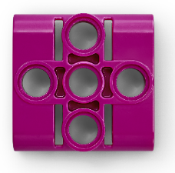
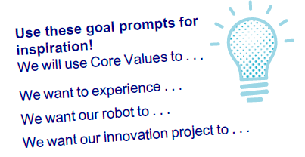

Reflection Questions
How can you aim your robot toward a model?
How did you use the engineering design process and team roles in this session?
Notes:
Team Tasks (100-120 minutes)
Facilitator Tips
Example prompts for goal setting are provided in the Engineering Notebook.
Remind the team to back up saved program files.
After a program is downloaded onto the controller, it cannot be transferred back to be opened and edited.
Have the team practice their new skills by trying to drive the robot to a model and then returning to home.
Robot Game Connection: Have the team code the robot to push an object and deliver it to a target area on the mat.

Slide 7

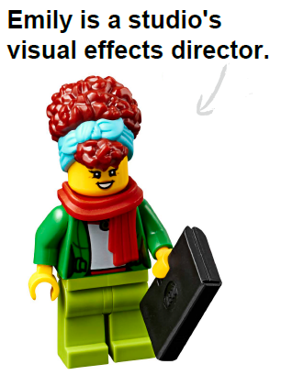
Visual Effects Director Spark
Project Spark
Visual effects and other video and audio technology can create a powerful impact for viewers of movies and other types of media. Using innovative techniques, visual effects directors can make a movie scene really exciting and immersive!
Notes:
Team Tasks (100-120 minutes) Read the Project Spark.
Facilitator Tips
Provide the digital building instructions for the models to the team.
The team will need Bags 1, 7, and 8 from the Challenge set. Larger pieces may be in an unnumbered LEGO® bag.
Have the team think about how they could use one part of the visual effects story for their innovation project solution.
Encourage and support discussion about the Project Spark questions.
Check out Career Connections pages in the Engineering Notebook that link to jobs listed in the sessions.

Slide 8
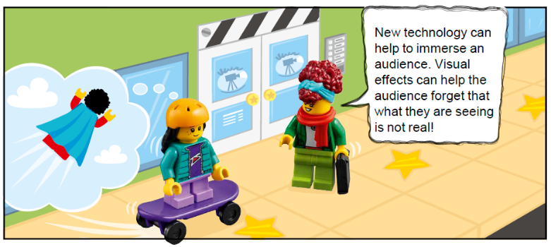
Visual Effects Director Spark
Think about and research:
What movies use visual effects?
How does a visual effects director collaborate with others on a movie set?
What tools or technology are used to help create exciting visuals?
How can visual effects make an audience feel like they are part of the action?
Notes:
Team Tasks (100-120 minutes) Read the Project Spark.
Facilitator Tips
Provide the digital building instructions for the models to the team.
The team will need Bags 1, 7, and 8 from the Challenge set. Larger pieces may be in an unnumbered LEGO® bag.
Have the team think about how they could use one part of the visual effects story for their innovation project solution.
Encourage and support discussion about the Project Spark questions.
Check out Career Connections pages in the Engineering Notebook that link to jobs listed in the sessions.

Slide 9

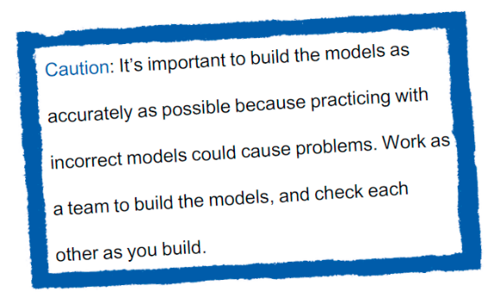

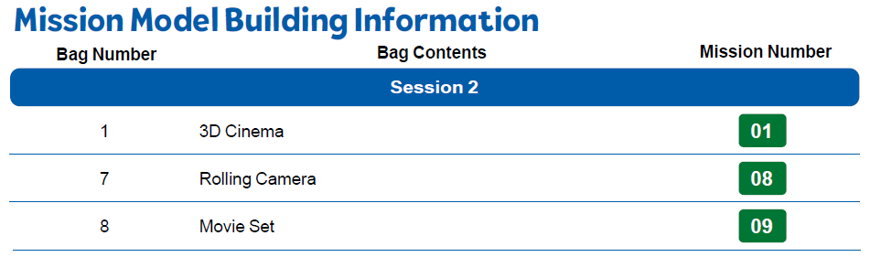
Visual Effects Director Spark
Build the Visual Effects Director models in Bags 1, 7, and 8.
Notes:
Team Tasks (100-120 minutes)
Facilitator Tips
Provide the digital building instructions for the models to the team.
The team will need Bags 1, 7, and 8 from the Challenge set. Larger pieces may be in an unnumbered LEGO® bag.
Have the team think about how they could use one part of the visual effects story for their innovation project solution.
Encourage and support discussion about the Project Spark questions.
Check out Career Connections pages in the Engineering Notebook that link to jobs listed in the sessions.

Slide 10
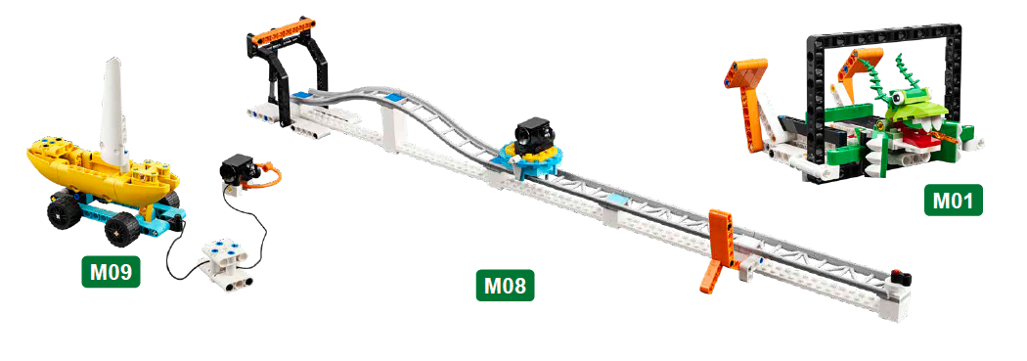
Visual Effects Director Spark
Look over the missions that correspond to the models.
Notes:
Team Tasks (100-120 minutes)
Facilitator Tips
Provide the digital building instructions for the models to the team.
The team will need Bags 1, 7, and 8 from the Challenge set. Larger pieces may be in an unnumbered LEGO® bag.
Have the team think about how they could use one part of the visual effects story for their innovation project solution.
Encourage and support discussion about the Project Spark questions.
Check out Career Connections pages in the Engineering Notebook that link to jobs listed in the sessions.

Slide 11

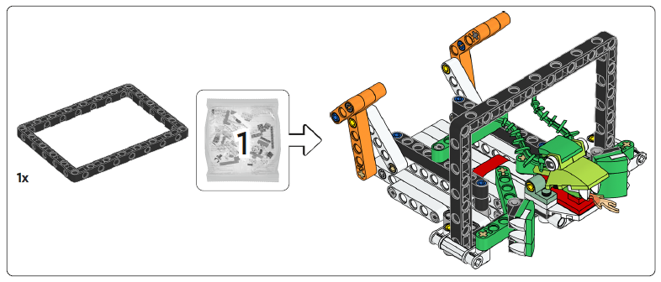
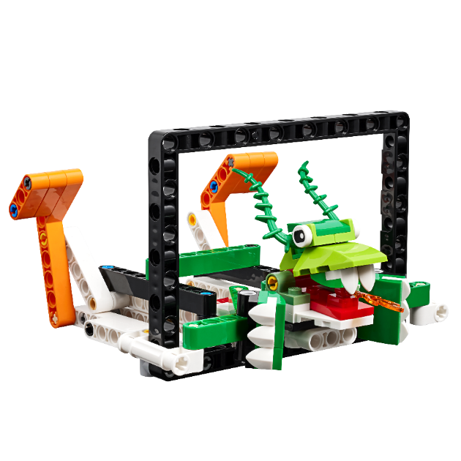
3D Cinema
Notes:
Team Tasks (100-120 minutes)
Facilitator Tips
Provide the digital building instructions for the models to the team.
The team will need Bags 1, 7, and 8 from the Challenge set. Larger pieces may be in an unnumbered LEGO® bag.
Have the team think about how they could use one part of the visual effects story for their innovation project solution.
Encourage and support discussion about the Project Spark questions.
Check out Career Connections pages in the Engineering Notebook that link to jobs listed in the sessions.

Slide 12
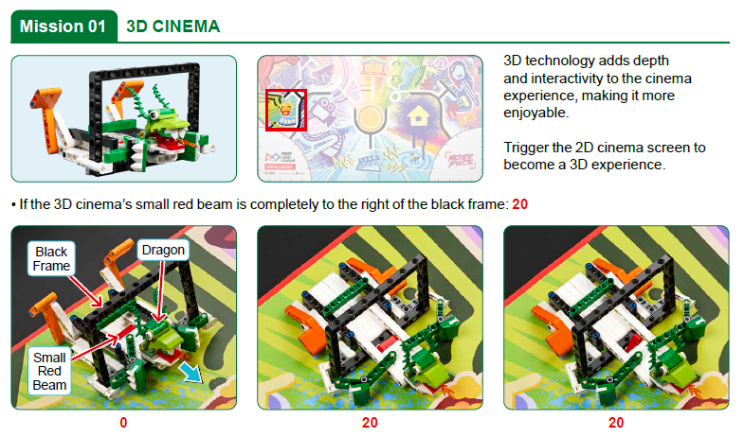
Notes:
Team Tasks (100-120 minutes)
Facilitator Tips
Provide the digital building instructions for the models to the team.
The team will need Bags 1, 7, and 8 from the Challenge set. Larger pieces may be in an unnumbered LEGO® bag.
Have the team think about how they could use one part of the visual effects story for their innovation project solution.
Encourage and support discussion about the Project Spark questions.
Check out Career Connections pages in the Engineering Notebook that link to jobs listed in the sessions.

Slide 13
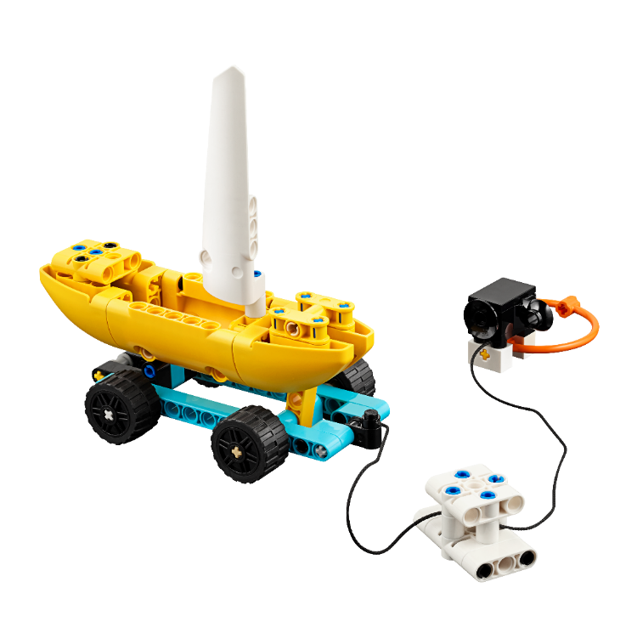
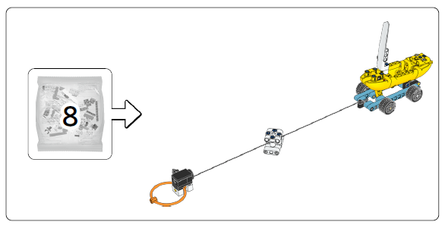
Movie Set
Notes:
Team Tasks (100-120 minutes)
Facilitator Tips
Provide the digital building instructions for the models to the team.
The team will need Bags 1, 7, and 8 from the Challenge set. Larger pieces may be in an unnumbered LEGO® bag.
Have the team think about how they could use one part of the visual effects story for their innovation project solution.
Encourage and support discussion about the Project Spark questions.
Check out Career Connections pages in the Engineering Notebook that link to jobs listed in the sessions.

Slide 14
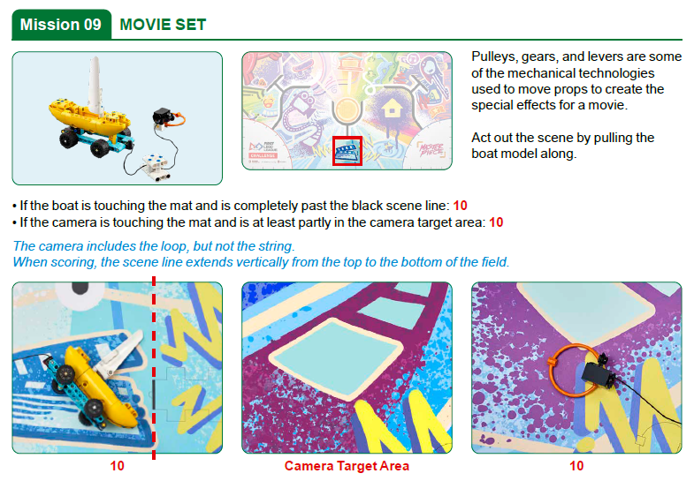
Notes:
Team Tasks (100-120 minutes)
Facilitator Tips
Provide the digital building instructions for the models to the team.
The team will need Bags 1, 7, and 8 from the Challenge set. Larger pieces may be in an unnumbered LEGO® bag.
Have the team think about how they could use one part of the visual effects story for their innovation project solution.
Encourage and support discussion about the Project Spark questions.
Check out Career Connections pages in the Engineering Notebook that link to jobs listed in the sessions.

Slide 15
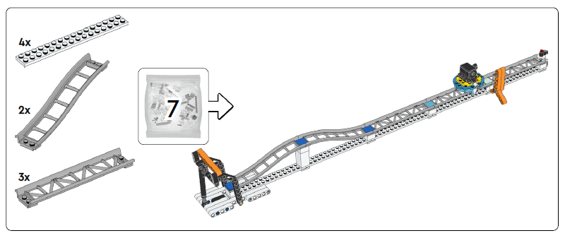
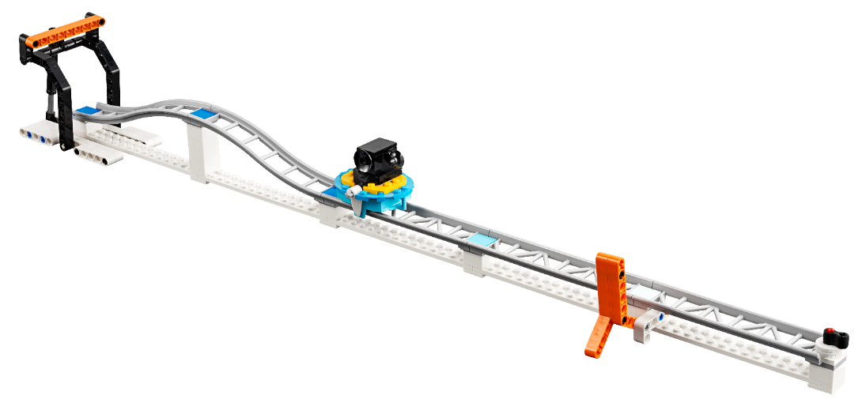
Rolling Camera
Notes:
Team Tasks (100-120 minutes)
Facilitator Tips
Provide the digital building instructions for the models to the team.
The team will need Bags 1, 7, and 8 from the Challenge set. Larger pieces may be in an unnumbered LEGO® bag.
Have the team think about how they could use one part of the visual effects story for their innovation project solution.
Encourage and support discussion about the Project Spark questions.
Check out Career Connections pages in the Engineering Notebook that link to jobs listed in the sessions.

Slide 16
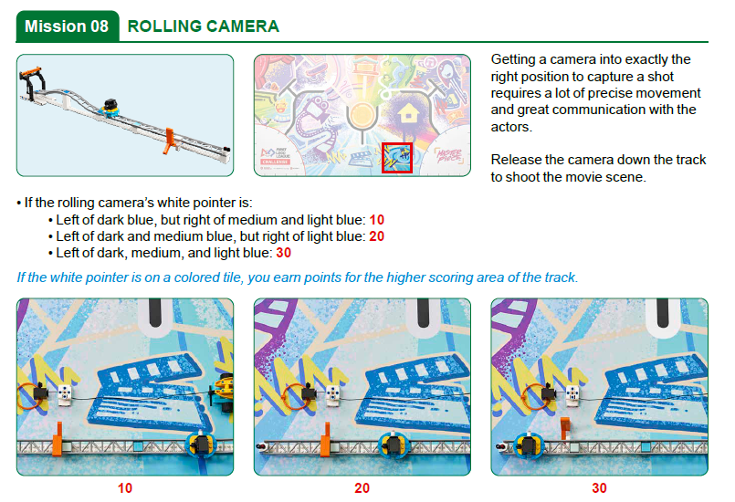
Notes:
Team Tasks (100-120 minutes)
Facilitator Tips
Provide the digital building instructions for the models to the team.
The team will need Bags 1, 7, and 8 from the Challenge set. Larger pieces may be in an unnumbered LEGO® bag.
Have the team think about how they could use one part of the visual effects story for their innovation project solution.
Encourage and support discussion about the Project Spark questions.
Check out Career Connections pages in the Engineering Notebook that link to jobs listed in the sessions.

Slide 17

Visual Effects Director Spark
Look over the missions that correspond to the models.
Talk about how the mission models are related to the Project Spark.
Capture your ideas.
Notes:
Team Tasks (100-120 minutes)
Facilitator Tips
Provide the digital building instructions for the models to the team.
The team will need Bags 1, 7, and 8 from the Challenge set. Larger pieces may be in an unnumbered LEGO® bag.
Have the team think about how they could use one part of the visual effects story for their innovation project solution.
Encourage and support discussion about the Project Spark questions.
Check out Career Connections pages in the Engineering Notebook that link to jobs listed in the sessions.

Slide 18

Share
Get together at the mat.
Place each model where it belongs. Refer to the field setup section of the Robot Game Rulebook.
Show the robot skills you learned.
Show how the models work and explain how they relate to the Project Spark.
Chat about reflection questions.
Clean up your space.
Notes:
Share (10-15 minutes)
Facilitator Tips
Provide the digital building instructions for the models to the team.
The team will need Bags 1, 7, and 8 from the Challenge set. Larger pieces may be in an unnumbered LEGO® bag.
Have the team think about how they could use one part of the visual effects story for their innovation project solution.
Encourage and support discussion about the Project Spark questions.
Check out Career Connections pages in the Engineering Notebook that link to jobs listed in the sessions.

Slide 19
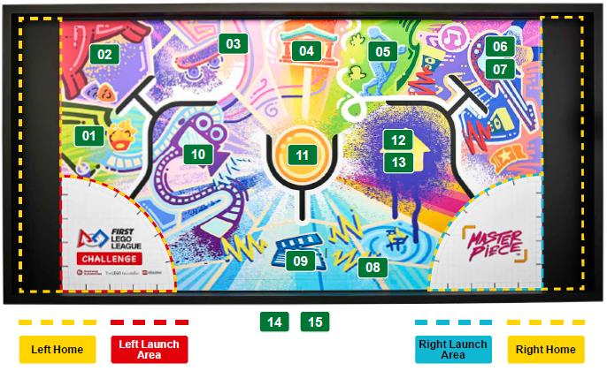
Models built this session are for the circled missions.
Notes:
Facilitator Tips
Provide the digital building instructions for the models to the team.
The team will need Bags 1, 7, and 8 from the Challenge set. Larger pieces may be in an unnumbered LEGO® bag.
Have the team think about how they could use one part of the visual effects story for their innovation project solution.
Encourage and support discussion about the Project Spark questions.
Check out Career Connections pages in the Engineering Notebook that link to jobs listed in the sessions.

Slide 20



Reflection Questions
What other effects are used in movies that don’t require expensive technology?
Can you think of examples of visual effects in exhibits or live performances?
Notes:
Facilitator Tips
Provide the digital building instructions for the models to the team.
The team will need Bags 1, 7, and 8 from the Challenge set. Larger pieces may be in an unnumbered LEGO® bag.
Have the team think about how they could use one part of the visual effects story for their innovation project solution.
Encourage and support discussion about the Project Spark questions.
Check out Career Connections pages in the Engineering Notebook that link to jobs listed in the sessions.

Slide 21



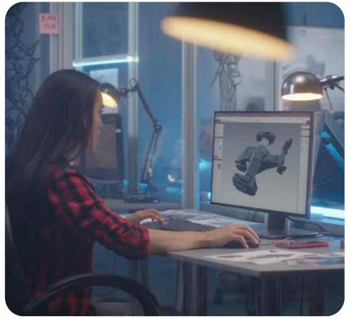
Career Connections
Visual Effects Director
Role:
A visual effects director produces images and settings that help the audience engage with the performance.

Slide 22


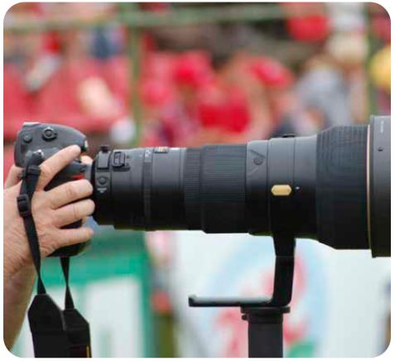
Career Connections
Sports Photographer
Role:
A sports photographer is skilled at taking pictures of athletes in action. Photographers often use large lenses so they can zoom in while keeping a safe distance.

Slide 23

Multimedia Resources
You may wish to embed a relevant, age-appropriate video for your students here. See the Notes for an example.
Notes:
Choose a relevant, age-appropriate video for your students.
Example: How are movies made? | The movie making process explained (6:07)

Slide 24

Clean Up
Notes:
Allow time for cleanup and place any unfinished models and their pieces in a sealed plastic bag.
Clean Up Pointers
You may wish to play a video or song during clean up time Link on
GoNoodle: https://family.gonoodle.com/activities/clean-up
Link on YouTube Kids: https://www.youtubekids.com/watch?v=ZJFk87ZsHn0
Link on Youtube: https://youtu.be/ZJFk87ZsHn0

Slide 25


LEGO, the LEGO logo, the SPIKE logo, MINDSTORMS and the MINDSTORMS logo are trademarks of the LEGO Group. ©2023 The LEGO Group. All rights reserved. FIRST®, the FIRST® logo, Coopertition®, Gracious Professionalism®, and FIRST IN SHOWSM, are trademarks of For Inspiration and Recognition of Science and Technology (FIRST). LEGO® is a registered trademark of the LEGO Group. FIRST® LEGO® League and MASTERPIECESM are jointly held trademarks of FIRST and the LEGO Group. All other trademarks are the property of their respective owners. ©2023 FIRST and the LEGO Group. All rights reserved.

