Slide 1

Session 6
Identify Solutions
Notes:
Facilitator Tips - Provide extra paper or a shared online file for the team to capture the process used to create their robot and innovation project solutions. The team will be judged on their final robot and project solutions as well as the process they used.
Session 6 Tips =
Building the experts in Bag 13 is a great time for the team to review what they learned about the Project Sparks.
Provide sticky notes and planning cards for the team to place on the mat to map out their mission strategy.
Encourage the team to find the missions where points can be scored most easily and do them first.
The Pseudocode page can be photocopied. It can be used for each mission the team attempts.

Slide 2

Session Overview
Outcomes
The team will create a mission strategy plan and write pseudocode for a mission.
The team will conduct research on their identified problem and start the Innovation Project Planning page.
Notes:
Facilitator Tips - Provide extra paper or a shared online file for the team to capture the process used to create their robot and innovation project solutions. The team will be judged on their final robot and project solutions as well as the process they used.
Session 6 Tips =
Building the experts in Bag 13 is a great time for the team to review what they learned about the Project Sparks.
Provide sticky notes and planning cards for the team to place on the mat to map out their mission strategy.
Encourage the team to find the missions where points can be scored most easily and do them first.
The Pseudocode page can be photocopied. It can be used for each mission the team attempts.

Slide 3
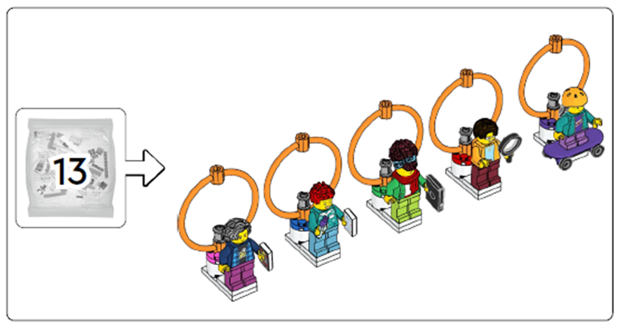
Introduction
Locate Bag 13 and assemble the expert minifigures.
Work as a team to assemble the minifigures and discuss their jobs. Think about how these experts could help with your innovation project ideas.
Notes:
Introduction (10-15 minutes)
Facilitator Tips –
Building the experts in Bag 13 is a great time for the team to review what they learned about the Project Sparks.
Provide sticky notes and planning cards for the team to place on the mat to map out their mission strategy.
Encourage the team to find the missions where points can be scored most easily and do them first.
The Pseudocode page can be photocopied. It can be used for each mission the team attempts.

Slide 4

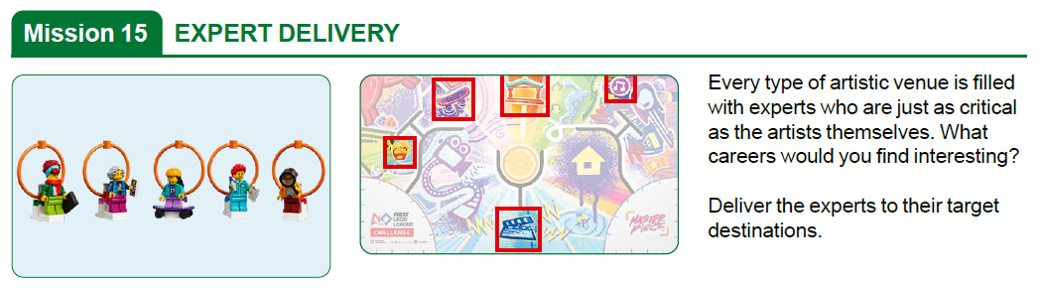
Expert Delivery
Notes:
Introduction (10-15 minutes)
Facilitator Tips –
Building the experts in Bag 13 is a great time for the team to review what they learned about the Project Sparks.
Provide sticky notes and planning cards for the team to place on the mat to map out their mission strategy.
Encourage the team to find the missions where points can be scored most easily and do them first.
The Pseudocode page can be photocopied. It can be used for each mission the team attempts.

Slide 5
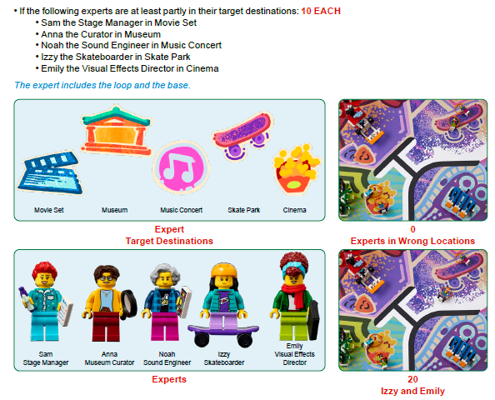

Slide 6


Pseudocode & Mission Strategy
Watch the “Robot Game Missions” video.
Visit the
FIRST® LEGO® League
YouTube Channel
to watch the MASTERPIECESM
“Robot Game Missions” video
Notes:
Mission videos can be found in the Robot Game Rulebook too!
Missions are tasks that can be completed for points. The missions are explained in this section, which should be read by the team as they stand next to the field.
Team Tasks (100-120 minutes)
Facilitator Tips –
Building the experts in Bag 13 is a great time for the team to review what they learned about the Project Sparks.
Provide sticky notes and planning cards for the team to place on the mat to map out their mission strategy.
Encourage the team to find the missions where points can be scored most easily and do them first.
The Pseudocode page can be photocopied. It can be used for each mission the team attempts.

Slide 7
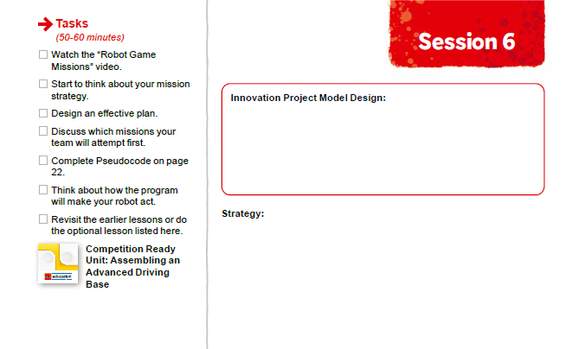

Pseudocode & Mission Strategy
Start to think about your mission strategy.
Notes:
Team Tasks (100-120 minutes)
Facilitator Tips –
Building the experts in Bag 13 is a great time for the team to review what they learned about the Project Sparks.
Provide sticky notes and planning cards for the team to place on the mat to map out their mission strategy.
Encourage the team to find the missions where points can be scored most easily and do them first.
The Pseudocode page can be photocopied. It can be used for each mission the team attempts.

Slide 8

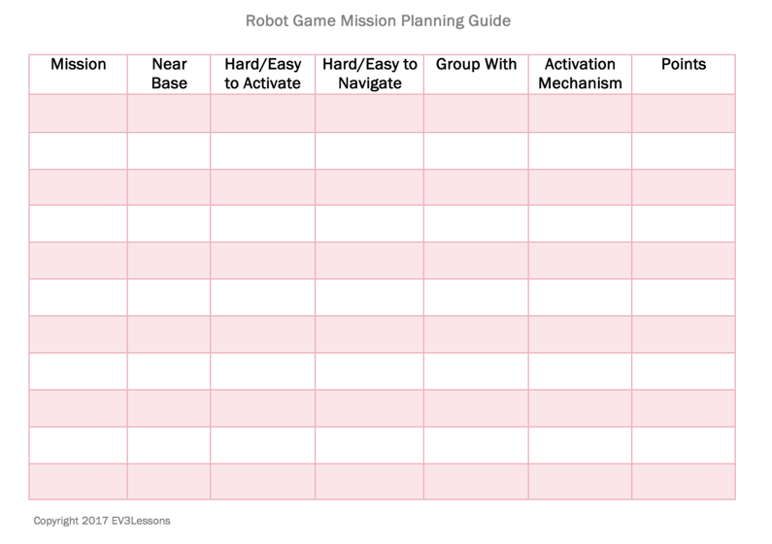
Pseudocode &
Mission Strategy
Design an effective work plan.
Discuss which missions your team will attempt first.
Example from Droid Robotics (flltutorials.com)
Notes:
Team Tasks (100-120 minutes)
Facilitator Tips –
Building the experts in Bag 13 is a great time for the team to review what they learned about the Project Sparks.
Provide sticky notes and planning cards for the team to place on the mat to map out their mission strategy.
Encourage the team to find the missions where points can be scored most easily and do them first.
The Pseudocode page can be photocopied. It can be used for each mission the team attempts.

Slide 9

Pseudocode &
Mission Strategy
Complete Pseudocode page 22.
Notes:
Team Tasks (100-120 minutes)
Facilitator Tips –
Building the experts in Bag 13 is a great time for the team to review what they learned about the Project Sparks.
Provide sticky notes and planning cards for the team to place on the mat to map out their mission strategy.
Encourage the team to find the missions where points can be scored most easily and do them first.
The Pseudocode page can be photocopied. It can be used for each mission the team attempts.

Slide 10


Pseudocode & Mission Strategy
Think about how the program will make your robot act.
Revisit the earlier lessons or do the optional lesson listed here.
Notes:
Team Tasks (100-120 minutes) Assembling an Advanced Driving Base – https://education.lego.com/en-us/lessons/prime-competition-ready/assembling-an-advanced-driving-base#lesson-plan
URL for SPIKE on-line: https://spike.legoeducation.com (remember to use a Chrome browser)
Facilitator Tips –
Building the experts in Bag 13 is a great time for the team to review what they learned about the Project Sparks.
Provide sticky notes and planning cards for the team to place on the mat to map out their mission strategy.
Encourage the team to find the missions where points can be scored most easily and do them first.
The Pseudocode page can be photocopied. It can be used for each mission the team attempts.

Slide 11
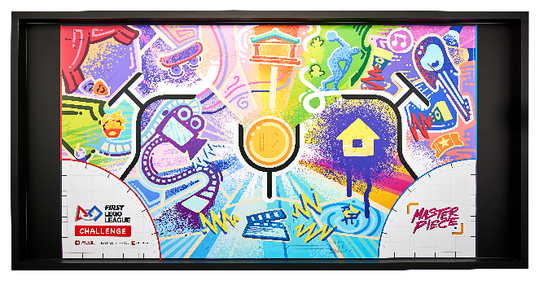
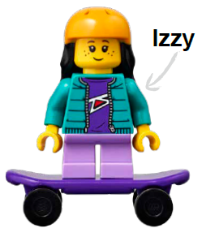

Reflection Questions
How could you use line following to help you navigate the mat?
How did you use the engineering design process to create your mission strategy?
Notes:
Team Tasks (100-120 minutes)
Facilitator Tips –
Building the experts in Bag 13 is a great time for the team to review what they learned about the Project Sparks.
Provide sticky notes and planning cards for the team to place on the mat to map out their mission strategy.
Encourage the team to find the missions where points can be scored most easily and do them first.
The Pseudocode page can be photocopied. It can be used for each mission the team attempts.

Slide 12
Identify Solutions
Research the problem you chose and any existing solutions.
Generate solution ideas. Make a plan for how you will develop your solution. Use page 23, Innovation Project Planning, as a tool.
Notes:
Team Tasks (100-120 minutes)
Facilitator Tips -
Be sure the team collects their sources in a shared location, either online or on paper.
Take some extra time with the team if needed to explore all the solution ideas and narrow it down to one.
Make sure their solution has the potential to be developed and they can explain their solution clearly.
The Innovation Project Planning page can be completed over multiple sessions and helps the team document their process.

Slide 13
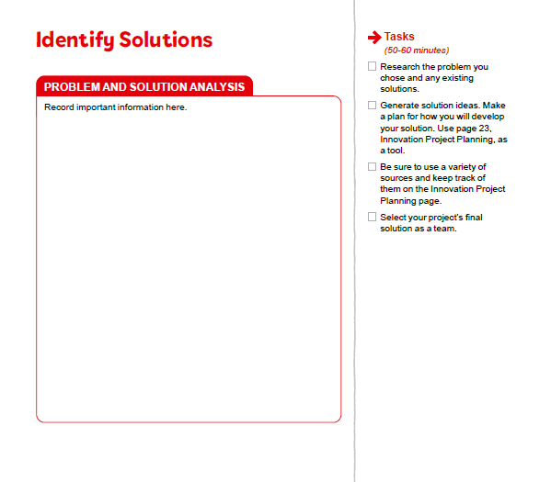



Plan Innovation Project Solutions
Be sure to use a variety of sources and keep track of them on the Innovation Project Planning page.
Select your project’s final solution as a team.
Notes:
Team Tasks (100-120 minutes)
Facilitator Tips -
Be sure the team collects their sources in a shared location, either online or on paper.
Take some extra time with the team if needed to explore all the solution ideas and narrow it down to one.
Make sure their solution has the potential to be developed and they can explain their solution clearly.
The Innovation Project Planning page can be completed over multiple sessions and helps the team document their process.

Slide 14

Plan Innovation Project Solutions
Notes:
Team Tasks (100-120 minutes)
Facilitator Tips -
Be sure the team collects their sources in a shared location, either online or on paper.
Take some extra time with the team if needed to explore all the solution ideas and narrow it down to one.
Make sure their solution has the potential to be developed and they can explain their solution clearly.
The Innovation Project Planning page can be completed over multiple sessions and helps the team document their process.

Slide 15

Share
Get together at the mat.
Review your Pseudocode page. Make changes to the page if necessary.
Explain what you discovered in your research. Discuss any solution ideas.
Discuss the reflection questions.
Clean up your space.
Notes:
Share - (10-15 minutes)
Facilitator Tips -
Be sure the team collects their sources in a shared location, either online or on paper.
Take some extra time with the team if needed to explore all the solution ideas and narrow it down to one.
Make sure their solution has the potential to be developed and they can explain their solution clearly.
The Innovation Project Planning page can be completed over multiple sessions and helps the team document their process..

Slide 16
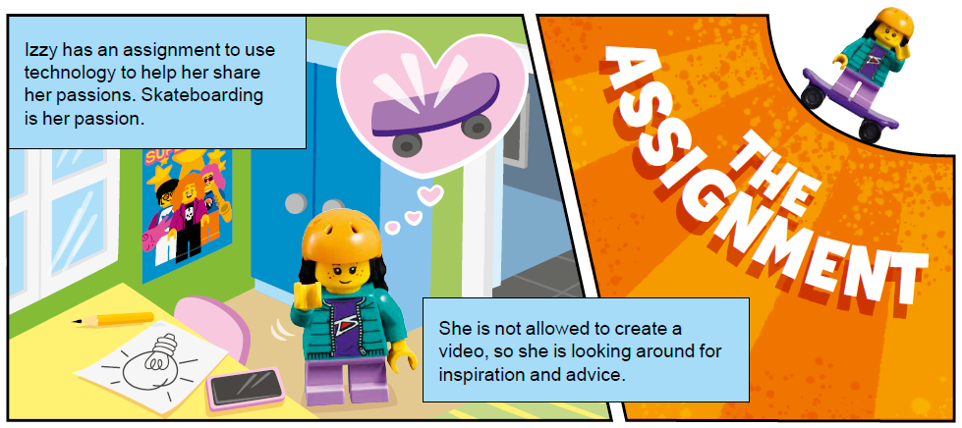
Reflection Questions
What types of improvements do existing solutions need?
What are your brand-new ideas to solve the problem?
Notes:
Facilitator Tips -
Be sure the team collects their sources in a shared location, either online or on paper.
Take some extra time with the team if needed to explore all the solution ideas and narrow it down to one.
Make sure their solution has the potential to be developed and they can explain their solution clearly.
The Innovation Project Planning page can be completed over multiple sessions and helps the team document their process..

Slide 17

Multimedia Resources
You may wish to embed a relevant, age-appropriate video for your students here. See the Notes for an example.
Notes:
Choose a relevant, age-appropriate video for your students.
Example: Writing Videos for Kids: How to Evaluate Sources for Reliability (3:48)

Slide 18

Clean Up
Notes:
Allow time for cleanup and place any unfinished models and their pieces in a sealed plastic bag.
Clean Up Pointers
You may wish to play a video or song during clean up time Link on
GoNoodle: https://family.gonoodle.com/activities/clean-up
Link on YouTube Kids: https://www.youtubekids.com/watch?v=ZJFk87ZsHn0
Link on Youtube: https://youtu.be/ZJFk87ZsHn0

Slide 19


LEGO, the LEGO logo, the SPIKE logo, MINDSTORMS and the MINDSTORMS logo are trademarks of the LEGO Group. ©2023 The LEGO Group. All rights reserved. FIRST®, the FIRST® logo, Coopertition®, Gracious Professionalism®, and FIRST IN SHOWSM, are trademarks of For Inspiration and Recognition of Science and Technology (FIRST). LEGO® is a registered trademark of the LEGO Group. FIRST® LEGO® League and MASTERPIECESM are jointly held trademarks of FIRST and the LEGO Group. All other trademarks are the property of their respective owners. ©2023 FIRST and the LEGO Group. All rights reserved.

