Slide 1
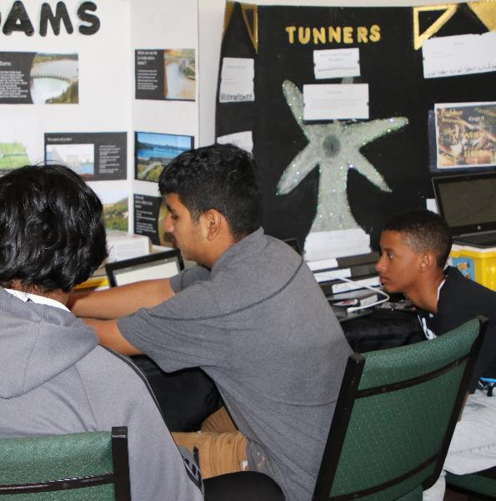
Session 8
Continue Creating
Notes:
Session 8 Tips =
Have the team discuss how the guided mission is an example of Coopertition®.
The team should think about strategy when choosing missions to solve. Multiple missions can be completed on the same run to save time.
Encourage the team to discuss how their program works. Break the program into blocks that control one movement.
Treat the robot game like a sport. The team needs to practice, practice, practice to perform well in the robot game.
Where the robot starts in a launch area strongly influences where it ends. Have the team keep good notes about where the robot is placed.

Slide 2
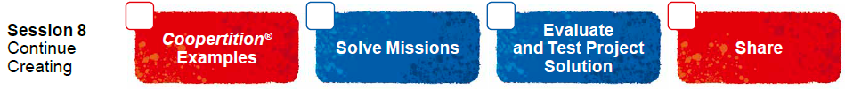
Session Overview
Outcomes
The team will evaluate and improve on their innovation project solution.
The team will design robot attachments and create programs to solve missions.
Notes:
Facilitator Tips - Use the Core Values where appropriate to encourage the team. To celebrate the team learning these important values, highlight examples of when the team demonstrates these principles.
Session 8 Tips =
Have the team discuss how the guided mission is an example of Coopertition®.
The team should think about strategy when choosing missions to solve. Multiple missions can be completed on the same run to save time.
Encourage the team to discuss how their program works. Break the program into blocks that control one movement.
Treat the robot game like a sport. The team needs to practice, practice, practice to perform well in the robot game.
Where the robot starts in a launch area strongly influences where it ends. Have the team keep good notes about where the robot is placed.

Slide 3
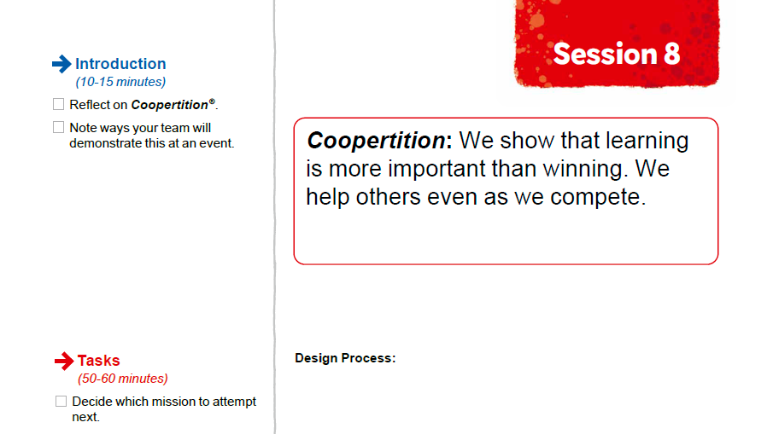

Introduction
Reflect on Coopertition®.
Note ways your team will demonstrate this at an event.
Notes:
Introduction (10-15 minutes)
Facilitator Tips -
Have the team discuss how the guided mission is an example of Coopertition®.
The team should think about strategy when choosing missions to solve. Multiple missions can be completed on the same run to save time.
Encourage the team to discuss how their program works. Break the program into blocks that control one movement.
Treat the robot game like a sport. The team needs to practice, practice, practice to perform well in the robot game.
Where the robot starts in a launch area strongly influences where it ends. Have the team keep good notes about where the robot is placed.

Slide 4

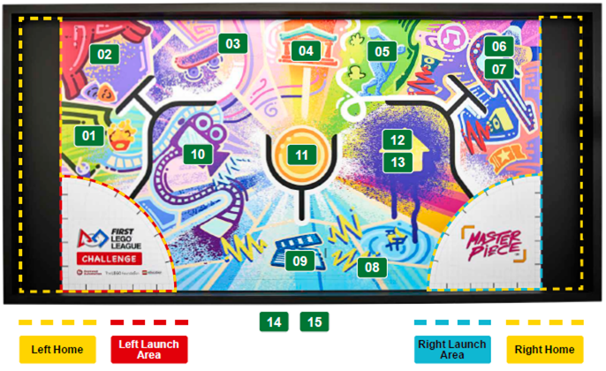
Solve Missions
Decide which mission to attempt next.
Think about your mission strategy and plan.
Build any attachments you need to complete missions.
Notes:
Team Tasks (100-120 minutes)
Facilitator Tips –
Have the team discuss how the guided mission is an example of Coopertition®.
The team should think about strategy when choosing missions to solve. Multiple missions can be completed on the same run to save time.
Encourage the team to discuss how their program works. Break the program into blocks that control one movement.
Treat the robot game like a sport. The team needs to practice, practice, practice to perform well in the robot game.
Where the robot starts in a launch area strongly influences where it ends. Have the team keep good notes about where the robot is placed.

Slide 5
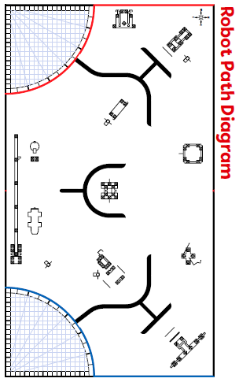
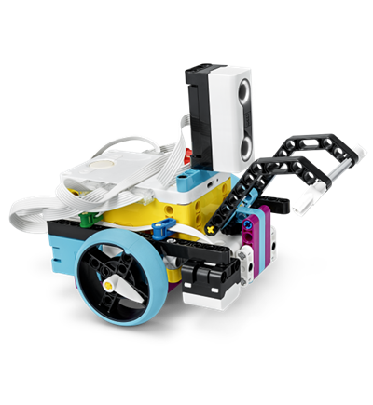
Solve Missions
Iterate and refine your program so your robot completes the mission reliably.
Be sure to document your design process and testing for each mission!
Notes:
Team Tasks (100-120 minutes)
Facilitator Tips –
Have the team discuss how the guided mission is an example of Coopertition®.
The team should think about strategy when choosing missions to solve. Multiple missions can be completed on the same run to save time.
Encourage the team to discuss how their program works. Break the program into blocks that control one movement.
Treat the robot game like a sport. The team needs to practice, practice, practice to perform well in the robot game.
Where the robot starts in a launch area strongly influences where it ends. Have the team keep good notes about where the robot is placed.

Slide 6

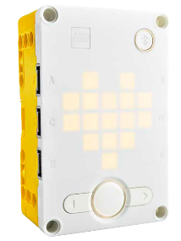
Guiding Questions:
Describe the attachments you built.
Explain your different programs and what the robot will do.
How did you test your programs and attachments?
What changes did you make to your robot and programs?
How does your robot plan connect with the robot design rubric?
Notes:
Team Tasks (100-120 minutes)
Facilitator Tips –
Have the team discuss how the guided mission is an example of Coopertition®.
The team should think about strategy when choosing missions to solve. Multiple missions can be completed on the same run to save time.
Encourage the team to discuss how their program works. Break the program into blocks that control one movement.
Treat the robot game like a sport. The team needs to practice, practice, practice to perform well in the robot game.
Where the robot starts in a launch area strongly influences where it ends. Have the team keep good notes about where the robot is placed.

Slide 7

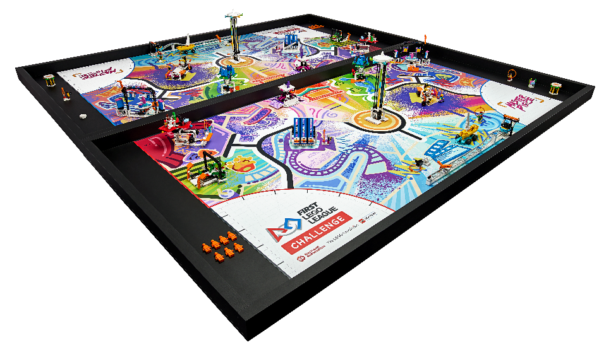
Reflection Questions
How has your team used Core Values to develop your robot solution?
In what order will you run the missions in the Robot Game?
Notes:
Team Tasks (100-120 minutes)
Facilitator Tips –
Have the team discuss how the guided mission is an example of Coopertition®.
The team should think about strategy when choosing missions to solve. Multiple missions can be completed on the same run to save time.
Encourage the team to discuss how their program works. Break the program into blocks that control one movement.
Treat the robot game like a sport. The team needs to practice, practice, practice to perform well in the robot game.
Where the robot starts in a launch area strongly influences where it ends. Have the team keep good notes about where the robot is placed.

Slide 8
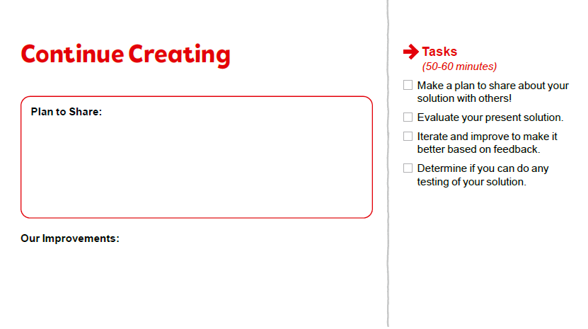
Evaluate & Test Project Solution
Make a plan to share about your solution with others!
Evaluate your present solution.
Notes:
Team Tasks (100-120 minutes)
Facilitator Tips
The team can create a survey to evaluate their solution or ask for feedback from someone who is an expert or user for their chosen problem.
The team should iterate and improve their innovation project solution following feedback from others.
The team should think about how they use innovation to help solve problems they encounter.
The team should reference the rubrics so they can be prepared for judging at the event.
The team could go through multiple cycles of the engineering design process as they test and improve their innovation project solution.

Slide 9

Evaluate & Test Project Solution
Iterate and improve to make it better based on feedback.
Determine if you can do any testing of your solution.
Notes:
Team Tasks (100-120 minutes)
Facilitator Tips
The team can create a survey to evaluate their solution or ask for feedback from someone who is an expert or user for their chosen problem.
The team should iterate and improve their innovation project solution following feedback from others.
The team should think about how they use innovation to help solve problems they encounter.
The team should reference the rubrics so they can be prepared for judging at the event.
The team could go through multiple cycles of the engineering design process as they test and improve their innovation project solution.

Slide 10

Share
Get together at the mat.
Show any missions you are working on or have completed.
Discuss how you will share your solution and project plan with others.
Discuss the reflection questions.
Clean up your space.
Notes:
Share (10-15 minutes)
Facilitator Tips
The team can create a survey to evaluate their solution or ask for feedback from someone who is an expert or user for their chosen problem.
The team should iterate and improve their innovation project solution following feedback from others.
The team should think about how they use innovation to help solve problems they encounter.
The team should reference the rubrics so they can be prepared for judging at the event.
The team could go through multiple cycles of the engineering design process as they test and improve their innovation project solution.

Slide 11
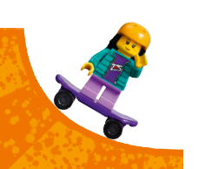
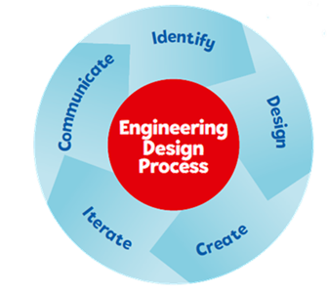

Reflection Questions
How can you realistically implement your Innovation Project solution?
Could your Innovation Project solution be manufactured? What would it cost?
Notes:
Facilitator Tips
The team can create a survey to evaluate their solution or ask for feedback from someone who is an expert or user for their chosen problem.
The team should iterate and improve their innovation project solution following feedback from others.
The team should think about how they use innovation to help solve problems they encounter.
The team should reference the rubrics so they can be prepared for judging at the event.
The team could go through multiple cycles of the engineering design process as they test and improve their innovation project solution.

Slide 12
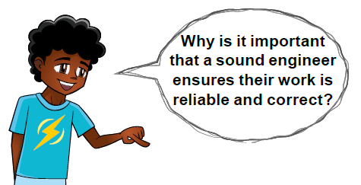
Career Connections
Sound Engineer
Warehouse Worker
Role: A sound or audio engineer mixes different sounds, controls volume, and creates an optimal listening experience.

Slide 13

Multimedia Resources
You may wish to embed a relevant, age-appropriate video for your students here. See the Notes for an example.
Notes:
Choose a relevant, age-appropriate video for your students.
Example: Innovation Project 101 https://youtu.be/EdGwO4sB1rQ

Slide 14

Clean Up
Notes:
Allow time for cleanup and place any unfinished models and their pieces in a sealed plastic bag.
Clean Up Pointers
You may wish to play a video or song during clean up time Link on
GoNoodle: https://family.gonoodle.com/activities/clean-up
Link on YouTube Kids: https://www.youtubekids.com/watch?v=ZJFk87ZsHn0
Link on Youtube: https://youtu.be/ZJFk87ZsHn0

Slide 15


LEGO, the LEGO logo, the SPIKE logo, MINDSTORMS and the MINDSTORMS logo are trademarks of the LEGO Group. ©2023 The LEGO Group. All rights reserved. FIRST®, the FIRST® logo, Coopertition®, Gracious Professionalism®, and FIRST IN SHOWSM, are trademarks of For Inspiration and Recognition of Science and Technology (FIRST). LEGO® is a registered trademark of the LEGO Group. FIRST® LEGO® League and MASTERPIECESM are jointly held trademarks of FIRST and the LEGO Group. All other trademarks are the property of their respective owners. ©2023 FIRST and the LEGO Group. All rights reserved.

