Slide 1
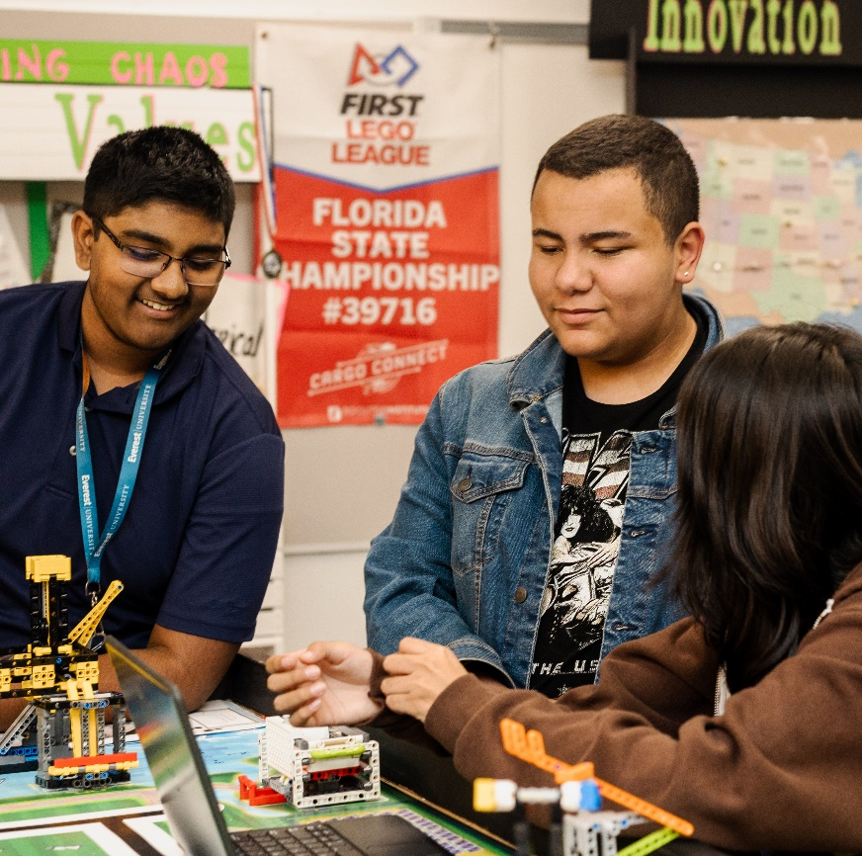
Session 10
Iterate Solutions
Notes:
Facilitator Tips –
Their presentation can be a slideshow, poster, play, or even a skit. Props can be used, such as costumes, shirts, or hats.
Scripts can be made for the judging session when the team presents their innovation project and robot solutions. Provide copies for each team member.
The team might need more space to store all their materials for the presentation.
Encourage the team to run their robot in practice 2.5-minute robot matches so that they get used to the time limit.
Provide the team with the innovation project rubric.

Slide 2
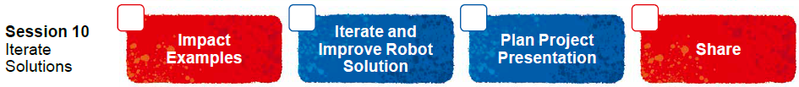
Session Overview
Outcomes
The team will plan and create their innovation project presentation, where they will pitch their solution.
The team will continue to solve missions for the robot game.
Notes:
Facilitator Tips –
Their presentation can be a slideshow, poster, play, or even a skit. Props can be used, such as costumes, shirts, or hats.
Scripts can be made for the judging session when the team presents their innovation project and robot solutions. Provide copies for each team member.
The team might need more space to store all their materials for the presentation.
Encourage the team to run their robot in practice 2.5-minute robot matches so that they get used to the time limit.
Provide the team with the innovation project rubric.

Slide 3
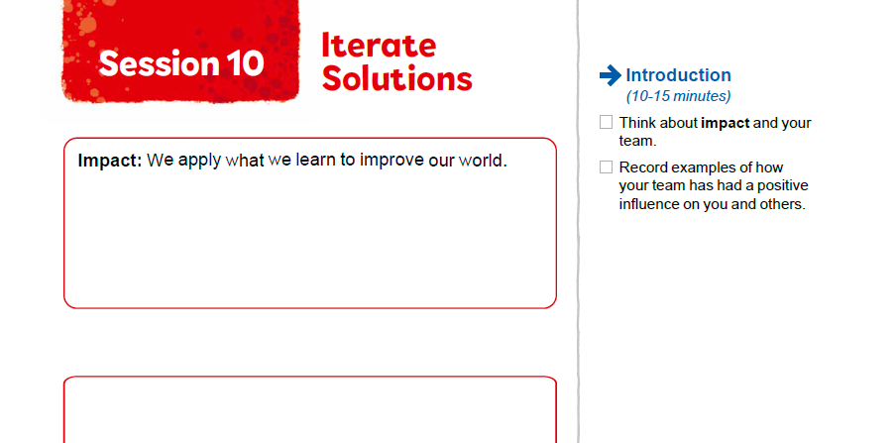

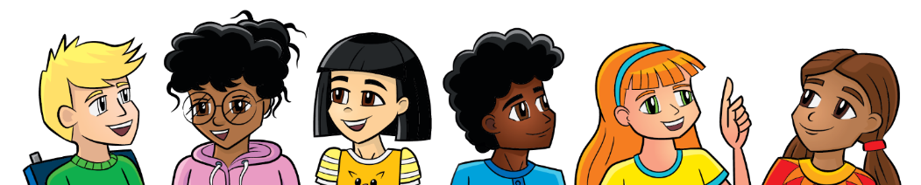
Introduction
Think about impact and your team.
Record examples of how your team has had a positive influence on you and others.
Notes:
Introduction (10-15 minutes)
Facilitator Tips –
Their presentation can be a slideshow, poster, play, or even a skit. Props can be used, such as costumes, shirts, or hats.
Scripts can be made for the judging session when the team presents their innovation project and robot solutions. Provide copies for each team member.
The team might need more space to store all their materials for the presentation.
Encourage the team to run their robot in practice 2.5-minute robot matches so that they get used to the time limit.
Provide the team with the innovation project rubric.

Slide 4

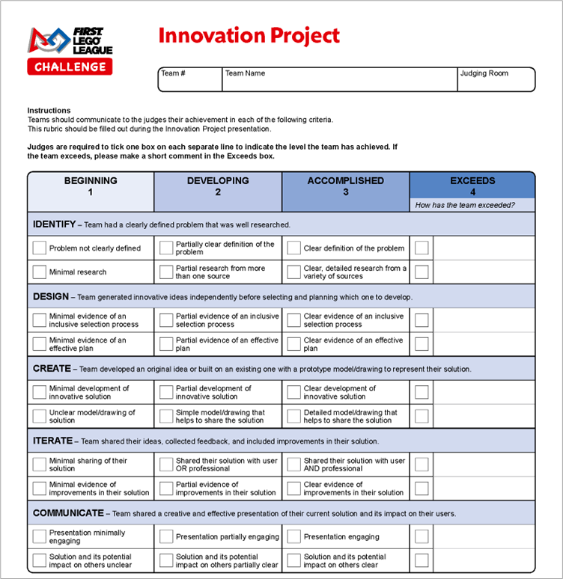
Iterate and Improve Robot Solution
Plan out your project presentation. Refer to the Innovation Project rubric for what to cover.
Notes:
Team Tasks (100-120 minutes)
Facilitator Tips –
Their presentation can be a slideshow, poster, play, or even a skit. Props can be used, such as costumes, shirts, or hats.
Scripts can be made for the judging session when the team presents their innovation project and robot solutions. Provide copies for each team member.
The team might need more space to store all their materials for the presentation.
Encourage the team to run their robot in practice 2.5-minute robot matches so that they get used to the time limit.
Provide the team with the innovation project rubric.

Slide 5
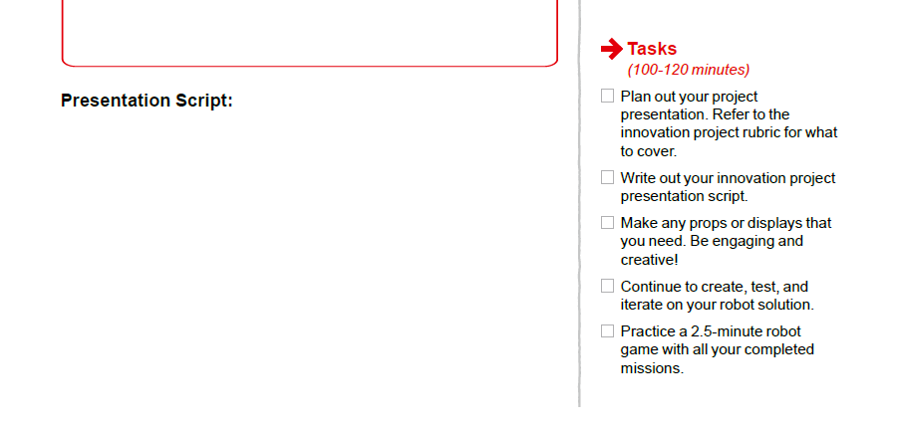

Iterate and Improve Robot Solution
Write out your Innovation Project presentation script.
Make any props or displays that you need. Be engaging and creative!
Notes:
Team Tasks (100-120 minutes)
Facilitator Tips –
Their presentation can be a slideshow, poster, play, or even a skit. Props can be used, such as costumes, shirts, or hats.
Scripts can be made for the judging session when the team presents their innovation project and robot solutions. Provide copies for each team member.
The team might need more space to store all their materials for the presentation.
Encourage the team to run their robot in practice 2.5-minute robot matches so that they get used to the time limit.
Provide the team with the innovation project rubric.

Slide 6
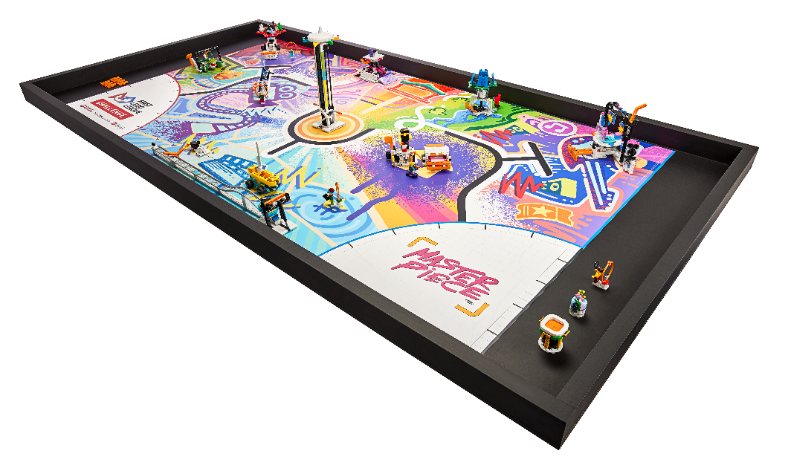
Iterate and Improve Robot Solution
Continue to create, test, and iterate on your robot solution.
Practice a 2.5 minute Robot Game with all your completed missions.
Notes:
Team Tasks (100-120 minutes)
Facilitator Tips –
Their presentation can be a slideshow, poster, play, or even a skit. Props can be used, such as costumes, shirts, or hats.
Scripts can be made for the judging session when the team presents their innovation project and robot solutions. Provide copies for each team member.
The team might need more space to store all their materials for the presentation.
Encourage the team to run their robot in practice 2.5-minute robot matches so that they get used to the time limit.
Provide the team with the innovation project rubric.

Slide 7

Share
Get together at the mat.
Share the project presentation work completed.
Share what missions you have completed.
Discuss how everyone will be involved in the presentation.
Discuss the reflection questions and clean up your space.
Notes:
Share (10-15 minutes)
Facilitator Tips –
Their presentation can be a slideshow, poster, play, or even a skit. Props can be used, such as costumes, shirts, or hats.
Scripts can be made for the judging session when the team presents their innovation project and robot solutions. Provide copies for each team member.
The team might need more space to store all their materials for the presentation.
Encourage the team to run their robot in practice 2.5-minute robot matches so that they get used to the time limit.
Provide the team with the innovation project rubric.

Slide 8
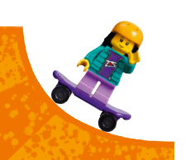

Reflection Questions
How did you decide which missions to attempt?
How can your innovation project solution help your community?
What skills have you developed throughout your MASTERPIECESM experience?
Notes:
Facilitator Tips –
Their presentation can be a slideshow, poster, play, or even a skit. Props can be used, such as costumes, shirts, or hats.
Scripts can be made for the judging session when the team presents their innovation project and robot solutions. Provide copies for each team member.
The team might need more space to store all their materials for the presentation.
Encourage the team to run their robot in practice 2.5-minute robot matches so that they get used to the time limit.
Provide the team with the innovation project rubric.

Slide 9

Multimedia Resources
You may wish to embed a relevant, age-appropriate video for your students here. See the Notes for an example.
Notes:
Choose a relevant, age-appropriate video for your students.
Example: Tournaments video https://youtu.be/vOdPEO3dUJg

Slide 10
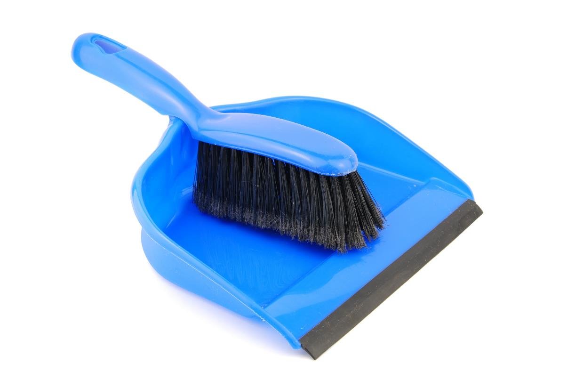
Clean Up
Notes:
Allow time for cleanup and place any unfinished models and their pieces in a sealed plastic bag.
Clean Up Pointers
You may wish to play a video or song during clean up time Link on
GoNoodle: https://family.gonoodle.com/activities/clean-up
Link on YouTube Kids: https://www.youtubekids.com/watch?v=ZJFk87ZsHn0
Link on Youtube: https://youtu.be/ZJFk87ZsHn0

Slide 11


LEGO, the LEGO logo, the SPIKE logo, MINDSTORMS and the MINDSTORMS logo are trademarks of the LEGO Group. ©2023 The LEGO Group. All rights reserved. FIRST®, the FIRST® logo, Coopertition®, Gracious Professionalism®, and FIRST IN SHOWSM, are trademarks of For Inspiration and Recognition of Science and Technology (FIRST). LEGO® is a registered trademark of the LEGO Group. FIRST® LEGO® League and MASTERPIECESM are jointly held trademarks of FIRST and the LEGO Group. All other trademarks are the property of their respective owners. ©2023 FIRST and the LEGO Group. All rights reserved.

