Slide 1
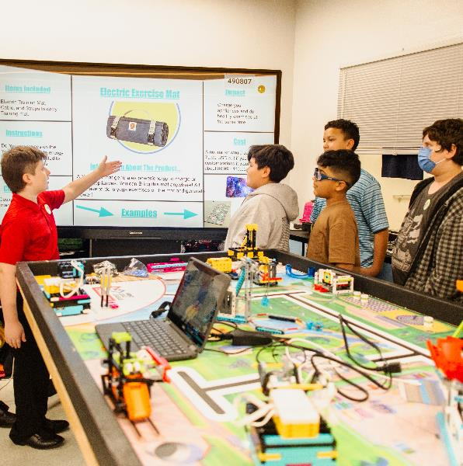
Session 11
Presentation Planning
Notes:
Facilitator Tips –
Have the team review the rubrics for examples of where inclusion is evaluated.
It’s important for the team to practice how to communicate their innovation project and robot design solutions.
Provide the team with the robot design rubric.
Every team member should be involved in the presentation at the judging session.
The team should know who will run the robot during the matches.

Slide 2
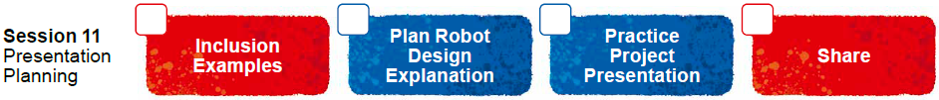
Session Overview
Outcomes
The team will finalize their live innovation project presentation.
The team will finalize their robot for the robot game and prepare their robot design explanation.
Notes:
Facilitator Tips –
Have the team review the rubrics for examples of where inclusion is evaluated.
It’s important for the team to practice how to communicate their innovation project and robot design solutions.
Provide the team with the robot design rubric.
Every team member should be involved in the presentation at the judging session.
The team should know who will run the robot during the matches.

Slide 3
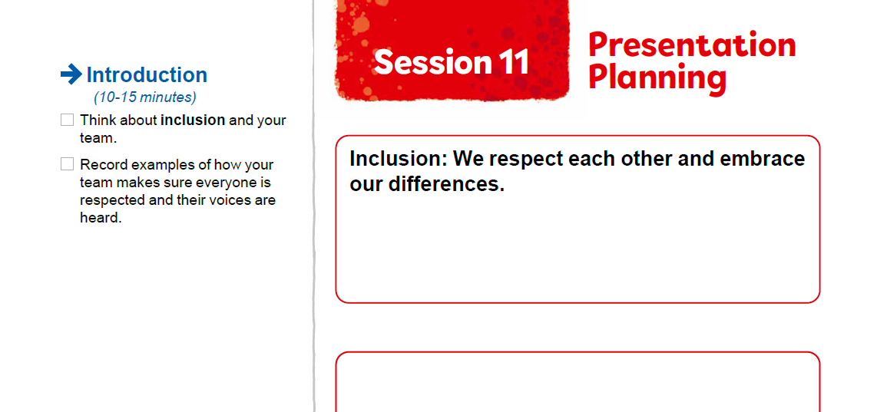


Introduction
Think about inclusion and your team.
Record examples of how your team makes sure everyone is respected and their voices are heard.
Notes:
Introduction (10-15 minutes)
Facilitator Tips –
Have the team review the rubrics for examples of where inclusion is evaluated.
It’s important for the team to practice how to communicate their innovation project and robot design solutions.
Provide the team with the robot design rubric.
Every team member should be involved in the presentation at the judging session.
The team should know who will run the robot during the matches.

Slide 4

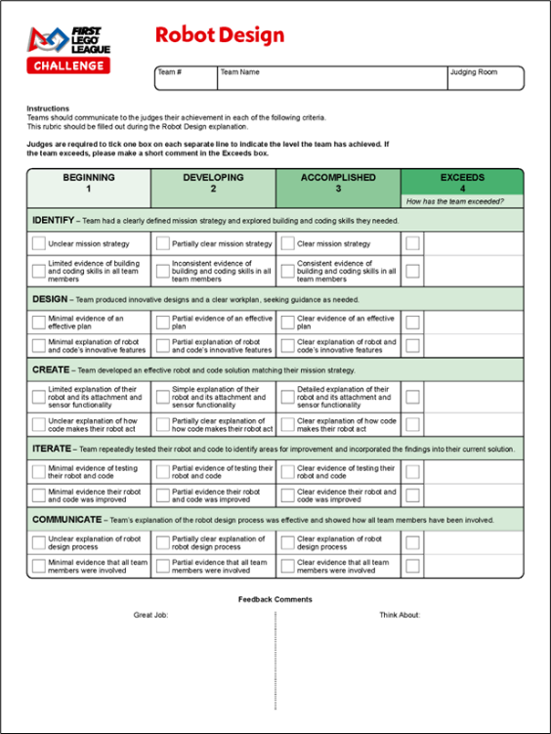
Plan Robot Design
Explanation
Continue working on your Innovation Project presentation.
Plan and write out your Robot Design explanation. Refer to the Robot Design rubric for what to cover.
Notes:
Team Tasks (100-120 minutes)
Facilitator Tips –
Have the team review the rubrics for examples of where inclusion is evaluated.
It’s important for the team to practice how to communicate their innovation project and robot design solutions.
Provide the team with the robot design rubric.
Every team member should be involved in the presentation at the judging session.
The team should know who will run the robot during the matches.

Slide 5
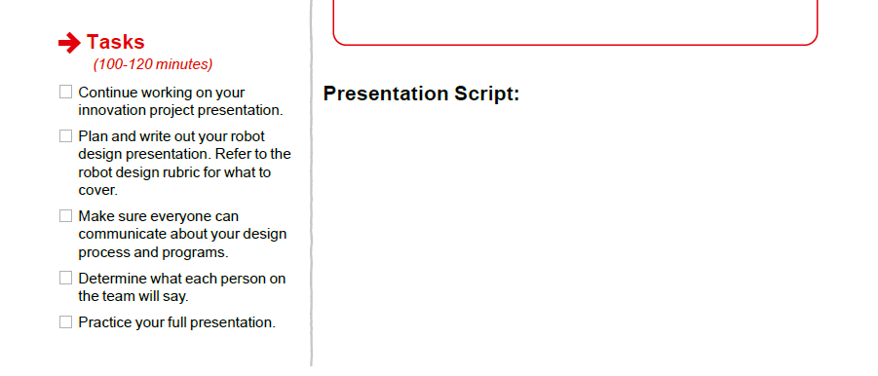

Plan Robot Design Explanation
Make sure everyone can communicate about your design process and programs.
Determine what each person on the team will say.
Practice your full presentation.
Notes:
Team Tasks (100-120 minutes)
Facilitator Tips –
Have the team review the rubrics for examples of where inclusion is evaluated.
It’s important for the team to practice how to communicate their innovation project and robot design solutions.
Provide the team with the robot design rubric.
Every team member should be involved in the presentation at the judging session.
The team should know who will run the robot during the matches.

Slide 6
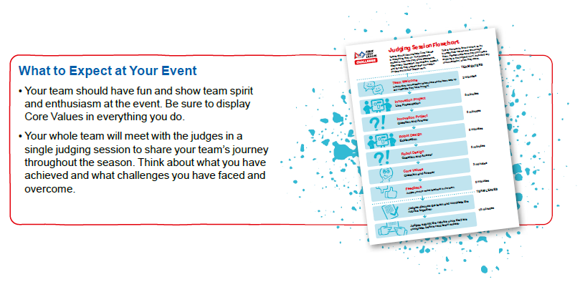
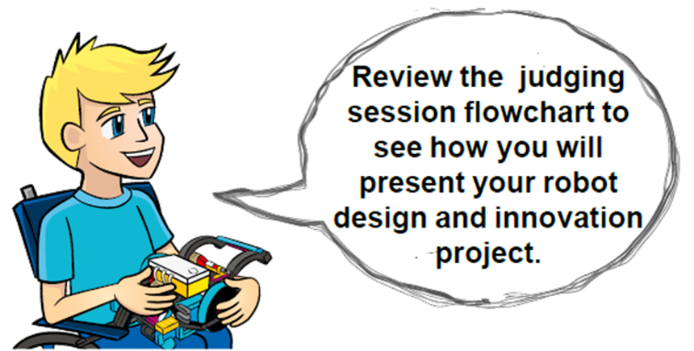
Plan Robot Design Explanation
Notes:
Team Tasks (100-120 minutes)
Facilitator Tips –
Have the team review the rubrics for examples of where inclusion is evaluated.
It’s important for the team to practice how to communicate their innovation project and robot design solutions.
Provide the team with the robot design rubric.
Every team member should be involved in the presentation at the judging session.
The team should know who will run the robot during the matches.

Slide 7

Share
Get together at the mat.
Discuss the presentation and each person’s role.
Run a practice 2.5-minute match and explain what missions were done.
Discuss the reflection questions.
Decide what else needs to be done and clean up your space.
Notes:
Share (10-15 minutes)
Facilitator Tips –
Have the team review the rubrics for examples of where inclusion is evaluated.
It’s important for the team to practice how to communicate their innovation project and robot design solutions.
Provide the team with the robot design rubric.
Every team member should be involved in the presentation at the judging session.
The team should know who will run the robot during the matches.

Slide 8
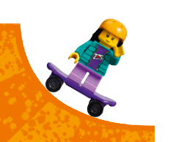
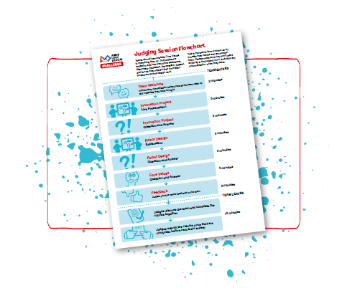
Reflection Questions
What will you do if one mission does not work?
How is everyone involved in the presentation?
How has FIRST® LEGO® League impacted you?
Notes:
Facilitator Tips –
Have the team review the rubrics for examples of where inclusion is evaluated.
It’s important for the team to practice how to communicate their innovation project and robot design solutions.
Provide the team with the robot design rubric.
Every team member should be involved in the presentation at the judging session.
The team should know who will run the robot during the matches.

Slide 9

Multimedia Resources
You may wish to embed a relevant, age-appropriate video for your students here. See the Notes for an example.
Notes:
Choose a relevant, age-appropriate video for your students.
Example: Judging Session overview https://youtu.be/B6cmntZVFSM

Slide 10

Clean Up
Notes:
Allow time for cleanup and place any unfinished models and their pieces in a sealed plastic bag.
Clean Up Pointers
You may wish to play a video or song during clean up time Link on
GoNoodle: https://family.gonoodle.com/activities/clean-up
Link on YouTube Kids: https://www.youtubekids.com/watch?v=ZJFk87ZsHn0
Link on Youtube: https://youtu.be/ZJFk87ZsHn0

Slide 11


LEGO, the LEGO logo, the SPIKE logo, MINDSTORMS and the MINDSTORMS logo are trademarks of the LEGO Group. ©2023 The LEGO Group. All rights reserved. FIRST®, the FIRST® logo, Coopertition®, Gracious Professionalism®, and FIRST IN SHOWSM, are trademarks of For Inspiration and Recognition of Science and Technology (FIRST). LEGO® is a registered trademark of the LEGO Group. FIRST® LEGO® League and MASTERPIECESM are jointly held trademarks of FIRST and the LEGO Group. All other trademarks are the property of their respective owners. ©2023 FIRST and the LEGO Group. All rights reserved.

