Slide 1
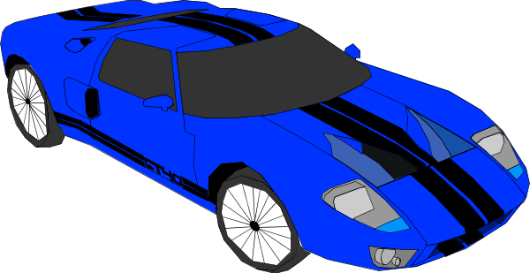
Motorsport data analysis
Engineers gather and interpret data from a wide range of trials.
This activity is about data from a motor race.

Slide 2
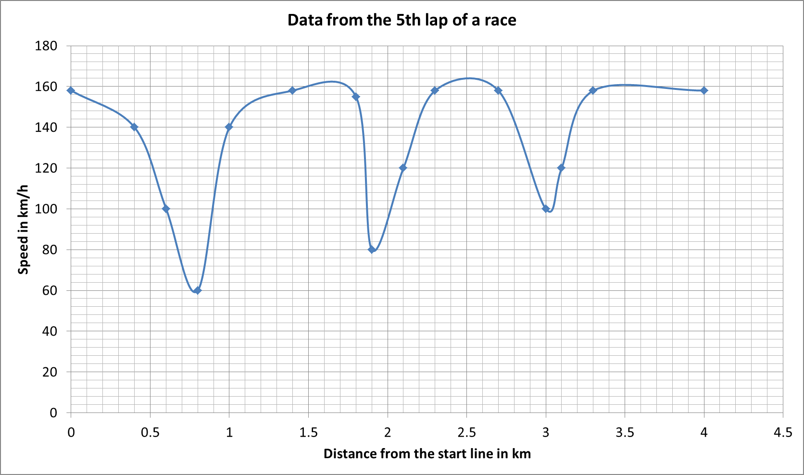
Data from a lap of a motor race
How many km is a lap of the track?
How many bends do you think are on the track?
Do you think this was the 1st lap, or a later lap?
What is the maximum speed?
A race is 300 km long, how many laps would that be?

Slide 3
The winner finishes the 300 km long race in one hour and twenty minutes.
The slowest car takes 107% of the time that the winner takes.
Work out the time between the first and last car finishing the race.
When the winner finishes the race, about how far does the last car have left to travel?

