Slide 1
Magic Square puzzles
8 | 1 | 6
3 | 5 | 7
4 | 9 | 2
Practical investigation creating ‘magic squares’ in the school playground.

Slide 2
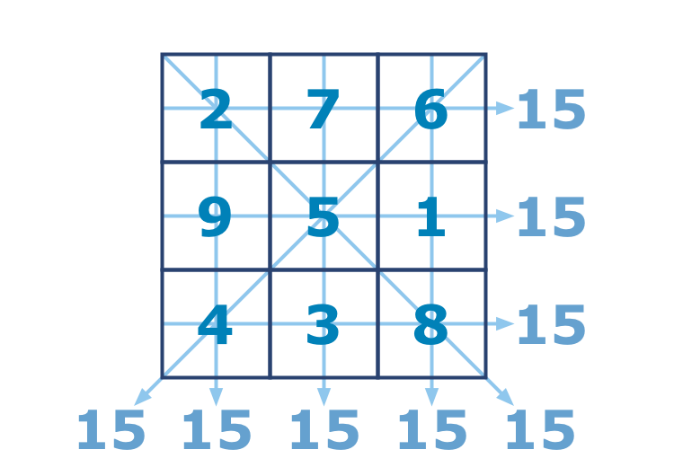
Magic Squares – What are they?
Numbers 1 to 9
Each Row, Column and Diagonal add up to the same total
The Magic Number is 15
3 x 3 GRID

Slide 3
Magic Squares - Grids
What is the Magic Number?
Grid size | Grid | Numbers | Magic Number
3x3 |  | 1-9 | 15
4x4 |  | 1-16 | 34
5x5 |  | 1-25 | 65
8 | 1 | 6
3 | 5 | 7
4 | 9 | 2
8 | 1 | 6 | 10
3 | 5 | 7 | 11
4 | 9 | 2 | 12
16 | 15 | 14 | 13
8 | 1 | 6 | 10 | 17
3 | 5 | 7 | 11 | 18
4 | 9 | 2 | 12 | 19
16 | 15 | 14 | 13 | 20
25 | 24 | 23 | 22 | 21

Slide 4
Magic Squares
8 | 1 | 6
3 | 5 | 7
4 | 9 | 2
8
 | 5 | 7
 |  | 2
Try this one
Numbers 1-9
Magic Number is 15

Slide 5
Magic Squares
? | 7 | 6
 | 5 | ?
4 | 3 | ?
 |  | 6
9 | 5
 | 3
What are the missing numbers on this one?
Remember:
Numbers 1-9
Magic Number is 15

Slide 6
Magic Squares
2 | 7 | 6
9 | 5 | 1
4 | 3 | 8
 |  | 6
9 | 5
 | 3
The answer:

Slide 7
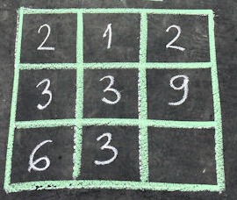
Magic Squares - Activity
Draw the 3x3 grid with chalk
Add your own numbers 1-9
Get your partner to have a go
Remember the magic number is 15

Slide 8
Magic Squares - Extension
2 |  | 12 | 13
16 | 9
5 |  | 15
11 |  | 1 | 8
2 | 7 | 12 | 13
16 | 9 | 6 | 3
5 | 4 | 15 | 10
11 | 14 | 1 | 8
Try creating your own 4 x 4 magic square, like this…
Remember:
Numbers between 1-16
Magic Number is 34

