Slide 1
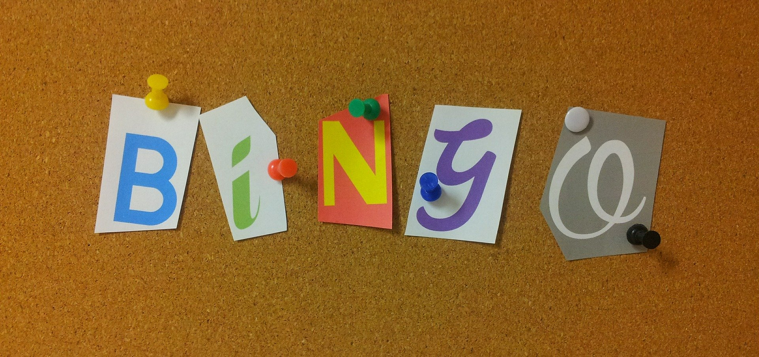
Times table bingo
Answer each multiplication problem and see if you can win the game!

Slide 2
How to play Times table bingo!
Your teacher will read out a multiplication question.
Work out the answer and see if you have it on your card.
If the answer is on your card then highlight it with your highlighter pen.
Once all your numbers are highlighted shout BINGO! The first to do this is the winner!
Notes:
Players have won the game once all their numbers are covered. As a variant and to add extra ‘winners’ players could call horizontal or vertical lines as well as the full card. Highlighter pens can be given out to mark the cards. If these are to be re-used then they could be laminated and learners given plastic counters or chips to cover their cards with. Once a learner calls the teacher will need to check that they have correctly answered each problem to complete their card. If not then the game continues until another winner is found! The game can be reset and re-played as many times as required to ensure that learners confident in using the times tables being practiced. Some learners may also find it beneficial to have a pen and paper nearby to help them to work out the answer to each question, particularly for lower ability learners or for more challenging multiplications.

Slide 3
4 | 20 | 16
35 | 45 | 6
50 | 15 | 90
Notes:
These cards are based on the 2, 5 and 10 times tables. 10 different cards have been provided, and more can be created if needed using the additional blank template. These can be printed onto card or paper.

Slide 4
30 | 6 | 14
25 | 22 | 120
40 | 15 | 55
Notes:
These cards are based on the 2, 5 and 10 times tables. 10 different cards have been provided, and more can be created if needed using the additional blank template. These can be printed onto card or paper.

Slide 5
18 | 45 | 8
50 | 4 | 100
25 | 30 | 10
Notes:
These cards are based on the 2, 5 and 10 times tables. 10 different cards have been provided, and more can be created if needed using the additional blank template. These can be printed onto card or paper.

Slide 6
24 | 30 | 2
8 | 80 | 14
60 | 35 | 4
Notes:
These cards are based on the 2, 5 and 10 times tables. 10 different cards have been provided, and more can be created if needed using the additional blank template. These can be printed onto card or paper.

Slide 7
50 | 4 | 12
10 | 5 | 60
22 | 55 | 70
Notes:
These cards are based on the 2, 5 and 10 times tables. 10 different cards have been provided, and more can be created if needed using the additional blank template. These can be printed onto card or paper.

Slide 8
15 | 90 | 40
2 | 18 | 6
30 | 35 | 14
Notes:
These cards are based on the 2, 5 and 10 times tables. 10 different cards have been provided, and more can be created if needed using the additional blank template. These can be printed onto card or paper.

Slide 9
8 | 110 | 20
45 | 24 | 12
80 | 16 | 14
Notes:
These cards are based on the 2, 5 and 10 times tables. 10 different cards have been provided, and more can be created if needed using the additional blank template. These can be printed onto card or paper.

Slide 10
12 | 40 | 20
15 | 70 | 18
90 | 25 | 4
Notes:
These cards are based on the 2, 5 and 10 times tables. 10 different cards have been provided, and more can be created if needed using the additional blank template. These can be printed onto card or paper.

Slide 11
14 | 30 | 5
8 | 40 | 22
120 | 15 | 35
Notes:
These cards are based on the 2, 5 and 10 times tables. 10 different cards have been provided, and more can be created if needed using the additional blank template. These can be printed onto card or paper.

Slide 12
55 | 30 | 4
2 | 100 | 25
60 | 90 | 14
Notes:
These cards are based on the 2, 5 and 10 times tables. 10 different cards have been provided, and more can be created if needed using the additional blank template. These can be printed onto card or paper.

Slide 13
Notes:
This is a blank card for adding your own numbers or for learners to add their own numbers.

Slide 14
2, 5 and 10 times tables
2 times tables | 5 times tables | 10 times tables
2 x 1 = 2 | 5 x 1 = 5 | 10 x 1 = 10
2 x 2 = 4 | 5 x 2 = 10 | 10 x 2 = 20
2 x 3 = 6 | 5 x 3 = 15 | 10 x 3 = 30
2 x 4 = 8 | 5 x 4 = 20 | 10 x 4 = 40
2 x 5 = 10 | 5 x 5 = 25 | 10 x 5 = 50
2 x 6 = 12 | 5 x 6 = 30 | 10 x 6 = 60
2 x 7 = 14 | 5 x 7 = 35 | 10 x 7 = 70
2 x 8 = 16 | 5 x 8 = 40 | 10 x 8 = 80
2 x 9 = 18 | 5 x 9 = 45 | 10 x 9 = 90
2 x 10 = 20 | 5 x 10 = 50 | 10 x 10 = 100
2 x 11 = 22 | 5 x 11 = 55 | 10 x 11 = 110
2 x 12 = 24 | 5 x 12 = 60 | 10 x 12 = 120
Notes:
This is a list of times tables for 2, 5 and 10. This could be printed and used for calling out the bingo card numbers. A highlighter could be used to mark which ones have been called so there is no duplication.

