Slide 1
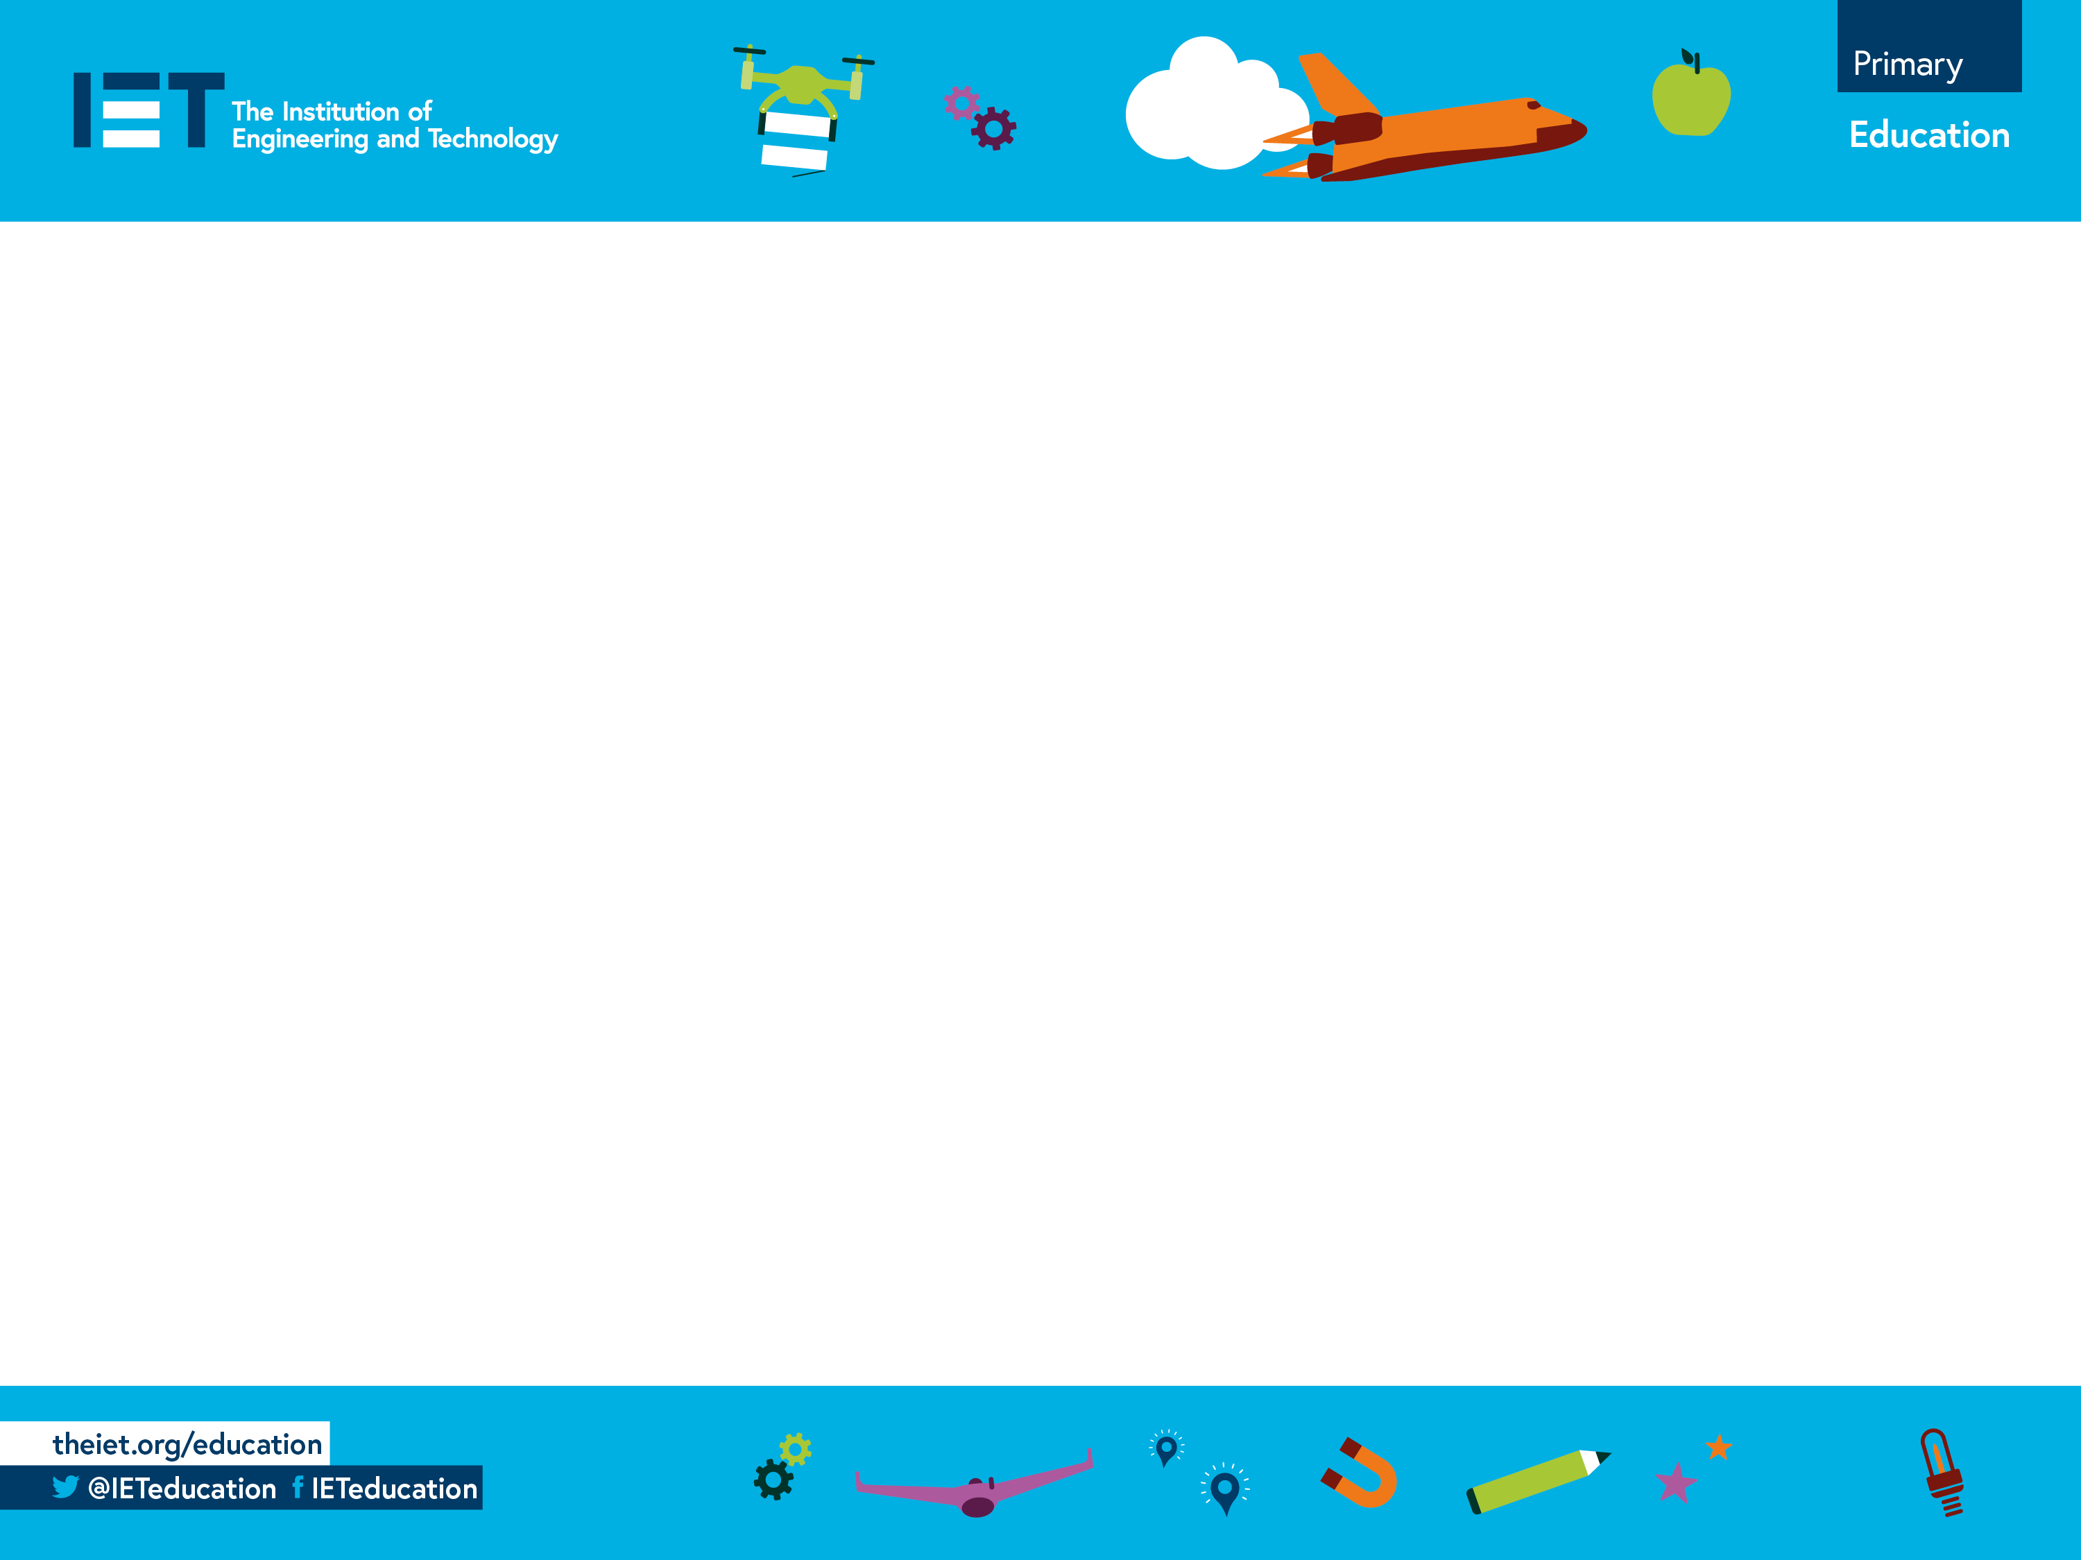
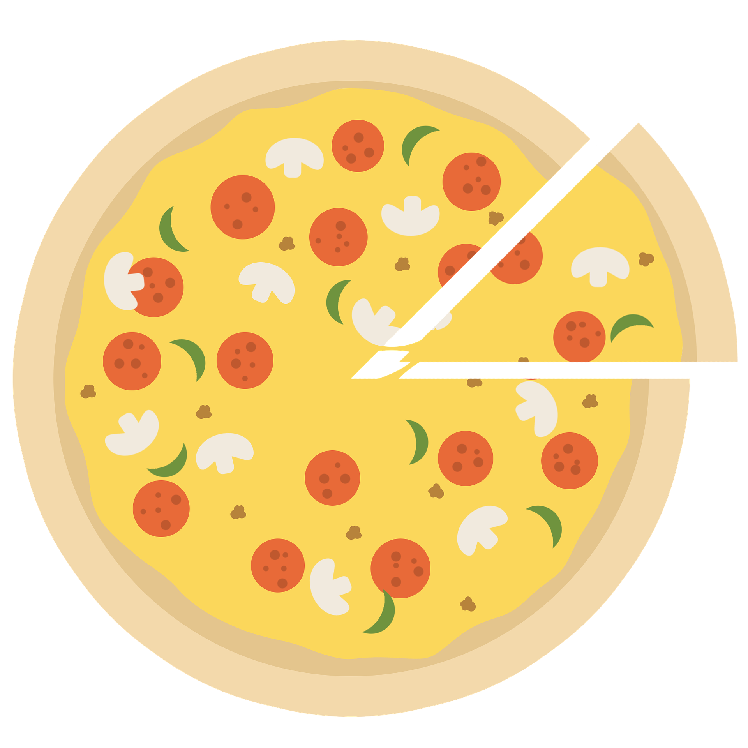
Pizza fractions
Understanding fractions through a pizza cutter approach

Slide 2
Pizza Fractions
1 Whole Pizza
We have a delicious pizza.
To share it with our friends we can use fractions.
Each piece of pizza we cut is a fraction of the whole pizza.

Slide 3
To share your pizza with 2 friends
you would cut the pizza into 2 halves.
2 Halves

Slide 4
To share your pizza with 4 friends
you would cut the pizza into 4 quarters.
4 Quarters

Slide 5
Colour the Pizza Fractions
3 Quarters
1 Quarter
1 Half
Whole

