Slide 1
Practical Probability
Working out the probabilities of picking fruit from a bag.

Slide 2
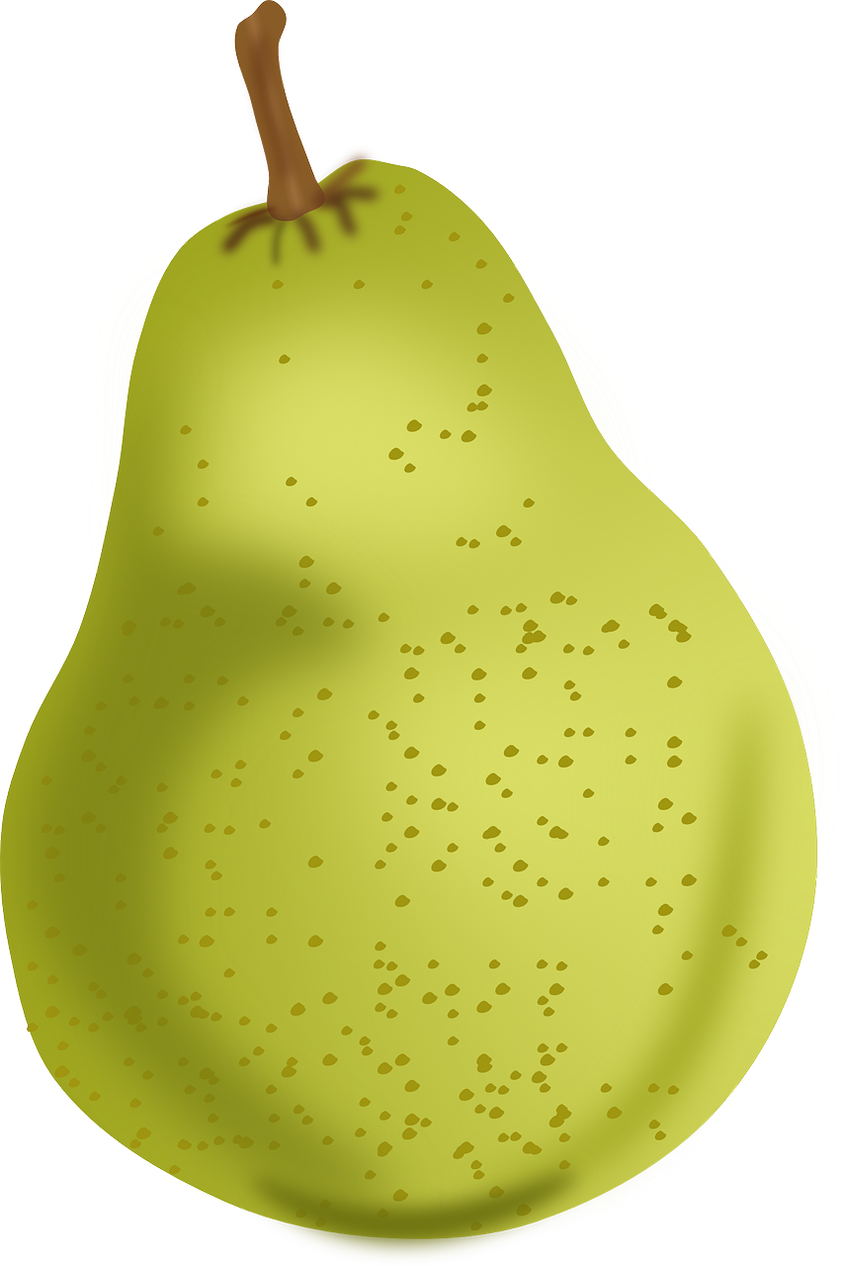
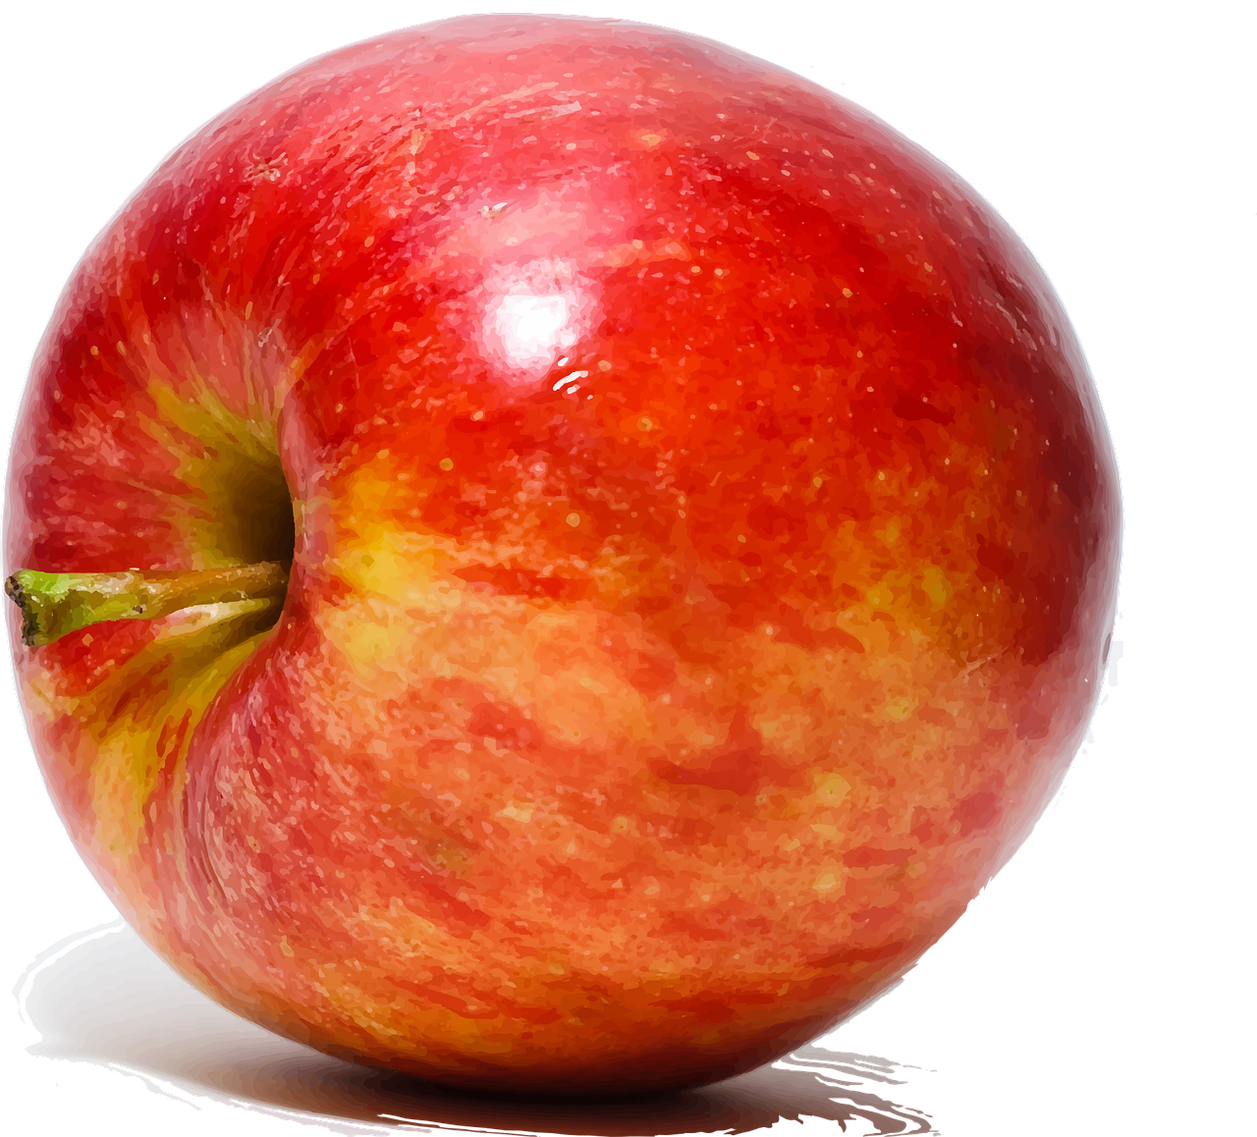
What’s in the bag?
1
8
7
4
4
3
5

Slide 3
Probability?
How many of that type of fruit
_____________________________
Probability =
Total number of items in the bag

Slide 4
If you pick fruit from the bag at random, what is the probability that it is a an apple?
Total number of fruit in the bag = 32
Total number of apples = 4
4
__
Probability of picking an apple =
32
1
Simplify
=
__
8

Slide 5
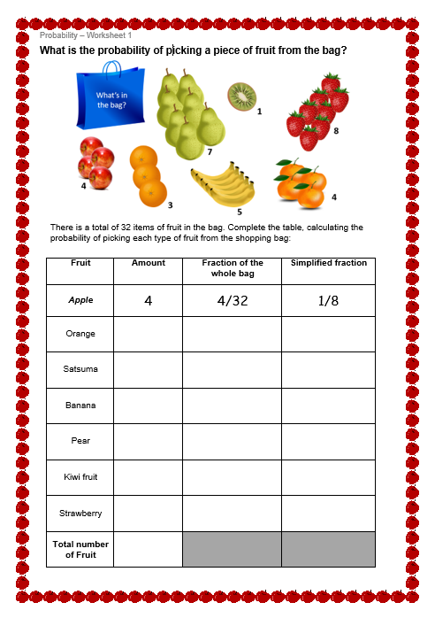
Probability Worksheet
Fill in worksheet 1 with the probability of picking each item in the bag

Slide 6
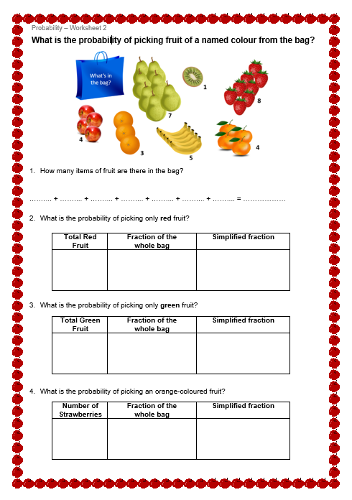
Probability Worksheet
Fill in worksheet 2 with the probability of picking fruit of a named colour from the bag

