Slide 1
Queues
You are in a shop, about to pay for something.
Which till queue would you join?
Why?
Till 1
Till 2
Till 3
Till 4
10 items
20 items
8 items
2 items
10 items
8 items
5 items
7 items
3 items
1 item

Slide 2
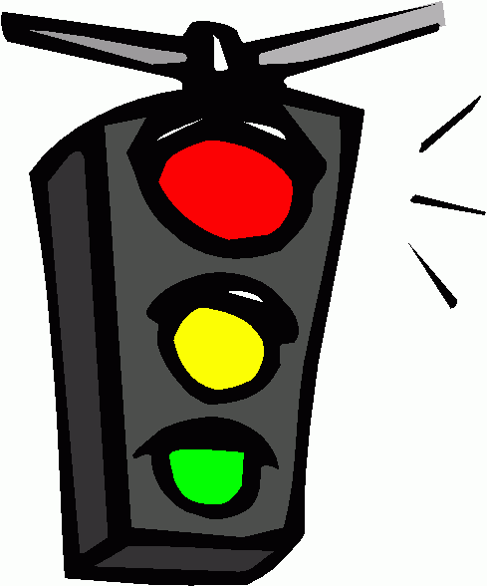
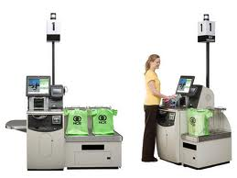
Queuing theory is an area of maths which has many applications.
When you log onto the internet you join a queue for a server.
Computer engineers and systems designers study queues to help them
make systems work more efficiently.
Civil engineers use it for traffic lights and retailers use queuing theory to reduce your wait time.
In the following task you will examine data from two queuing systems. Both systems have three service points (checkouts) but the queues have different rules.

Slide 3
System 1 Separate Queues
Rule
People join whichever queue they think will serve them the quickest. This is normally the shortest queue when they arrive, which means the people are shared out equally between the queues.
System 2 Single Queue
Rule
Everyone waits in one queue, and moves to the first available checkout when it becomes free.

Slide 4
System 1 Separate Queues
System 2 Single Queue
Waiting times for 25 People
Time (mins) | Frequency
0 | 5
1 | 5
2 | 5
3 | 3
4 | 4
8 | 1
10 | 2
Waiting times for 25 People
Time (mins) | Frequency
0 | 3
1 | 2
2 | 3
3 | 9
4 | 3
5 | 3
6 | 2
Using this data, compare both systems and suggest which you think is most efficient in reducing waiting time.

