Slide 1
Easy cookie recipe
How to scale up a recipe
Notes:
The recipe used here is based on https://www.bbcgoodfood.com/recipes/chocolate-chunk-cookies

Slide 2
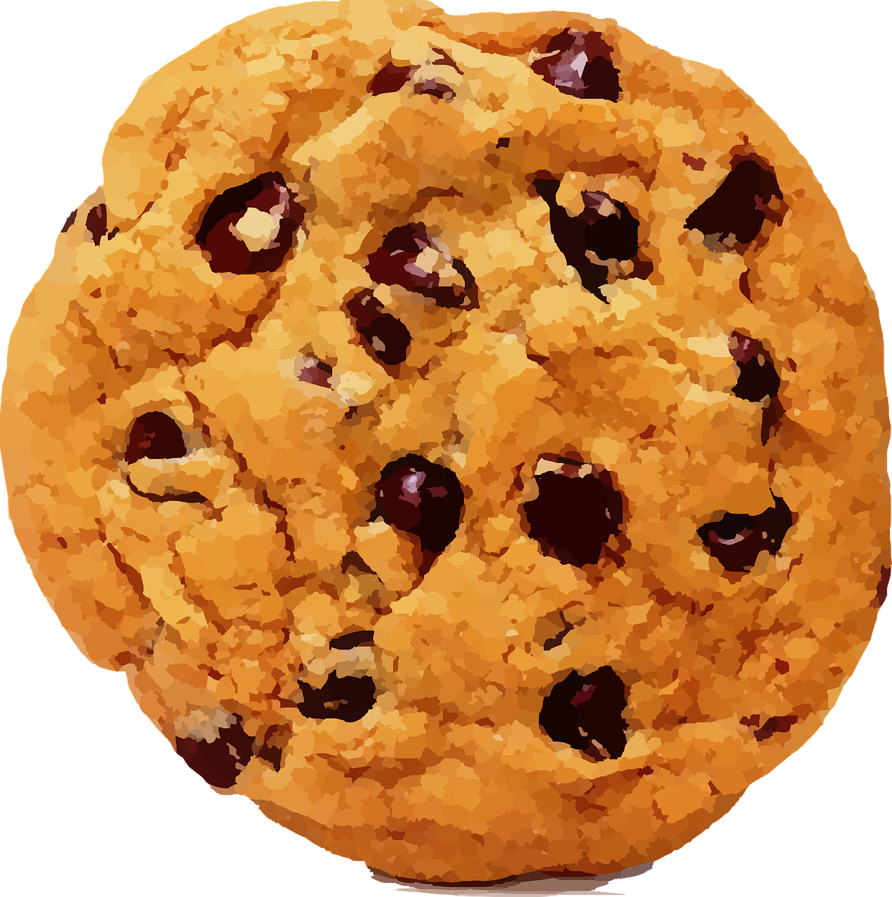
Cookie Recipe – Makes 5
75g sugar
90 g plain flour
60 g butter
1/2 tsp vanilla extract
1/4 tsp of bicarbonate of soda
1/8 tsp salt
1/2 medium egg
75 g chocolate chips

Slide 3
Worksheets - Scaling up
How many more ingredients are needed for a class party?
10 Cookies
20 Cookies

Slide 4
Cookie Recipe – Makes 10
150g sugar
180 g plain flour
120 g butter
1 tsp vanilla extract
1/2 tsp of bicarbonate of soda
1/4 tsp salt
1 medium egg
150 g chocolate chips

Slide 5
Cookie Recipe – Makes 20
300g sugar
360 g plain flour
240 g butter
2 tsp vanilla extract
1 tsp of bicarbonate of soda
1/2 tsp salt
2 medium eggs
300 g chocolate chips

