Slide 1
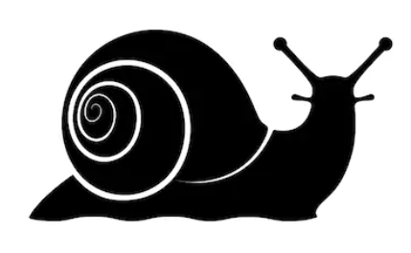
Measuring time
Teach the measurement of time
by racing to be the slowest!

Slide 2
Slow Walking Race Rules
Walk very slowly from the start to the finish
You must keep moving and only go forward
Winner is the last person over the finish line.

Slide 3
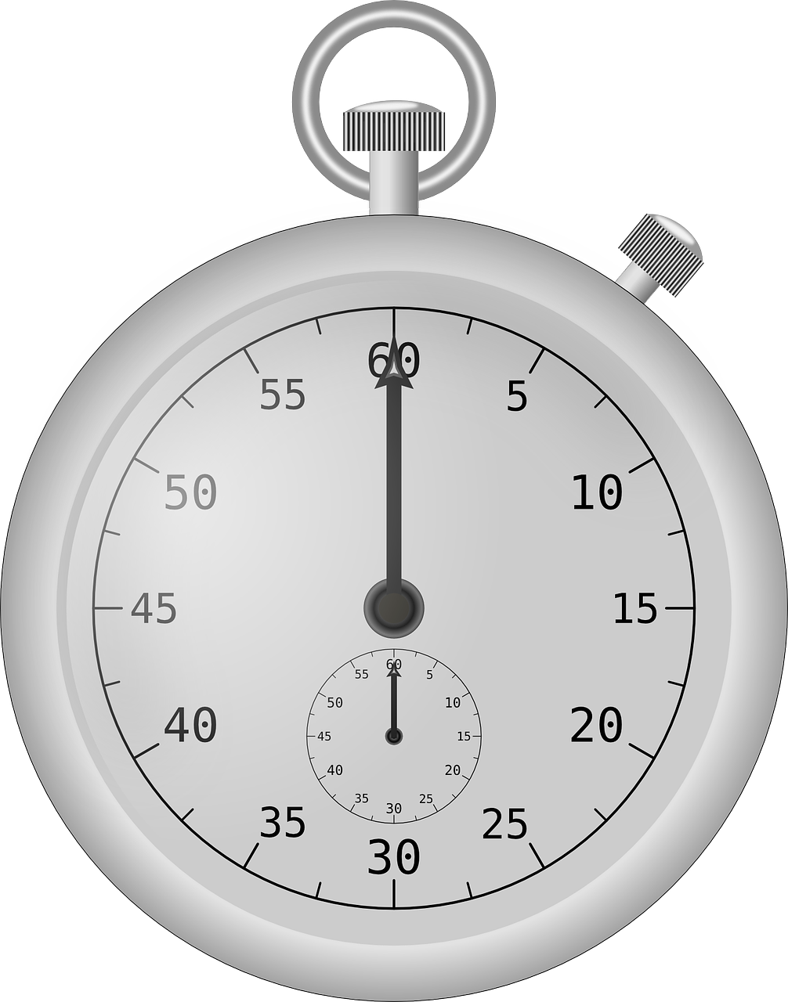
Slow Walking Race Instructions
Competing in groups
One person holds stopwatch
One person records times
Everyone else races
Swap roles after each race
Overall individual winner, slowest time
Overall team winner, slowest time.

Slide 4
Slow Race Results
Who | Time (Minutes and seconds) | Position

