Slide 1
Dress up game
A dress-the-model activity
to work out how many combinations of clothes are possible

Slide 2
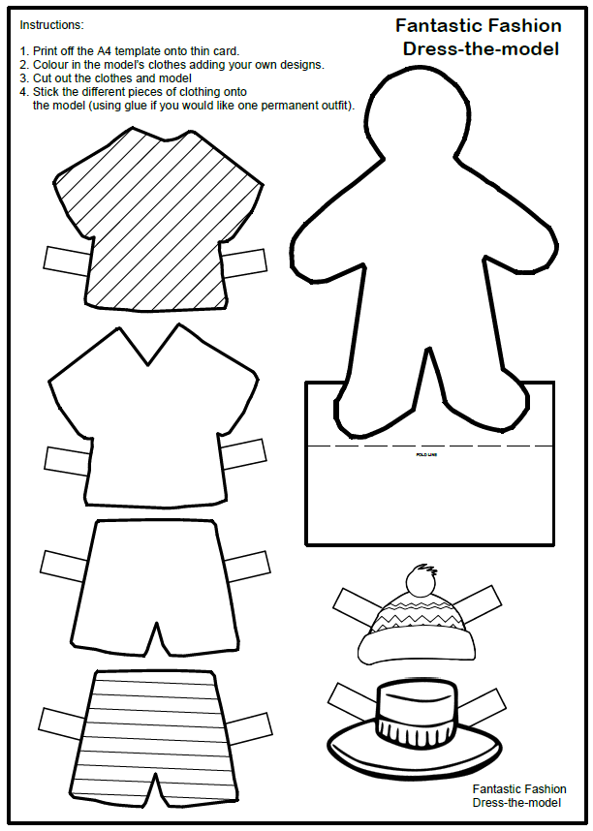
Step 1
You will need the Dress-the-model
handout

Slide 3
Step 2
Colour in the model’s clothes adding your own designs if you wish
Cut out the clothes and model safely with scissors
Attach the different pieces of clothing onto the model.

Slide 4
How many ways can the model get dressed?
Step 3
The model has a set number of clothes:
2 hats, a warm hat and a sun hat
2 shirts, one round neck one v neck
2 pairs of shorts, one plain one stripy.
Using Multiplication this could be worked out as:
2 x 2 x 2 = 8
So there are 8 ways the model could get dressed.

Slide 5
Dressing the model table
This is how many ways to dress-the-model in an information table:
 | 1 | 2 | 3 | 4 | 5 | 6 | 7 | 8
Hat | Warm | Warm | Warm | Warm | Sun | Sun | Sun | Sun
Shirt | Round neck | Round neck | V Neck | V Neck | Round neck | Round neck | V Neck | V Neck
Shorts | Plain | Stripy | Plain | Stripy | Plain | Stripy | Plain | Stripy

