Slide 1
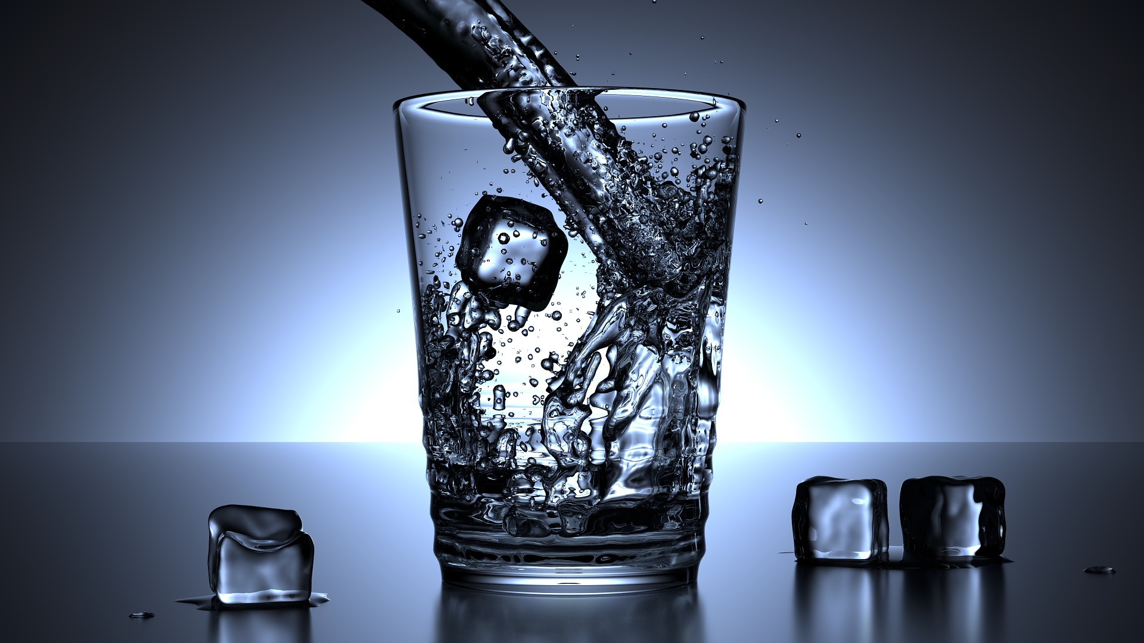
Fun with fractions
Using measurement and fractions

Slide 2
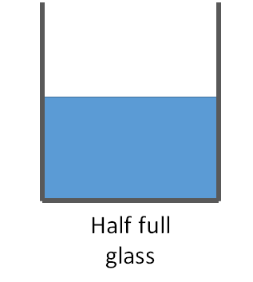
More or Less?
A
B
Full glass
Glass A has less water than glass B
Glass B has more water than glass A

Slide 3
Step 1
Fill two half size glasses with water. Then pour them into the larger glass.
Glass 1
Glass 2
Large Glass

Slide 4
Volume
As the two smaller glasses fill the larger glass one small glass is half the volume of the larger glass.
Glass 1
Glass 2
Large Glass

Slide 5
Step 2
Now fill four smaller glasses with water and pour them into a large glass.
Glass 1
Glass 2
Glass 3
Glass 4
Large Glass

Slide 6
Volume
As the four smaller glasses fill the larger glass they are four quarter the volume of the larger glass. So one small glass is one quarter of the volume.
Glass 1
Glass 2
Glass 3
Glass 4
Large Glass

Slide 7
Combinations?
Experiment with quarter and half size glasses full of water to see what combinations you can get to fill up the large glass.
Quarter Glass
Half Glass
Large Glass

Slide 8
Half full or Half empty?
An engineer would say:
the glasses are twice the size they need to be!

