Slide 1
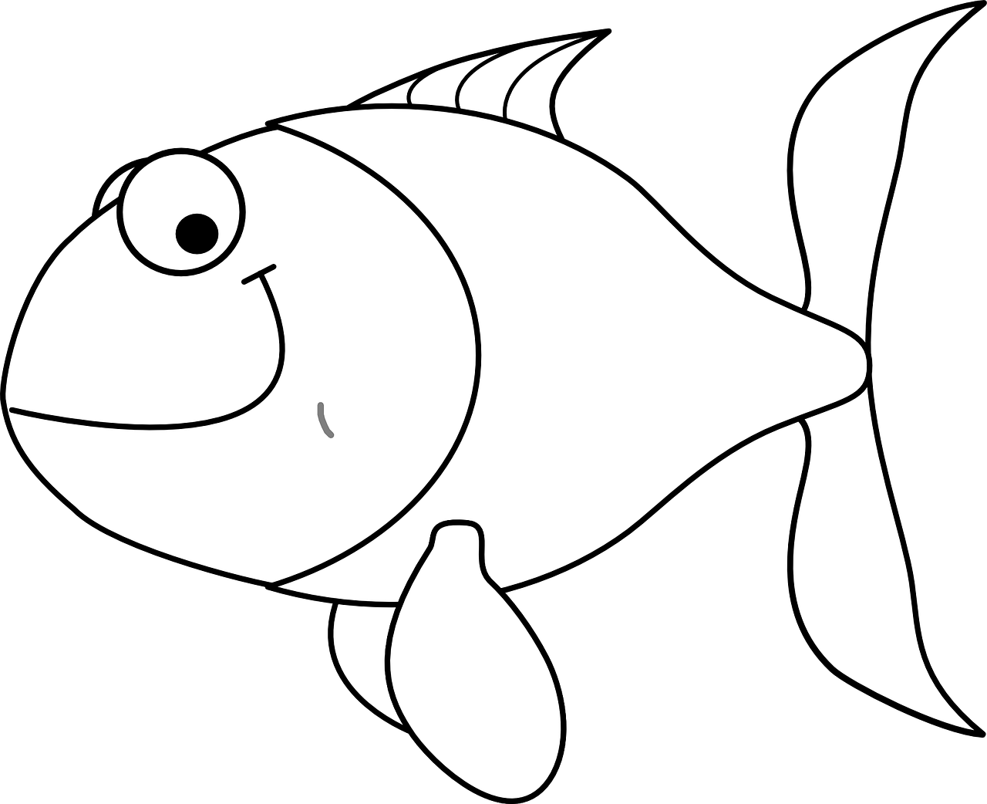
How to work out scale
Scaling activity to change the size of items

Slide 2
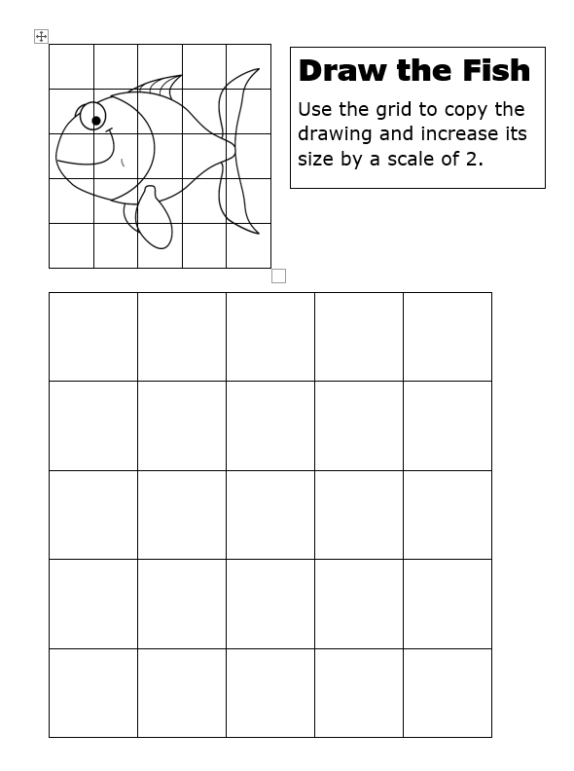
Step 1 - Scaling up
Draw the fish into the large grid so it is twice the size.
The small grid squares are 15 mm tall.
The large grid squares are as tall as two of the small grid squares:
15 mm + 15 mm = 30 mm
We could work also work this out using multiplication:
2 × 15 mm = 30 mm

Slide 3
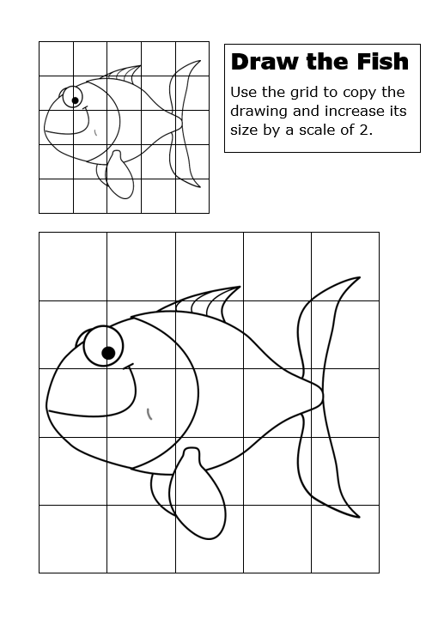
Draw the Fish - Scaling up

Slide 4
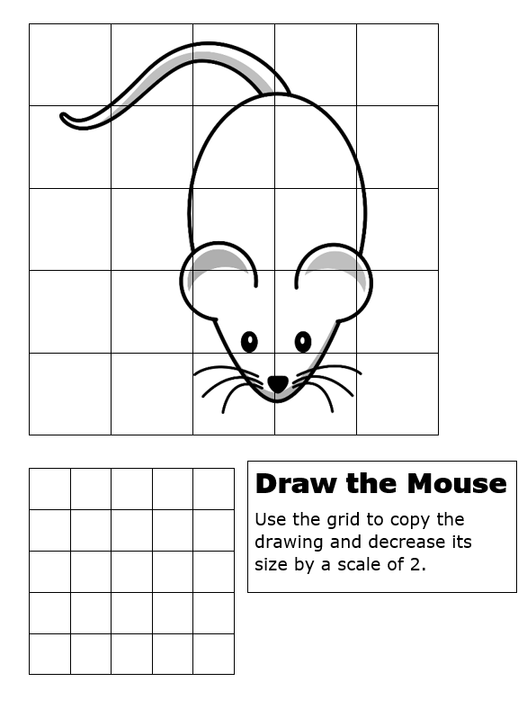
Step 2 - Scaling down
Draw the mouse into the smaller grid so it is half its size.
The large grid squares are 30 mm tall.
The small grid squares are half as tall – we can work this out using division:
30 mm ÷ 2 = 15 mm

Slide 5
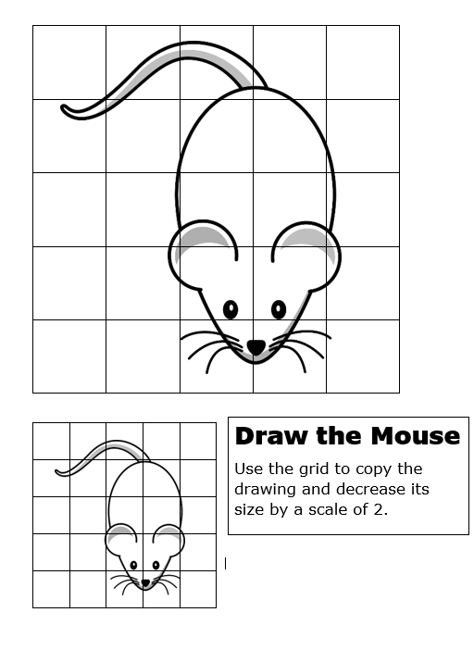
Draw the Mouse - Scaling down

