Slide 1
Edges, vertices and faces
Making cut-out 3D shapes and counting the number of edges, vertices and faces

Slide 2
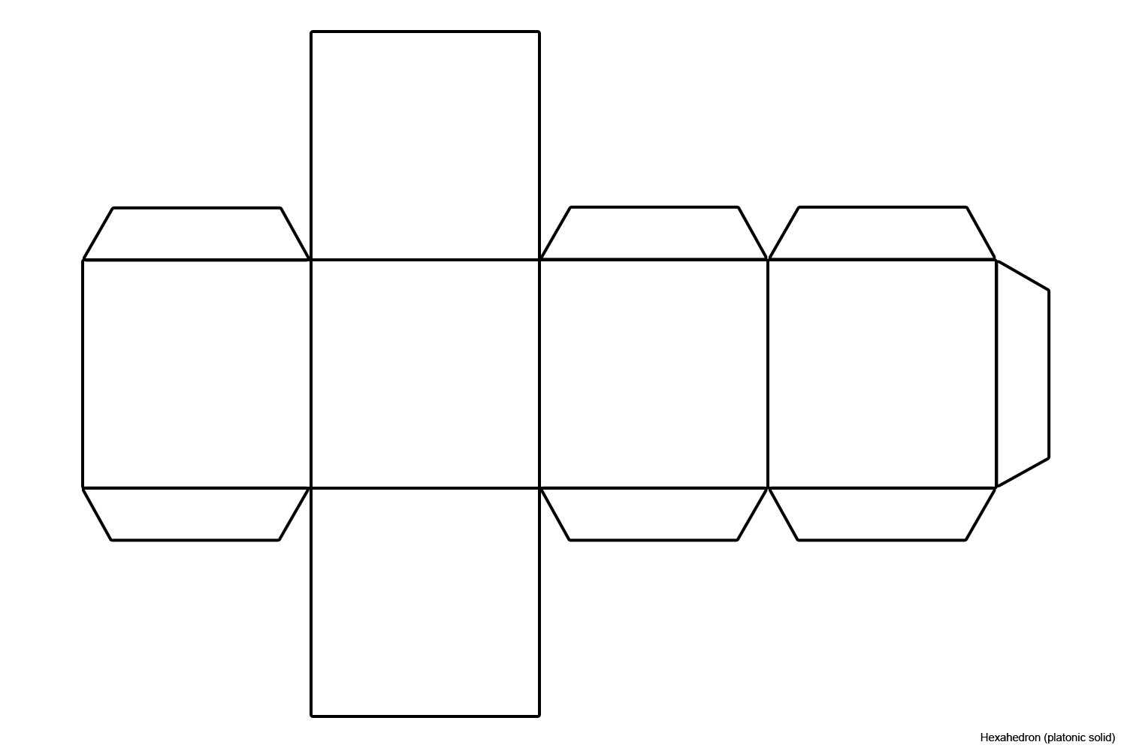
Making the shapes
Cut out each of your shape nets, including the flaps!
Put glue on each of the flaps.
Fold up each net to make the shape.
Notes:
Teacher should demonstrate how to fold up each net into a 3D shape. Teacher could show how to make each shape one at a time, with learners following them as they do it. If available, a visualiser or small webcam would help with this. Sometimes learners forget the flaps and cut out the nets without them, so remind them about the need for these when making each shape. Learners could use double sided tape instead of a glue stick on the flaps, or use tape on the outside of the shapes to hold them together.

Slide 3
Cube
Notes:
Example cube net.

Slide 4
Cube
Notes:
Example finished cube.

Slide 5
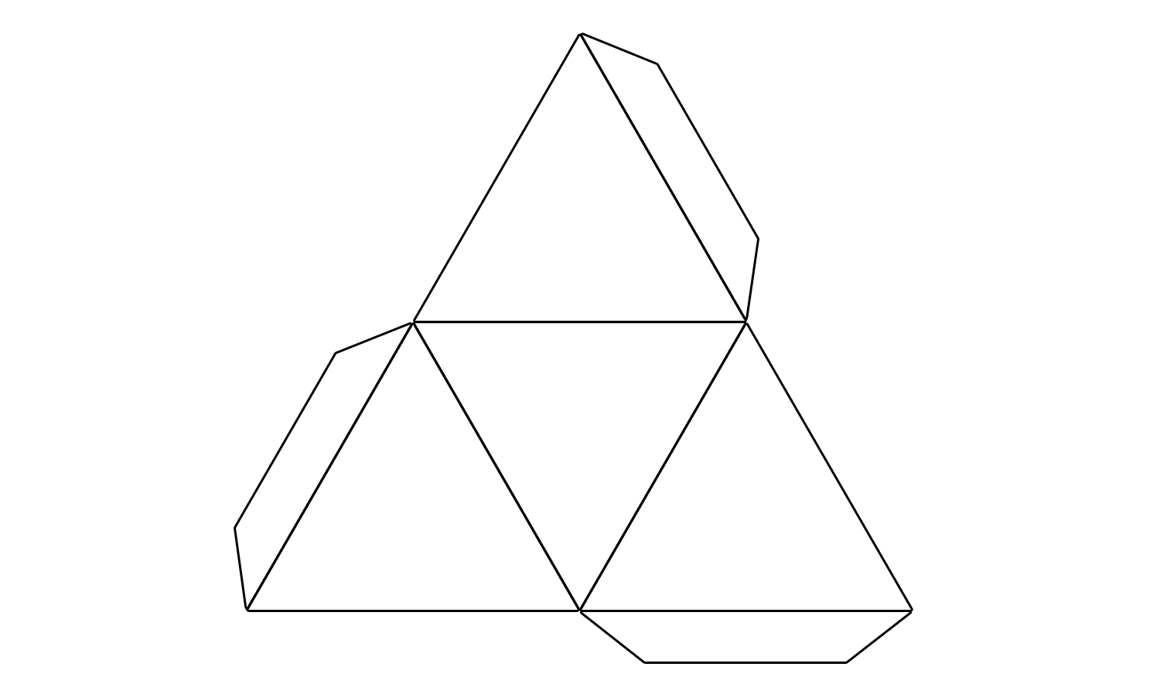
Pyramid
Notes:
Example pyramid net.

Slide 6
Pyramid
Notes:
Example finished pyramid.

Slide 7
Cylinder
Notes:
Example cylinder net.

Slide 8
Cylinder
Notes:
Example finished cylinder

Slide 9
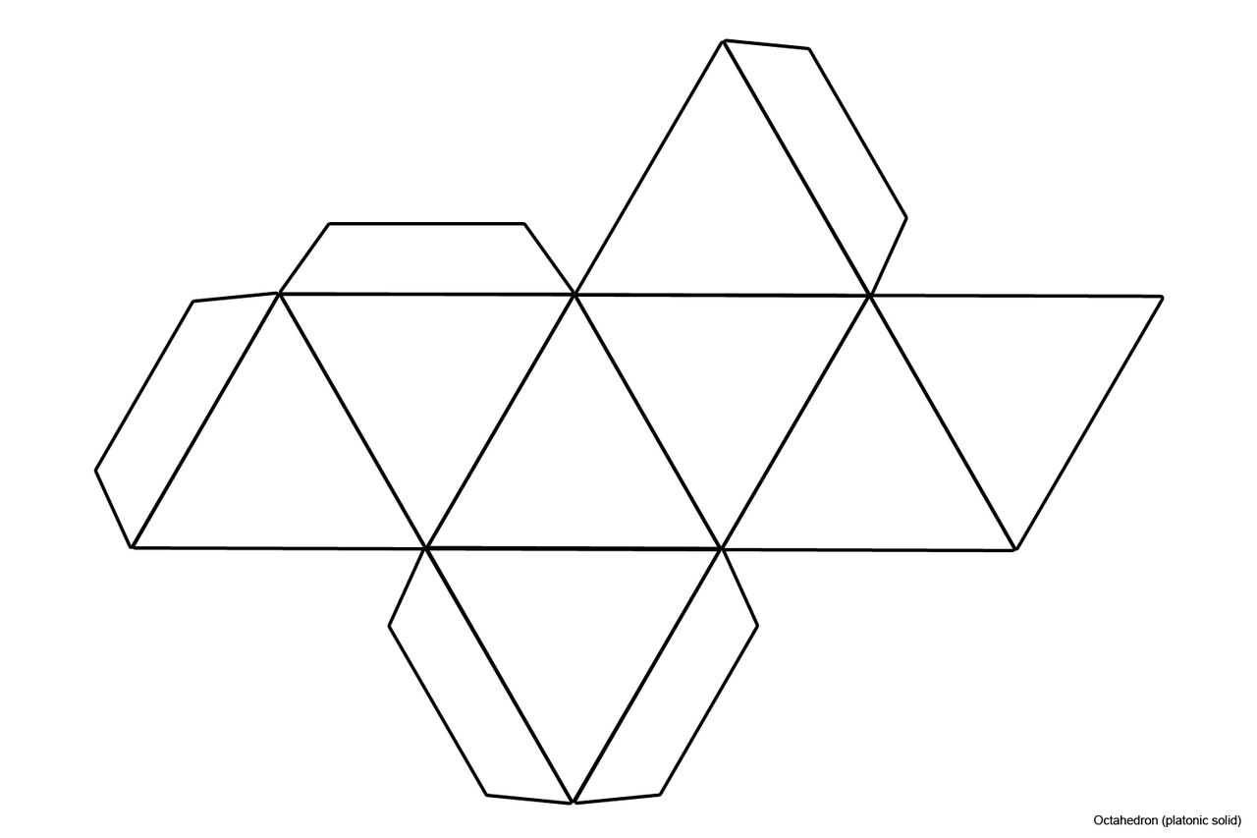
Octahedron
Notes:
Example octahedron net.

Slide 10
Octahedron
Notes:
Example finished octahedron.

Slide 11
Edges, vertices and faces
Shape | Number of edges | Number of vertices | Number of faces
Cube
Pyramid
Cylinder
Octahedron
Notes:
This slide can be printed and used as a handout for learners to write the number of edges, vertices and faces on each 3D shape that they have made.

Slide 12
Edges, vertices and faces - answers
Shape | Number of edges | Number of vertices | Number of faces
Cube | 12 | 8 | 6
Pyramid | 6 | 4 | 4
Cylinder | 2 | 0 | 3
Octahedron | 12 | 6 | 8
Notes:
Show the answers after learners have filled in their own sheet – learners could also use this slide to self and/or peer assess their responses.

Slide 13
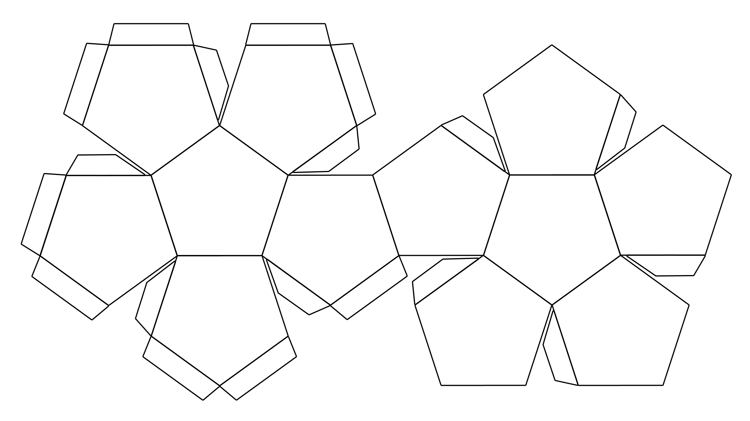
Extension - Dodecahedron
Notes:
This could be used as an extension for more able learners.

