Slide 1
Calculate journey times
An activity to compare journey times for different modes of transport

Slide 2
Distance, Speed and Time
Distance
Distance
Time =
Speed
Speed
Time
Notes:
Use the triangle to work out the formula for the parameter required – in this case time.

Slide 3
Average Speeds
Walking – 3 miles per hour (mph)
Bike – 15 mph
Car – 55 mph
Train – 125 mph
Jet airplane – 550 mph
Notes:
Any statistics or data on transport speeds used in this presentation is solely for the purpose of this activity and may not be an accurate reflection of actual current times

Slide 4
What is the Journey Time?
A journey of 100 miles in a car:
Distance
Using the formulae
Time =
Speed
100 miles
Insert the values
Time =
55 mph
Time =
1.82 hours
Convert to minutes
Time =
1.82 hrs x 60 = 109.2 mins
Convert to hours & minutes
Time =
1 hour 49 mins 12 seconds

Slide 5
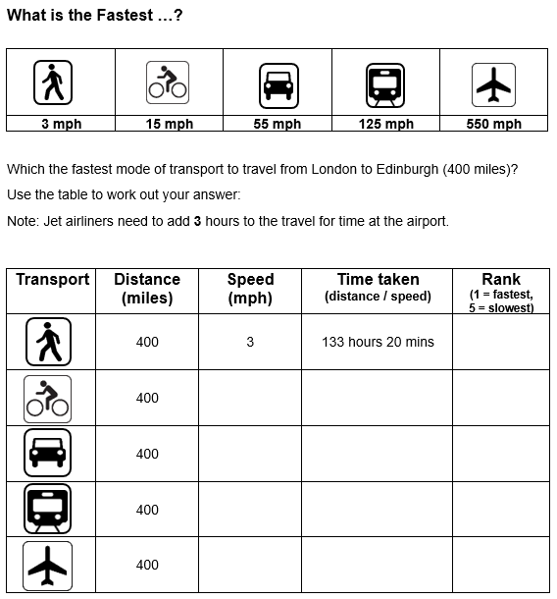
Compare the Journey Times
Complete the activity sheet, calculating the journey times
Rank the different modes of transport from fastest (1) to slowest (5)
Which mode of transport would you use? Why?

