Slide 1
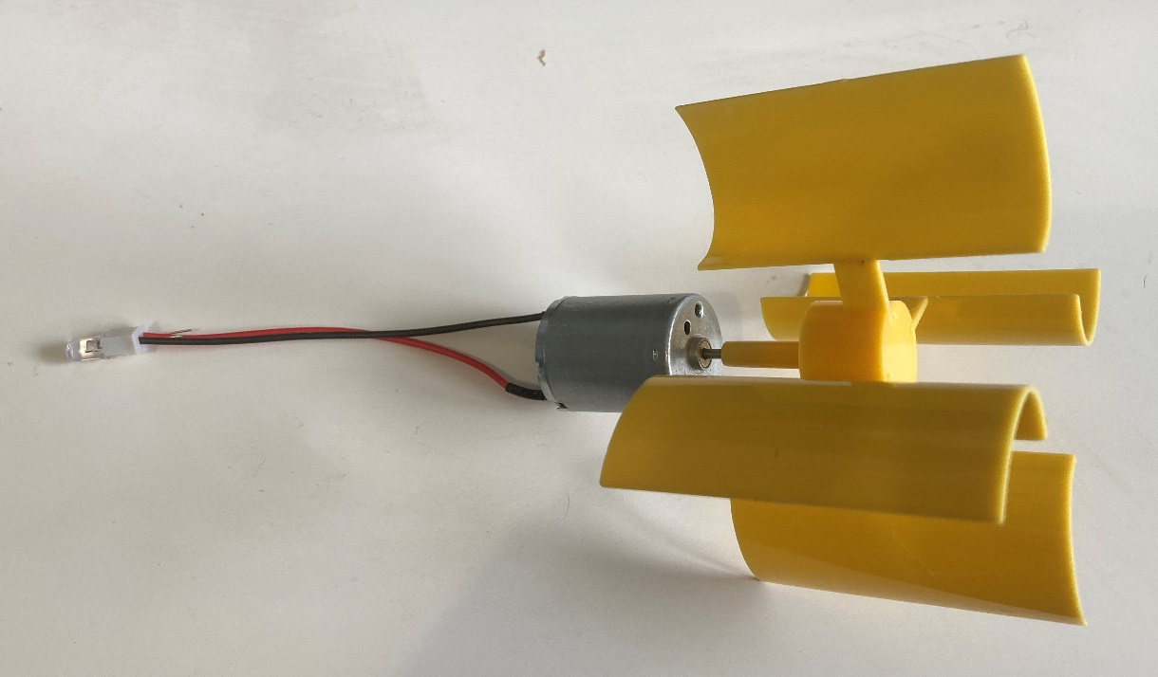
Sustainable lighting design
Designing and making a sustainably powered light

Slide 2
Stay safe
Whether you are a scientist researching a new medicine or an engineer solving climate change, safety always comes first. An adult must always be around and supervising when doing this activity. You are responsible for:
• ensuring that any equipment used for this activity is in good working condition
• behaving sensibly and following any safety instructions so as not to hurt or injure yourself or others
Please note that in the absence of any negligence or other breach of duty by us, this activity is carried out at your own risk. It is important to take extra care at the stages marked with this symbol: ⚠

Slide 3
How big is 1 billion?
Around 1 billion people in the whole world have no access to mains electricity. How much of the world map do you think that this covers?
Notes:
A blank copy of the world map could be handed out and learners could colour in how much of the globe they think represents 1 billion people, or where people are more likely to not have access to mains electricity.

Slide 4
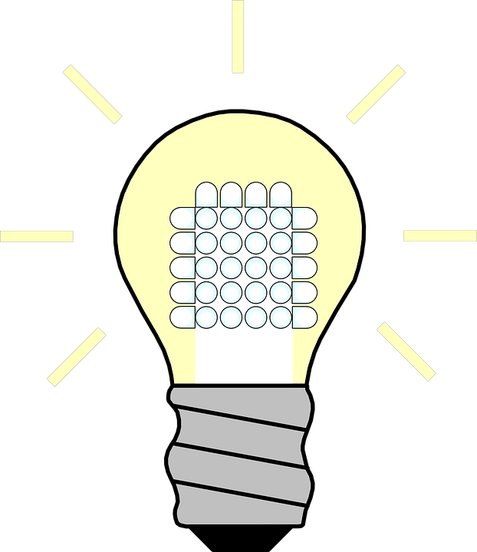
Design brief
Situation
People in some developing countries do not have access to mains electricity. This means children have no light for reading and studying at night, which can affect their education.
Design Brief
Your task is to produce a prototype for a reading lamp for children living in places with no access to mains electricity. The lamp must be powered by a renewable energy source, such as the wind.
Notes:
Discuss the situation and design brief with learners.

Slide 5
Tasks
To satisfy the needs of the brief you must:
Select the components and parts that you will need from those given by your teacher
Produce a labelled sketch of your design
Make your design by assembling the components and parts
Test your design to check that it works
Notes:
Teacher should give a range of relevant components, such as motors/generators, hi-bright LEDs and/or lamps, block connectors, wires/cables, parts to make turbine blades etc (see resources section of lesson plan). CAD software could be used to produce the sketches, or they could be drawn by hand, depending on resources and time available.

Slide 6
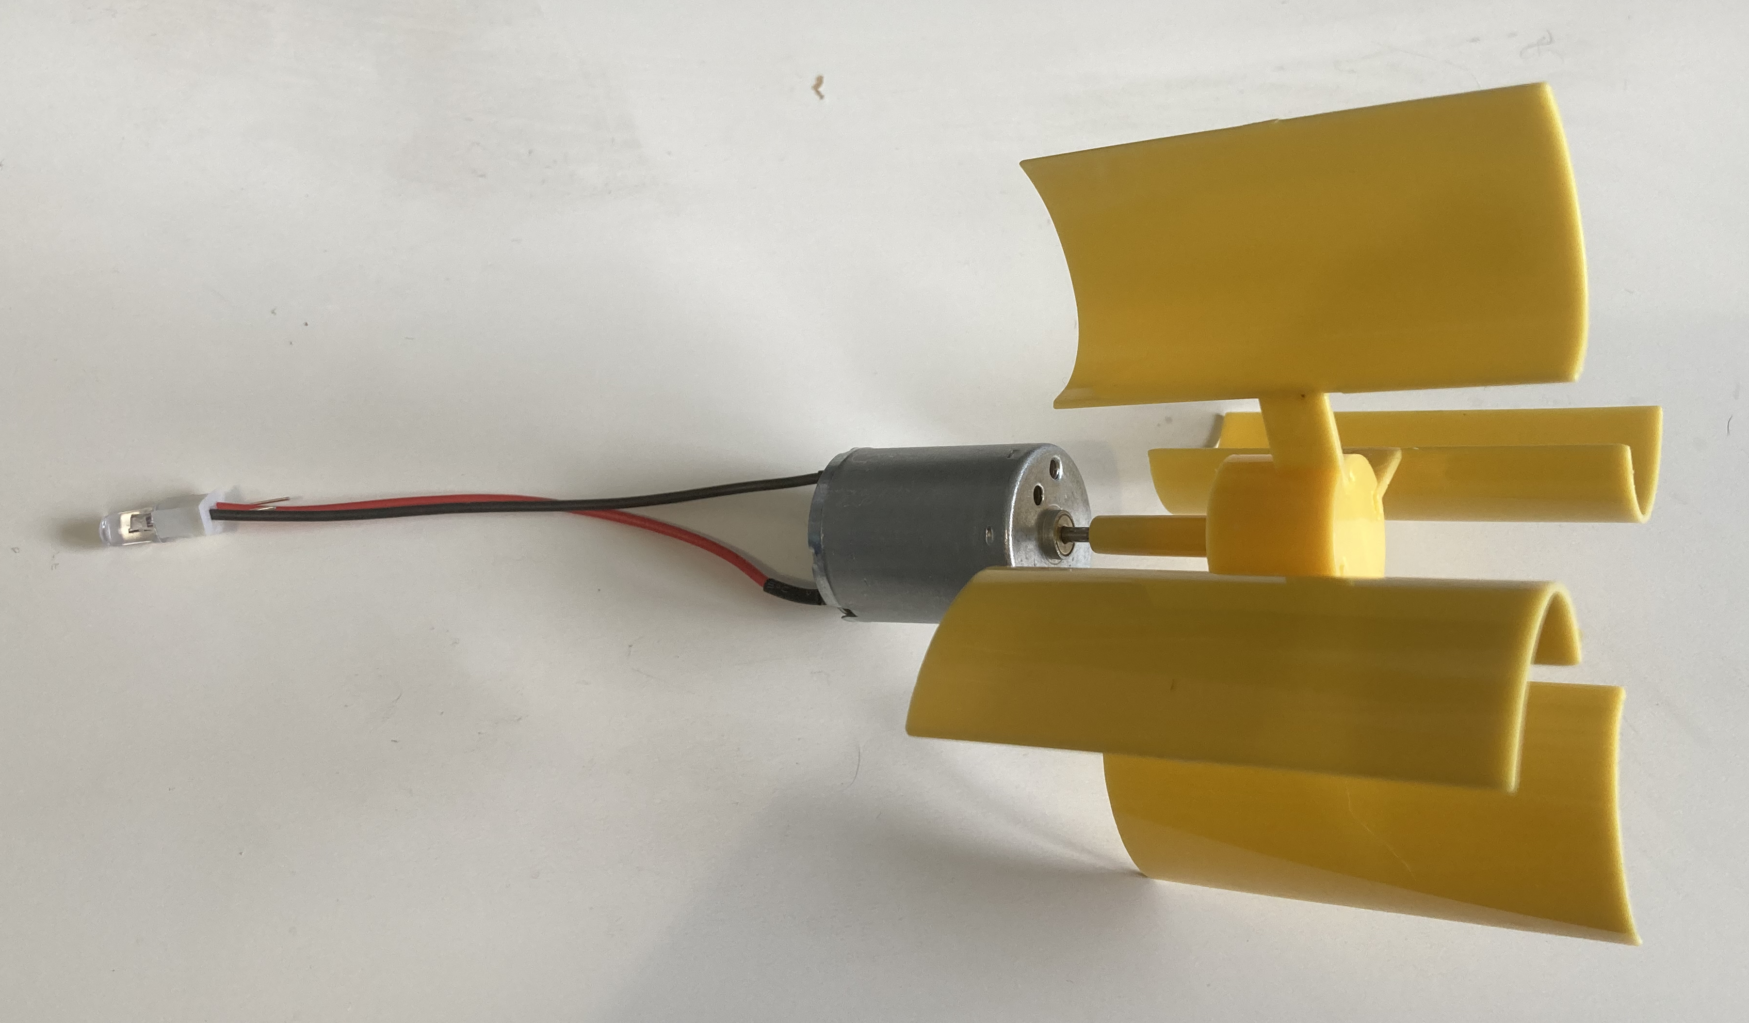
Example prototype
Notes:
The following slides show how a simple prototype could be assembled. This could be used to support lower ability learners who struggle to develop their own more individual design.

Slide 7
Step 1 ⚠
Block connector
Red wire
Push both legs of an LED into one end of the block connector
Connect a red wire to the long leg of the LED and a black wire to the short leg of the LED through the other end of the block connector
LED
Black wire
Notes:
Instead of a block connector the wires could be soldered to the LED legs if soldering equipment is available. Wires should be cut to an appropriate size either by the learners, or by teachers in advance. Many modern hi-bright LEDs do not require a protective resistor, but some do. This must be checked before assembling the prototype.

Slide 8
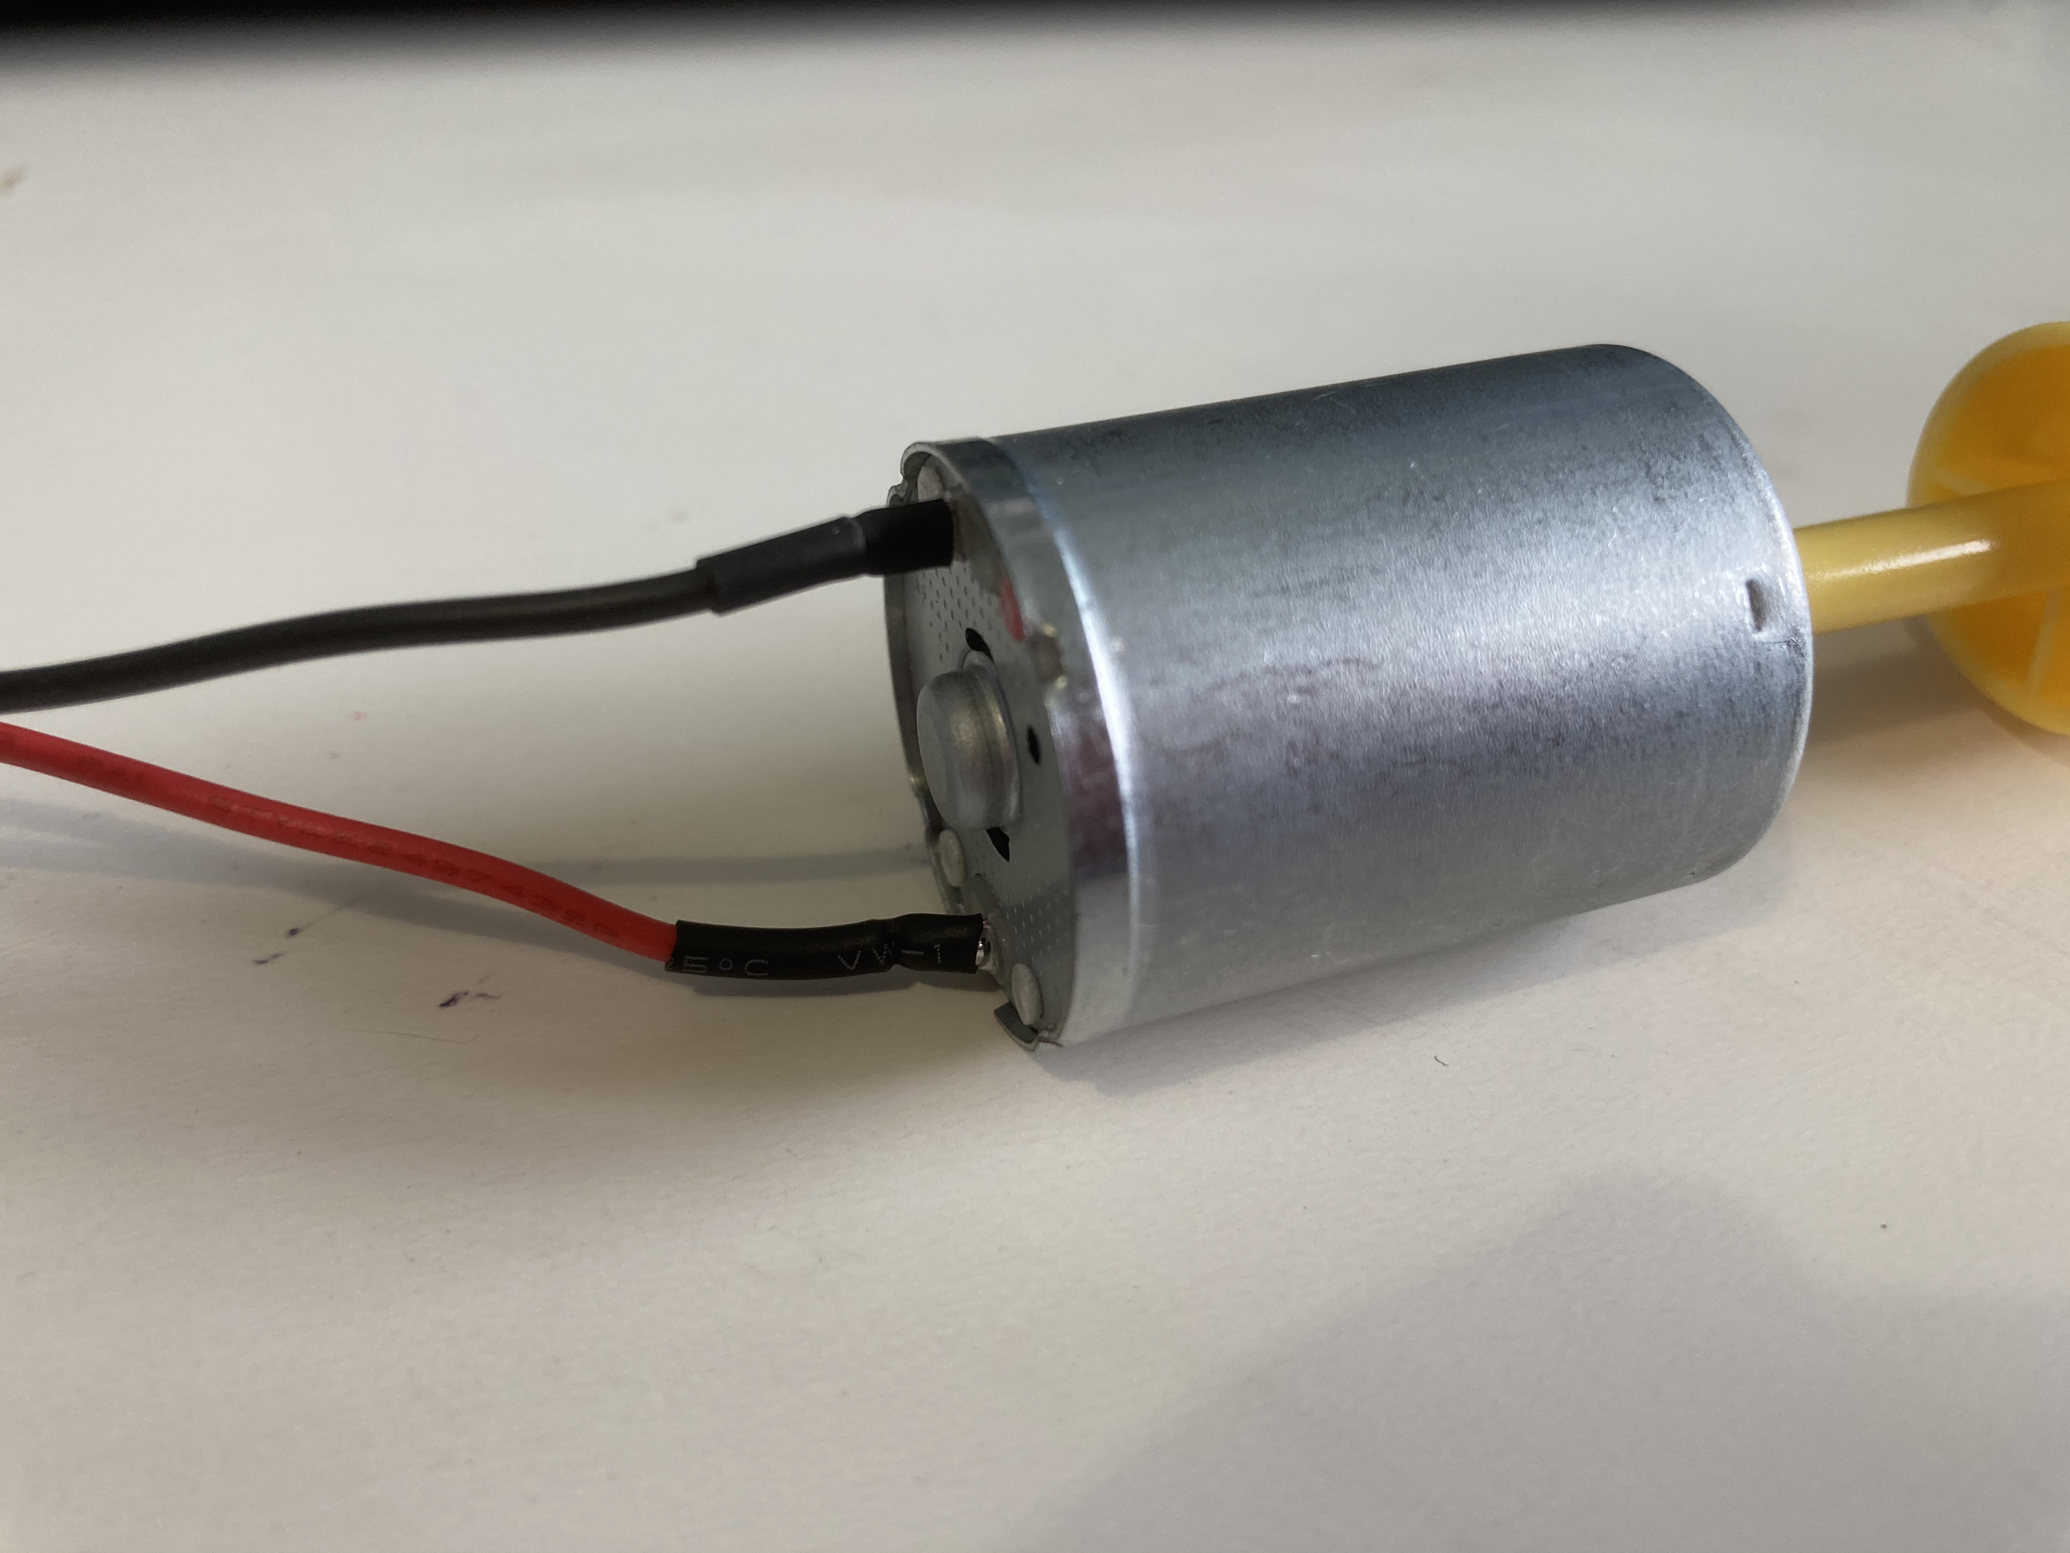
Step 2 ⚠
Black wire
Connect the black wire to the negative leg of the generator
Connect the red wire to the positive leg of the generator
Red wire
Generator
Notes:
Wires can be soldered to the legs of the generator or wrapped around the legs, with insulation tape used to secure them.

Slide 9
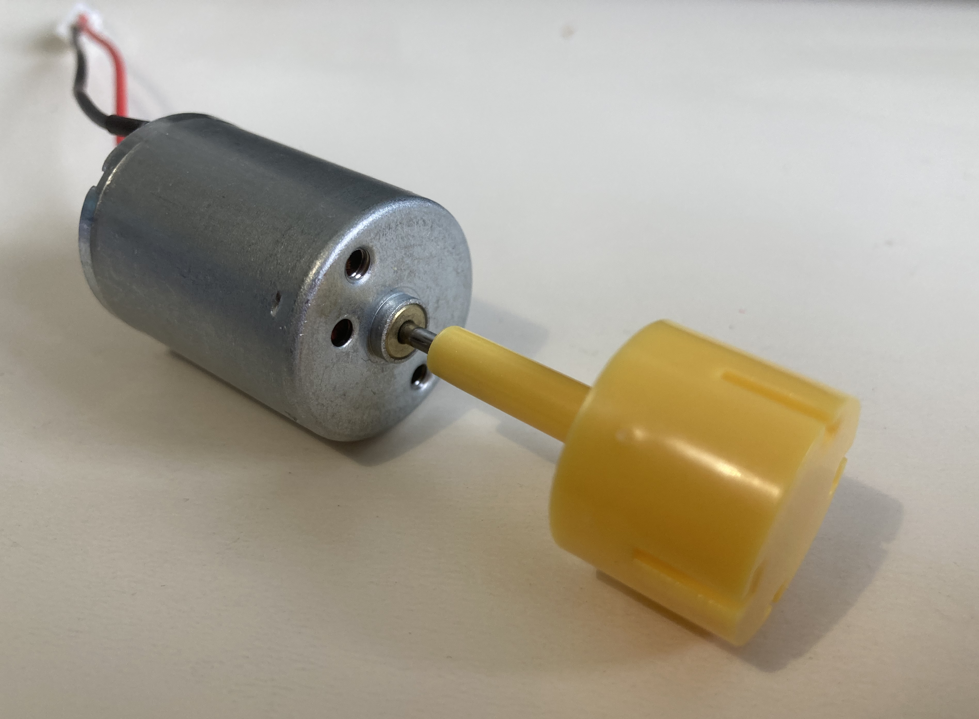
Step 3 ⚠
Attach the blades to the generator
Test your finished product to check that it works!
Notes:
Blades could be pre-produced in advance by the teacher (for example, using laser cutter or 3D printer), or kits can be purchased from Amazon or Rapid Electronics. The LED should light up when the blades rotate.

Slide 10
Extension
Improve the design of the circuit by adding additional LEDs and a power switch
Add a solar cell so the light can be powered by the sun

