Slide 1
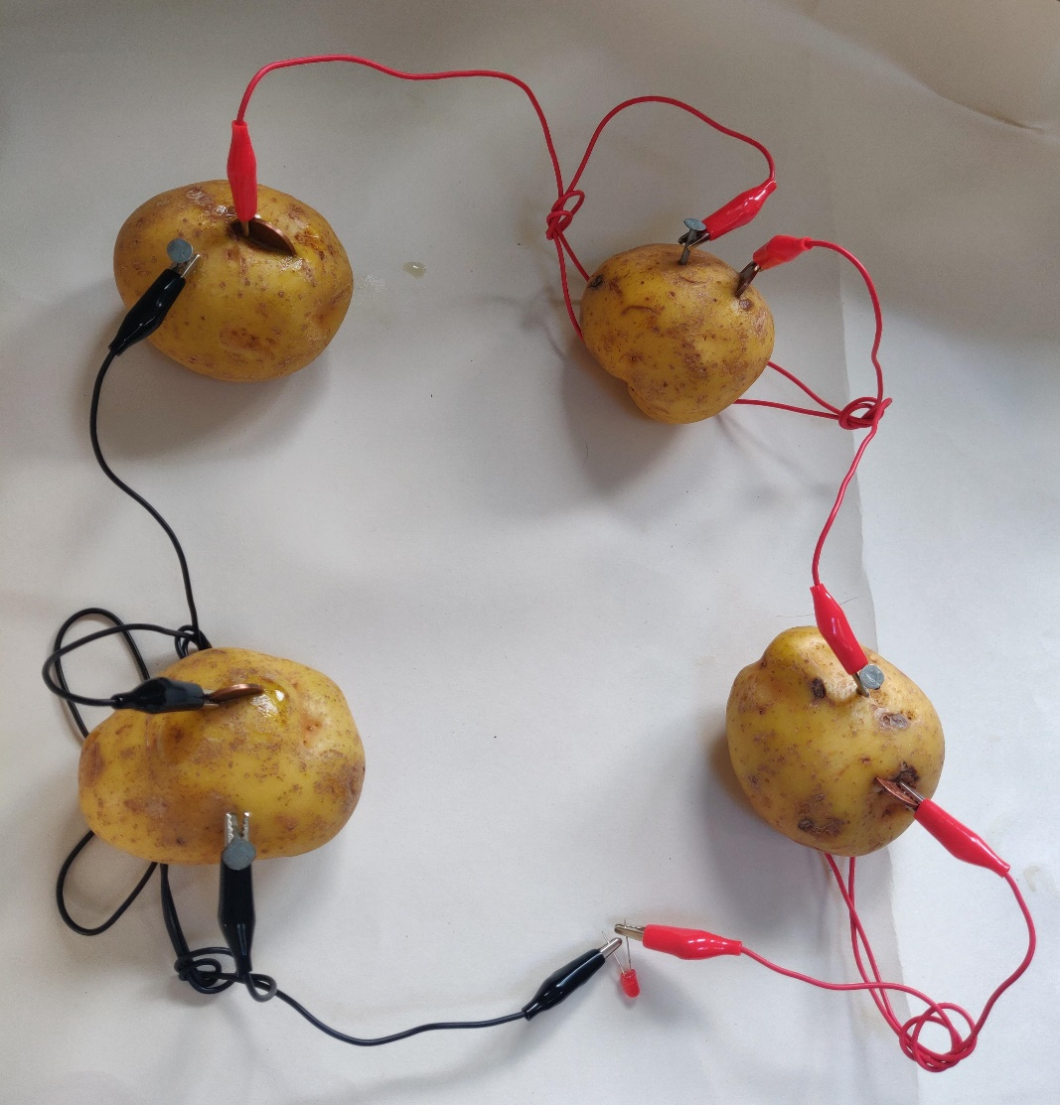
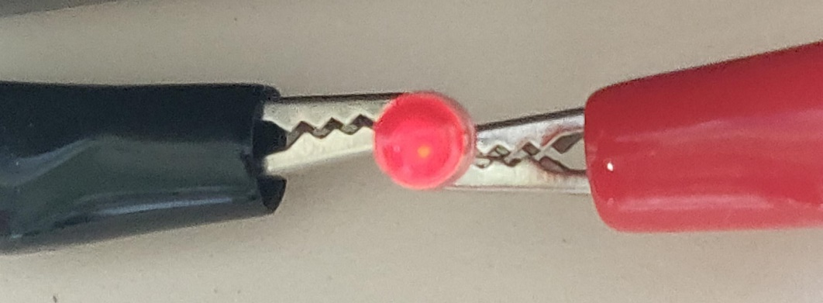
How to Make a Potato Battery
Making a potato powered light

Slide 2
Stay safe
Whether you are a scientist researching a new medicine or an engineer solving climate change, safety always comes first. An adult must always be around and supervising when doing this activity. You are responsible for:
ensuring that any equipment used for this activity is in good working condition
behaving sensibly and following any safety instructions so as not to hurt or injure yourself or others
Please note that in the absence of any negligence or other breach of duty by us, this activity is carried out at your own risk. It is important to take extra care at the stages marked with this symbol: ⚠

Slide 3
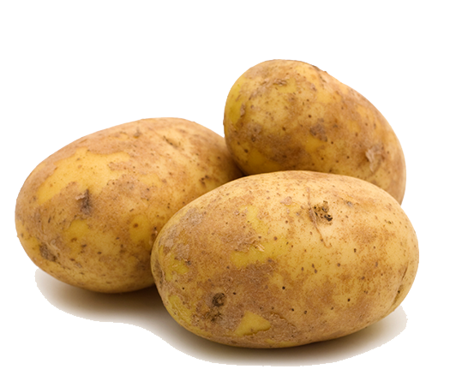
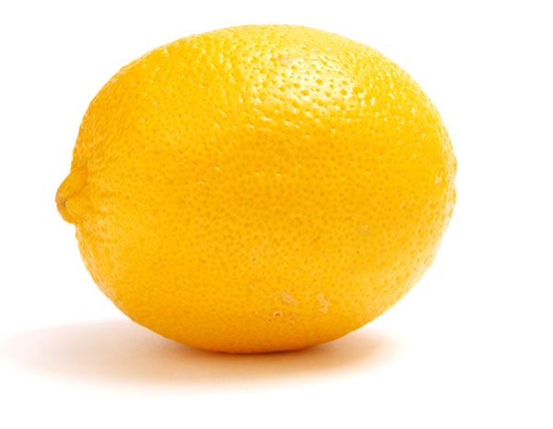
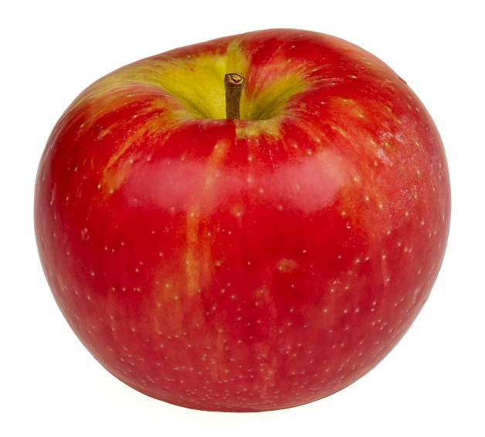
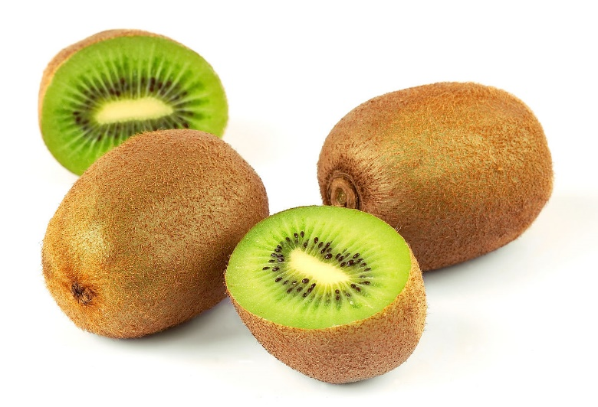
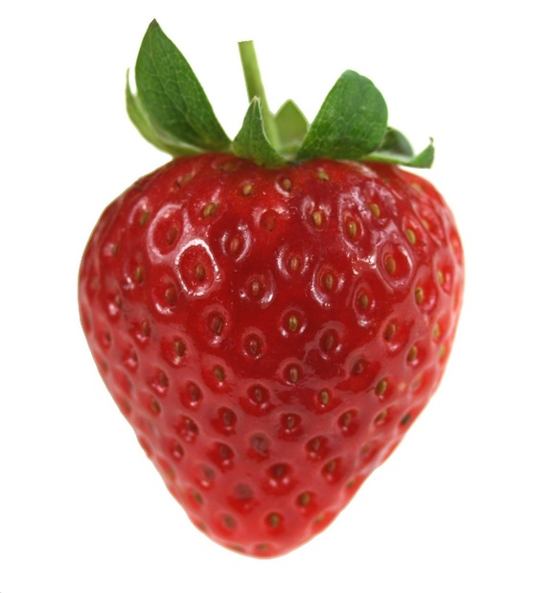
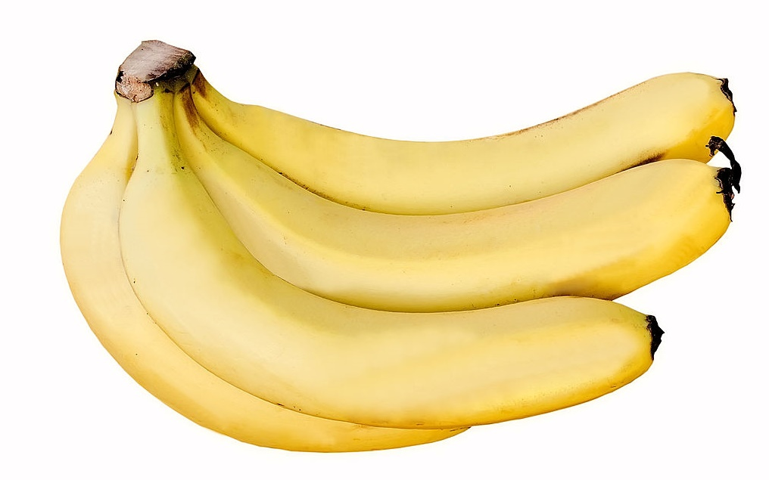
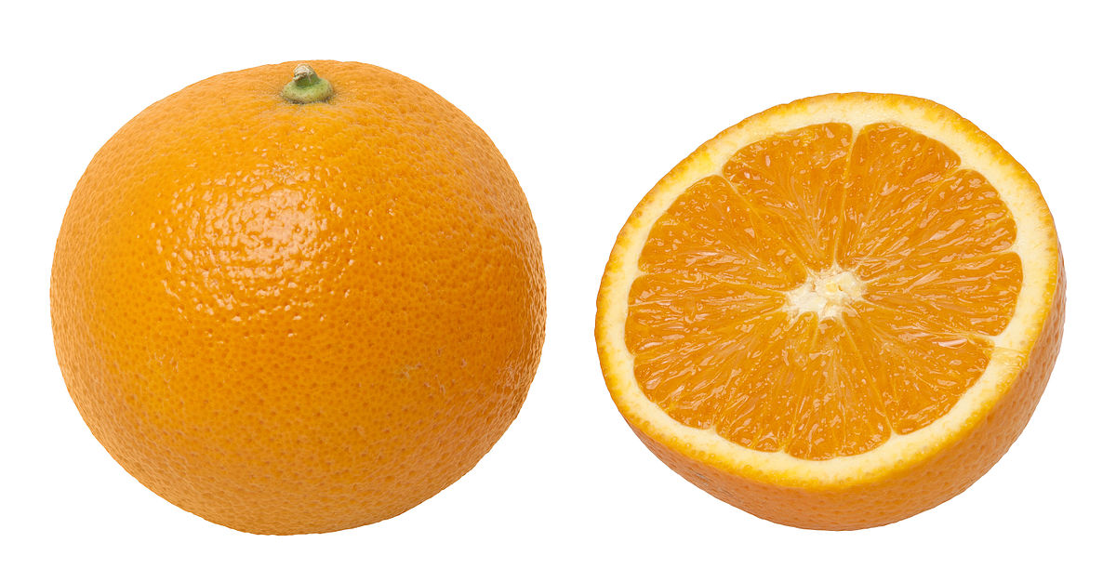
Which of these will power an LED bulb?
This Photo by Unknown Author is licensed under CC BY-SA
Notes:
4 will, 3 will not – can you guess which ones?!

Slide 4
Which of these will power an LED bulb? Why?
This Photo by Unknown Author is licensed under CC BY-SA
Notes:
To make a battery from organic material, all you need is two metals – an anode, which is the negative electrode, such as zinc, and a cathode, the positively charged electrode, such as copper. The acid inside the potato forms a chemical reaction with the zinc and copper, and when the electrons flow from one material to another, energy is released.

Slide 5
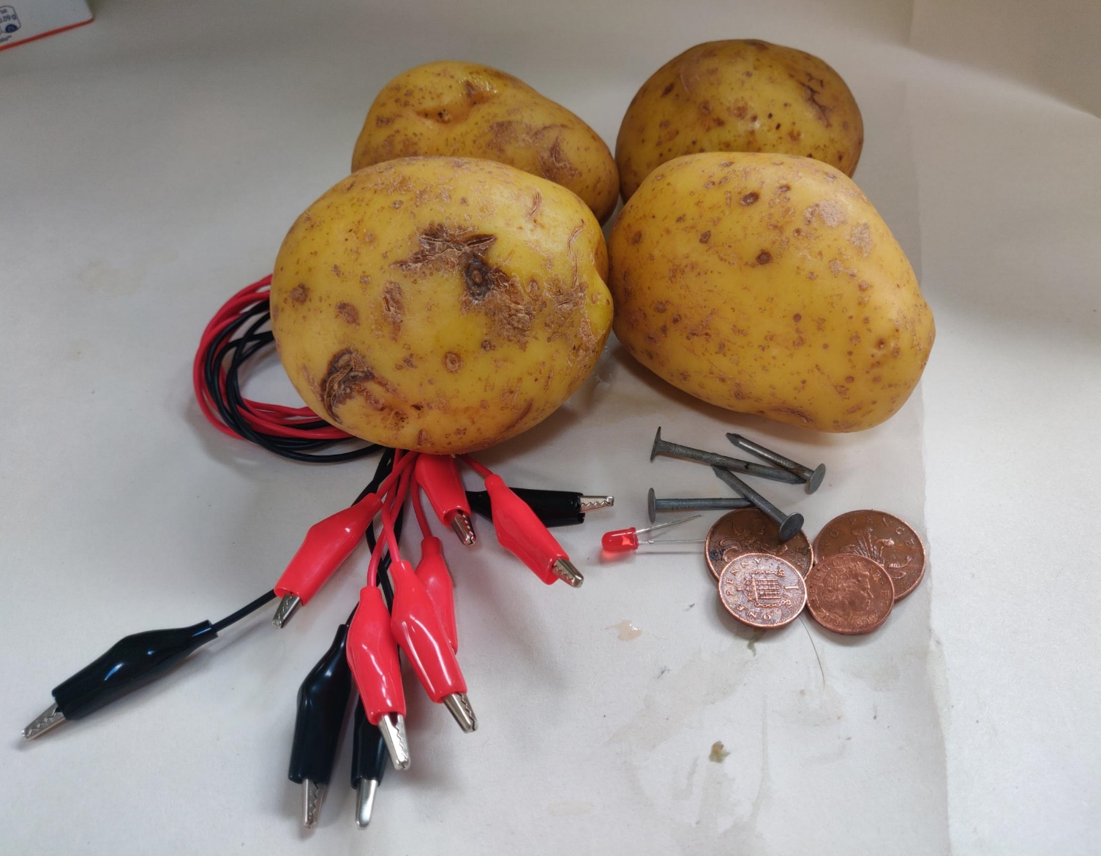
Equipment
4 Potatoes
3 Red crocodile clips
2 Black crocodile clips
4 Coins (2p/1p)
4 Zinc plated nails
Light emitting diode (LED)
Notes:
Work in pairs for ease of equipment.
Groups of 3 or 4 for lower ability and individual for more able students.
The coins must be copper, e.g. 1p or 2p.

Slide 6
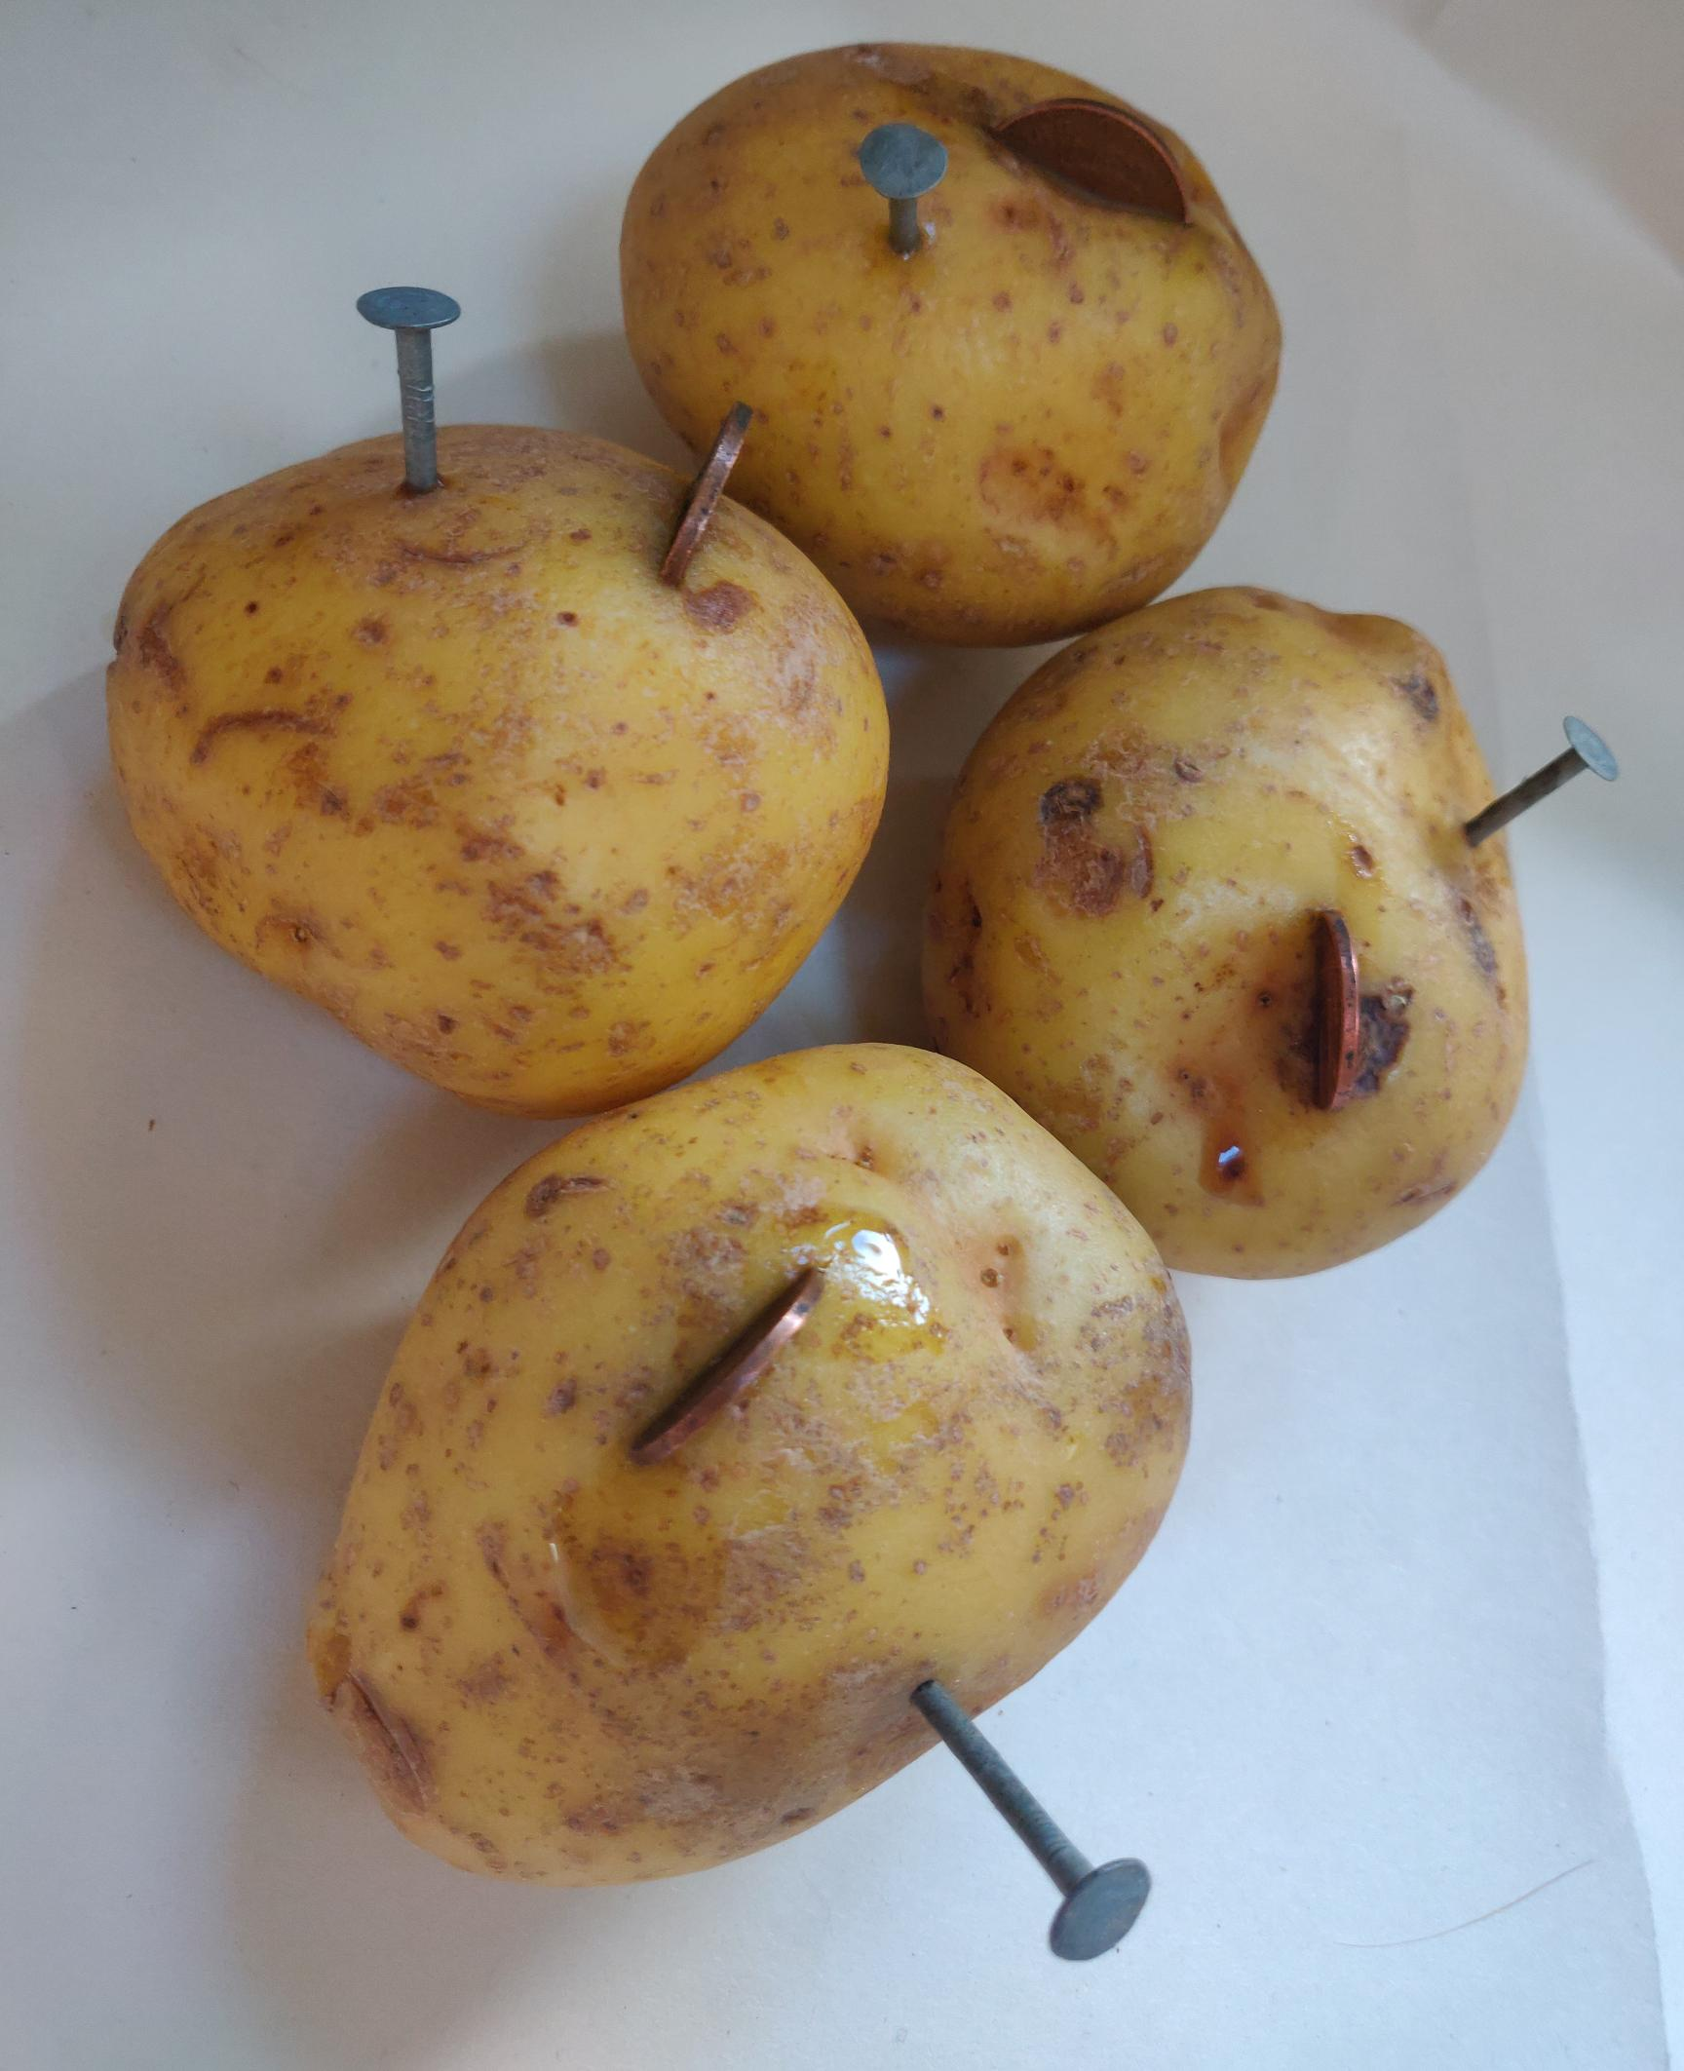
Step 1 ⚠
Place the coins and nails into each potato as shown
Notes:
There needs to be adequate coin/nail above the surface of the potato to attach the crocodile clips to.
Do not let the coins and nails touch each other on each potato.

Slide 7
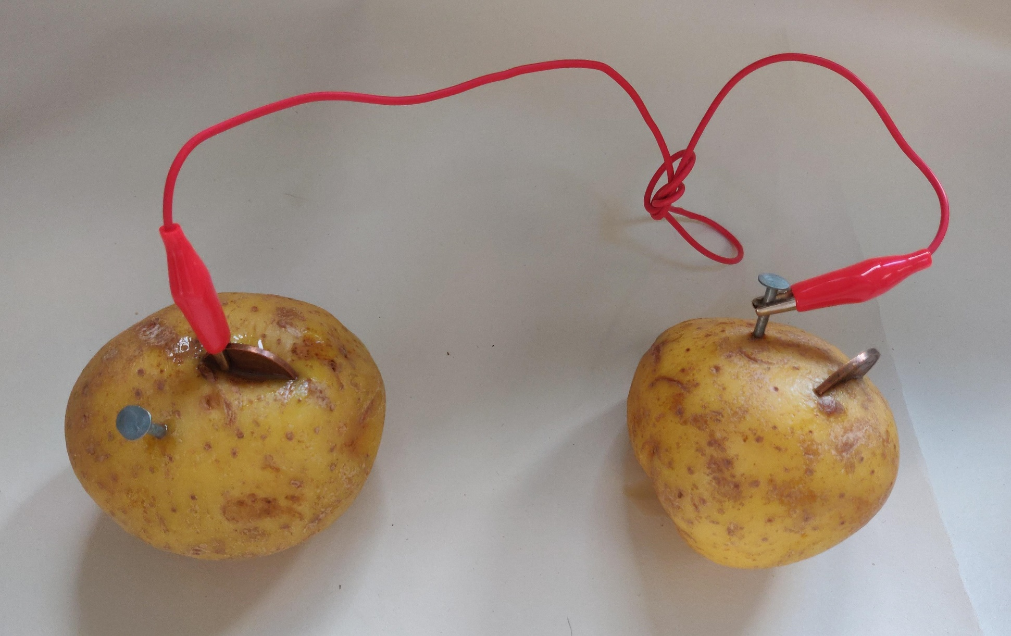
Step 2 ⚠
Attach a RED clip to the coin in potato 1
Attach other RED clip to the nail in the potato 2
1
2
Notes:
The potatoes are labelled for ease of following the instructions.
What is the difference between the red and black cables? Why does it matter which way they are connected?

Slide 8
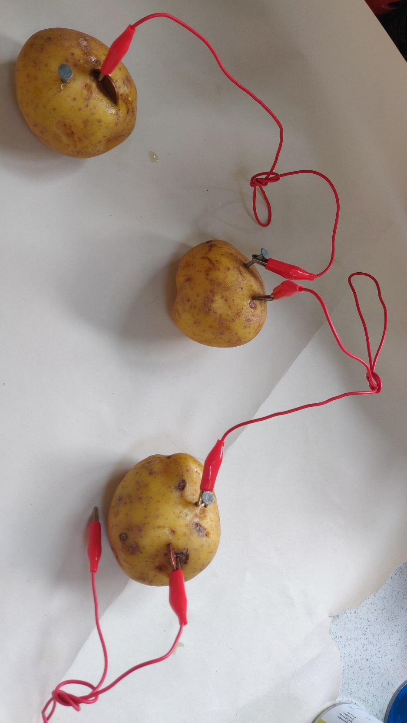
Step 3 ⚠
1
Connect the coin from potato 2 to the nail in potato 3 with a RED clip
2
3
Notes:
Tie a knot in the crocodile cables if they are too long, as this prevents them looking messy and getting tangled.
Physically number the potatoes if students are struggling with the concept.

Slide 9
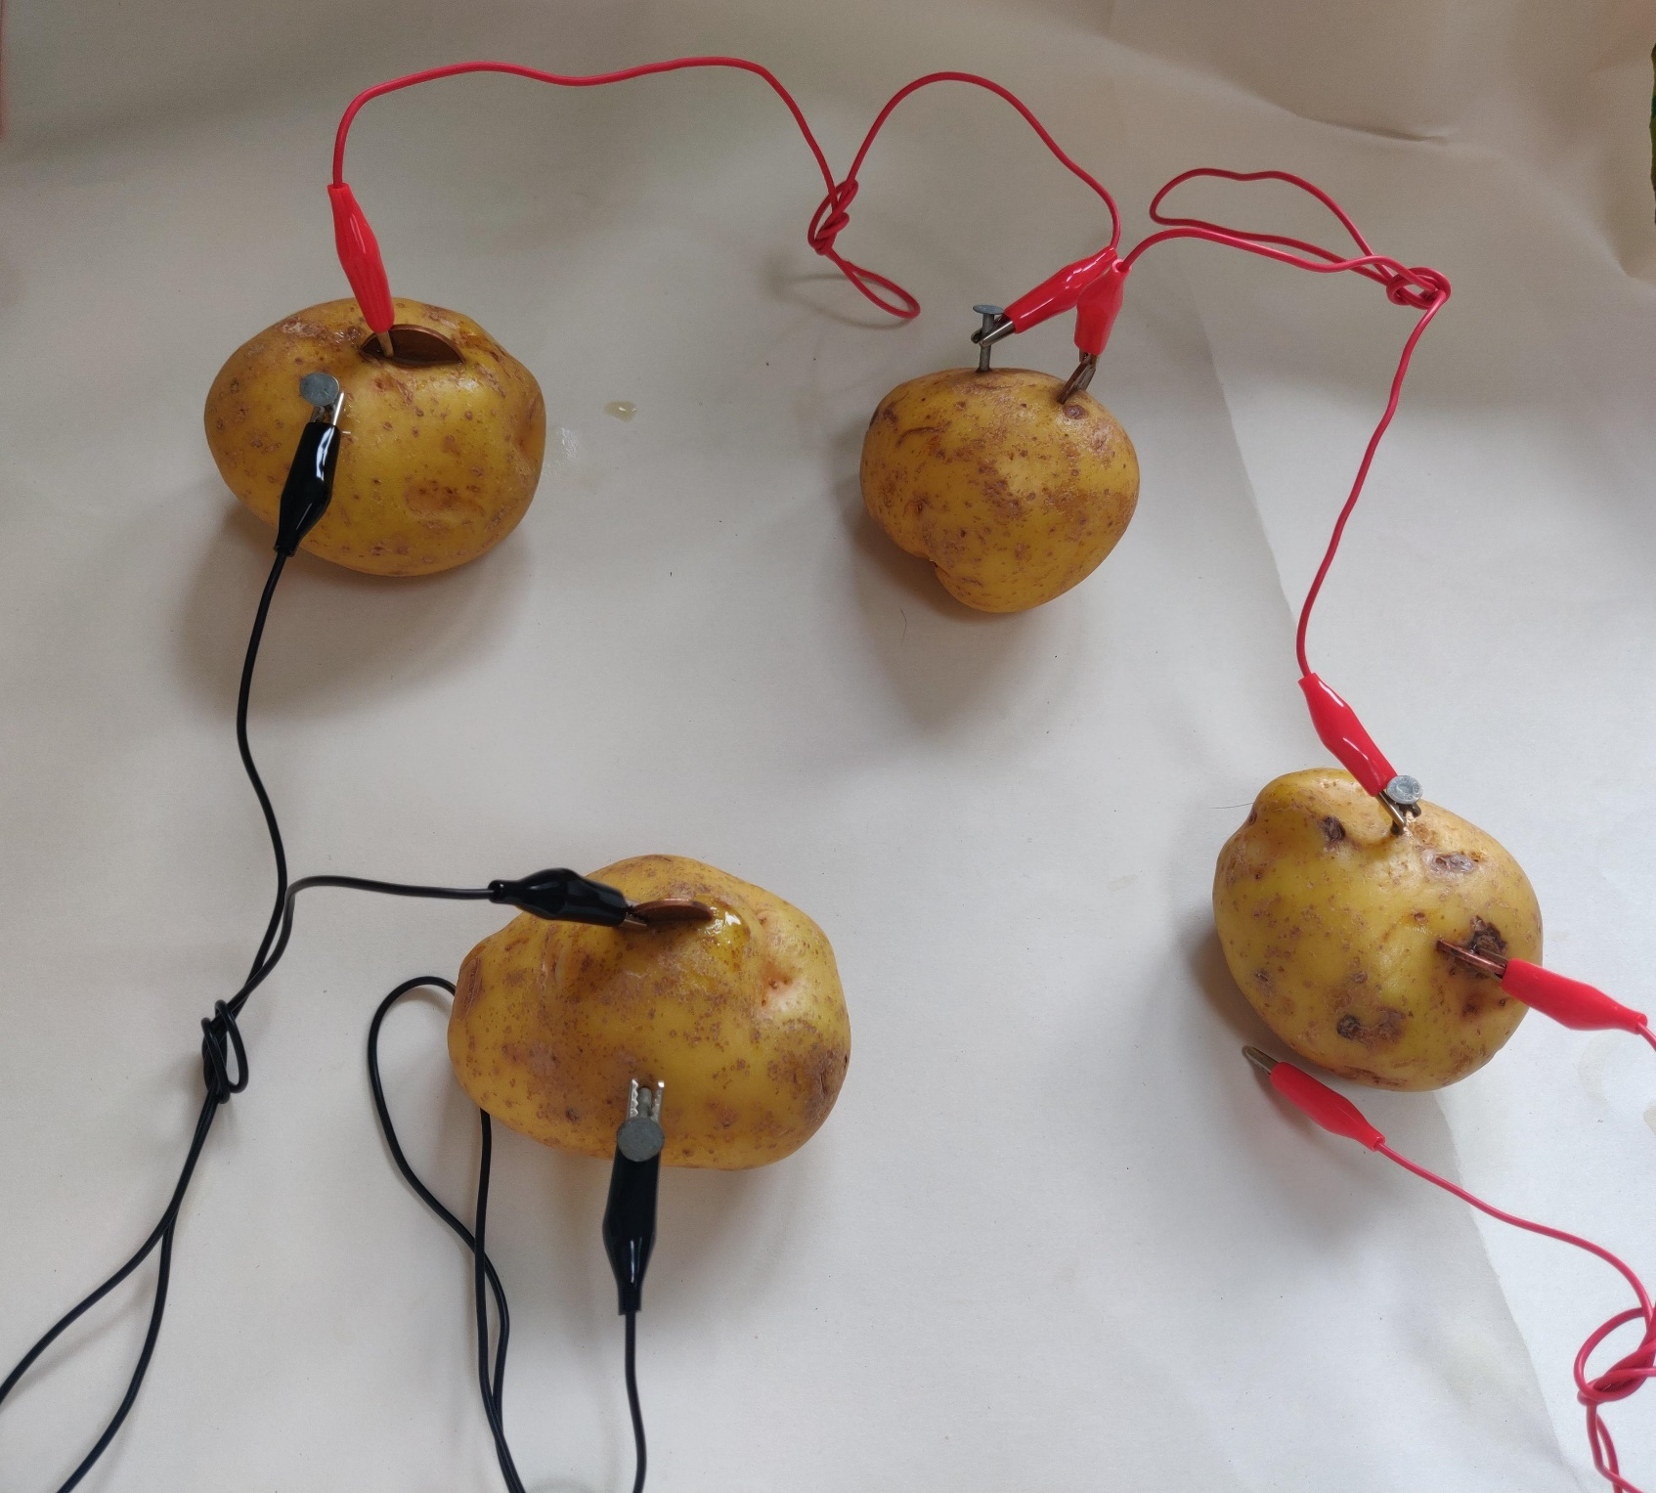
Step 4 ⚠
Connect a RED clip to the coin in potato 3
Connect a BLACK clip to the nail in potato 1 to the coin in potato 4
Connect a BLACK clip to the nail in potato 4
1
2
3
4

Slide 10
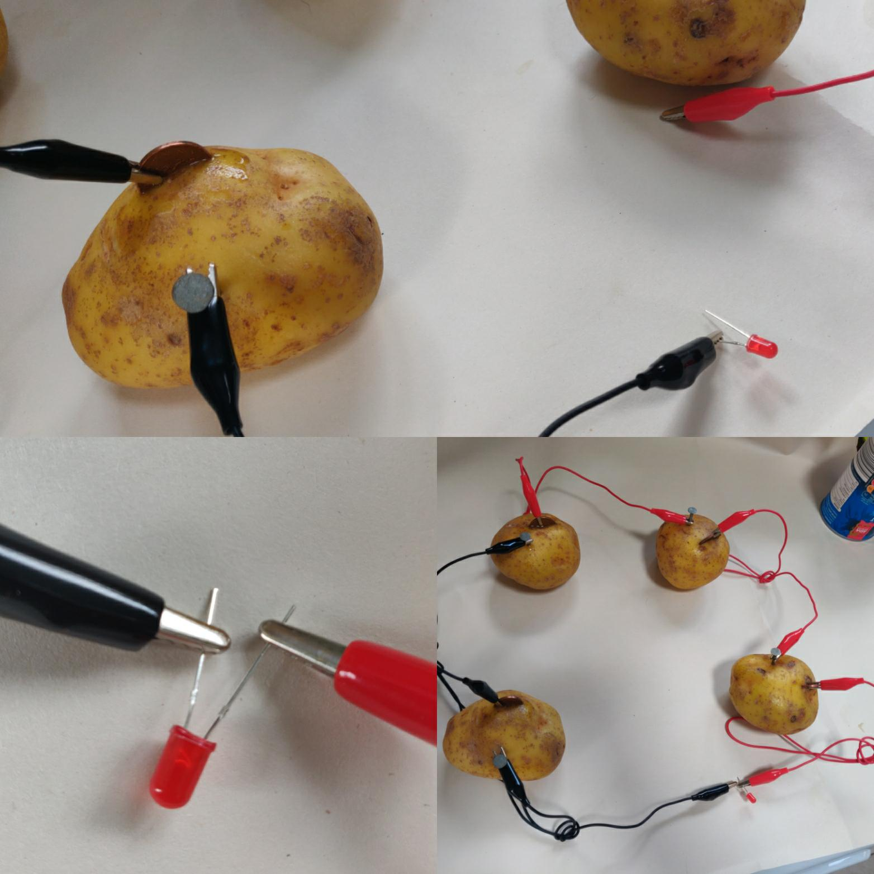
Step 5 ⚠
3
Connect the free BLACK clip from potato 4 to the short leg on the LED
Connect the free RED clip to the longer leg on the LED
Make sure that the two clips do not touch each other
4
1
2
3
4
Notes:
Make sure the correct clips are on the correct legs of the LED (red to long leg, black to short leg). If they are connected the wrong way around the LED will not light.
Make sure that the clips from the red and black leads do not touch,

Slide 11
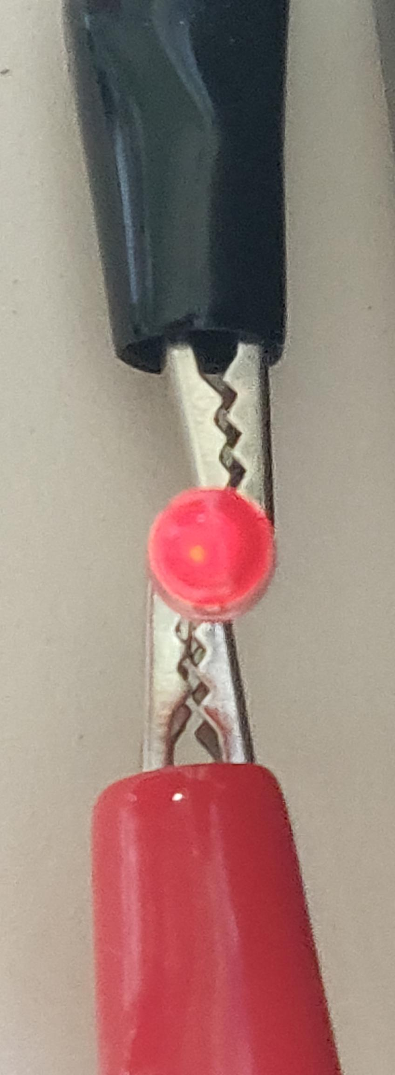
Step 6 ⚠
The complete circuit will cause the LED to emit light.
Notes:
Check the circuit with an multimeter to ensure a voltage is being produced if the LED does not light.
Check all connections if the circuit does not work.

Slide 12
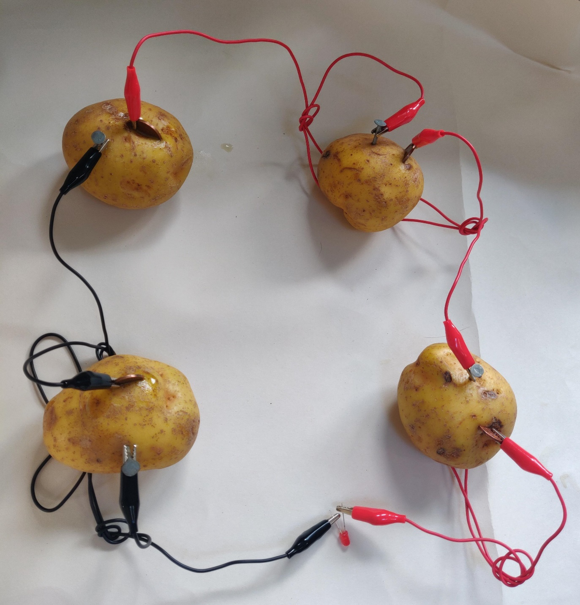

Slide 13
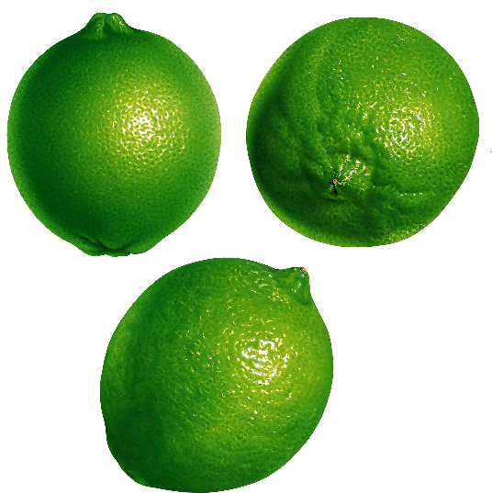
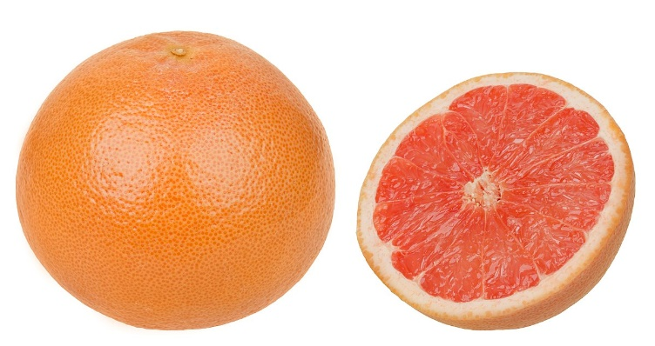
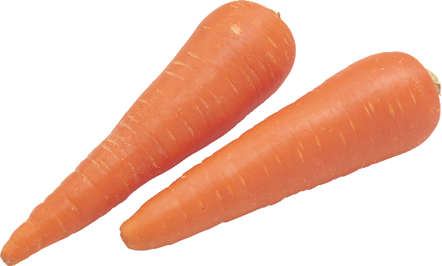
Extension
When could you use potato power in reality?
Experiment with a combination of fruit, potatoes and other vegetables to see which combinations work. Are any better than others?

