Slide 1
Produce a treadle pump
Making a prototype of a treadle pump

Slide 2
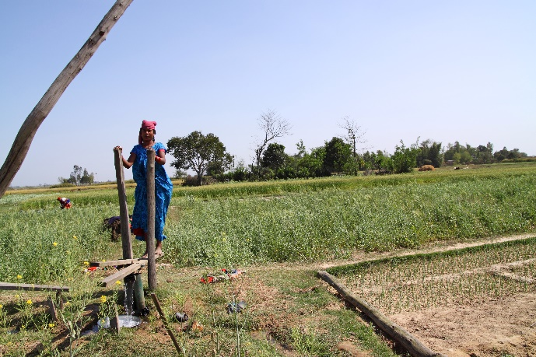
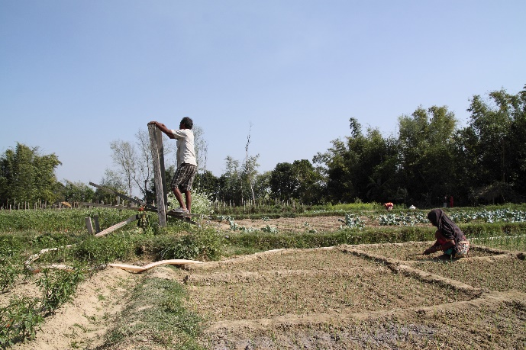
Design Brief
Situation
People in remote Nepal villages require water to irrigate their crops. This must be sourced from wells as deep as 7.5 metres. It can take a lot of time and effort to raise the amounts needed, therefore making food growing difficult in dry weather.
Brief
Design a treadle pump that will assist the villagers in raising the amount of water required to successfully irrigate their crops.
Notes:
Image credit: Anna de la Vega (photographer), Practical Action https://practicalaction.org/

Slide 3
Design Criteria
The treadle pump must:
Be capable of sucking up water from wells at a fast rate.
Be driven by the operator's body weight and leg muscles.
Be designed so that the operator can use it for long periods without tiring.
Be robust and capable of being used continuously outdoors.
Make use of materials that could be sourced locally.
Notes:
Further information on treadle pumps can be found at the Practical Action website. https://practicalaction.org/treadle-pumps

Slide 4
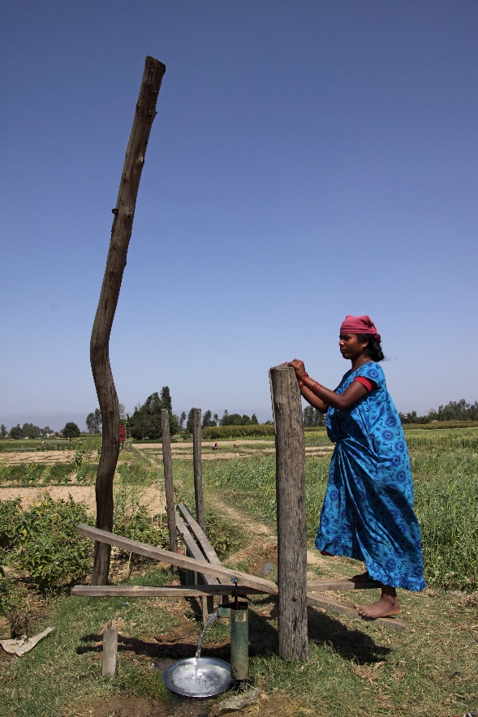
Prototype production
Produce a final prototype of your design.
You will need to select appropriate materials, tools and processes.
Produce a record of manufacture with photographs of your product.
Notes:
Image credit: Anna de la Vega (photographer), Practical Action https://practicalaction.org/

Slide 5
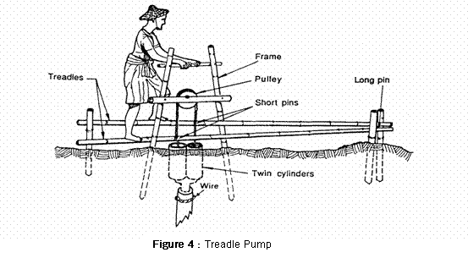
Treadle pump example – Practical Action
Notes:
Image source: Practical Action https://practicalaction.org/ https://www.flickr.com/photos/practicalaction/9266545027/in/album-72157631850927059/

Slide 6
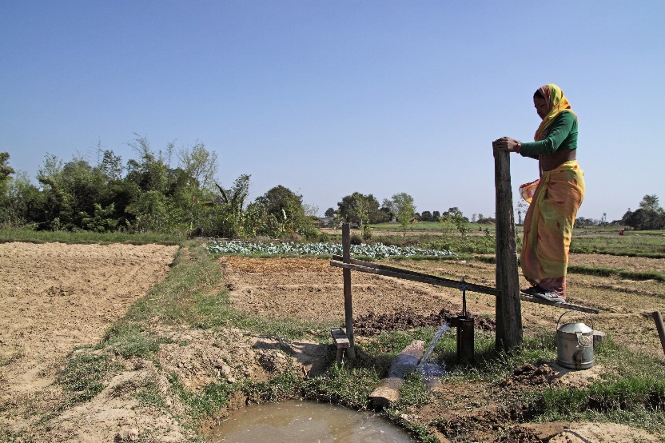
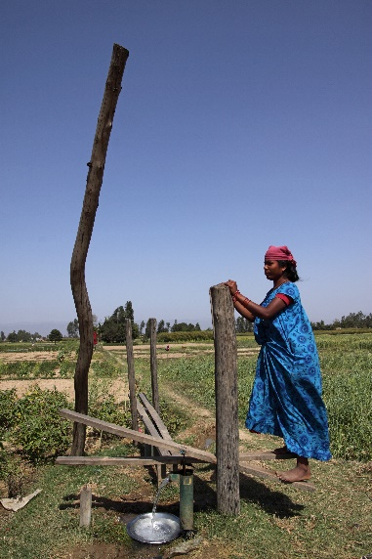
Treadle pumps in use (Nepal)
Notes:
Image credit: Anna de la Vega (photographer), Practical Action https://practicalaction.org/

