Slide 1
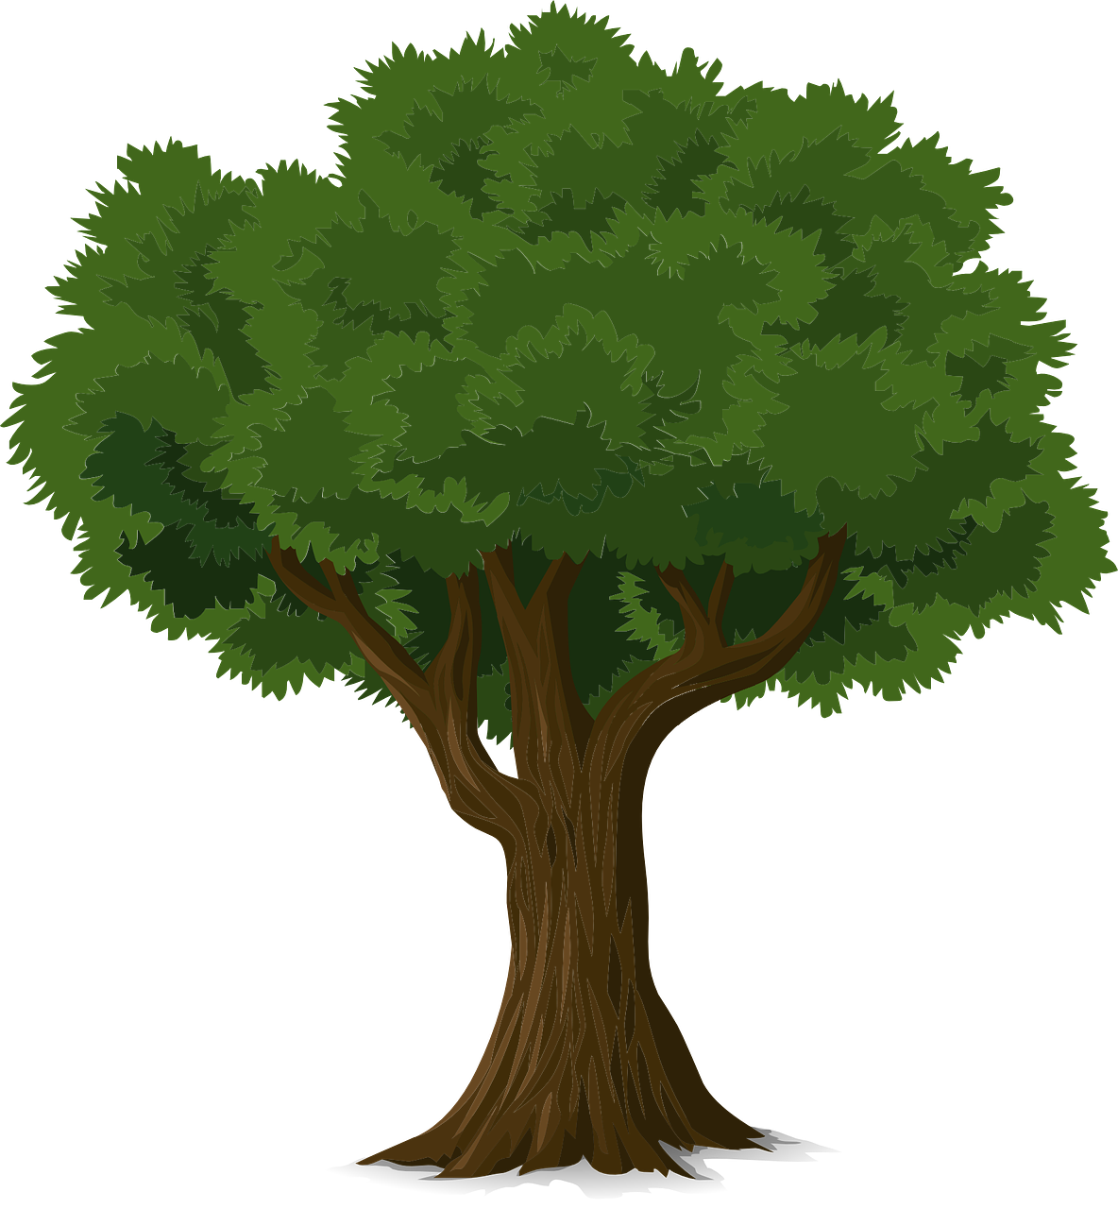
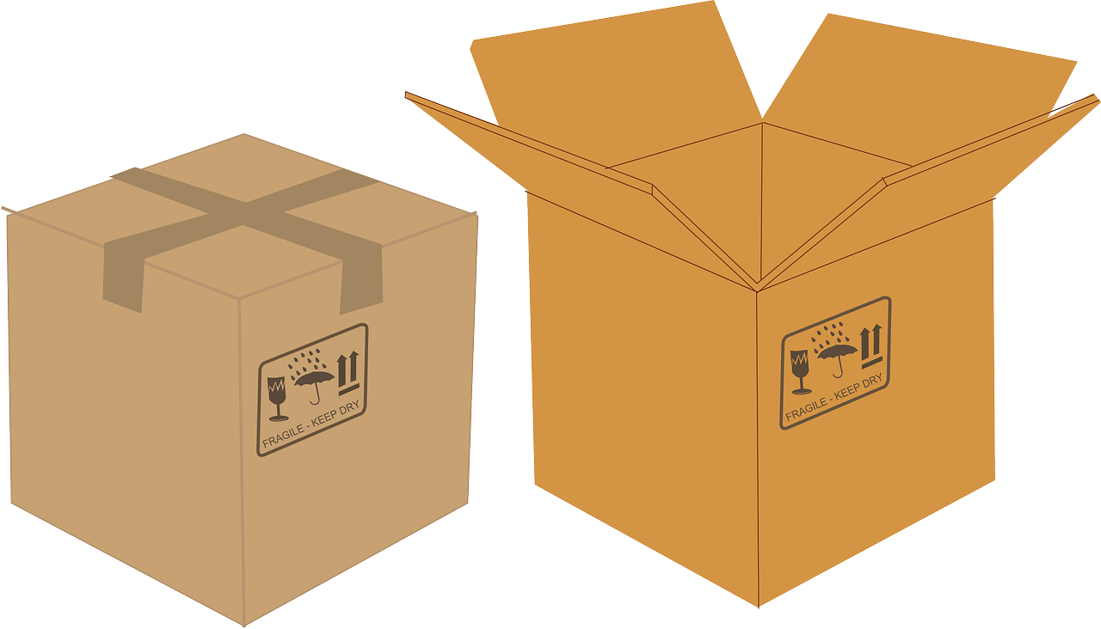
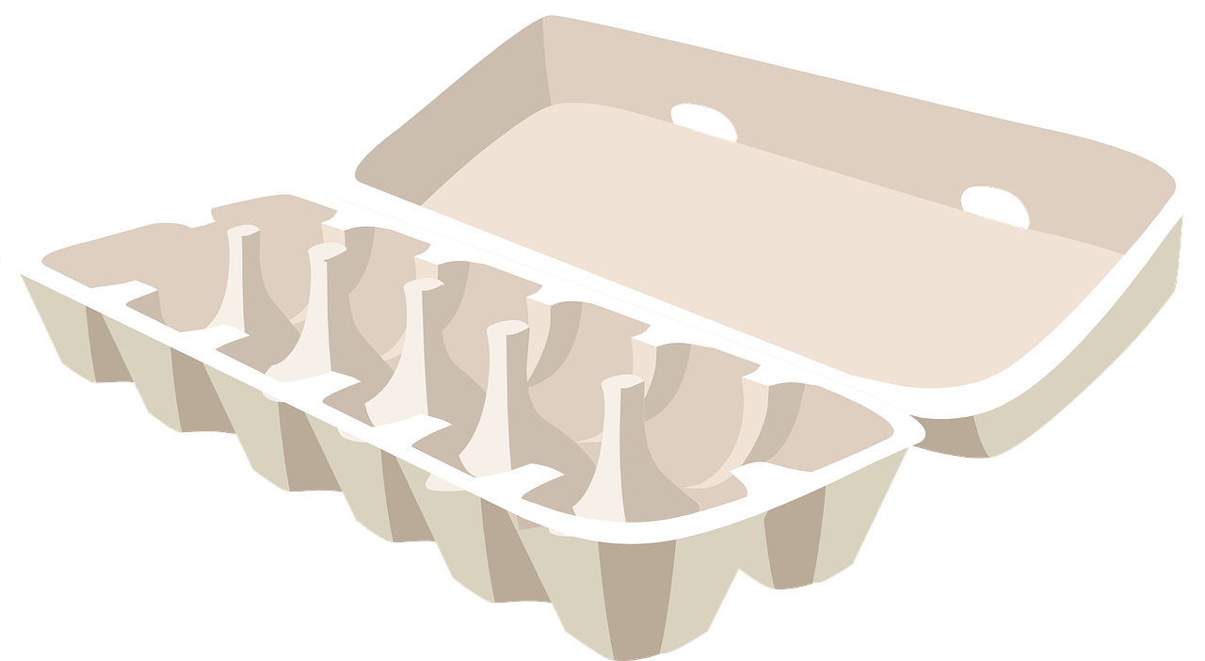
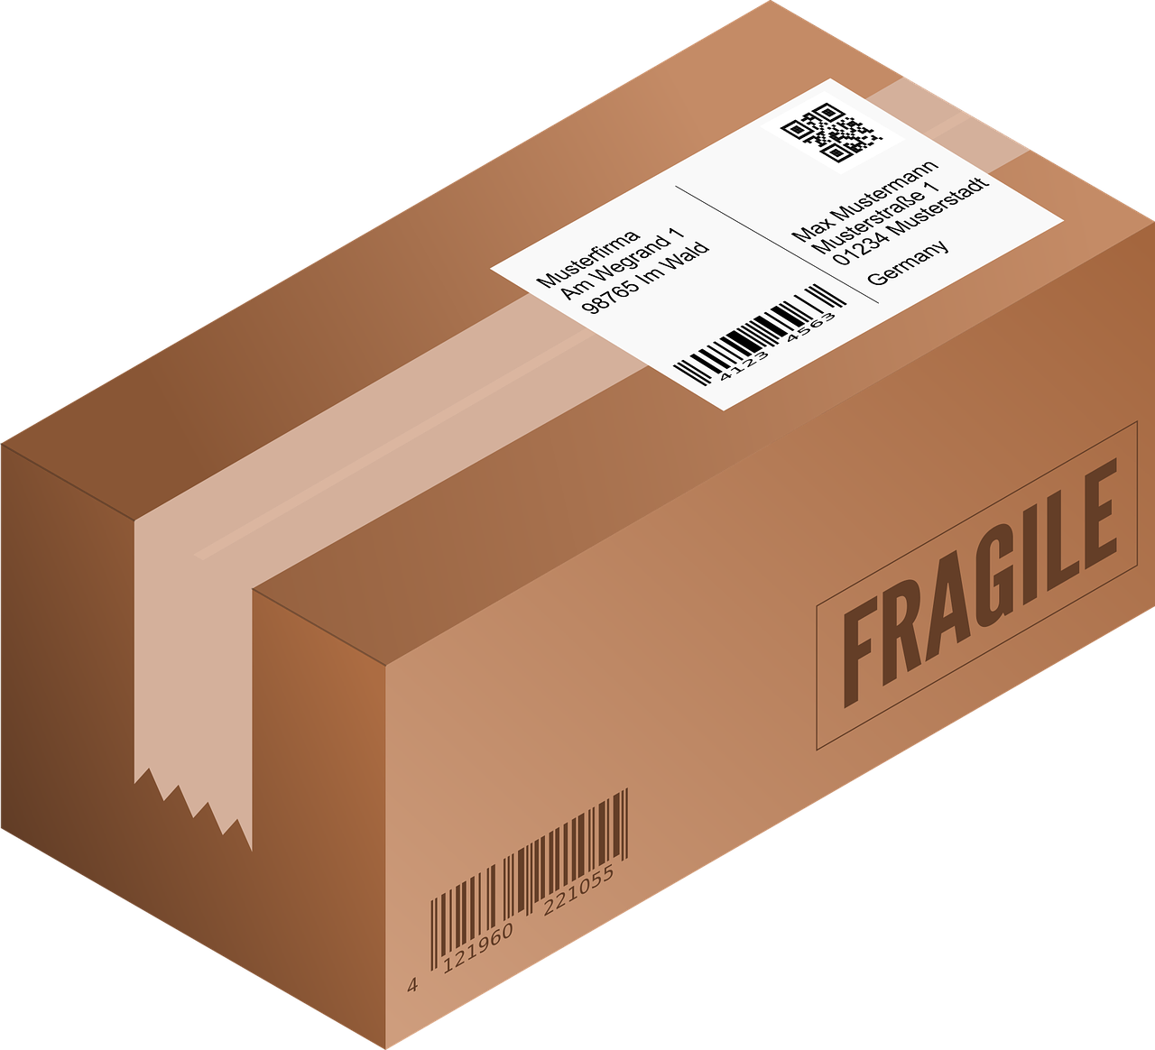
How much paper comes from a tree
Measuring the weight of packaging
and working out how many items can be made from one tree

Slide 2
How much paper from a tree?
A tree can give up to 40 kg of paper
40 kg

Slide 3
Packaging Activity
Choose an item of packaging
Measure the weight in grams
Work out how many items can be made from one tree?
?

Slide 4
Packaging Activity
For example:
Convert g to kg
Egg box = 55 g
55 g
____
= 0.055 kg
1000
40
___
0.055
Tree gives 40 kg
40
___
= 727 egg boxes
0.055

Slide 5
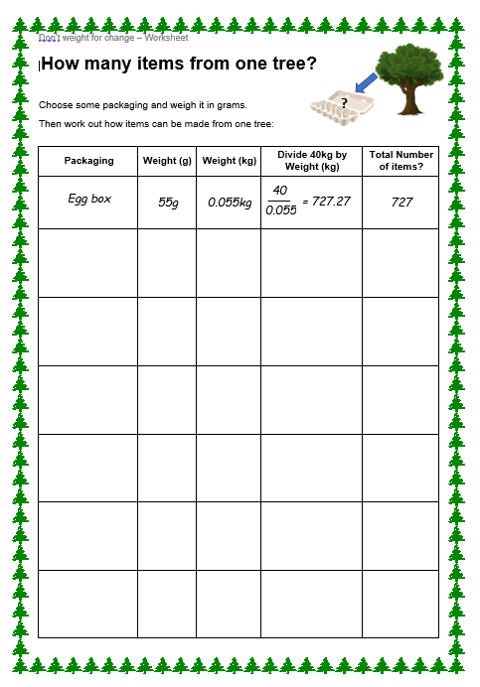
Packaging Activity - Worksheet
Fill the worksheet for each type of packaging that you have.

Slide 6
Some other interesting facts about paper
About 324 litres of water is used to make 1 kilogram of paper – that’s about 10 litres of water to make one piece of A4 paper!
Recycling 1 ton of paper saves around 682.5 gallons of oil, 26,500 litres of water and 17 trees.
People though paper usage would reduce due to computers. However, this hasn’t happened - demand for paper is expected to double before 2030.
Every tree produces enough oxygen for 3 people to breathe.
Humans cut down about 15 billion trees each year. That’s almost two for each person on the planet!

