Slide 1
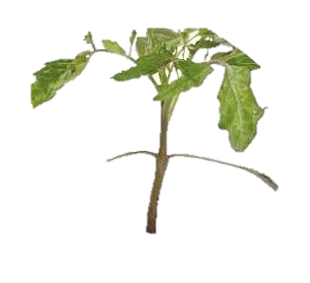
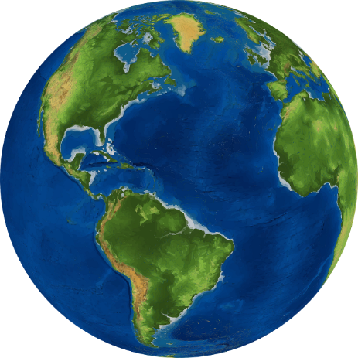
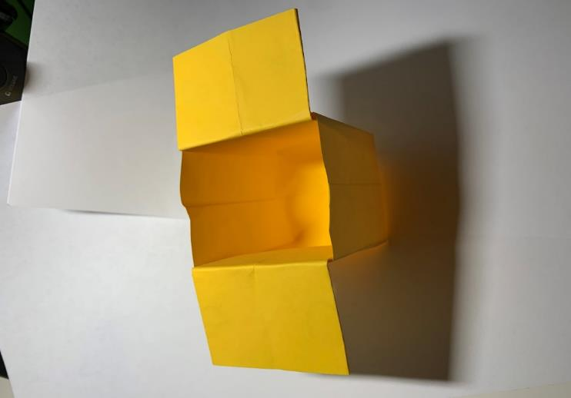
DIY Paper Planters
Making biodegradable paper containers to grow plants

Slide 2
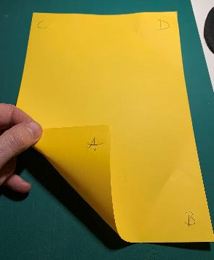
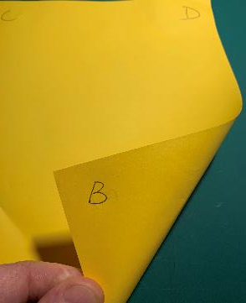
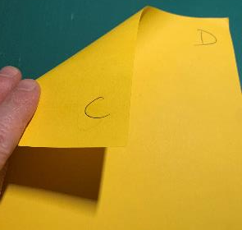
Use A4 paper - add letters to each corner, front and back
A4

Slide 3
Step 1 – Fold the paper in half (A-B to C-D)
FOLD

Slide 4
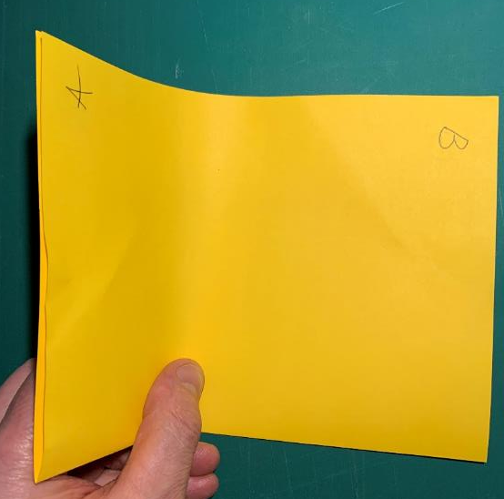
Step 2 – Fold in half again (A to B)
FOLD

Slide 5
Step 3 – Fold corner of B and flatten

Slide 6
Step 4 – Fold corner B back to D
FOLD

Slide 7
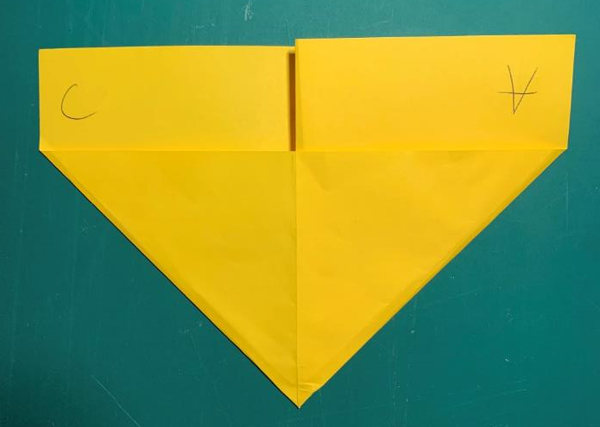
Step 5 – Fold corner of C and flatten

Slide 8
Step 6 – Fold corner A back to C
FOLD

Slide 9
Step 7 – Fold corner A to middle
FOLD

Slide 10
Step 8 – Fold corner B to the middle, then fold A over, to the middle
FOLD

Slide 11
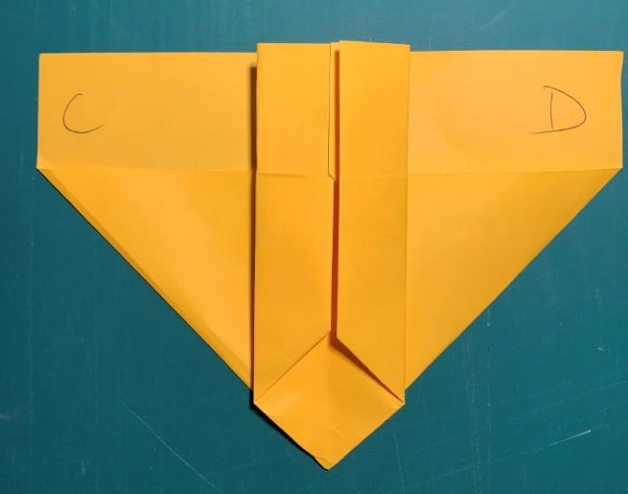
Step 9 – Fold B over, to the middle, then turn the paper over
FOLD
TURN OVER

Slide 12
Step 10 – Repeat Step 7-8, then fold the top tab down
FOLD
TURN OVER

Slide 13
Step 11 – Fold the other top tab, then pull the tabs apart

Slide 14
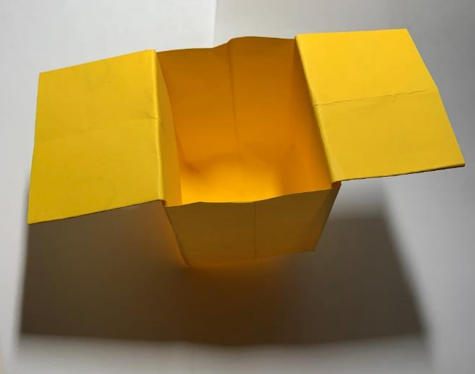
Step 12 – Push the bottom flat
The planter is now ready

Slide 15
Growing your Plant
Put some damp soil or compost in the plant box
Push one seed about 2 cm below the surface and cover with soil
Cover the plant box with cling film
Stand it on a plate or tray in a warm, sunny place e.g. a windowsill
Once it has sprouted, you can plant it (still in the container) outside

