Slide 1
Design a Hoverboard
Designing a magnetic levitating hoverboard
HOVER
BOARD

Slide 2
How the Lexus hoverboard was designed
Story behind the design:
https://www.youtube.com/watch?v=oyGlNLpQ7CQ
Science behind the design:
https://www.youtube.com/watch?v=qGiGMX0t3_U

Slide 3
Design Brief
Situation
1980s films predicted that by 2015 people using hoverboards would be a very common sight! Only now is the technology finally reaching the point where they can become a reality.
HOVER
BOARD
Brief
Design a hoverboard for use by teenagers, that can move forwards without making contact with the ground. Your product should use a suitable method of keeping the board in the air, such as magnetism.

Slide 4
Design Criteria
The product must:
Be suitable for use by teenagers.
Be able to move forwards whilst a person is standing on it, without touching the ground.
Use magnetism or another suitable method to achieve levitation.
Be aesthetically appealing to the target audience.

Slide 5
Magnetic Hoverboard Design
Use this space to sketch your idea for your product.
Don’t forget to annotate your design to show how it meets the design criteria!
Notes about design:

Slide 6
Target market review
Ask three people from the target audience to suggest one improvement each to your design.
Select one of these suggested improvements and use it to update your design.

Slide 7
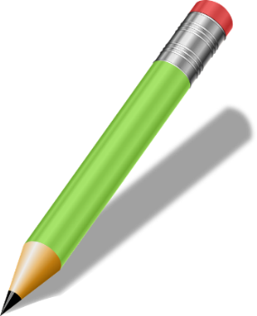
Extension
Consider the potential uses of the product you have designed.
How could this technology be used or modified to meet social and environmental needs?

